Slide 1
Week 1: Know more about the company, its domains of work and various policies and rules to be followed.

Slide 2
Week 2: We learnt Basics of Python, conditionals, loops, data structures like lists, tuples and dictionaries, logging, regular expressions, etc.

Slide 3
Week 3:\ We learnt basic of Numpy, Pandas, Matplotlib and Seaborn packages of Python. These are th must for Machine Learning in Python.

Slide 4
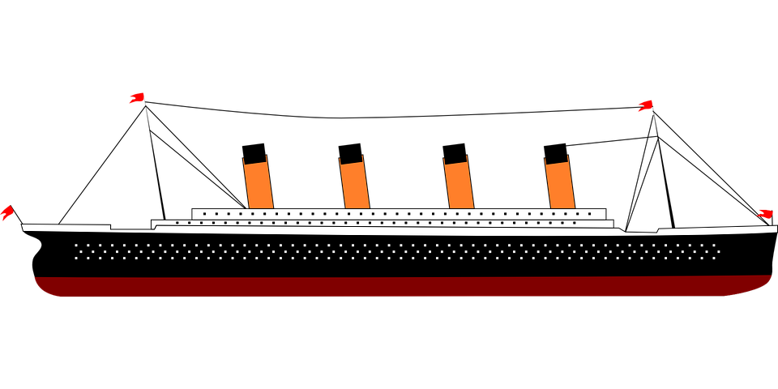
Insights from the disaster: Titanic
A brief data analysis of deaths.

Slide 5
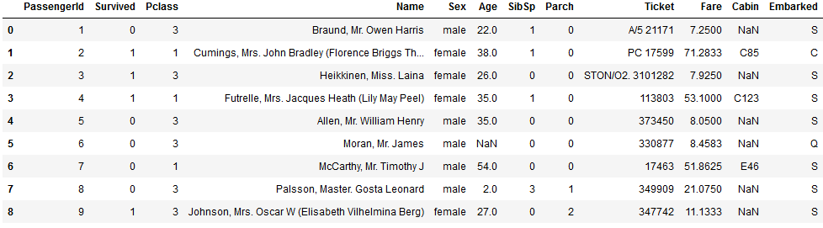
About the dataset
The train dataset had 891 rows each corresponding to the details of a passenger on board.

Slide 6
The dataset
The dataset contains the following 12 columns: PassengerId: A Unique ID for every passenger Survived: A 0 or 1 value. 1 indicates the passenger survived, 0 means didn’t. Pclass: A proxy for socio-economic status. 1 denotes Upper, 2 Middle and 3 Lower. Name: The name of the passenger Sex: Male or Female Age: Age of the passenger at the time of travel SibSp: Number of Siblings travelling along. Parch: Number of parents/children of passenger travelling along. Ticket: Ticket number for each passenger Fare: Total fare while purchasing tickets. (Involves fare of passenger as well as fare of siblings, parents and children travelling along, if any) Cabin: Cabin Number of the passenger Embarked: Port of Embarkation. C denotes Cherbourg, Q for Queenstown and S for Southampton

Slide 7
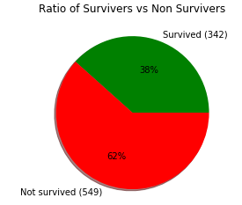
The incident
This figure illustrates that only 38% of the passengers onboard survived. The causalities outnumbered the survivors

Slide 8
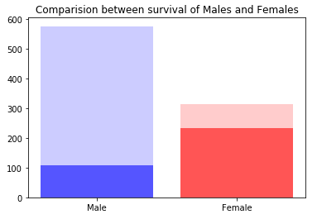
Comparison
The Male Survival Ratio was only 18.89% as compared to 74.2% for females. This clearly depicts that females were given priority in the rescue operations over males.

Slide 9
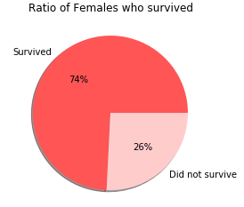
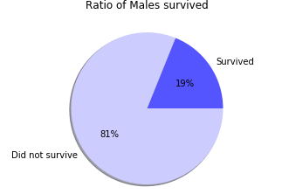
Key Findings
Females had higher chances of surviving as compared to males.
Most of the staff were male and had to stay back ,whereas females were prioritized to board the life boats.

Slide 10
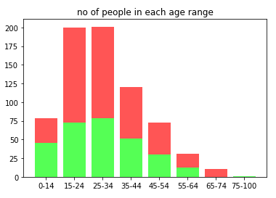
Age Wise Survival Stats
Age wise distribution of people form different age categories. Also it can be inferred that children had the highest survival rates.

Slide 11
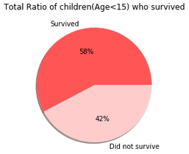
Passengers less than 15 years of age had a 58% chance of survival.

Slide 12
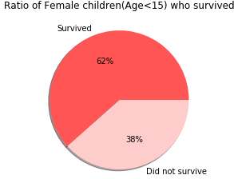
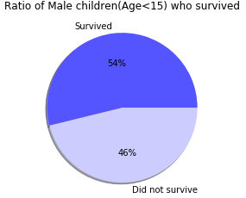

Slide 13
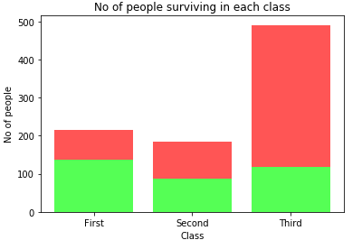
Class wise survival stats
Class 3 was the cheapest and had the most number of passengers. Class 1 had higher rate of survival, which is evident from the stats and also ovbious given the fact that class 1 had higher fares.

Slide 14
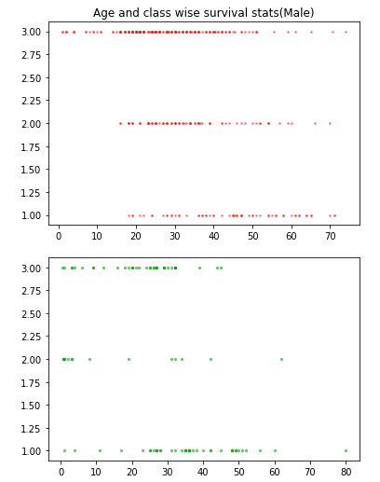
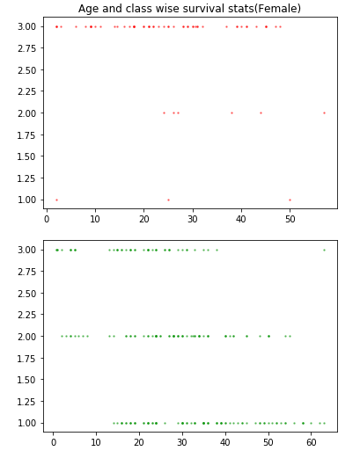

Slide 15
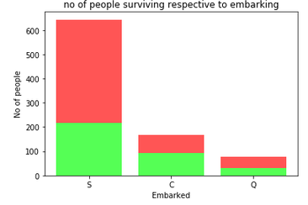

Slide 16
Points inferred
The rescue operations for the passengers gave priority to females and children over males.
Also, the passengers of higher ages were given the least priority.
The class 1 was given the highest priority while class 3 was given the least priority, possibly because class 1 had the highest ticket prices.

Slide 17
Thank You

