Slide 1

"Analyzing Ramen Ratings: Insights from The Ramen Rater Dataset"
Problem Statement:
"People love ramen, but not all brands and flavors are the same. Some are rated high, while others are not. This project analyzes thousands of ramen reviews to find the best brands, top countries for ramen, and whether packaging style (Cup, Bowl, Pack) affects ratings. Our goal is to understand what makes a great ramen!"

Slide 2
Overview of what we cover in the presentation:
1. Problem Understanding
What are we trying to achieve? (e.g., predicting ramen ratings, identifying trends)
Why is this problem important?
2. Data Collection & Understanding
Overview of the dataset (columns, data types, missing values)
Key statistics and initial insights

Slide 3
Overview of what we cover in the presentation:
3. Data Preprocessing & Cleaning
Handling missing values (drop, fill, or impute)
Converting categorical data into numerical (one-hot encoding, label encoding)
Normalization or standardization (if required)
4. Exploratory Data Analysis (EDA)
Understanding data distribution using graphs (histograms, bar charts)
Correlation between features
Insights from visualizations

Slide 4
Overview of what we cover in the presentation:
5. Feature Engineering & Selection
Selecting the most important features
Creating new features (if necessary)
Removing unnecessary columns
6. Model Selection & Training
Choosing the right ML algorithms (e.g., Linear Regression, Decision Tree, Random Forest)
Splitting the data into training and testing sets
Training the model on the dataset

Slide 5
Overview of what we cover in the presentation:
7. Model Evaluation
Performance metrics (Accuracy, Precision, Recall, F1-score, RMSE)
Comparing different models to find the best one

Slide 6
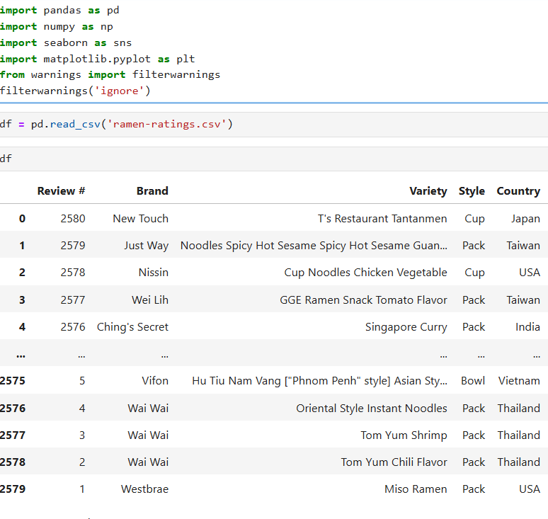
STEPS FOR MACHINE LEARNING PROGRAM
1.Importing libraries
2.loading dataset

Slide 7
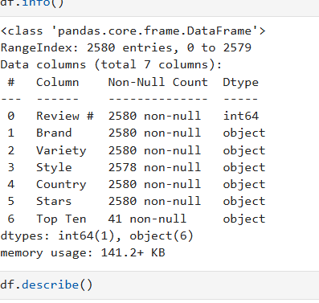
STEPS FOR MACHINE LEARNING PROGRAM
3. Exploratory Data Analysis (EDA)

Slide 8
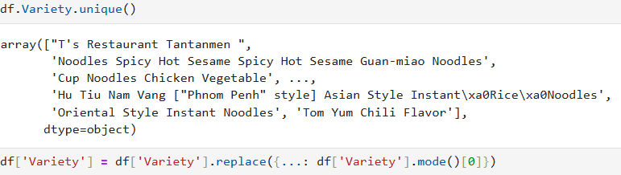
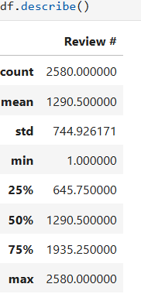
STEPS FOR MACHINE LEARNING PROGRAM
EDA-1.shape
2.describe
3.duplicates
4.info
5.null values
6.Bivarient

Slide 9
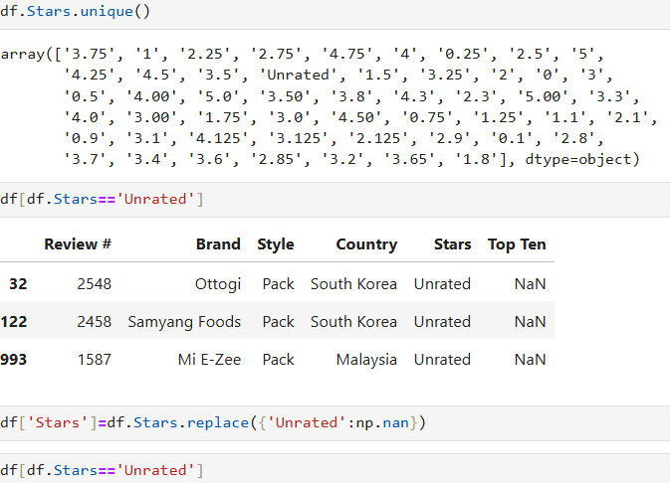
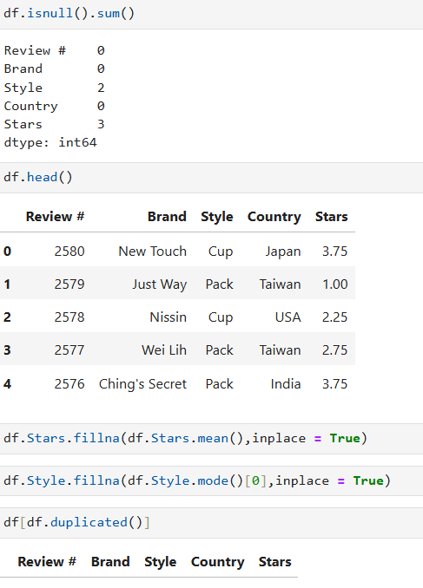
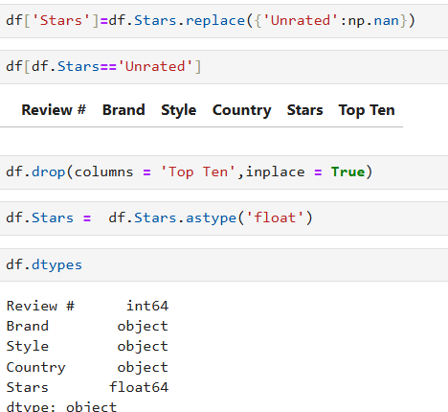

Slide 10
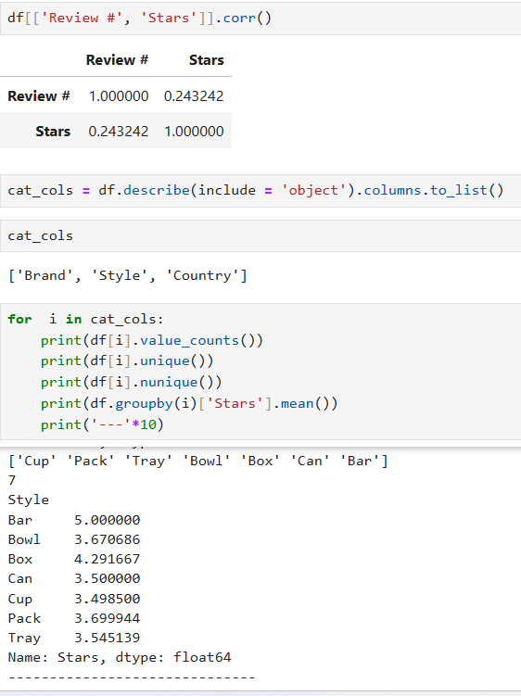
STEPS FOR MACHINE LEARNING PROGRAM
4 Data free processing

Slide 11
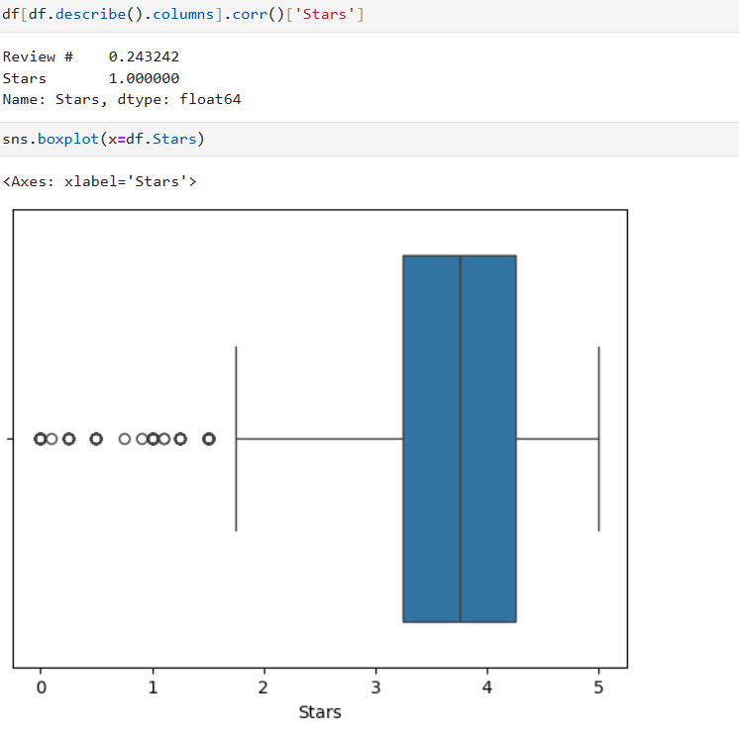
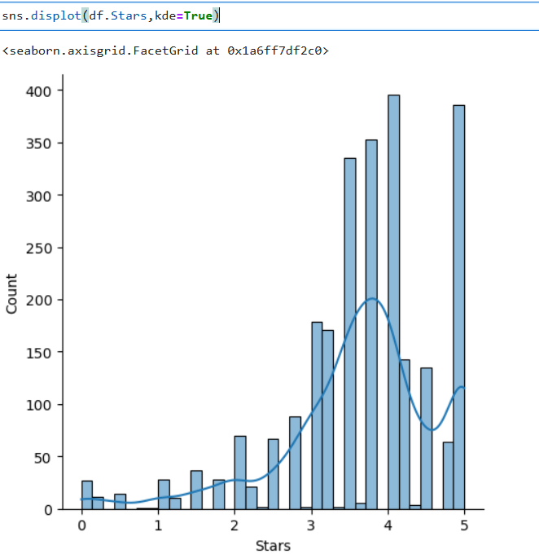

Slide 12
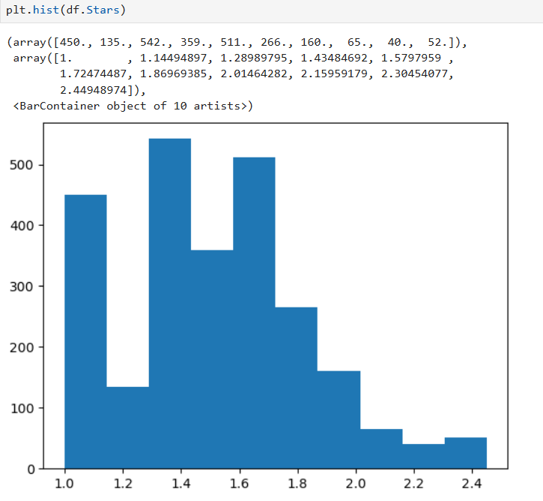
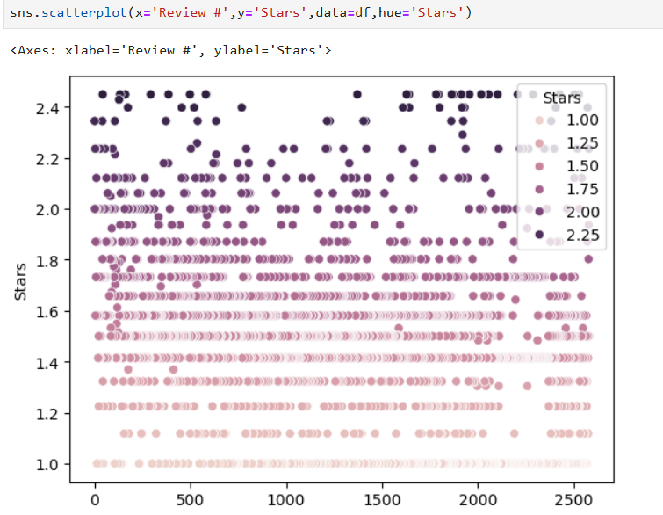

Slide 13
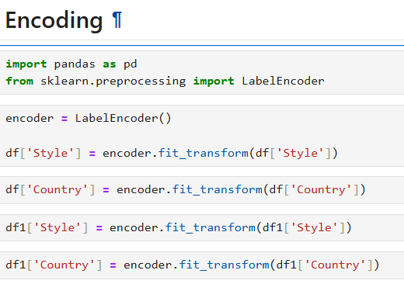
STEPS FOR MACHINE LEARNING PROGRAM
4. Data transformation

Slide 14
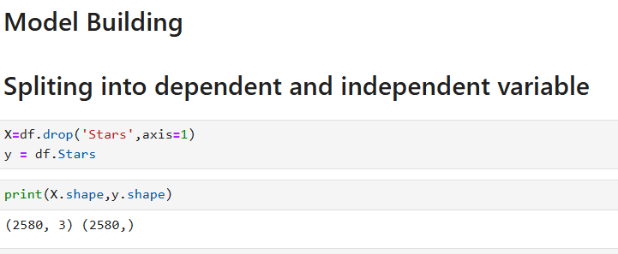
STEPS FOR MACHINE LEARNING PROGRAM
5 Model Building

Slide 15
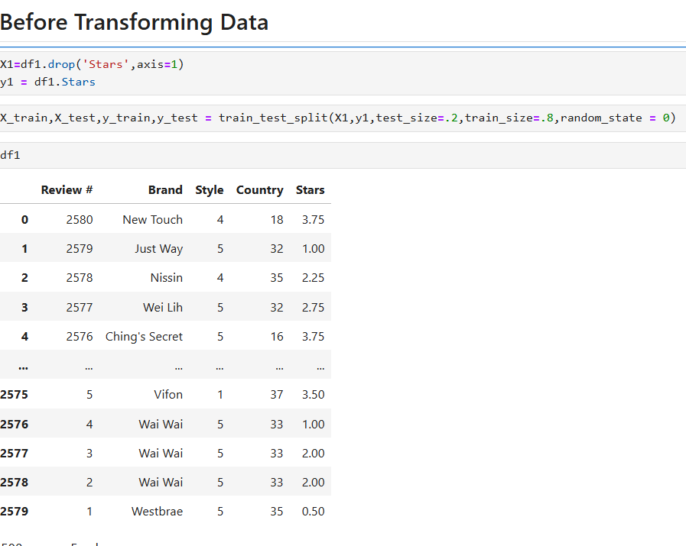

STEPS FOR MACHINE LEARNING PROGRAM
Model Selection & Training
Encoding for before transforamation

Slide 16
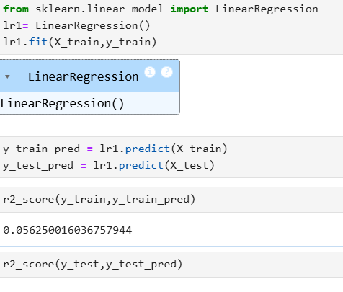
LINEAR REGRESSION

Slide 17
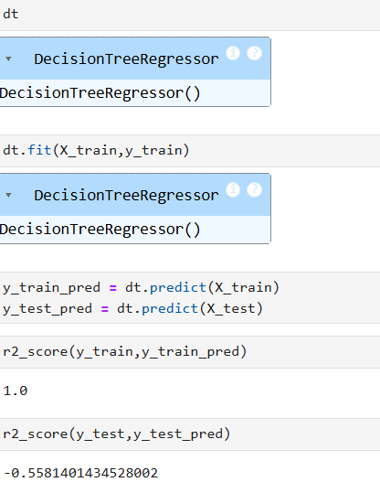
Decision Tree

Slide 18
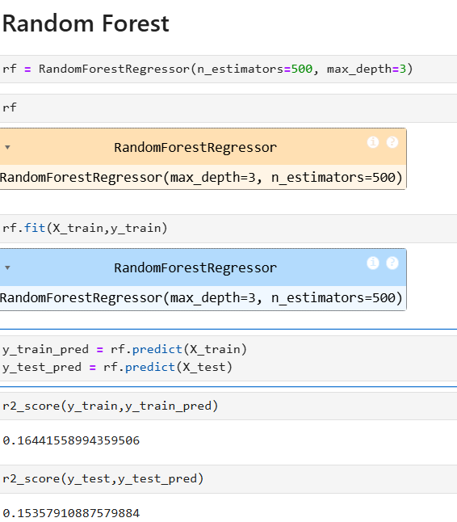
Random Forest

Slide 19
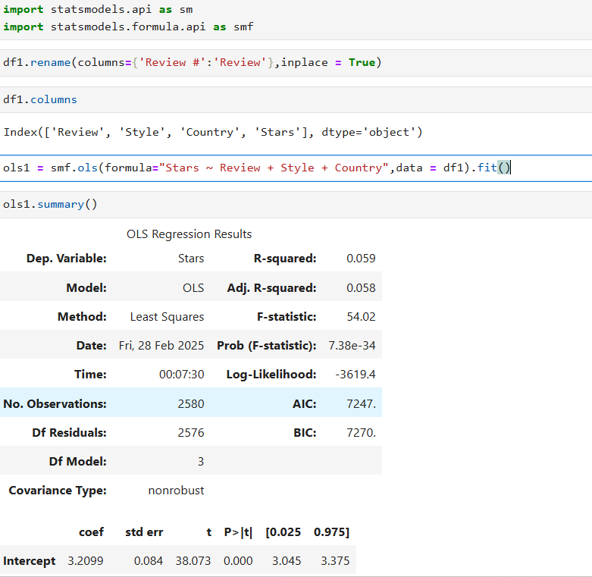
OLS(Ordinary Least Squares)

Slide 20
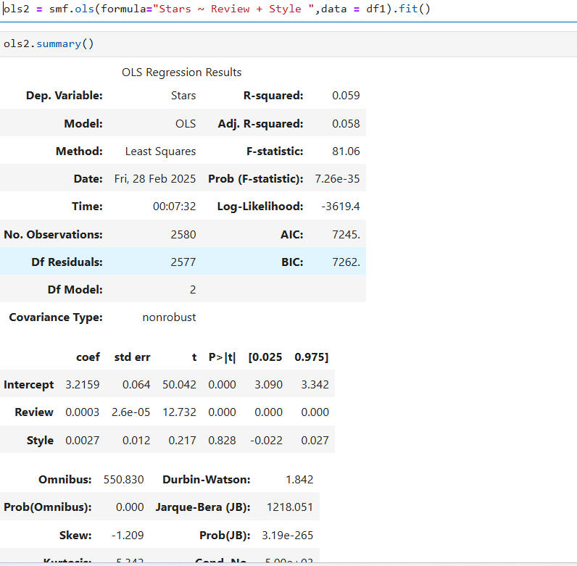

Slide 21
Buliding model after transforming Data (Normalaized Data)

Slide 22
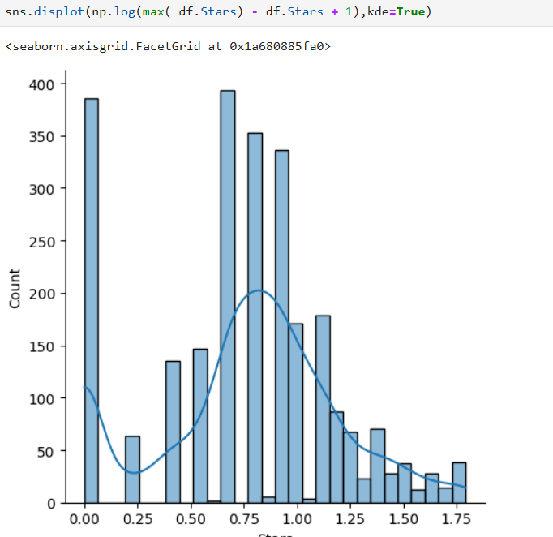
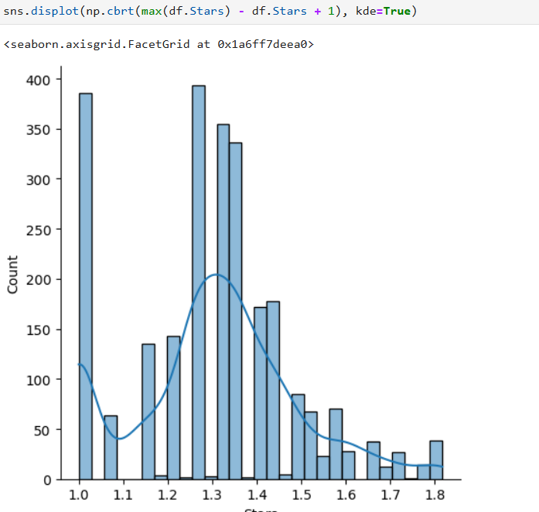

Slide 23
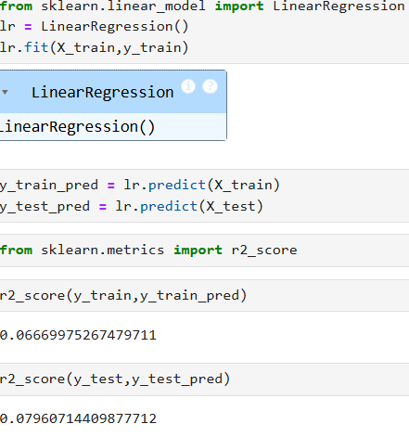
Linear Regression

Slide 24
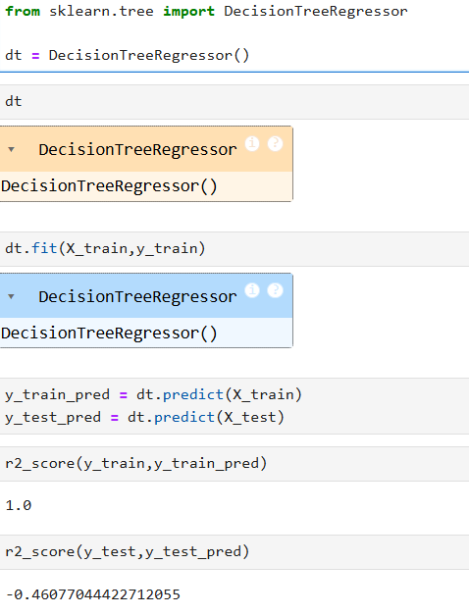
Decession Tree

Slide 25
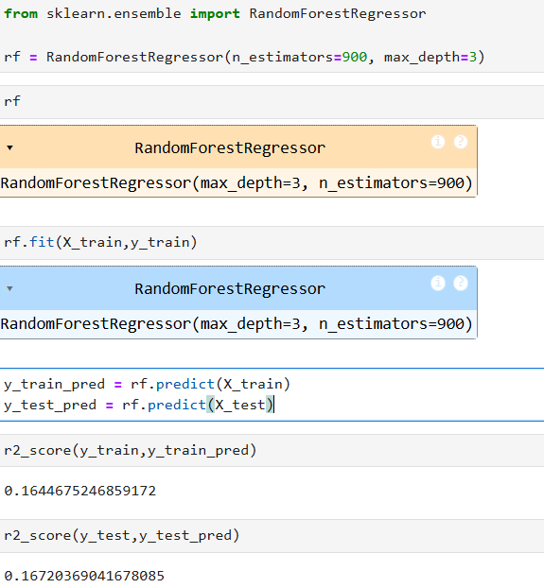
Random Forest

Slide 26
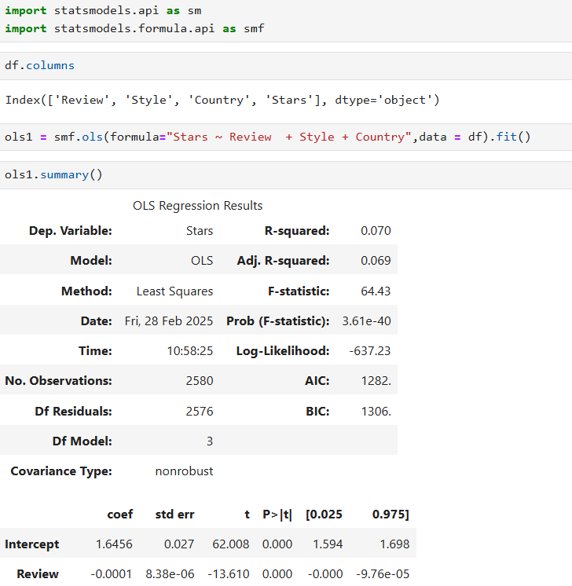
OLS(Ordinary Least Squares)

Slide 27
Conclusion
OLS Model (Based on R² = 70% and Adjusted R² = 69%)
Model Explanation Power
R² = 70% means that 70% of the variation in the dependent variable is explained by the independent variables in the model.
This indicates a good fit, but 30% of the variance remains unexplained, suggesting that other factors might influence the target variable.

Slide 28
Impact of Adjusted R²
Adjusted R² = 69%, slightly lower than R², suggests that some independent variables might not be significantly contributing to the model.
Adjusted R² accounts for the number of predictors, meaning adding more variables did not greatly improve model performance

Slide 29

THANK YOU

