Slide 1
Easy Food Share
An idea to allow poor people to get food for free or at minimal cost with a focus of reducing food waste
ITIS 6400/8400 Human Computer Interaction
Nayana Naik
30th April, 2019

Slide 2
Problem Statement
The idea is to help the homeless or poor people by getting them food for free or at minimal cost.
Reducing the food waste from different restaurants or other locations by utilizing the same food.
Establishing a community of food banks and associated people.

Slide 3
Design Goals
Users can quickly grab free food available with just few steps.
Allowing the user to select the type of food from different choices.
Enable the user to choose the delivery option for the food.
Users can rate the food provider and its quality of food.
Users [ donators ] can donate the food using few simple steps.
Users [ volunteers ] can help the food community by delivering the food to poor people.

Slide 4
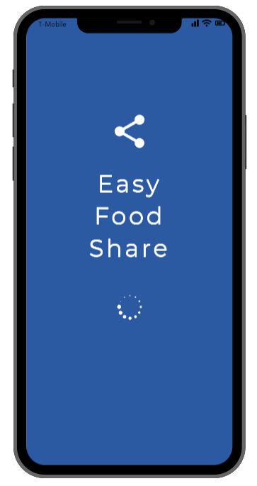
DESIGN CONCEPT
Based on user,usability and design goals we have opted to
evaluate fitment of three design concepts
Web based application
Smart phone application
Vending machine application
Finally, we have chosen “Smart phone application”
among the above design concepts based on the design goals evaluation

Slide 5
Project Prototypes
Smart phone application

Slide 6
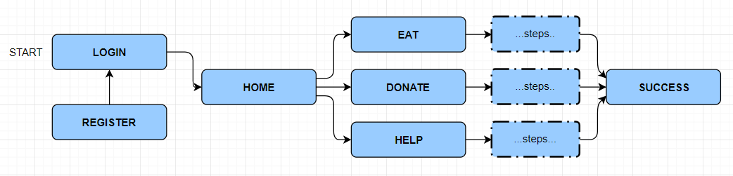
Interface Flow
Login to the application
OR
Register towards the application if not registered previously.
Once, successfully signed in - Home screen comes up with eat, donate and help option.
Eat - user who is hungry and wants to eat food.
Donate - user who is willing to donate food for needy people.
Help - willing to volunteer towards the food community.
START

Slide 7
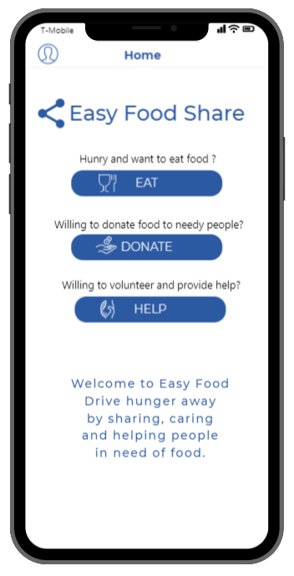
Home Screen
Allows to select “one” option from three allowed options based on user choice.
Each option having a button, clicking upon same takes the user towards the next respective screens.
Each option has description associated with it, which explains about the respective feature.

Slide 8
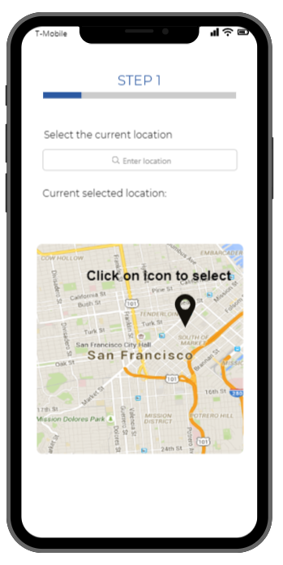
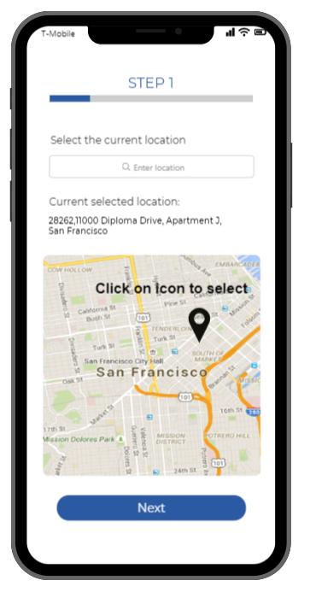
Eat option - Step 1
Satisfying design goal 1
Step 1 allows user to select the current location
Initially, current address and “Next” button is hidden.
Clicking on the map location, displays the current location address.
At the same, “Next” button appears to proceed further.

Slide 9
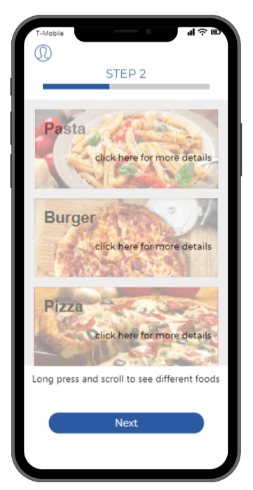
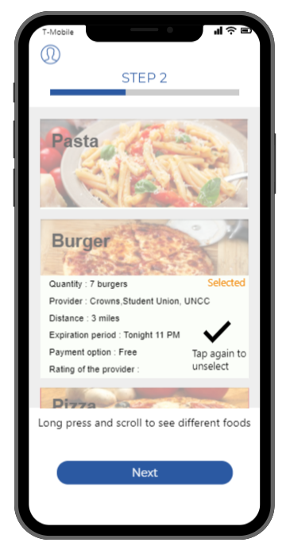
Eat option - Step 2
Satisfying design goal 2
Step 2 allows user to select the food from different available foods
Initially, it shows a scrollable list view.
Enables user to scroll and see different foods available.
Tap on the food image, shows more details and gets selected.
Once selected, shows a “right” tick as confirmation.

Slide 10
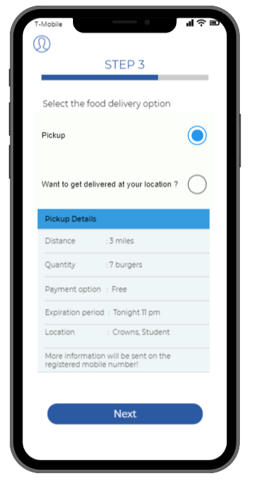
Eat option - Step 3
Satisfying design goal 3
Step 3 allows user to select the delivery option
Radio button allows user to select one option from available two options.
Based on the selected radio button, the details appear.
Tap on the “Next” button takes the user to further steps.

Slide 11
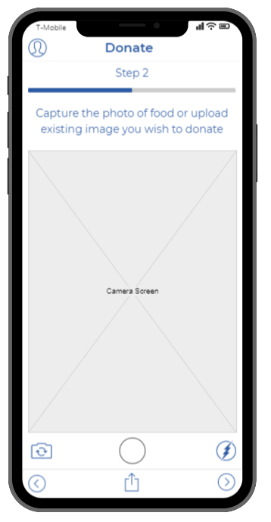
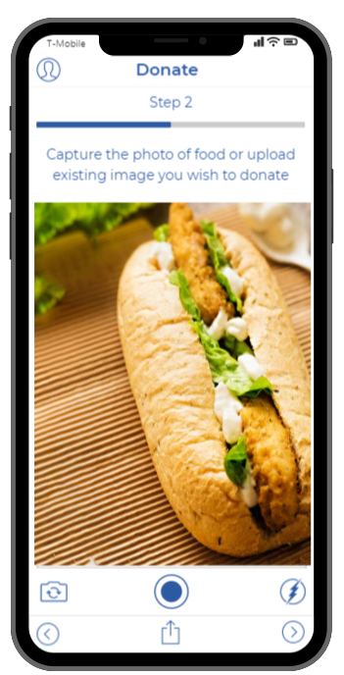
Donate option - Step 2
Satisfying design goal 5
Step 2 allows user to take the picture of the food which he/she wants to donate.
Tapping on the center circle button allows to capture the photo.
Once captured, the photo is shown in a large view on the screen as shown in the interface.

Slide 12
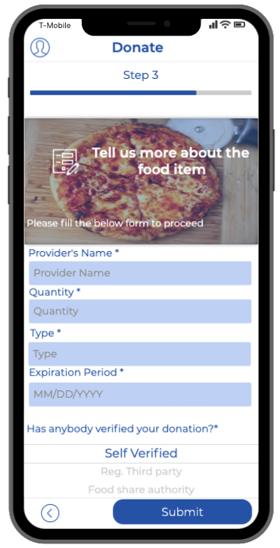
Donate option - Step 3
Step 3 enables the user to provide the details of food which is to be donated.
It gives a form having two text fields and one drop down list to fill out accordingly.
Once the form is completely filled, user can click on the submit button to proceed further.

Slide 13
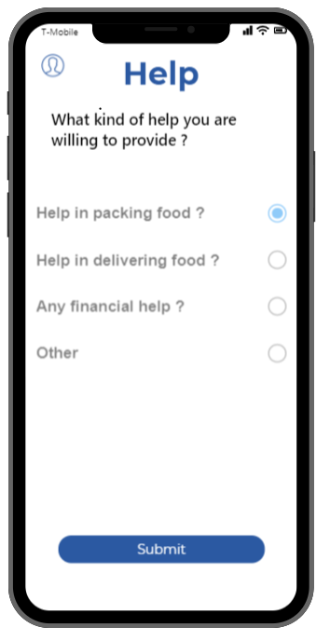
Help option
Satisfying design goal 6
Help enables the user to choose one of the radio button option from different available options.
Only one option can be chosen based on the preference and then submit button is used to move towards next screen interface.

Slide 14
EVALUATION RESULTS
Smart phone application

Slide 15
Participant Evaluation Methodology
Performed user study across a group of user to analyzed their performance , collect feedback and based on this that did minor changes.
Simple evaluation, focus on efficiency, learnability, effectiveness.
Perform three task and captured results.
Overall 10 users participated in this evaluation study, they all were able to complete the evaluation successfully.

Slide 16
Discount Evaluation
Cognitive Walkthrough
Identified three tasks to evaluate from the perspective of users also set of questions related to each task.
Task 1: User wants to avail the eat option to eat food.
Task 2: A person wants to upload the photo of a food item he wants to donate to the needy people.
Task 3: A person wants to volunteer towards the cause.
Heuristic Walkthrough
Performed evaluation based on all heuristic methods.
Find out flows in each methods.
Used rating map to score flows.

Slide 17
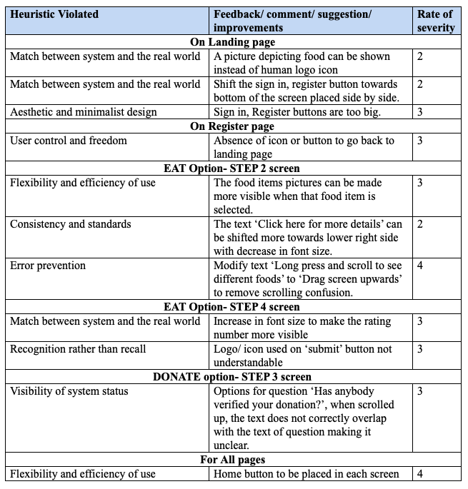
Result of Heuristic Evaluation

Slide 18
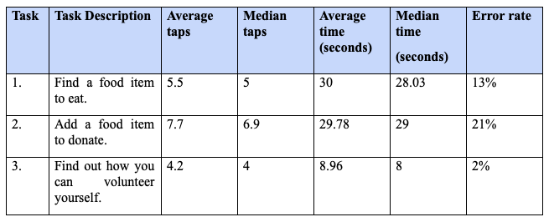
Evaluation Result

Slide 19
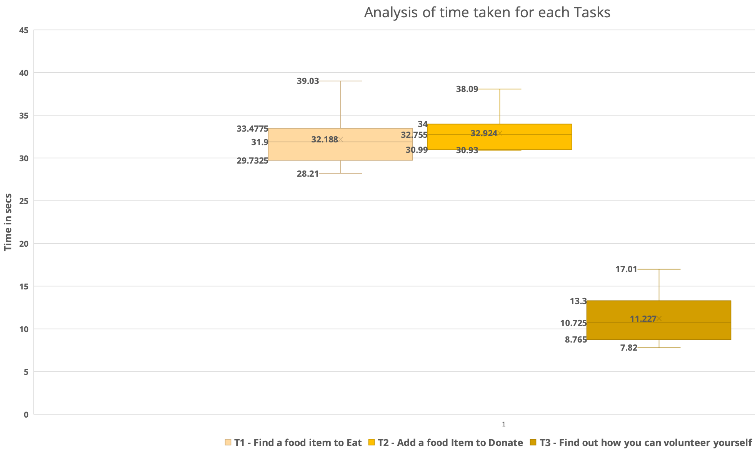
Evaluation Result - Box Plot

Slide 20
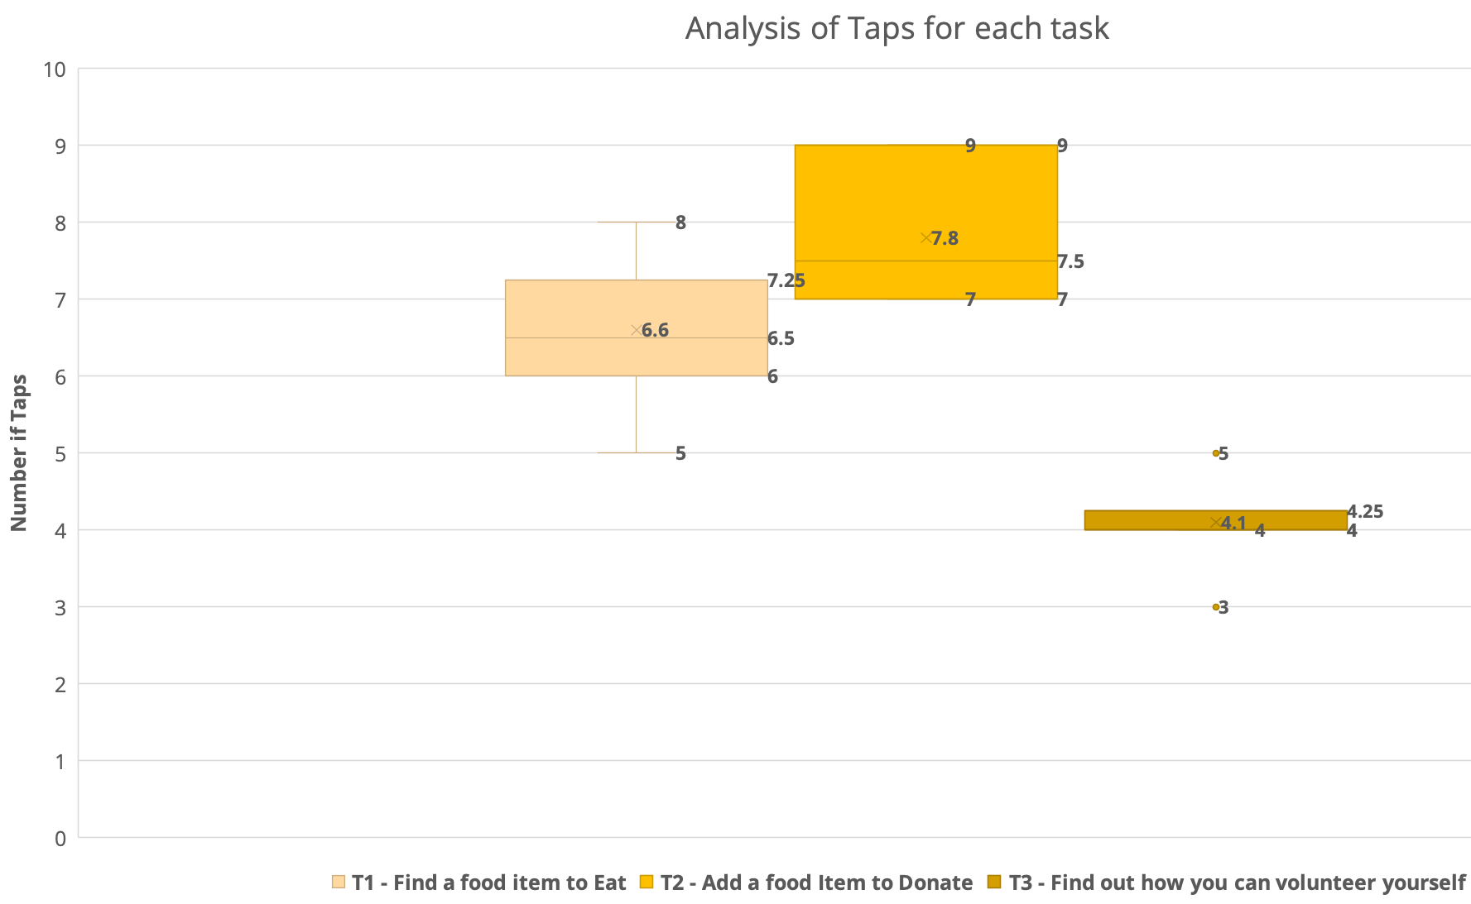
Evaluation Result - Box Plot

Slide 21
Usability Goal evaluation
Learnability: Strongly supports
Efficiency: Strongly supports
Memorability: Strongly supports
Errors: Strongly supports
Satisfaction: Strongly supports

Slide 22
Design Goals evaluation
The users/ consumer should be able to quickly choose the type and select available free food located within minimum distance shown or to opt for delivery option for food - Strongly supports.
The consumers can rate the food provider and the quality of food by rating system with minimal ambiguity - Strongly supports.
The donators or producers should be able to upload details of excess food without any hurdle - Strongly supports.
The volunteers should be able to choose whether they want to help financially, packing or delivering food item - Strongly supports.

Slide 23
LESSONS LEARNED
Smart phone application

Slide 24
Future Improvements
Simplicity of the design
Increasing the font size on EAT option-step 4 to make the rating more visible.
Donate option-step 4, the scroll list for ‘Has anybody verified your donation’ overlap the other input fields which should be fixed.
Shifting the sign and register button towards bottom of the screen place side by side in the landing screen.
EAT option - step 2, the food items pictures can be made more visible when the food item is selected.

