Slide 1
Architect: Yee-Kang Chang
Install
October 2015
Decoupling Java SDKs for Expedited Delivery of Security Fixes
WebSphere Analysis Document
Associated Features: 120021

Slide 2
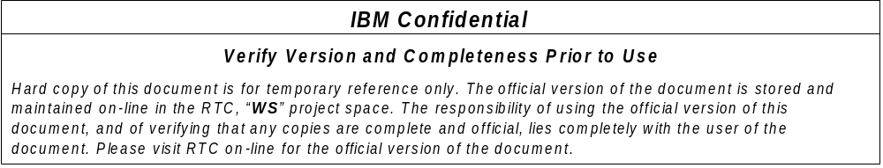
Analysis Document Instructions
The analysis document is intended to serve two purposes:
It is a way to communicate the value and cost of the function to product management team and other parts of the organization. It will be used to determine its relative priority to other work.
It is a tool for communicating early and high-level thoughts about the expected system design in a way that shows relationships between affected components and therefore prompts early feedback from reviewers, allowing for a successful system design.
The analysis document is a required step in the WebSphere development process. Creation and review of the analysis document by the Chief Architect is required for a feature to be prioritized and targeted for a release.
This template should be used as a guideline for the analysis document contents. Deviations from this outline should be taken as often as is appropriate for the component and the issues that are relevant to its design.
Each page includes some directions on what should be covered on that page. Again, these are guidelines. The purpose of the instructions are merely to remind you of what types of information should be covered. You should not be limited by this. Create additional pages if needed. You should cover as much of whatever information is needed to demonstrate your expected design -- to help you get that design right before investing too much time in going down the wrong track.
IBM Confidential
September 6, 2013
Notes:
A pot file is a Design Template file, which provides you the “look” of the presentation
You apply a pot file by opening the Task Pane with View > Task Pane and select Slide Design – Design Templates.
Click on the word Browse… at bottom of Task Pane and navigate to where you stored BlueOnyx Deluxe.pot (black background) or BluePearl Deluxe.pot (white background) and click on Apply.
You can switch between black and white background by navigating to that pot file and click on Apply.
Another easier way to switch background is by changing color scheme. Opening the Task Pane, select Slide Design – Color Schemes and click on one of the two schemes. All your existing content (including Business Unit or Product Names) will be switched without any modification to color or wording.
Start with Blank Presentation, then switch to the desired Design Template
Start a new presentation as Blank Presentation
You can switch to Blue Onyx Deluxe.pot by opening the Task Pane with View > Task Pane and select Slide Design – Design Templates.
Click on the word Browse… at bottom of Task Pane and navigate to where you stored BlueOnyx Deluxe.pot (black background) and click on Apply.
Your existing content will take on Blue Onyx’s black background, and previous black text will turn to white.
You should add your Business Unit or Product Name by modifying it on the Slide Master
You switch to the Slide Master view by View > Master > Slide Master.
Click on the Title Page thumbnail icon on the left, and click on the Business Unit or Product Name field to modify it.
Click on the Bullet List Page thumbnail icon on the left, and click on the Business Unit or Product Name field to modify it.
Click on Close Master View button on the floating Master View Toolbar
You can turn on the optional date and footer fields by View > Header and Footer
Suggested footer on all pages including Title Page: Presentation Title | Confidential
Date and time field can be fixed, or Update automatically. It appears to the right of the footer.
Slide number field can be turned on as well. It appears to the left of the footer.

Slide 3
This WAD will cover the specifics of the feature as it pertains to WAS.
The overall initiative is a collaboration between the WAS, JTC, Capilano, Middleware Security teams.

Slide 4
VALUE DEFINITION
IBM Confidential
September 6, 2013

Slide 5
Background
Describe background information that will be useful to help understand how this feature will be used or integrated into the product. Use this slide to cover existing concepts and the Key Concepts chart to cover new material that will need documentation.
Problem Statement
IBM PSIRT policy is to ship Security Vulnerability patch within 30 days and never to exceed 90 (AIM policy) or 120 (SWG policy for SEV 1).
Oracle Java CPUs for Security Vulnerabilities
  Come out frequently – Nearly every quarter
  Are publicly disclosed
  IBM Java ships within 2 weeks of Oracle Java
  WAS repackages and ships within 2 weeks of IBM Java putting WAS within 30 days of Oracle GA.
Challenge
Currently, the only way to ship IBM Java is for the product teams to bundle and ship.
IBM’s overall average response time today is roughly 75 days with some teams exceeding 200 days...
Decoupling Java from IBM products would allow customers to begin installing Java fixes within 2 weeks after Oracle ships and announces.
IBM Confidential
September 6, 2013

Slide 6
Key Concepts
Describe specific documentation needs of this design. Specifically, think about and explain any new concepts, terms and actions that may be introduced as part of this design. Important: If you are not planning to write a full-fledged SDD after this WAD, please understand that, this is the only vehicle ID/Pubs has to get all the information on design. So, please think hard and provide as detailed information as possible.
No new concepts
Recap
  Offerings: Software packages that IBM Installation Manager install
  Extension offerings: Offerings that go on top of a particular “base” offering i.e. under the same install root “extending” its capabilities
IBM Confidential
September 6, 2013

Slide 7
High Level User Story
Identify the key user stories you are supporting in this design. Create as many as necessary to illustrate the business value a customer derives from the LI. Include things like, the roles of various users (i.e. administrator, programmer, deployer, etc.), scaling expectations, business conditions, etc. Keep it focused on the Customer's perspective and the value they expect to get.
As a WebSphere Application Server administrator, I want to apply Java security updates as soon as they are available so that my systems will not be exposed to security vulnerabilities.
As an IBM product that consumes Java SDK(s) and uses IBM Installation Manager, I want my users to have access to the latest Java security updates as soon as possible to minimize exposure to security vulnerabilities.
As an IBM product that consumes Java SDK(s) and uses IBM Installation Manager, I want to adopt common Java packages for Installation Manager for efficiency and speed of delivery.
As IBM, we want to improve our overall turnaround time for IM-based Java security fixes and optimize our processes to improve client satisfaction and reduce cost.
As WAS, we want greater flexibility in adding and removing Java SDK support so that we can quickly respond to changing business conditions.
IBM Confidential
September 6, 2013

Slide 8
COST ANALYSIS
IBM Confidential
September 6, 2013

Slide 9
Design Requirements
Enumerate any requirements that have been put on you, or that you will assume that are relevant to the design. This could, for example, include the requirement for introducing certain plug-points in the component to enable replace ability of function (e.g. JPA Provider override). If you know you are using open source, note the packages here and whether or not they are internal only or exposed for customer use or both.
Consistent install experience across WAS classic and WAS Liberty
  Adopt common (plain vanilla) Java SDKs from JTC “as-is” i.e. no WAS-specific customization
Leverage existing Installation Manager capabilities and infrastructure as much as possible
Consuming products can control what Java services are available to their users if necessary
IBM Confidential
September 6, 2013

Slide 10
Feature Design: Overview
Include as many charts as needed to depict the key design aspects of the Feature. This should be high level, pictures are more important than words. Do not attempt to go into depth to describe the function of existing components or depth of Feature design. The focus here is to describe key aspects of design usage, additions or changes to existing components and a high level design of new components. The focus is to identify all the major components involved in this Feature and their interactions. Describe the impact or expectations this Feature will have put on those components.
Java SDKs as Extension Offerings decoupled from the Base Offering
  Improve user experience working with Extension Offerings in Installation Manager
Adopt common Java SDKs i.e. work with Java binaries from JTC without customization
Common packaging and publishing for these Java SDK extension offerings by JTC
Streamline WAS processes in adopting and testing Java services
IBM Confidential
September 6, 2013

Slide 11
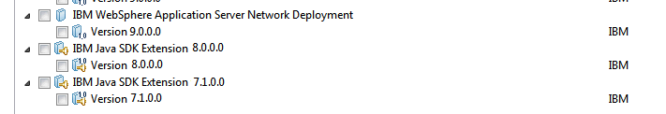
Java SDKs as Extension Offerings
WAS will be the base offering while Java SDKs become extension offerings that users can optionally install to the same location
Similar to what we have for Liberty Profile today
Classic: Users need to install the base PLUS at least 1 Java SDK extension offering at the same time
Liberty: Java SDK extension offerings are optional; Users can install Liberty without any Java SDK extensions
Common Java SDK extension offerings for both WAS classic and Liberty
Consuming base offerings would include common references provided and defined by Java SDK extension offerings to establish relationship and control where the Java binaries would be installed

Slide 12
Java SDKs as Extension Offerings
Which offering supports what? What are the options?
Runtime offerings
  Classic (All Editions): At least 1 of Java SDK v8 and v7.1
  Liberty (All Editions): None, any or all of Java SDK v8 and v7.1
  NDDMZ: At least 1 of Java SDK v8 and v7.1
Supplemental offerings
  App Client: At least 1 of Java SDK v8 and v7.1
  IHS: Java SDK v8 only
    z/OS: Not applicable (No Java SDK required; BAU)
  Plugin: Java SDK v8 only
    z/OS: Not applicable (No Java SDK required; BAU)
  WCT: Java SDK v8 only
Edge components
  ULB: Java SDK v8 only
  CP: Not applicable (No Java SDK required; BAU)
Where there is a choice, Java SDK v8 will be the default preference.

Slide 13
Java SDK as Extension Offerings
Updates (SRs and FPs)
  These will be version updates to the extension offerings
  For fixes in between fix packs that will be published and made publicly available e.g. critical security fixes, JTC is looking to adopt a versioning scheme that will have these fixes show up as another version updates e.g. 1st fix pack is V.R.M.10 and the next one is V.R.M.20 and the unused numbers will be reserved for such fixes. Hence, these fixes can be version updates to the extension offerings like a regular fix pack too.
APAR (Private) Fixes
  IM's fix mechanism will be leveraged
  Show up as proper fixes in IM that are targeting specific offerings or specific version(s) of offerings
  Users will select which fix (APAR) that they want to apply and IM will apply that to the selected offering – Same as how WAS fixes work today
  Typically not generally available but we have the option to publish them if the need arises.
All services are cumulative updates (BAU for Java services)

Slide 14
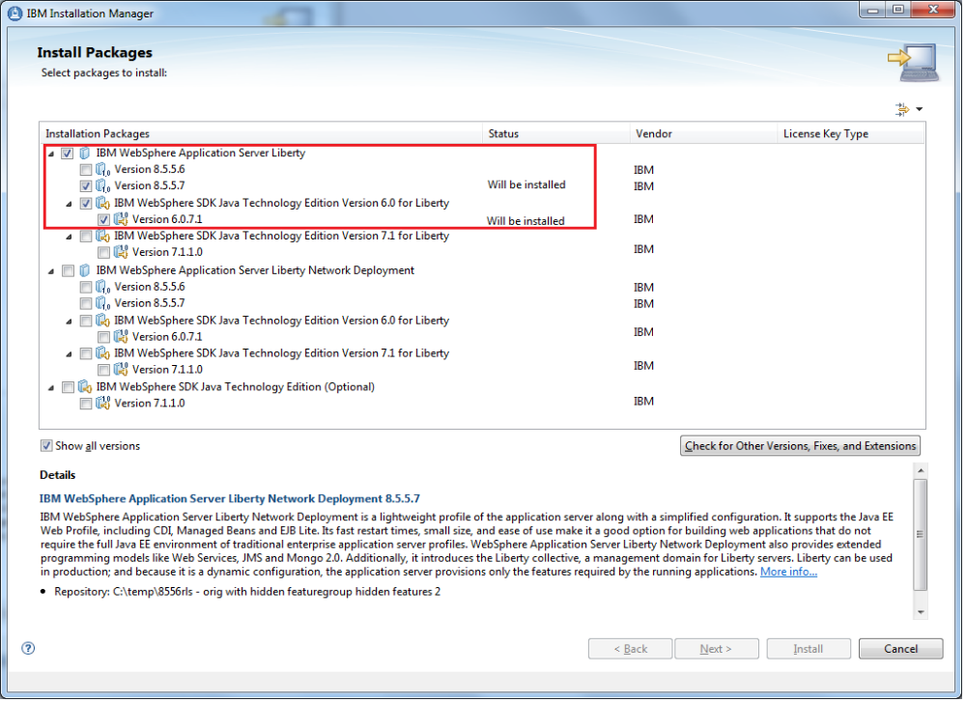
IM Enhancements
Better visual representation e.g. tree structure to convey relationship between Base and Extension offerings
Preferred Extension e.g. Java 8 if available will be automatically selected when Base is selected
Note: This is a mock up only.

Slide 15
WAS Efforts to Support a Standard IBM JDK
java.policy
  Standard JDK has an extra permission that we believe will work with WAS -- permission java.util.PropertyPermission "javax.realtime.version", "read";
  No ACTION required other than regression testing.
    Found issue with Derby and port permission – Move of Derby to 10.11 as part of v9 plan should resolve this.
ibmspnego.jar
  Is shipped in tWAS JDK and is no longer needed since WAS7.
  No ACTION required other than regression testing.
wsorbutil.jar
  Is shipped in tWAS JDK and in WAS directory. We believe this can easily be removed from the JDK directories without issue. Testing is needed to confirm. >> Already removed? Lori to follow up.
  No ACTION required other than regression testing.
orb.properties
  Is shipped in tWAS JDK and in WAS directory. We document the fact that the WAS version will take precedence over the JDK version. Testing to confirm but we are fairly sure WAS will work fine using a standard JDK build. >> Lori to follow up.
  No ACTION required other than regression testing.
java.security
  z/OS and IBM i use a copy of the java.security in the WAS directory.
  Still required and ACTION is to programmatically update the provider list with the CMS and PKCS11 providers – Same work for Java SDK v8 support in WAS classic v855x.
WAS-specific XML parser
  Is NOT shipped as part of the JDK binaries for WAS and ships today within the WAS directory.
  No ACTION required other than regression testing. >> Follow up with Michael G to see if we can remove the WAS copy.

Slide 16
Publishing Java SDK Extension Offerings
JTC will own, build, and publish the offerings and subsequent updates (fix packs and fixes) to Installation Manager live repositories and Fix Central as common artifacts that adopters can directly point to and reuse
For WAS, the strategy is for clients to be able to access the latest updates as soon as possible
  Live Repositories: One-time setup to point directly to the common repositories that JTC will provide and updates will automatically show up for WAS clients as soon as they are available i.e. when JTC publishes them
  Fix Central: Automate the process to enable the common artifacts for WAS users when JTC publishes them and integrate that into JTC publishing process
    These artifacts are by default “hidden” and adopters need to “enable” them for consumption by their users
    This is exactly the same as how JTC makes available Java updates for non-Installation Manager adopters today – We use it for the Java updates for Liberty archive installs
Note: For live repositories, there is an alternate approach – see Backup Materials for information – that allows adopters to control the exact Java updates that are available to the users. This is not the WAS strategy but is an available option.

Slide 17
Process
New SR or FP [JTC]
Package into IM components and offerings [JTC/Automated]
  Integrate into current packaging step as a job
  Push onto a common location (e.g. espresso) for product teams to use and test
Test by product teams [Product Teams]
  Product teams will pick up from common location and test
  WAS:
    JTC already runs WAS test buckets as part of their process – Consider additional coverage as appropriate
    Integrate with JTC publishing process and automate testing as soon as new Java builds are available
GM/GA
  No certification needed due to self-certification process
Publish to Fix Central and Live Repositories [JTC/Product Teams/Automated]
  WAS: Updates should be available to WAS clients as soon as publishing is completed
Note: As part of the Expedited Delivery of Security Fixes initiative, WAS will develop the first set of common Java SDK extension offerings and transfer over to JTC for on-going development and maintenance.

Slide 18
Programming Model
Identify Customer externals that must change to enable the user stories. Describe the changes you will make to the programming model in general terms. Be sure to include all relevant WebSphere programming model APIs (e.g. JEE applications, OSGI applications, Admin scripting, etc.). Also, discuss any SPI changes, if applicable. Detailed information may wait until iteration planning. Identify whether the programming model changes are to the 'core' or must be, unique to a particular edition or platform. Include any relevant thoughts about versioning.
Not Applicable
IBM Confidential
September 6, 2013

Slide 19
OSGi Applications Considerations
Describe how the feature will support OSGi Applications: If the feature is for a programming model capability, describe how the programming model will be surfaced in OSGi applications (e.g. what APIs/versions, OSGi services or OSGi Extenders will be provided, any OSGi lifecycle considerations, etc)? If the feature is for an operational capability, describe any unique considerations for how it will support OSGi applications (e.g. OSGi Application deployment, lifecycle management, configuration). Finally, in the Development Tools section consider any OSGi Applications tools requirements for enabling the programming model or operational capability within the WebSphere tools. Update “Test Impact” page with additional test considerations.
Not Applicable
IBM Confidential
September 6, 2013

Slide 20
Deprecation of Public Features
Describe, in general details, if any deprecation of externals is known at this time. This could be something like deprecate EJB 2.1 CMP Entity beans, but it is unlikely to be as detailed as individual methods at this point in time. Please refer to the release-to-release compatibility policy documented in the WfAB QuickPlace.
Not Applicable
IBM Confidential
September 6, 2013

Slide 21
Migration and Coexistence
Describe, in general details, known migration concerns for any existing customers and stack products when releasing this feature. Specific details are unlikely to be available at this time. Potential impacts could include: programming interfaces, administration scripts, user applications, default values. This feature cannot break multi-version cell support and minimally must be able to coexist with all features of existing versions in these scenarios.
Not applicable; We are introducing this for the first time in WAS v9
IBM Confidential
September 6, 2013

Slide 22
Install
Describe any significant installation requirements for this feature such as optional feature selection, special handling for feature packs, etc. The idea is to identify significant changes in how customer operations will work and significant work required by the install team to handle something new.
IM prerequisite: v1.8.5/1Q15
Packaging: Java SDK v8 will be packaged together with the WAS classic runtime offerings where appropriate so users will have it “by default”. Details will be in the Packaging WAD.
This is an Install WAD …
IBM Confidential
September 6, 2013

Slide 23
Setup / Configuration / Administration
Describe how this feature could impact customer setup, configuration, and / or administration as well as significant development effort required by admin components. Be sure to consider stack product impacts in this area as well.
managesdk’s Updates
Determine what Java SDKs are installed under <WAS>/java
Determine which Java SDK is the default giving preference to Java SDK v8
Java will be installed under <WAS>/java
  <WAS>
  /java
  /<java8>
  /<java71>
  /…
Extensible to handle new Java SDKs that will be supported down the road
  Option to have different systemlaunch.properties for different Java SDKs
IBM Confidential
September 6, 2013

Slide 24
Security
Does this feature affect how customers use or configure security? Does it use existing security models or require new ones?
java.security: Move to programmatically update the provider list with the CMS and PKCS11 providers
IBM Confidential
September 6, 2013

Slide 25
High Availability
Define your availability assumptions – how will you avoid SPOF, how do you recover your function in the presence of failure, how do you make failure transparent to the users of your function, etc.?
Not Applicable
IBM Confidential
September 6, 2013

Slide 26
Performance and Instrumentation
Identify any potential implications to performance. For example, provisioning would add code path to the startup of an individual module, but reduce code path required to startup a subset of the app server. Implications to changes in footprint are good to note here as well if there are desired goals known at this time.
Install time should be at par with v8.5.5 adjusting for size increase (if any) in WAS runtimes and Java SDKs
Performance tests and measurements will be covered under Release Fundamentals for WAS v9
IBM Confidential
September 6, 2013

Slide 27
Platform Considerations
Note any platform specific considerations.
For zOS background, see: http://washome.austin.ibm.com/xwiki/bin/download/zComfortTeam/educationlist/diffdocv61.doc . Contact websphere_platform_experts@us.ibm.com [official mail alias is TBD] for additional input regarding potential platform considerations that are not currently recognized.
For iSeries background, see: http://washome.austin.ibm.com/xwiki/bin/view/IBMiTeam/education
z/OS: Java SDKs will no longer be installed with both 32-bit and 64-bit binaries – Users will have to decide at install time the “bitness” that they want to use
IBM i: Not applicable to IBM i since Java SDKs are already “decoupled” on the platform i.e. the system provides Java SDKs and products will use those and do not need to carry their own
IBM Confidential
September 6, 2013

Slide 28
Cloud
Are there any additional considerations when operating within a cloud environment? For example, are changes required to the pattern engine to support this feature? How about requirements for bluemix environment? How about other IAAS or PAAS environments that we support, such as AWS or Docker? Any additional test scenarios need to be documented on the Test page as well.
Cloud deliverables such as WAS Patterns that use Installation Manager under the cover will need to be instrumented to install at least one additional offering i.e. one of the Java SDK offerings when they install and deploy WAS classic runtime
IBM Confidential
September 6, 2013

Slide 29
Developer Tools
Describe expectations around tools required for this feature. What changes are exposed to customers that affect how they will develop and deploy applications? Will WDT be impacted, or will new tools be required to support this feature? What about command line development, automated builds, or debugging requirements?
WDT and RAD will need to handle the new decoupled structure and be instrumented to install the Java SDK extension offerings for the Test Environments as appropriate
IBM Confidential
September 6, 2013

Slide 30
Test Impact
Describe, in general, expectations around testing. Are any new Continuous Test suites required, or changes to supported CT topologies? List the persona scenarios required to test this feature (be sure to include both developer experience scenarios, which will include tooling and application development, and stress testing scenarios). For all scenarios, specify whether JEE or OSGI applications are require. Are there specific combinations of components or technologies that should be persona tested? If not obvious from the feature description, does this feature apply to Liberty or tWAS or both? Should this be persona tested with specific topologies, configurations, JVMs, settings? Any unique HA or failover scenarios? Is executing under heavy stress or a 7-day Longrun recommended or required?
Automation infrastructure will be updated to handle the new decoupled structure
Automated tests will be added to test installs of the new common and decoupled Java SDK offerings with WAS runtimes
SVT would test the new decoupled setup indirectly – BAU as there isn’t specific persona for Install
IBM Confidential
September 6, 2013

Slide 31
Service Impact
What information will be provided to enable problem diagnosis? Consider customer self diagnosis, L2 identification of the failing component, and L3 diagnosing the cause of a problem. What failure conditions have been considered and how does a customer recognize and recovery from the failure conditions? Does the new feature introduce any new considerations for building and/or applying service? For example: any pre or post configuration actions; any new considerations as to how and when to apply an iFix; any new/changed metadata required in a fixpack or iFix?
WAS will not be re-packaging and publishing Java services going forward starting in v9
JTC will be building, packaging and publishing Java services with WAS users consuming them directly
Service Test Strategy
  Continue to test Java FPs as part of WAS FP cycles
  Document the latest tested levels and make known to users
  Java Fixes remain untested and provided “as-is”
  Improve automation/integration to run more tests
IBM Confidential
September 6, 2013

Slide 32
Stack Considerations
Stack products bundling WAS will get this for free
WAS (Liberty) embedders continue to BYOJ, which is BAU
  If you use IBM Installation Manager, you can choose to adopt these common Java SDK extension offerings or embed the common SUs (Shareable Units) directly
Attend 4Q15 VAS for further discussion if you are interested

Slide 33
wasdev.net community
WASdev.net provides how-to articles, videos, podcasts, sample configurations, scripts, and sample applications to complement the Knowledge Center for developer and devops scenarios . What will you create to publish on wasdev.net that would help build a community for developers and devops users? It doesn't need to be Liberty/WAS-specific; generic Java EE resources are also useful. What format will it be best in? How will this help your users? See: https://w3-connections.ibm.com/wikis/home?lang=en-gb#!/wiki/We86f8173e47f_4f66_adb3_ba970604d6d2/page/How%20to%20contribute%20to%20WASdev%20-%20start%20here
Consider articles and videos to socialize changes and improvements when WAS v9 release goes out the door
IBM Confidential
September 6, 2013

Slide 34
Potential Patent Considerations
Are there any design or implementation ideas that should be considered for further patent brainstorming activities?
No new ideas to disclose
IBM Confidential
September 6, 2013

Slide 35
Backup Materials
IBM Confidential
September 6, 2013

Slide 36
Adopting Common Java SDK Extension Offerings for Installation Manager
Required in Base Offering
Reference to the install contexts for the Java SDKs that you want to support
Enable passive.order.dependencies for SUs that require the JDK payloads
Optional Considerations
A bundle to enforce that at least one Java SDK extension offering is selected/installed if you must have at least one
OR adopt IM enhancements that allow a default preferred extension offering to be selected

Slide 37
Publishing Considerations for Live Repositories
If you want the latest and greatest to be available to your users as soon as possible:
Point directly to the common repositories that JTC maintain
New content will show up as soon as JTC publishes them
If you want to have control over what is available to your users and enable access when you are ready:
You publish (update) a composite repository to accept new SR/i-Fix level when ready
Composite repository contains links to actual (common) repositories of Java updates make available by JTC that you are ready to support
+ You have full control over a Java update is available e.g. to avoid field regressions
- An extra publishing step every time you need to add support for a new Java update

Slide 38
End of WAD
IBM Confidential
September 6, 2013

