Slide 1

India's Vaccination
- 1 BILLION GLORY DOSES
Title ID: 4CEDA_CP_01
Team Guide – Dr. P. G. Sunitha Hiremath
Neha Tarannum
Team 17
NAME​ | ROLL NO. | USN
Shrinidhi R H | 443 | 01FE20BCS227
Priya M | 455 | 01FE20BCS239
Suma Doddamani​ | 447​ | 01FE20BCS231
Nayana D G​ | 451​ | 01FE20BCS235

Slide 2
Contents
Problem statement
Objectives
Data Description
Domain Understanding
Analysis
Conclusion

Slide 3
Problem Statement :
Our dataset explores the rise of Covid and effect of vaccinations on Covid, which ultimately helped us to reach the milestone of 1 billion vaccinations in India.
Objectives:
Compare the variation of tests, cases and deaths in year 2020 and 2021.
Analyze the effect of vaccination on cases, deaths, positive rate and death rate.
Observe and note the patterns in vaccinations.
Compare the effect of first and second dose of vaccinations on cases and deaths.

Slide 4
Data Description
The given dataset is the daily basis count in Covid and vaccination sector.
It summarizes the information regarding the number of Covid cases, deaths, Covid tests and the status of vaccination.
The data helps to analyze the situation of approximately 2 years of data till Dec 15, 2021, the pre-release of vaccine in the first year and post-release of vaccine in the second year.
This dataset comprises 50 columns(attributes) and 686 rows(tuples).

Slide 5
Tests, cases and deaths
Domain Understanding
Column | Dtype | Definition
New_tests | float64 | Number of tests taken on that day
Total_tests | float64 | Total number of tests till that day
Positive_rate | float64 | Positive cases per new tests
Total_cases | int64 | Total number of cases till that day
New_cases | int64 | Number of positive cases on that day
Total_deaths | float64 | Total number of deaths till that day
New_deaths | float64 | Number of deaths on that day
Vaccinations
Column | Dtype | Definition
Total_vaccinations | float64 | Total vaccinations till that day
People_vaccinated | float64 | Number of 1st dose vaccinations on that day
People_fully_vaccinated | float64 | Number of 2nd dose vaccinations on that day
New_vaccinations | float64 | Number of vaccinations on that day

Slide 6
Effect of Covid and other causes for death
Column | Dtype | Definition
Cardiovasc_death_rate | float64 | Number of deaths occurring due to heart and blood vessels.
Diabetes_prevalence | float64 | Number of diabetes patients.
Female_smokers | float64 | Number of female smokers.
Male_smokers | float64 | Number of male smokers.
Extreme_poverty | float64 | Extreme poverty mainly refers to an income below the international poverty line($2.29 per day).
Population | float64 | Number of people living in a particular place.
Population_density | float64 | Number of people living in an area per square kilometre.
Gdp_per_capita | float64 | Measures the economic output of a nation per person.
Median_age | float64 | Age that divides the population in two parts of equal size.
Reproduction_rate | float64 | Number of offsprings produced in the life time of a women.

Slide 7
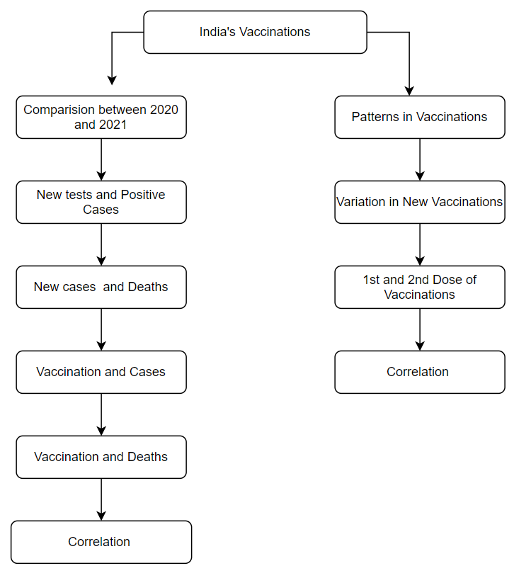
Analysis

Slide 8
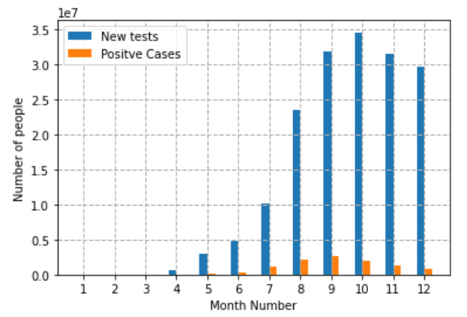
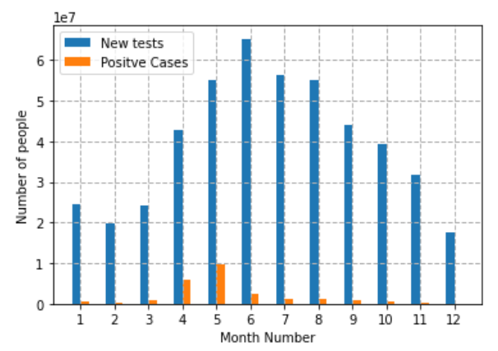
Analysis of tests and cases in the year 2020-21
How was the variation in tests and cases in the year 2020 and 2021?
Is there any relation between monthly tests and cases?
2020
2021
From the graph, we can analyze that the tests and cases started increasing from the month of April in 2020, till it reached its peak in October which was due to the emergence of first wave of Covid and later the cases started decreasing.
But from March 2021, we again witnessed the emergence of second wave, hence the tests and cases increased till cases reached its peak in May in 2021 and tests reached its peak in June, 2021.

Slide 9
Analysis of tests and cases in the year 2020-21
Statistical Analysis:
New Tests
New Cases
Year | Standard Deviation | Mean
2020 | 455119.6892 | 620352.9671
2021 | 532730.5332 | 1398453.4324
Year | Standard Deviation | Mean
2020 | 29540.1079 | 30524.3590
2021 | 99692.6364 | 70005.4240
The variation of new cases and new tests is much higher in 2021 when compared to 2020.
The main reason for much varying cases and tests could be because of the emergence of second wave of Covid in 2021, which resulted in the increase in number of tests and cases.
Vaccination could also be one of the factors.

Slide 10
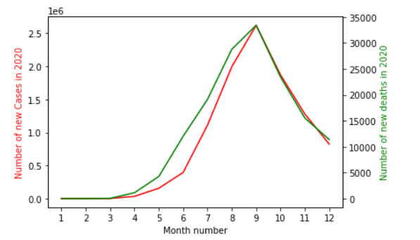
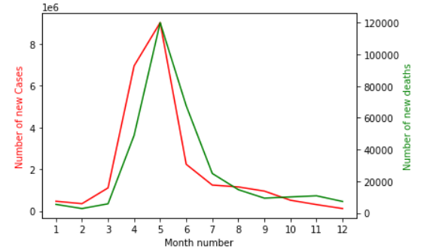
Analysis of cases and deaths in the year 2020-21
How are the variations of cases and deaths dependent on each other?
How effective was the second wave on people's life compared to the first wave?
2020
2021
From the graph, we can analyze that in the year 2020 both the cases and the deaths have reached the peak during the month of September.
Later, there was gradual decrease in both the cases and deaths.
In 2021, there is a sudden rise of cases from the month of February which indicates the emergence of second wave of Covid.
New cases and new deaths have reached the peaks in the month of May.

Slide 11
Analysis of cases and deaths in the year 2020-21
Statistical Analysis
New cases
New deaths
Year | Standard Deviation | Mean
2020 | 29540.1079 | 30524.3590
2021 | 99692.6364 | 70005.4240
Year | Standard Deviation | Mean
2020 | 374.9431 | 503.3581
2021 | 1249.2425 | 938.3495
By analyzing the variation of deaths in 2021, we can understand how severely the second wave hit our country.
There is a huge variation of cases and deaths in 2021 when compared to 2020.

Slide 12
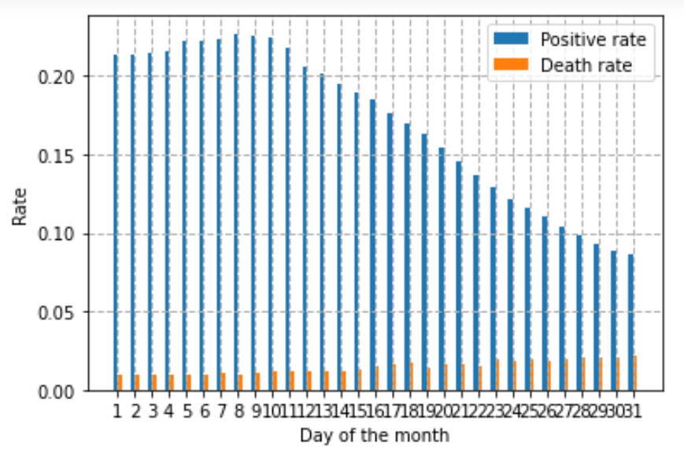
Q. How did the daily positive rate and death rate vary in the month of May, 2021?
Percentage Increase in Cases: 29.76 %
Percentage Increase in Deaths: 145.35 %
Earlier, we have just discussed that in the month of May, we had witnessed highest number of Covid cases and deaths.
From the graph, we can analyze that in the second week of May, we had maximum positivity rate and the last week of May had highest death rate.
Throughout the year, positive rate was much higher compared to death rate.

Slide 13
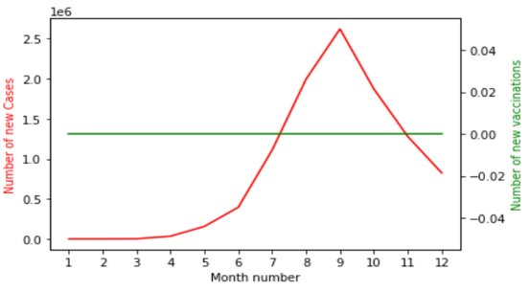
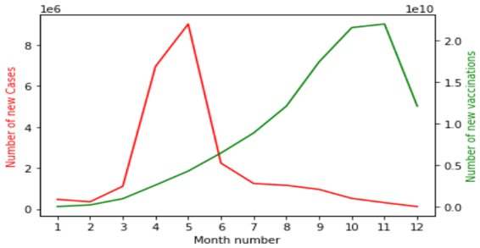
Analysis of vaccinations and cases in the year 2020 and 2021
1. What was the variation in vaccinations and cases in the year 2020 and 2021?
2. How did vaccination effect the new cases?
Pre-release of Vaccinations (2020)​
Post-release of Vaccinations (2021)​
In 2020, the line depicting the number of vaccinations is a straight line, since there were no vaccinations released. The line depicting the number of cases has gradually increased and has reached its peak in the month of September.
In the year 2021, the Covid cases reached the peak in the month of May and started declining later onwards.​
So, from the graph we can analyze that the people's urge to take vaccine started increasing gradually as the Covid cases gradually increased.

Slide 14
Analysis of Vaccination and cases in the year 2020 and 2021
Statistical Analysis
New Vaccinations
New cases
Year​ | Standard Deviation​ | Mean​
2020​ | 0​ | 0​
2021​ | 3214294.3841​ | 4087961.7371​
Year​ | Standard Deviation​ | Mean​
2020​ | 29540.1079​ | 30524.3590​
2021​ | 99692.6364​ | 70005.4240​
The variation was null in 2020, since there was no release of vaccinations, but the variation of new vaccinations was more in 2021.
But coming to the analysis of variation of new cases, we can see that new cases are less varying in 2020 compared to 2021.

Slide 15
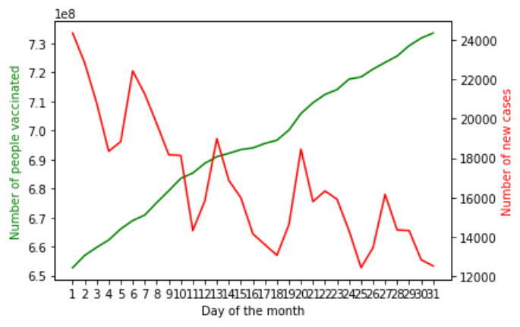
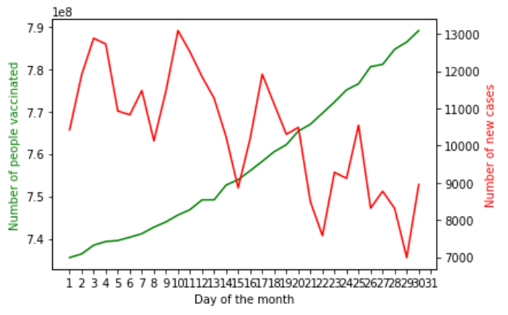
Q. What was the variation of new cases and vaccinations in October and November, 2021 and why?
October, 2021
November, 2021
Percentage Increase in Vaccinations: 72.19 %
Percentage Decrease in Vaccinations: 24.07 %
After reaching the peak in 2021 the Covid cases started decreasing by a considerable amount as people started getting the vaccinations.
There were sudden rise and dips in new cases which may be due to festivals like Deepavali, Dussehra, etc.
Maximum vaccinations occurred in the month of October and November.

Slide 16
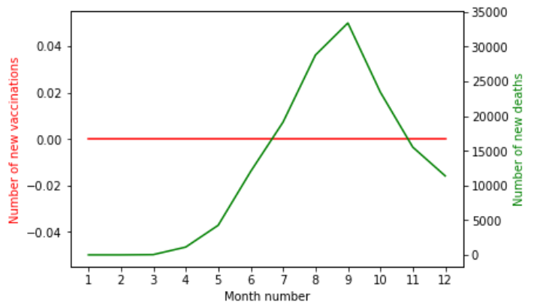
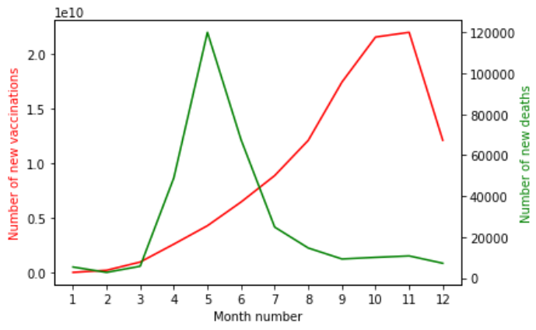
Analysis of Vaccinations and Deaths in the year 2020-21
How was the variation in death and vaccination?
What was the effect of vaccination on death?
2020
2021
Here, we can see the monthly count of the number of deaths increased gradually and reached the peak in the month of September, 2020.
From February, 2021 we can see a rapid surge in the Covid deaths, hence can be termed as the beginning of India's second wave of Covid. Not only cases increased, but deaths were much more in this second wave of Covid.
From the month of May, 2021 the deaths rapidly decreased this may be due to vaccination.

Slide 17
Analysis of Vaccinations and Deaths in the year 2020-21
Statistical Analysis
New Vaccinations
New deaths
Year | Standard Deviation | Mean
2020 | 0 | 0
2021 | 3214294.3841 | 4087961.7371
Year | Standard Deviation | Mean
2020 | 374.9431 | 503.3581
2021 | 1249.2425 | 938.3495
Here, there is more of variation of new vaccinations in the year 2021.
But as we can see evidently that the variation of new deaths is very less in 2020 as compared to 2021
So, here we can analyze that the vaccination may have effected on deaths.

Slide 18
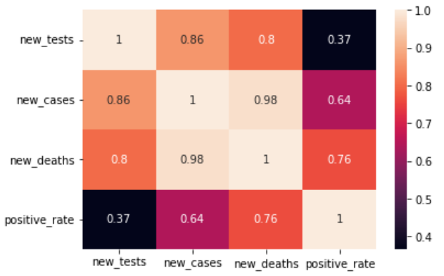
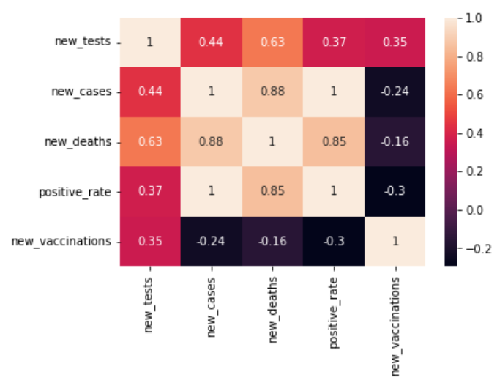
Correlation
2020
2021
New tests and new cases are strongly positively correlated i.e., almost dependent on each other.
New cases and deaths are strongly positively correlated i.e., almost dependent on each other.
New cases and positive rate are weakly positively correlated i.e., almost independent.
New tests and new cases are weakly positively correlated i.e., almost independent.
New cases and deaths are strongly positively correlated i.e., almost dependent on each other.
New vaccinations and new cases are weakly negatively correlated i.e., almost independent.
New vaccinations and deaths are weakly negatively correlated i.e., almost independent.

Slide 19
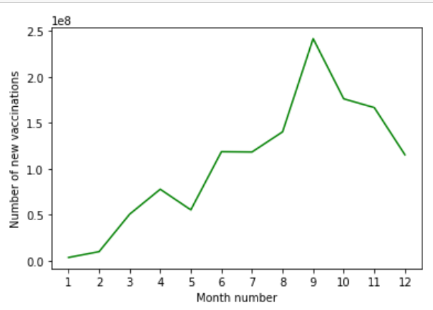
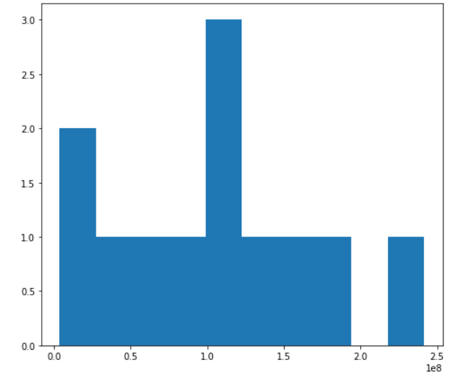
Patterns in Vaccinations
1. How did number of new vaccinations vary in 2021?
2. What were the most frequent ranges of new vaccinations?
Number of new vaccinations has increased gradually from February, 2021 due to the second wave of covid.
There was a peak in September, 2021 due to the beginning of the third wave of covid.
There was dip in number of vaccinations in May which also had peak in number of cases.
Most monthly vaccinations lie between 1e8 and 1.2e8 or between 0.1e8 and 0.3e8.
We can say that the number of vaccinations mostly depend upon the waves of covid.

Slide 20
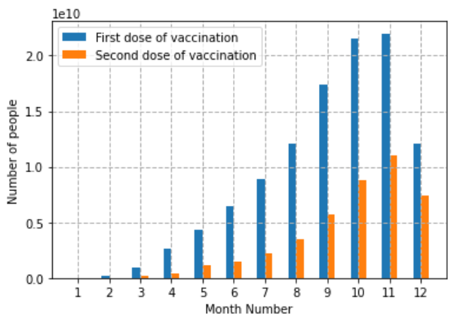
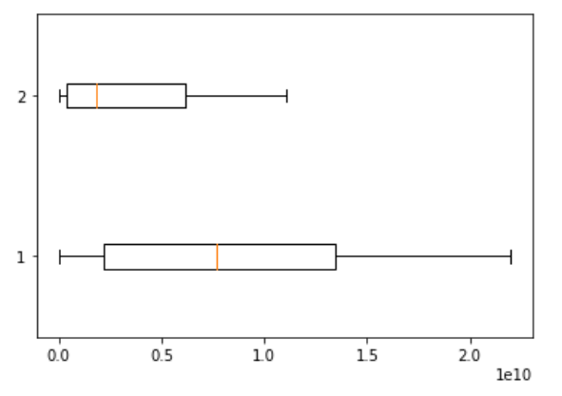
1st and 2nd Dose Monthly Vaccinations
1. Compare variations of first dose and second dose of vaccinations.
2. Were there any sudden rise or dip in 1st and 2nd doses of vaccinations?
We can see that the number of people vaccinated with first dose is more compared to people fully vaccinated.
There was rise in both 1st and 2nd doses of vaccinations in October and November.
Both data have no outliers i.e., there are no months with vaccinations out of the common range.

Slide 21
Patterns in Vaccinations
Statistical Analysis
In Peak Month of October:
Percentage Increase in new Vaccinations: 72.19 %
Percentage Decrease in new Vaccinations: 24.07 %
Percentage Increase in 1st dose of vaccinations: 23.66 %
Percentage Increase in 2nd dose of vaccinations: 52.76 %
Attribute | Standard Deviation | Mean
New Vaccinations | 3214294.3842 | 4087961.7371
First Dose Vaccinations | 2816687.0202 | 3364717.7894
Second Dose Vaccinations | 1464808.2608 | 1464808.2608
There was more variation in the first dose of vaccinations compared to second dose of vaccinations.
This may be due to more number of first dose of vaccinations compared to second dose of vaccinations.

Slide 22
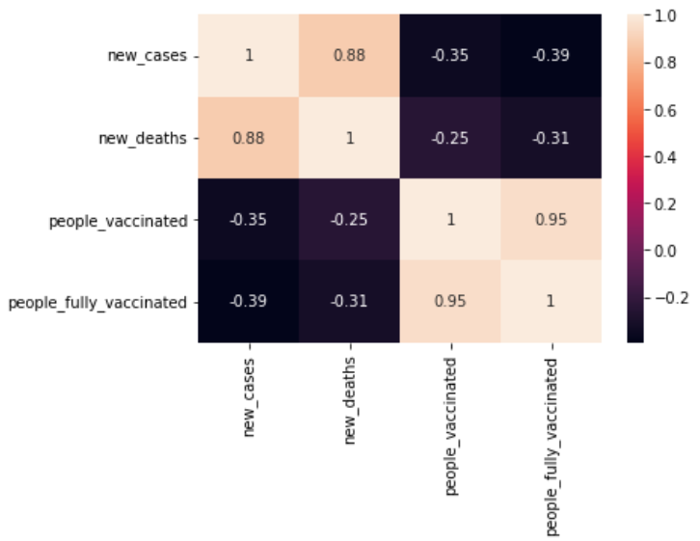
Correlation
1st dose and 2nd dose of vaccinations varied almost equally.
We can see that 2nd dose of vaccination had more effect on new cases and deaths as compared to that of 1st dose.

Slide 23
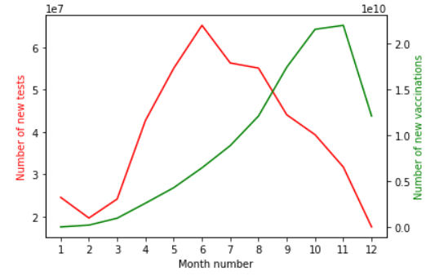
Q. How did the Government of India deal with second wave of Covid?
In Month of March:
Percentage Increase in new Tests: 22.90 %
Percentage Increase in new Vaccinations: 404.23 %
Only way to control the pandemic was to keep increasing the testing and vaccinations in addition to lockdown.
Increased testing almost certainly has resulted in the detection of a high proportion of mild cases.
Increased vaccinations almost certainly has helped reduce the impact of covid.

Slide 24
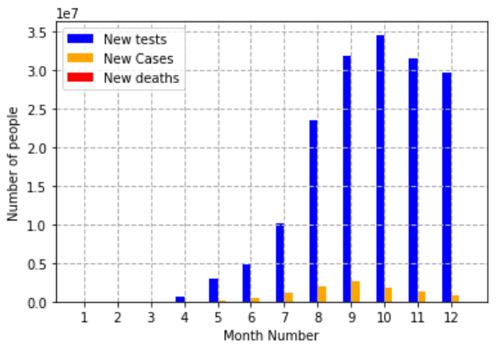
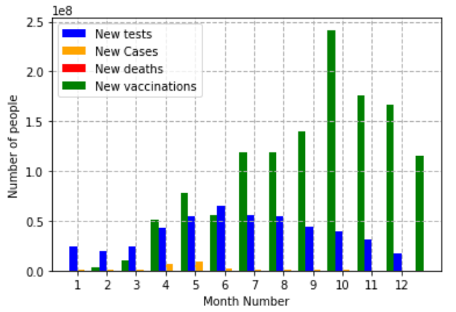
Conclusion
2020
2021
Testing helped to detect more cases and hence, reducing severe cases of covid.
In general, as cases increased, deaths also increased. But deaths did depend on cases.
Vaccination did not affect much on the number of cases or positive rate.
Cases mostly depended on waves of covid and other factors.
Vaccination affected the number of deaths by increasing the immunity of the people which is seen in further days or months.
Vaccinations depended on waves of covid and other factors.
There were more first dose vaccinations compared to second dose vaccinations.

Slide 25
"None are safe, until all are safe."
Thank you

