Slide 1
PROJECT TRAVELTIDE
Date : 29.11.2024
Author : Nayana Nagaraja

Slide 2

PROJECT OUTLINE
Goal of the project is to analyse travel data from Customers and provide offers and perks to customers to improve the business

Slide 3
Overview of project activities
Understanding the data and business
Data preprocessing
Feature engineering
Data Segmentation and Filtering
Business improvement plan

Slide 4
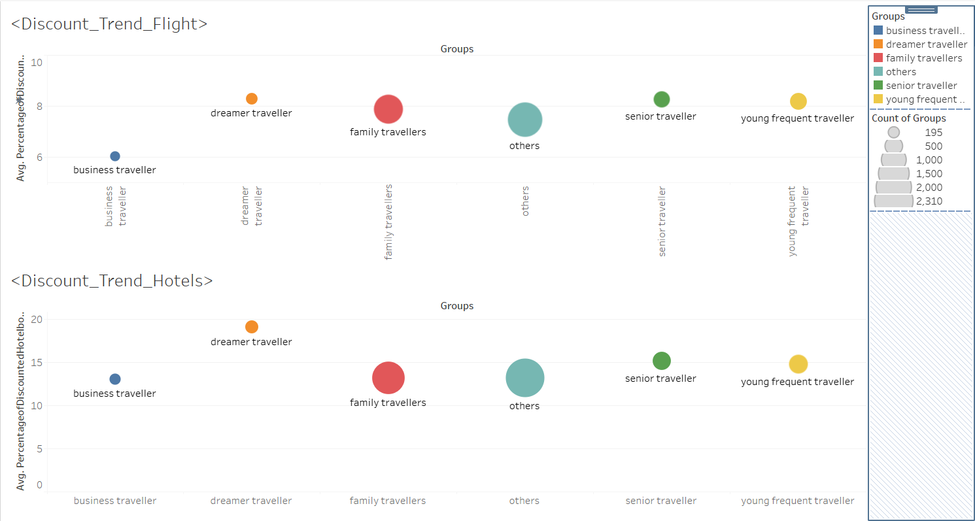
Discount Enthusiasts
Discount enthusiasts are the one who booked trips with discount more often. Here as per the data dreamers are discount enthusiasts and in flight segment expect business travellers all other looking for discount
PERKS: Number of dreamer traveller can be improved by offering discount
Notes:
This particular discount trend has been taken from percentage of discount booking from overall booking from a user

Slide 5
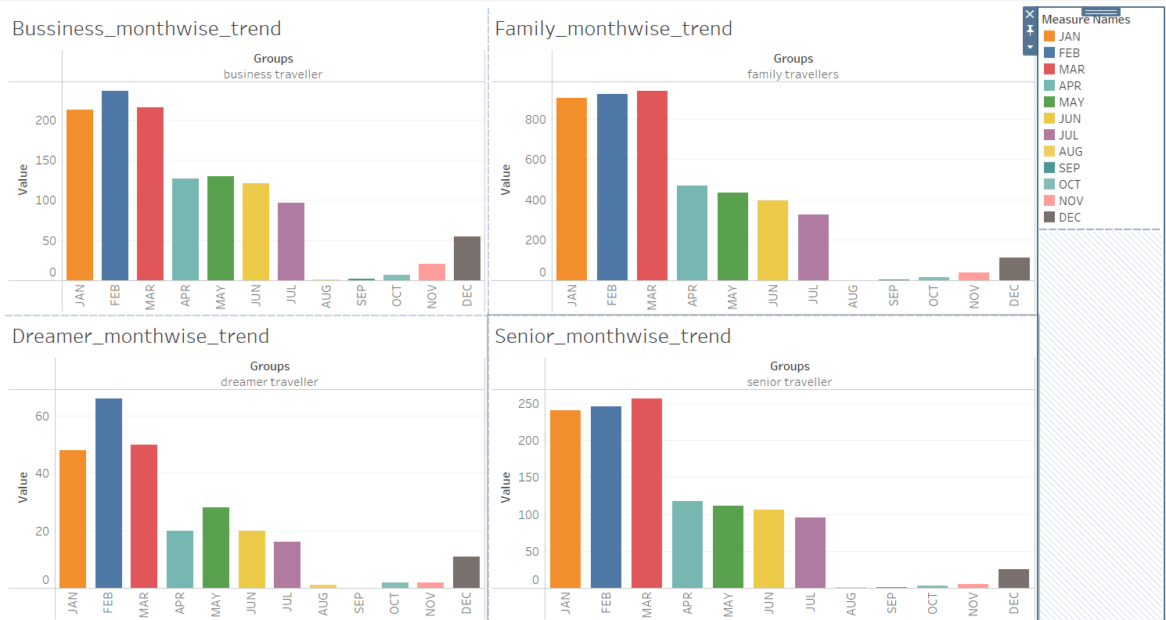
MONTHWISE TRENDS
Most of the groups travel during Jan, Feb and Mar
Perks: Give discount to all the groups except buisness and family during month from Aug to Dec
Notes:
Buisness travellers are not dependent on time of the year, and family travellers mostly prefer holiday season

Slide 6
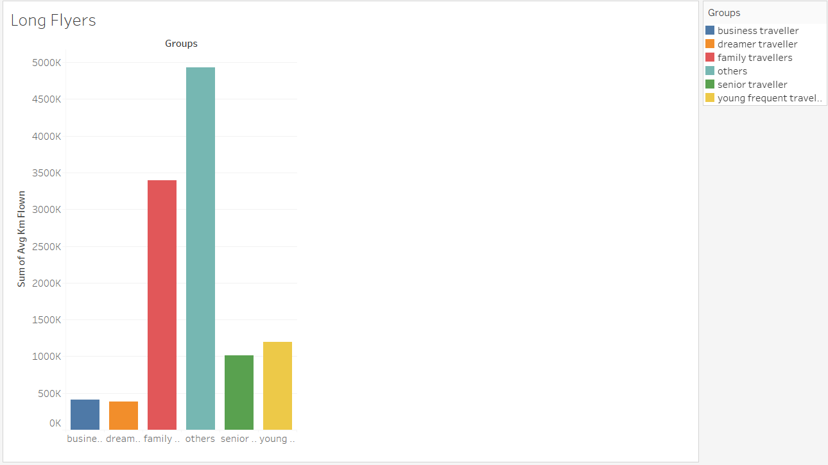
Long travellers
Family and other groups form the highest average flight time.
Perks
Since families wants to travel longer offer them with free seat allocation. So the families can travel longer together. Also provide them with extra baggage space to accommodate longer days. Offer families with kid friendly goodies.

Slide 7
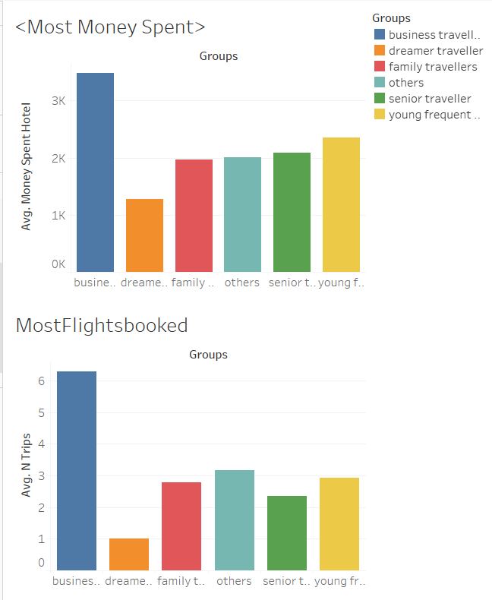
Money spenders
Business traveller have spent most on hotels and booked more flights than any other group
Perks: Provide business traveller with loyalty points and give free upgrades to business class or first class after accumulation of loyalty points

Slide 8
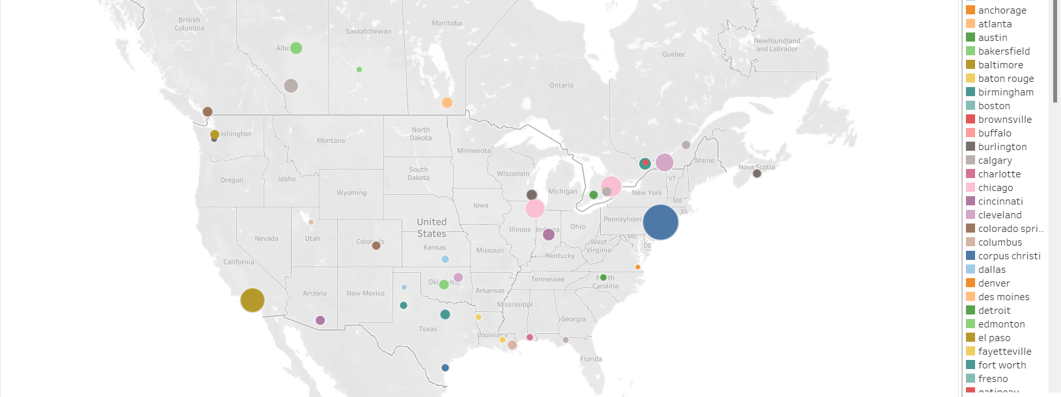
Geographical distribution
Traveltide has less user base from non-metropoliton cities,
Perks: Introduce a referral bonus for sign-in and booking, This will improve new user sign-in's from non metropoliton cities

Slide 9
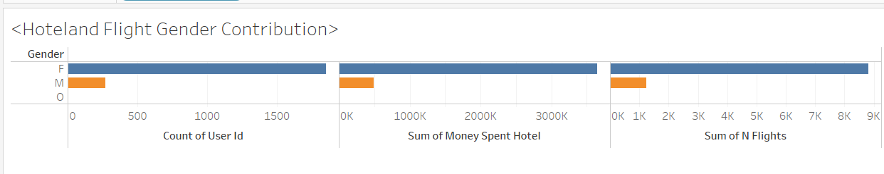
Gender-targeted
Gender based is target based on sole travellers excluding business and family group.
Here we see male user are less compared to female users in terms of number of users,money spent and number of flights
Perks: Provide discount for single male travellers on flights and hotels. Offer men goodies during flight travel and stay.
Also, Introduce some free lucky tickets for male cusotmer for games like NFL and NBA

