Slide 1
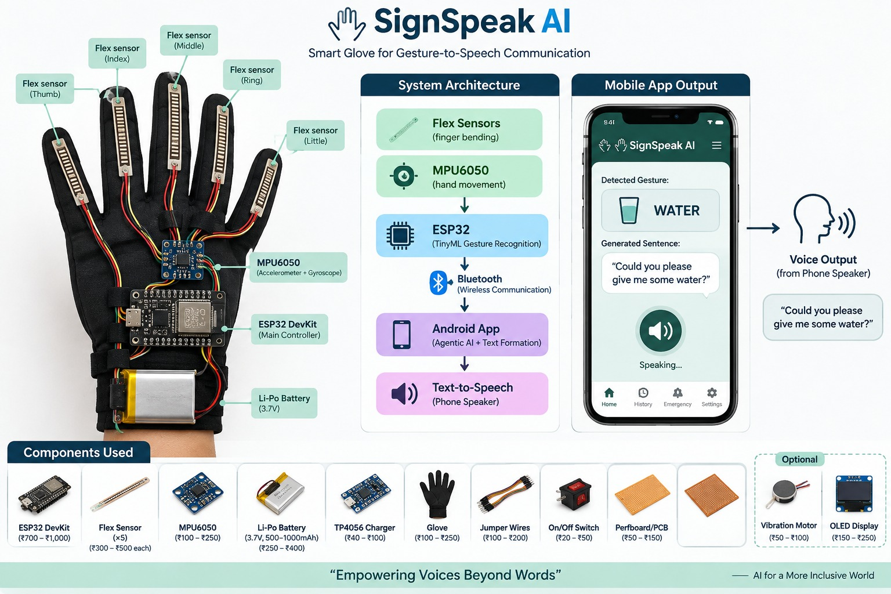
Signspeak AI-smart glove for gesture-to-speech communication
PROBLEM STATEMENT:
Communication barrier between gesture-based communication and people who do not understand the gesture
People who rely on hand gestures or sign language may struggle to communicate with others who cannot understand those gestures. This creates a gap between what the user wants to say and what the listener can understand.
1. GESTURE-ONLY COMMUNICATION
2. NO DIRECT TEXT BRIDGE
Meaning depends on the listener understanding the hand gesture.
There is no immediate conversion from a recognized gesture into a readable sentence.
3. VOICE OUTPUT IS MISSING
4. CONTEXT CAN BE HARD TO EXPRESS
Even after understanding the gesture, spoken communication is still needed in many situations.
A single gesture may need to become a clearer sentence for everyday communication.
SignSpeak AI - Empowering Voices Beyond Words

Slide 2
SOLUTION: SignSpeak AI
Smart glove that converts hand gestures into text first, then converts the generated text into voice
Sense → Recognize → Generate Text → Convert Text to Voice
1. YOU GESTURE
2. WE SENSE
3. WE RECOGNIZE
4. WE GENERATE TEXT
5. WE SPEAK
Move your fingers / hand to express a meaning
Five flex sensors + MPU6050 capture finger bending and hand movement
ESP32 reads the sensor values and identifies the gesture
Android app converts the recognized gesture into a sentence
The generated text is sent to Text-to-Speech and played through the phone speaker
PROJECT EXAMPLE
Gesture: WATER
Generated text: “Could you please
give me some water?”
Voice output
Text is generated first. Voice is produced only after text formation.
SignSpeak AI - Empowering Voices Beyond Words

Slide 3
OUTCOME:
From communication barrier to understandable text and voice
WITHOUT SIGNSPEAK AI
WITH SIGNSPEAK AI
COMPONENTS USED
User makes a gesture
Gesture → Sensing → Recognition
• 5 × Flex Sensors
• MPU6050 (Accelerometer + Gyroscope)
• ESP32 DevKit
• Li-Po Battery (3.7V)
• TP4056 Charger
• Glove
• Jumper Wires
• On/Off Switch
• Perfboard / PCB
↓
↓
Generated Text
Listener may not understand
the intended meaning
“Could you please give me
some water?”
× No direct text
× No immediate sentence
× No voice output
↓
Text-to-Speech → Voice Output
Software / communication:
Android App + Bluetooth + Text-to-Speech
Communication gap remains
Clearer communication through the phone speaker
Water is used only as the example gesture in this presentation.
SignSpeak AI - Empowering Voices Beyond Words

