Slide 1




Signspeak AI-smart glove for gesture-to-speech communication
Nayana shree N(Team Leader)
Niranjana M V
Sanjay S
Bhumireddy Venkata Hasini
Under the mentorship of,
Mentor Name: Indranil Bakshi
Notes:
Slide Duration: 5 min
Objective: To get an insight about Design Thinking
Procedure:
Explanation:
Introduce the topic "Design Thinking"
Design thinking is a creative approach to problem-solving that puts people at the center.
It starts with understanding the needs of those who will use what you're designing.
Then, it involves brainstorming ideas, prototyping solutions, and testing them to see what works best.
It's about being open-minded, collaborative, and willing to try new things to come up with innovative solutions that really fit people's needs.
Learning outcome: Students will be introduced to the topic Design Thinking.

Slide 2

Project Objectives
Problem Statement
Solution
Implementation
System Architecture of SignSpeak AI
Data Flow & Processing Workflow
UML Use Case Diagram
Outcome
Components Used
Notes:
Slide duration: 5 min
Objective: To know the content of the lesson.
Procedure:
Tell students what they are going to learn today.
Discuss each topics given in the slide.
Learning Outcome: Students will get to know the content of today's lesson.

Slide 3
Problem Statement:
PROBLEM STATEMENT:
People who rely on hand gestures or sign language may struggle to communicate with others who cannot understand those gestures. This creates a gap between what the user wants to say and what the listener can understand.
1. GESTURE-ONLY COMMUNICATION
2. NO DIRECT TEXT BRIDGE
There is no immediate conversion from a recognized gesture into a readable sentence.
Meaning depends on the listener understanding the hand gesture.
3. VOICE OUTPUT IS MISSING
4. CONTEXT CAN BE HARD TO EXPRESS
Even after understanding the gesture, spoken communication is still needed in many situations.
A single gesture may need to become a clearer sentence for everyday communication.
SignSpeak AI - Empowering Voices Beyond Words
Notes:
Total duration: 5mins
Learning Objective: In this slide, the trainer will explain the students what they will learn and be able to apply in the real life situations.
Procedure: Discuss the above as the outcome of the session
Learning outcome: Students will understand the learning outcome in this slide.

Slide 4
Solution:
Sense → Recognize → Generate Text → Convert Text to Voice
1. YOU GESTURE
2. WE SENSE
3. WE RECOGNIZE
4. WE GENERATE TEXT
5. WE SPEAK
Move your fingers / hand to express a meaning
Five flex sensors + MPU6050 capture finger bending and hand movement
ESP32 reads the sensor values and identifies the gesture
Android app converts the recognized gesture into a sentence
The generated text is sent to Text-to-Speech and played through the phone speaker
PROJECT EXAMPLE
Gesture: WATER
Generated text: “Could you please
give me some water?”
Voice output
Text is generated first. Voice is produced only after text formation.
SignSpeak AI - Empowering Voices Beyond Words
Notes:
Total duration: 5mins
Learning Objective: In this slide, the trainer will explain the students what they will learn and be able to apply in the real life situations.
Procedure: Discuss the above as the outcome of the session
Learning outcome: Students will understand the learning outcome in this slide.

Slide 5
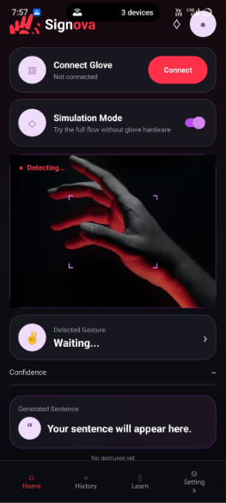
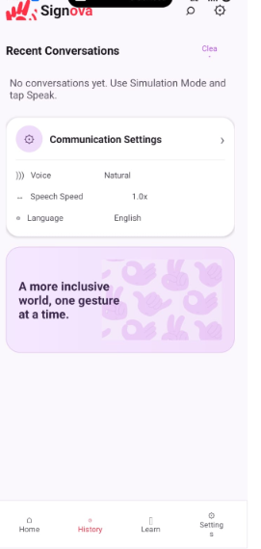
ANDROID APPLICATION IMPLEMENTATION
Home – Gesture Detection
History – Communication Settings

Slide 6
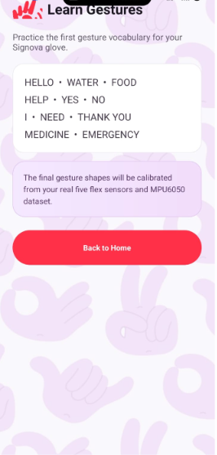
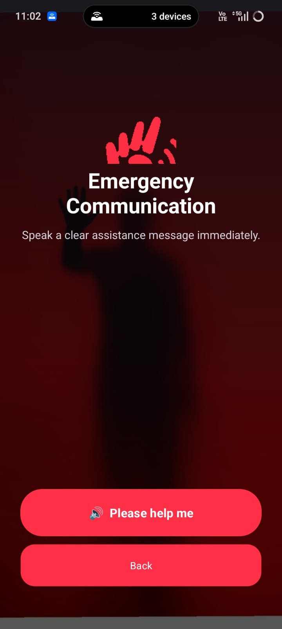
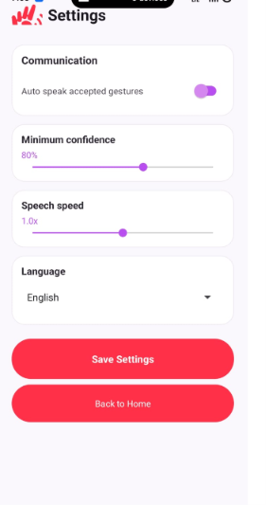
Learn Gestures
Emergency communication
Settings & Customization

Slide 7
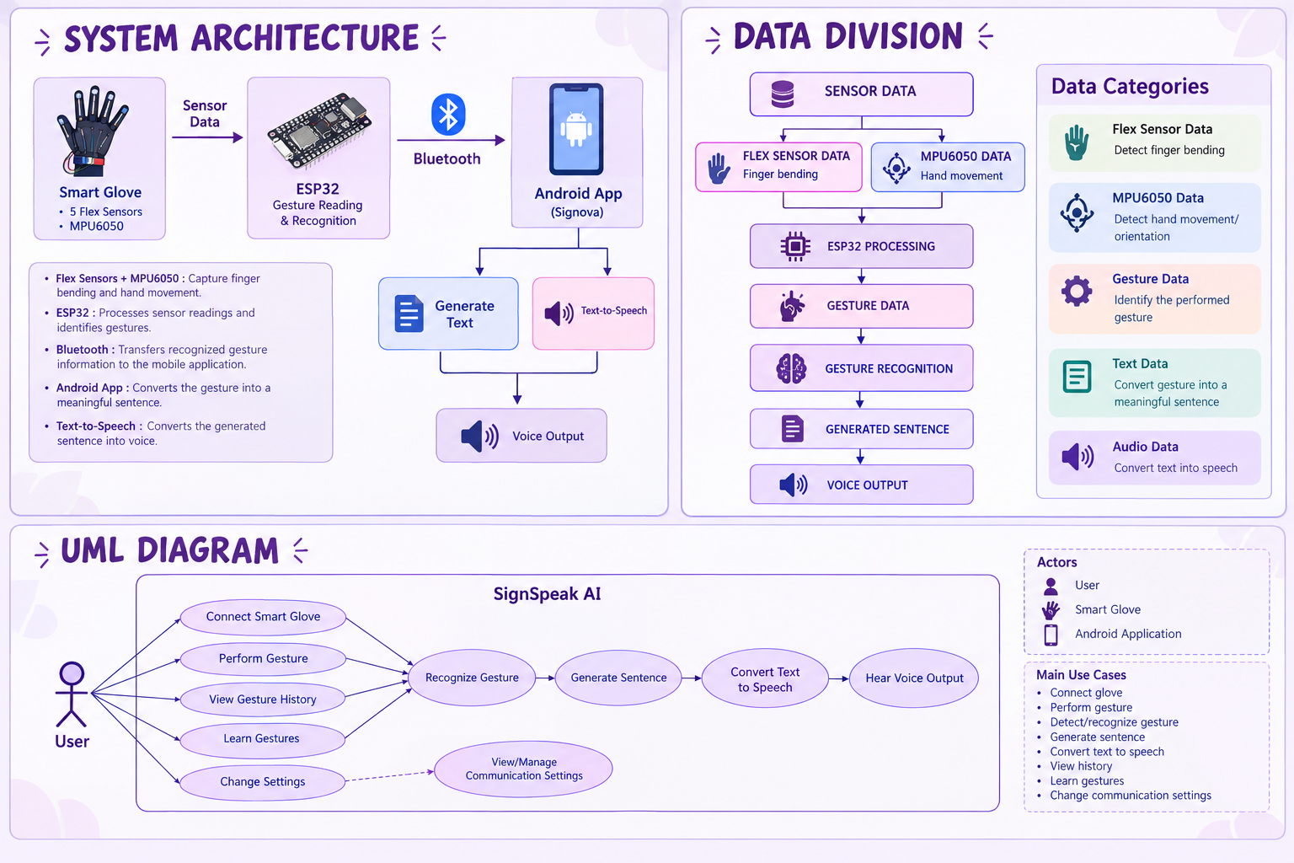
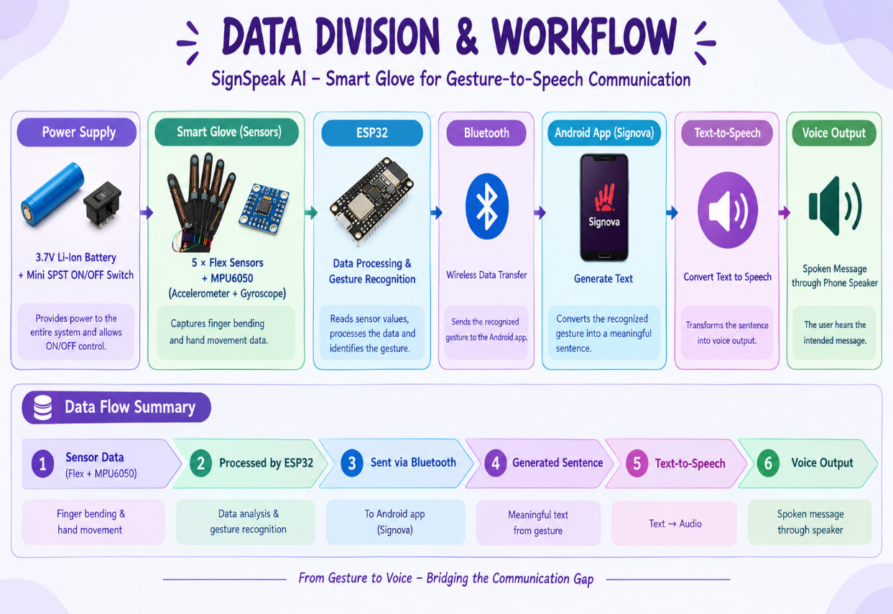

Slide 8
Outcome:
WITHOUT SIGNSPEAK AI
WITH SIGNSPEAK AI
User makes a gesture
Gesture → Sensing → Recognition
↓
↓
Generated Text
Listener may not understand
the intended meaning
“Could you please give me
some water?”
↓
× No direct text
× No immediate sentence
× No voice output
Text-to-Speech → Voice Output
Clearer communication through the phone speaker
Communication gap remains
Water is used only as the example gesture in this presentation.
SignSpeak AI - Empowering Voices Beyond Words
Notes:
Total duration: 5mins
Learning Objective: In this slide, the trainer will explain the students what they will learn and be able to apply in the real life situations.
Procedure: Discuss the above as the outcome of the session
Learning outcome: Students will understand the learning outcome in this slide.

Slide 9
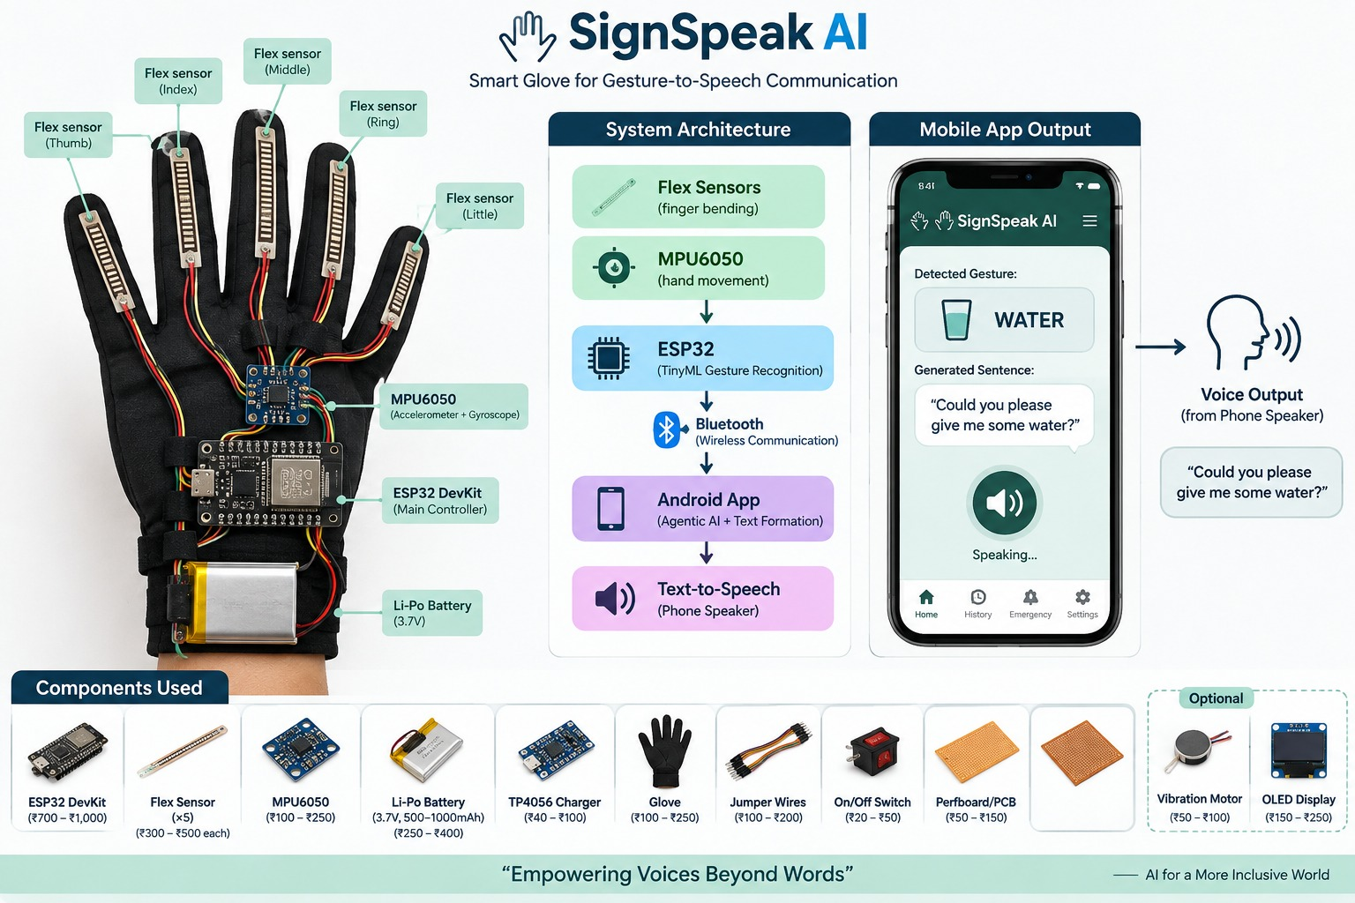
Components Used:
• 5 × Flex Sensors
• MPU6050 (Accelerometer + Gyroscope)
• ESP32 DevKit
• Li-Po Battery (3.7V)
• TP4056 Charger
• Glove
• Jumper Wires
• On/Off Switch
• Perfboard / PCB
Software / communication:
Android App + Bluetooth + Text-to-Speech

Slide 10
Thank You
Notes:
Time: 25 to 30 Sec

