Slide 1




Signspeak AI-smart glove for gesture-to-speech communication
Nayana shree N(Team Leader)
Niranjana M V
Sanjay S
Bhumireddy Venkata Hasini
Under the mentorship of,
Mentor Name: Indranil Bakshi
Notes:
Slide Duration: 5 min
Objective: To get an insight about Design Thinking
Procedure:
Explanation:
Introduce the topic "Design Thinking"
Design thinking is a creative approach to problem-solving that puts people at the center.
It starts with understanding the needs of those who will use what you're designing.
Then, it involves brainstorming ideas, prototyping solutions, and testing them to see what works best.
It's about being open-minded, collaborative, and willing to try new things to come up with innovative solutions that really fit people's needs.
Learning outcome: Students will be introduced to the topic Design Thinking.

Slide 2

Project Objectives
Problem Statement
Project Overview – Introduction
End Users
Wow Factor in Project
Block Diagram
Components Used
Result
outcomes
Conclusion
Future Perspective
Notes:
Slide duration: 5 min
Objective: To know the content of the lesson.
Procedure:
Tell students what they are going to learn today.
Discuss each topics given in the slide.
Learning Outcome: Students will get to know the content of today's lesson.

Slide 3
Problem Statement:
PROBLEM STATEMENT:
People who rely on hand gestures or sign language may struggle to communicate with others who cannot understand those gestures. This creates a gap between what the user wants to say and what the listener can understand.
1. GESTURE-ONLY COMMUNICATION
2. NO DIRECT TEXT BRIDGE
There is no immediate conversion from a recognized gesture into a readable sentence.
Meaning depends on the listener understanding the hand gesture.
3. VOICE OUTPUT IS MISSING
4. CONTEXT CAN BE HARD TO EXPRESS
Even after understanding the gesture, spoken communication is still needed in many situations.
A single gesture may need to become a clearer sentence for everyday communication.
SignSpeak AI - Empowering Voices Beyond Words
Notes:
Total duration: 5mins
Learning Objective: In this slide, the trainer will explain the students what they will learn and be able to apply in the real life situations.
Procedure: Discuss the above as the outcome of the session
Learning outcome: Students will understand the learning outcome in this slide.

Slide 4
Project Overview
Sense → Recognize → Generate Text → Convert Text to Voice
1. YOU GESTURE
2. WE SENSE
3. WE RECOGNIZE
4. WE GENERATE TEXT
5. WE SPEAK
Move your fingers / hand to express a meaning
Five flex sensors + MPU6050 capture finger bending and hand movement
ESP32 reads the sensor values and identifies the gesture
Android app converts the recognized gesture into a sentence
The generated text is sent to Text-to-Speech and played through the phone speaker
PROJECT EXAMPLE
Gesture: WATER
Generated text: “Could you please
give me some water?”
Voice output
Text is generated first. Voice is produced only after text formation.
SignSpeak AI - Empowering Voices Beyond Words
Notes:
Total duration: 5mins
Learning Objective: In this slide, the trainer will explain the students what they will learn and be able to apply in the real life situations.
Procedure: Discuss the above as the outcome of the session
Learning outcome: Students will understand the learning outcome in this slide.

Slide 5
End User
People with speech impairments.
Students and educators.
Patients and healthcare workers.
People who need assistance with everyday communication.

Slide 6
Wow Factor in Project
Smart glove technology: Converts finger and hand movements into digital input.
Real-time communication: Designed to recognize supported gestures and send them to the mobile app.
Gesture-to-voice conversion: Turns recognized gestures into meaningful text and spoken sentences.
Wireless connectivity: Uses Bluetooth to communicate with the Android application.
Portable design: Combines wearable sensors, an ESP32, and a smartphone.
Expandable system: More gestures, languages, and personalized messages can be added in future versions.

Slide 7
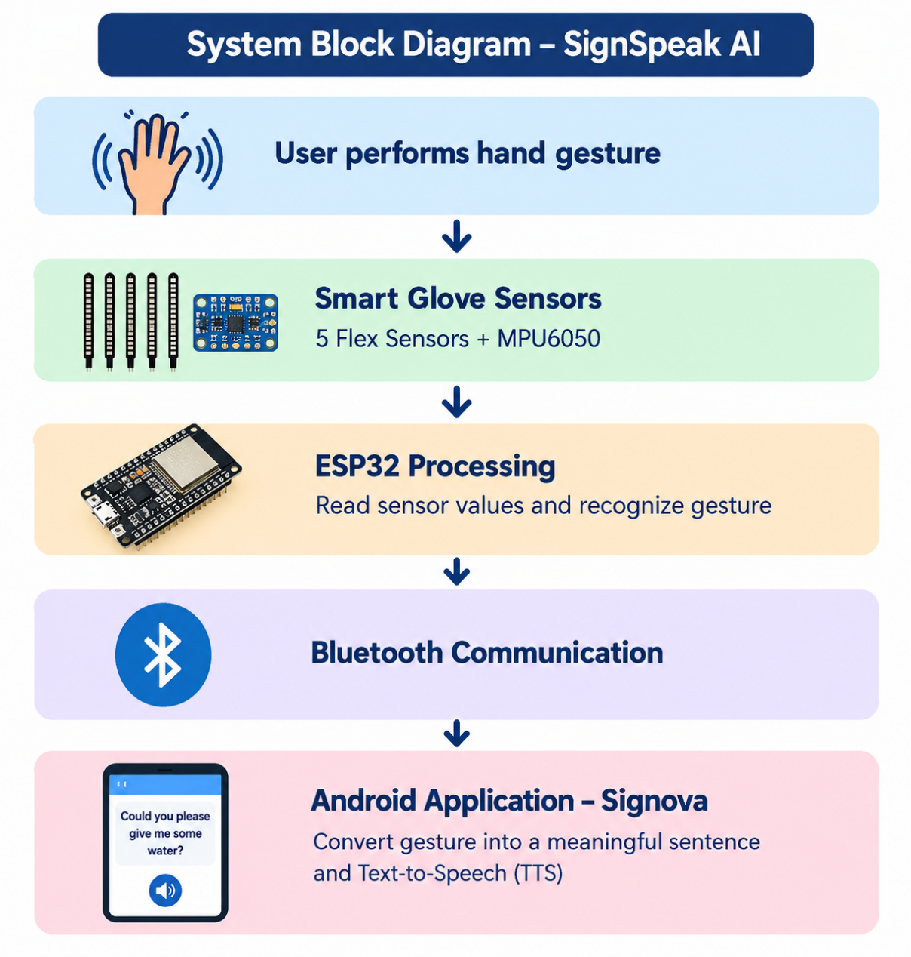
Block Diagram

Slide 8
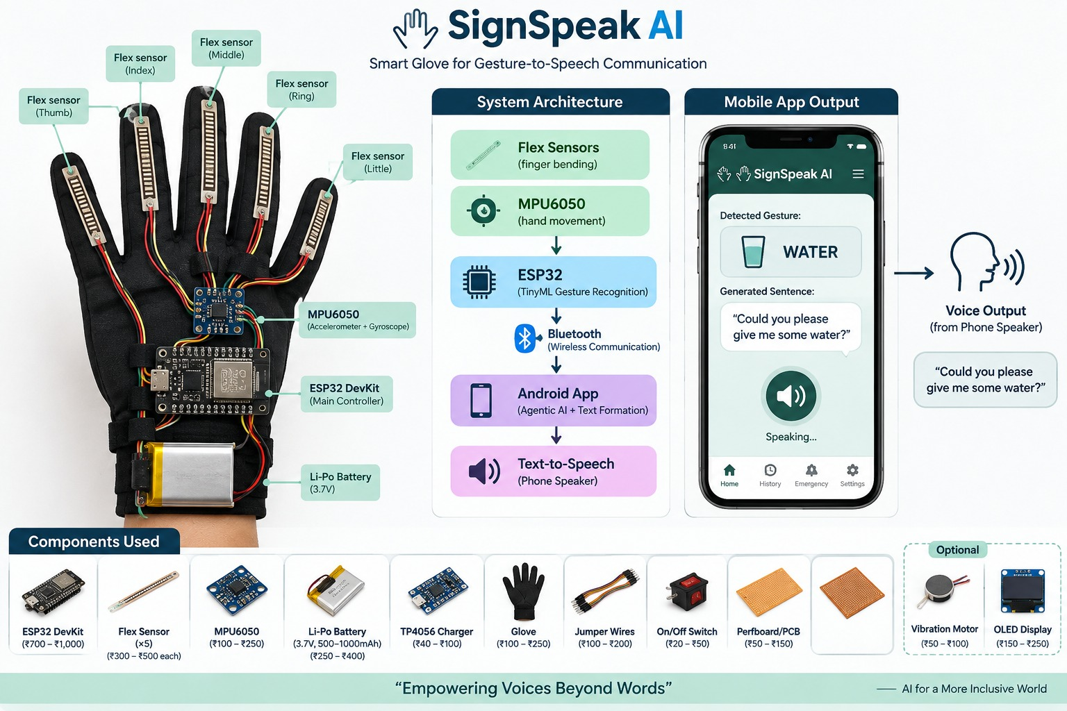
Components Used:
• 5 × Flex Sensors
• MPU6050 (Accelerometer + Gyroscope)
• ESP32 DevKit
• Li-Po Battery (3.7V)
• TP4056 Charger
• Glove
• Jumper Wires
• On/Off Switch
• Perfboard / PCB
Software / communication:
Android App + Bluetooth + Text-to-Speech

Slide 9
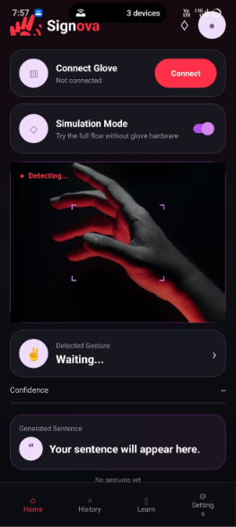
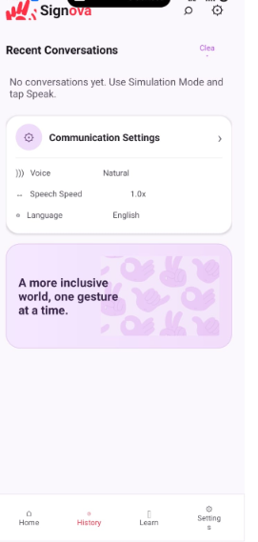
Results
ANDROID APPLICATION IMPLEMENTATION
Home – Gesture Detection
History – Communication Settings

Slide 10
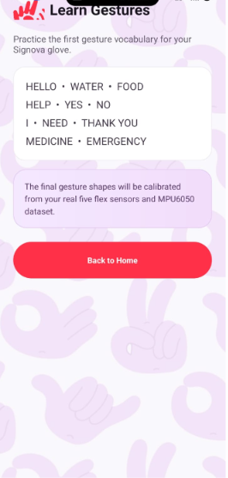
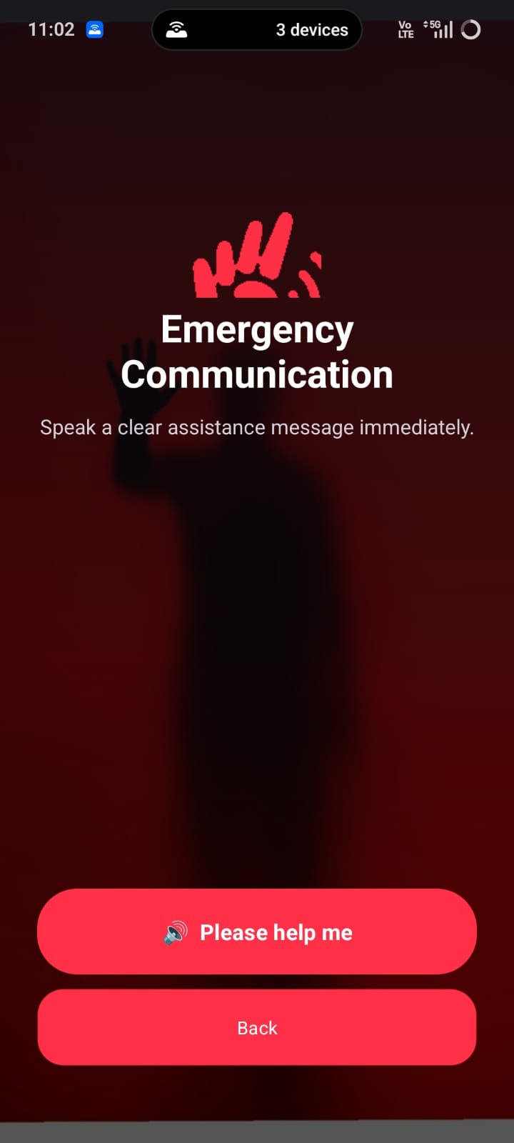
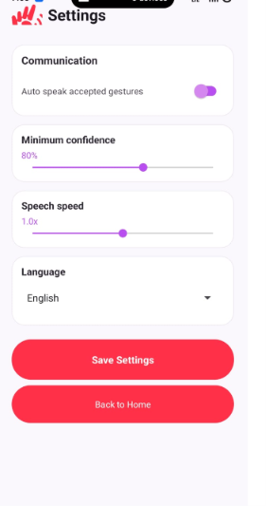
Learn Gestures
Emergency communication
Settings & Customization

Slide 11
Outcome:
WITHOUT SIGNSPEAK AI
WITH SIGNSPEAK AI
User makes a gesture
Gesture → Sensing → Recognition
↓
↓
Generated Text
Listener may not understand
the intended meaning
“Could you please give me
some water?”
↓
× No direct text
× No immediate sentence
× No voice output
Text-to-Speech → Voice Output
Clearer communication through the phone speaker
Communication gap remains
Water is used only as the example gesture in this presentation.
SignSpeak AI - Empowering Voices Beyond Words
Notes:
Total duration: 5mins
Learning Objective: In this slide, the trainer will explain the students what they will learn and be able to apply in the real life situations.
Procedure: Discuss the above as the outcome of the session
Learning outcome: Students will understand the learning outcome in this slide.

Slide 12
Conclusion
SignSpeak AI provides a practical approach to converting supported hand gestures into text and speech.
The system combines wearable sensors, ESP32 processing, Bluetooth communication, and an Android application.
Spoken output can help make basic everyday communication easier.
The project demonstrates how embedded systems and mobile applications can be combined to address a real-world communication challenge.
The system can be improved further through broader gesture support and more reliable recognition.

Slide 13
Future Perspective
More gestures: Expand the vocabulary of recognized gestures.
AI-based recognition: Explore machine-learning models to improve recognition across different users.
Multiple languages: Support speech output in regional and international languages.
Improved accuracy: Collect more sensor data and test under different hand positions and conditions.
Personalized gestures: Allow users to configure gestures for frequently used messages.

Slide 14
Thank You
Notes:
Time: 25 to 30 Sec

