Slide 1
Machine Learning Model Development for Classification of Raisin Grains
Machine Learning Foundation Course- Capstone Project
By Nayanathara Widyalankara
2022.04.30

Slide 2
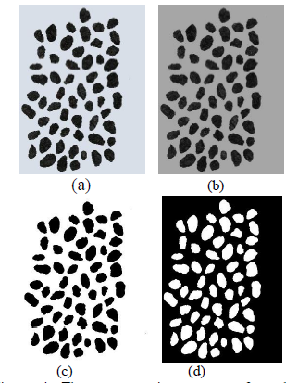
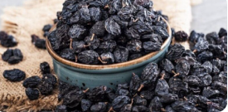
Introduction
The varieties of raisins used in the study is one of the products produced and exported in countries.
With image processing techniques, data sets can be created and building machine learning models will enable to build automatic systems product classification, calibration or to be used in different processing stages.
This project is focused on developing a Machine Learning model to Verities of the raisin grains: ; Kecimen and Besni

Slide 3
Dataset
Dataset was taken from UCI machine learning repository and the Data was collected from Raisin grains which are grown in Turkey.
900 data instances were used, including 450 pieces from both varieties; Kecimen and Besni
Area
Perimeter
MajorAxisLength
MinorAxisLength
Eccentricity
ConvexArea
Extent
Class
Attribute Information:

Slide 4






Model Development Environment & Tools
Environment: Google Colab
Language : Python
Libraries:
Pandas
NumPy
Matplotlib
Seaborn
Scikit-learn

Slide 5
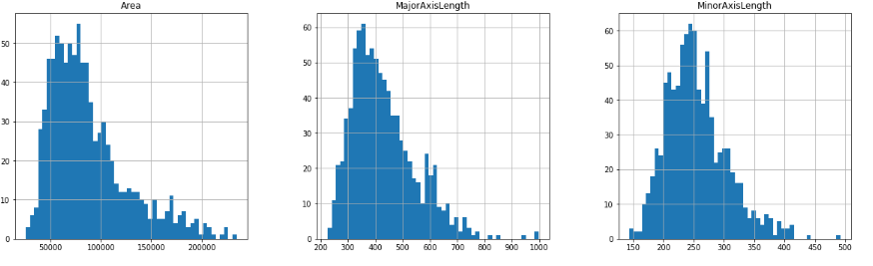
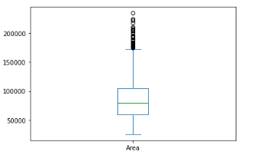
Data Preparation
Started the process by creating the dataframe and data exploration was done by checking the dimensions of the dataframe and analyzing the statistical information of data features
Dataset didn’t have any missing or duplicated values.
Categorical variables were converted into numerical variables.
Histograms and box plots were used to understand the behavior of data.
Outliers in the dataset were removed using Inter Quartile Range approach.

Slide 6
Feature Engineering
'Class' was selected as the Y variable since the model will be predicting it.
Correlation matrix, scatter plots and pair plot were used to select the features.
Features that have the highest correlation with the Y variable were selected
Correlation between those features were inspected and highly corelated features were grouped.
One feature each from the groups was selected, based on the correlation value to the Y variable
c
X variables: MinorAxisLength and ConvexArea
Y Variable: 'Class'

Slide 7
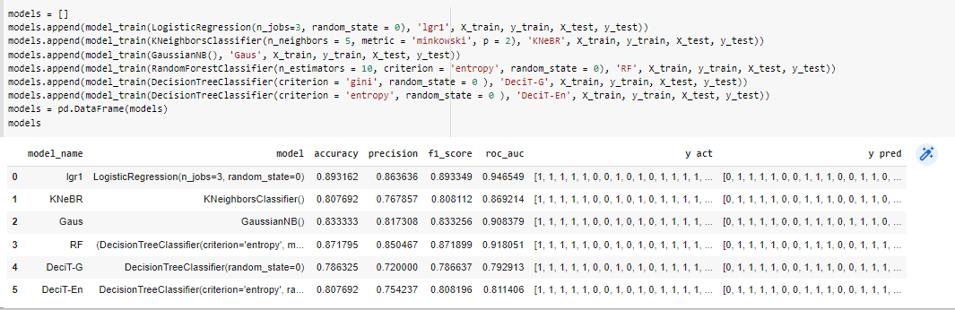
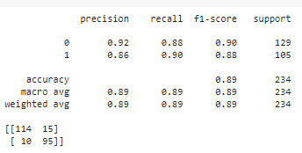
Model Development and Tunning
Dataset was split into test (30%) and train (70%) sets.
Each model was trained with a function and obtained the scores
Logistic Regression was selected as the best model its hyper parameters were tuned using grid search method.

Slide 8

Model Saving
Best trained logistic regression model was saved using pickle.

Slide 9
Conclusion
The dataset was in balance with reasonable distribution of raisin varieties which results in building an unbiased model.
Removing outliers of the dataset with “Inter Quartile Range approach” have validated the results of the model.
Among the different types of algorithms, “logistic regression” has the most impressive scores (Accuracy, Precision, Recall, F1-score= 89%). Which concludes that, it is the best model for the development.
Model has 92% of true positive rate and 86% true negative rate. This concludes that the model can accurately predicts “Besni” variety than the “Kecimen” variety.
With these results, it had achieved the objective the variety of classify the Raisin grains and further tuning can be done before deployment.

Slide 10
Discussion
When the results obtained from the study are evaluated, higher classification successes can be achieved by increasing the number of images or features obtained from the products and adding color, shape and texture features in addition to the morphological features.
automatic systems can be designed by using the created data sets for classification, calibration of the products or to be used in different processing stages.

Slide 11
Thank You

