Slide 1
Sales Analysis Dashboard
Nayana V

Slide 2
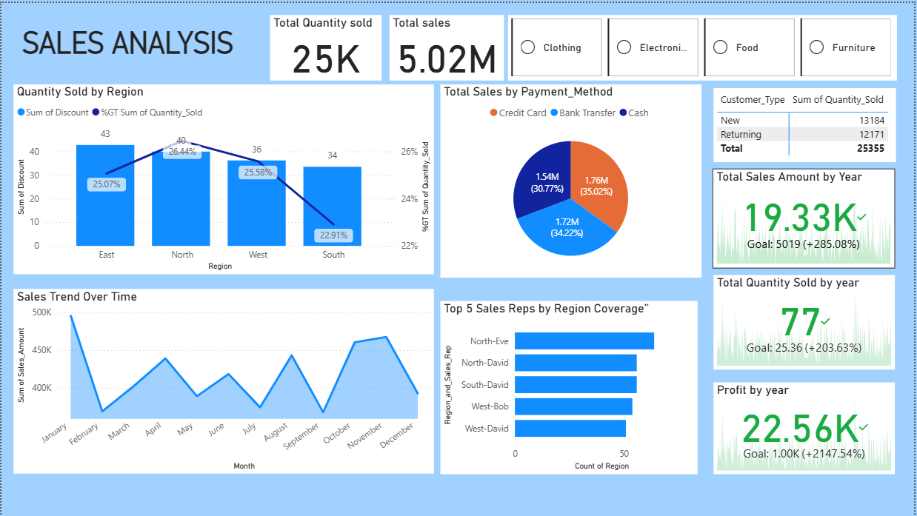

Slide 3
Executive Summary
• Total Sales: $5.02M
• Quantity Sold: 25K
• Profit: 22.56K (+2147% vs goal)
• Customer Mix: 52% New vs 48% Returning
Overall: Strong performance across all KPIs

Slide 4
Regional & Customer Insights
• North & East are leading contributors.
• South is underperforming → growth opportunity.
• Returning customers ≈ 12K → strong loyalty base.
Focus on South region & deepen customer retention.

Slide 5
Sales Trends & Payment Behavior
• High months: January, Oct–Nov.
• Low months: Feb & Aug.
• Payment split:
- Credit Card: 35%
- Bank Transfer: 34%
- Cash: 31%
Digital transactions dominate → reduce the cash further.

Slide 6
Key Insights
1. Expand efforts in South region.
2. Strengthen digital payment adoption.
3. Support and reward top-performing sales reps.
4. Launch promotions in low-performing months.
5. Enhance customer loyalty programs.

