Slide 1
Stock Sage: AI-Driven Equity Research Tool
Krishna Dubey (211020425)
Pankaj Kumar Giri (211020430)
Nayandeep (21100033)
Supervisor: Dr. Santosh Kumar
Date: 04/10/2024
International Institute of Information Technology, Naya Raipur

Slide 2
TABLE OF CONTENTS
CONTENTS
INTRODUCTION
2. LITERATURE REVIEW
3. RESEARCH GAP
4. PROBLEM STATEMENT
MOTIVATION & OBJECTIVES
6. METHODOLOGY
7. RESULTS & DISCUSSIONS
8. END TERM PLAN
9. CONCLUSION
10. REFERENCES

Slide 3

INTRODUCTION
Equity research analysis is crucial for informed investment decisions.
Manual research can cause:
Delayed Decision-making
High Effort and Time Consumption
Fragmented Information Analysis
Our tool aims to automate data aggregation from multiple sources, providing quick, accurate answers to complex queries.
Utilizes advanced technologies like LangChain, OpenAI API, and FAISS for efficient text processing, semantic search, and contextual understanding.

Slide 4
Literature Review
(Background Works with Research Gaps)
Study | Authors (Year) | Methodology | Key Findings | Challenges | Research Gap | Expected Improvement
Automate Strategy Finding with LLM in Quant Investment | Zhizhuo Kou et al. (2024) [1] | LLMs combined with a multi-agent system to generate alpha factors from multimodal financial data and real-time market data | Outperforms traditional models in trading strategy generation | Computational cost and scalability issues | Lack of focus on simplifying equity research No method for handling fragmented data across multiple news sources | Automation in the tedious task of extracting specific answers from multiple articles, streamlining research.
Revolutionizing Finance with LLMs: An Overview of Applications and Insights | M.S. Usha et al. (2024) [2] | LLMs for sentiment analysis and QA | Enhances sentiment analysis and financial question-answering | Difficulty with ambiguous queries | Does not address aggregation of fragmented information from multiple sources Lacks multi-source knowledge retrieval | Adds multi-source aggregation, allowing analysts to extract data from various news sources more efficiently.

Slide 5
Literature Review
(Background Works with Research Gaps)
Study | Authors (Year) | Methodology | Key Findings | Challenges | Research Gap | Expected Improvement
Large Language Models in Finance: A Survey | Touvron et al. (2023) [3] | Survey of LLM applications in financial tasks | Highlights few-shot/zero-shot learning for financial applications | Cost of fine-tuning and handling large documents | No focus on optimizing token usage or handling large financial documents cost-effectively | Optimization of API costs by chunking relevant text and reducing token use, improving cost efficiency.
AI in Equity Research | Recosense Labs. (2024) [4] | AI tools like NER and document analyzers | Automates data extraction, improving accuracy | Handling unstructured data | No user-friendly interface for efficient querying and summary generation for equity analysts | Providing an easy-to-use Streamlit-based interface for querying and summarizing news articles.

Slide 6
Research Gaps
Real-World Applicability and Integration
Handling Large Data Sources and Aggregation
Cost Efficiency and Token Management
User Interface (UI) Design for Analysts
Multi-Source Knowledge Retrieval

Slide 7
Problem Statement
Manual Process: Equity research analysts spend excessive time manually reviewing and summarizing financial news from multiple sources.
Fragmented Information: Key insights are often scattered across various articles, making it difficult to form a comprehensive view.
Limitations of Current Tools: Existing tools, such as ChatGPT, face limitations in handling large documents, multi-source aggregation, and cost-efficiency.
Need for Automation: A tool is required to automate data aggregation, provide concise answers, and streamline the research process, enhancing decision-making accuracy for analysts.

Slide 8
Motivation and Objectives
Manual equity research is time-consuming and inefficient due to the high volume and complexity of financial news.
Automate the extraction and aggregation of relevant data from multiple news sources using generative AI models.
Minimize manual effort by leveraging semantic search and vector databases for quick information retrieval.
Smart selection of relevant text chunks to reduce API usage and overall costs.
User-Friendly Interface: Provide an intuitive tool for analysts to input queries and obtain accurate, context-aware insights.

Slide 9
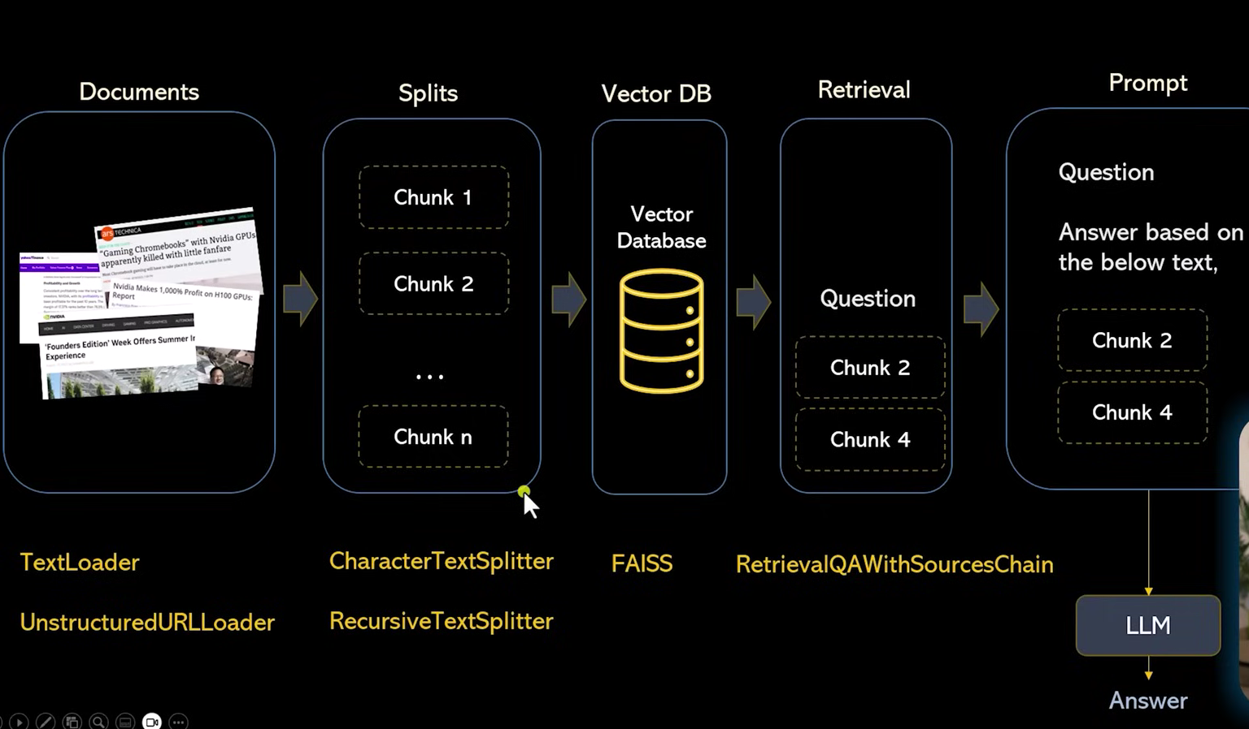
METHODOLOGY
Technical Architecture

Slide 10
METHODOLOGY
Project Pipeline - Overview
Prompting
✏️
Data Loading
📄
Vector DB Integration
🧩
Retrieval QA
🔍
LLM
🤖
Data Splitting
✂️
UI Setup
💻
Answer Generation
✅

Slide 11
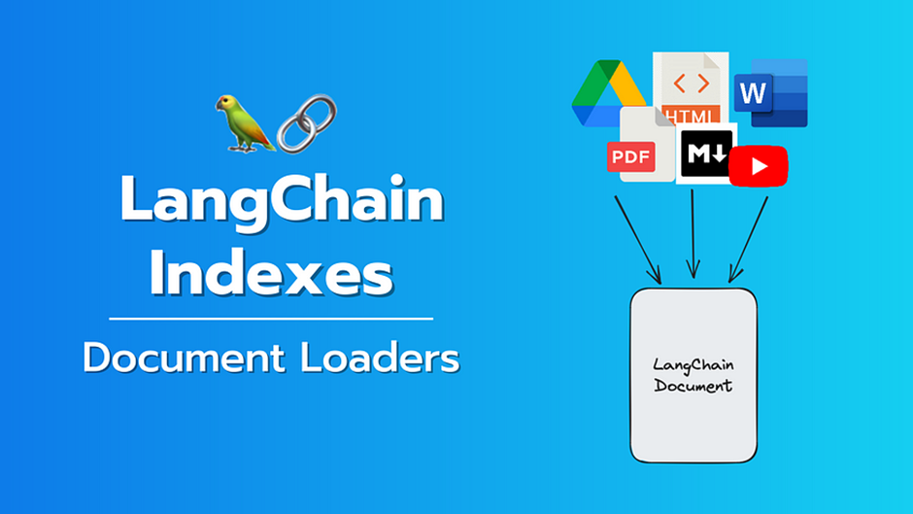
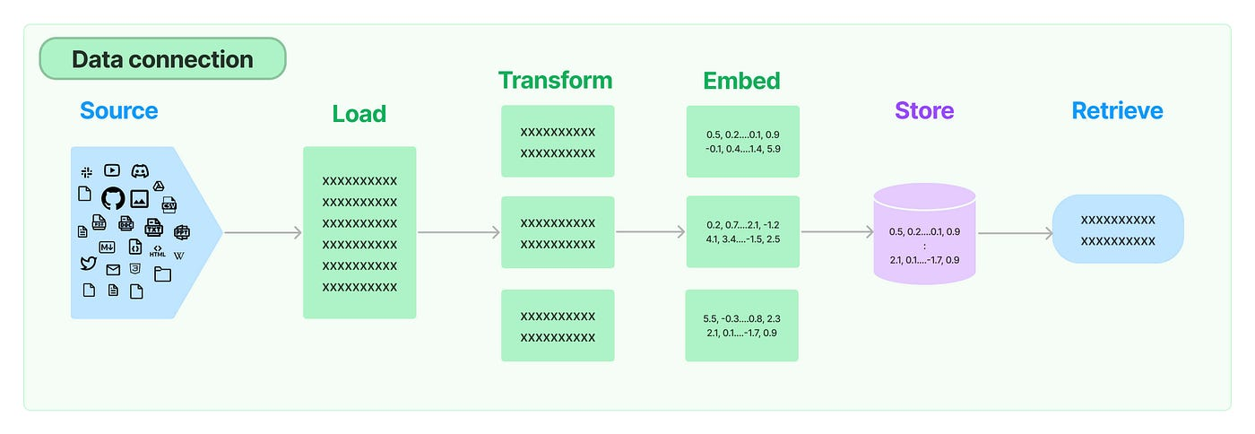
Step 1: Data Loading 📄
Aggregate financial news from diverse sources (MoneyControl, Economic Times, etc.)
Tools:
Document Loaders: TextLoader and UnstructuredURLLoader
Process:
Load news articles using LangChain’s document loaders from local files or URLs
Store text content in a standardized format for subsequent processing

Slide 12
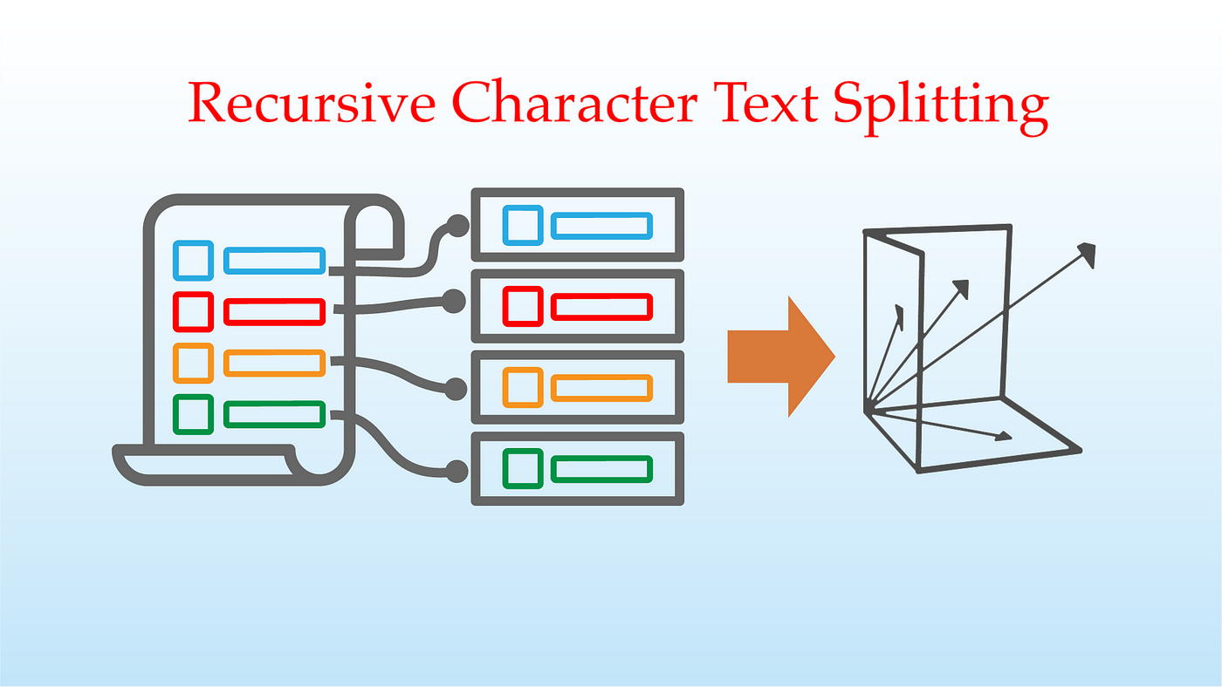
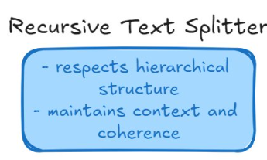
Step 2: Data Splitting ✂️
Manage large documents within LLM token limits
Tools:
LangChain Text Splitters: CharacterTextSplitter and RecursiveCharacterTextSplitter
Process:
Split long text documents into smaller chunks.
Maintain context between chunks using overlapping techniques
Optimize chunk sizes for efficient LLM input and minimize token usage.

Slide 13
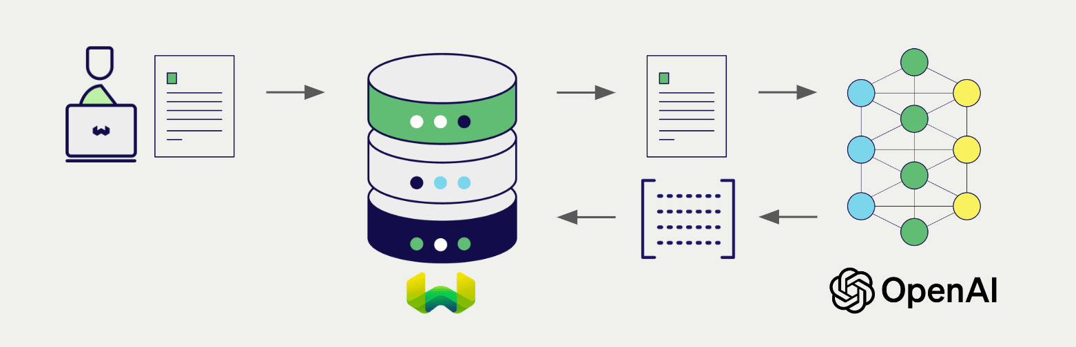
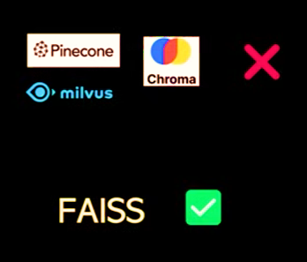
Step 3: Embeddings and Vector DB Integration 🧩
Transform text chunks into numerical vectors for efficient semantic search
Tools:
OpenAI Embeddings API for generating vector representations
FAISS (Facebook AI Similarity Search) for storing and retrieving vectors
Process:
Convert each text chunk into vectors using embeddings
Store vectors in the FAISS index to enable quick similarity search

Slide 14
Step 4: Initial UI Setup 💻
Create a basic interface for users to input financial news URLs and process the data
UI Development:
Using Streamlit
One can input up to 3 news URLs in the sidebar for processing
On clicking "Inspect URLs", the tool performs the following:
Loads content from the provided URLs
Splits the news content into smaller chunks
Generates vector embeddings
Saves the embeddings in a FAISS index for quick semantic search later
Current Output: Embeddings saved as a pickle file for future retrieval and querying

Slide 15
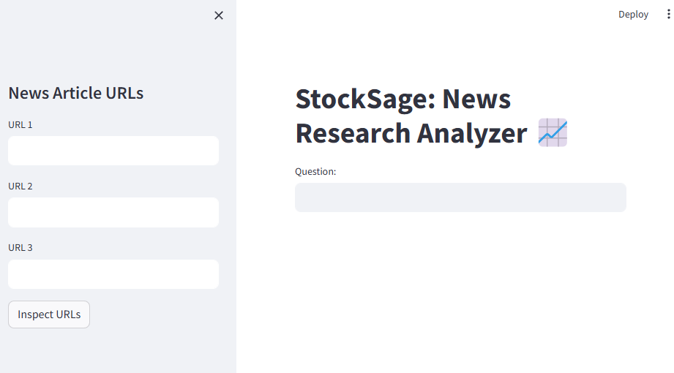
RESULTS & DISCUSSIONS
Implemented a basic Streamlit UI to accept URLs and initiate processing

Slide 16
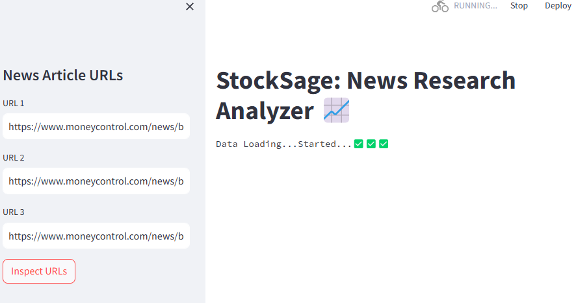

RESULTS & DISCUSSIONS
UI provides real-time updates on each stage’s progress

Slide 17
RESULTS & DISCUSSIONS
Current Limitations:
URL Handling: Currently limited to 3 URLs
No Query Functionality Yet
Basic UI: Only the initial setup is in place, lacks sophisticated search and display features
Next Steps:
Implement retrieval QA and prompt-based querying
Enhance the UI for more detailed output and user interaction
Once integrated, the tool will provide real-time financial analysis and context-aware answers, significantly improving research efficiency for analysts

Slide 18

End Term Plan
Problem Identification 🔍
Technical Architecture Setup 🛠
Data Loading 📄
Data Splitting ✂️
Embeddings Creation & Vector DB Integration 🔗
Initial UI Setup 💻
Retrieval QA with Sources Chain 🔄
Prompting & LLM Integration 🧠
Web App Completion with All Functionalities and Deployment🚀

Slide 19
CONCLUSIONS
Successfully set up a basic pipeline that automates document loading, text splitting, and embedding creation, laying a strong foundation for advanced functionalities.
Developed an interactive UI using Streamlit, which currently enables real-time processing of news articles and offers updates on data ingestion and embedding generation.
Implemented core components like text chunking and vector database integration, crucial for building a robust retrieval-based research tool for equity analysts.
The existing framework is well-structured for integrating advanced querying and answer generation, supporting continued development in the next stages.

Slide 20
REFERENCES
Kou, Zhizhuo, Alan, and Shen. "Automate Strategy Finding with LLM in Quant Investment." arXiv preprint arXiv:2409.06289, 2024.
Usha, M.S., and Kirange, D.K. "Revolutionizing Finance with LLMs: An Overview of Applications and Insights." arXiv preprint arXiv:2401.11641, 2024.
Touvron, Hugo, and Leclerc, G. "Large Language Models in Finance: A Survey." arXiv preprint arXiv:2311.10723, 2023.
Recosense Labs. "AI in Equity Research." Recosense Labs Publication, 2024.
Li, Xiadong, and Zhang, C. "LLMs for Financial Market Forecasting." arXiv preprint arXiv:2311.10723, 2023.

Slide 21

Thank You
..
Dr. Shyama Prasad Mukherjee International Institute of Information Technology, Naya Raipur

