Slide 1
Population Synthesis
Using Gibbs Sampling
Nayan Garg

Slide 2

What is Population Synthesis?

Slide 3
Urban Planning
Transportation Modelling
Public Health Research
Agent and Activity Based Models
Population Behaviour

Slide 4
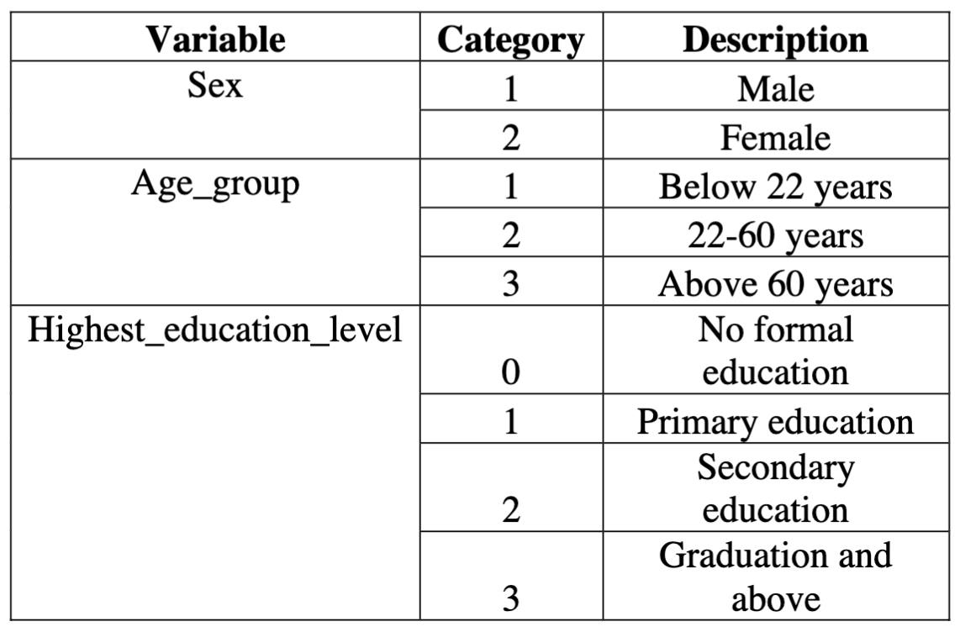
Problem Statement

Slide 5
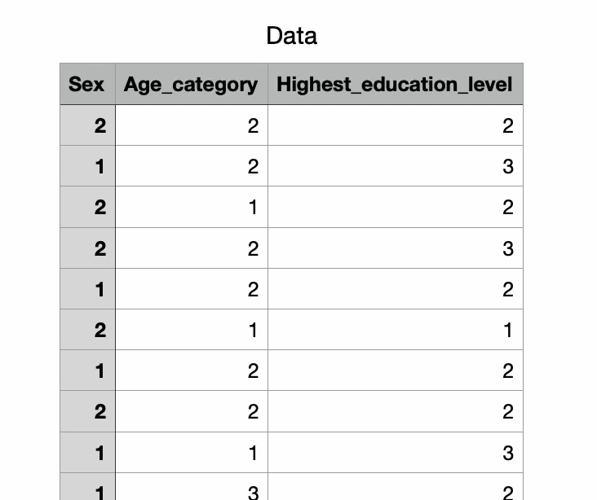
Data - 200 Samples

Slide 6
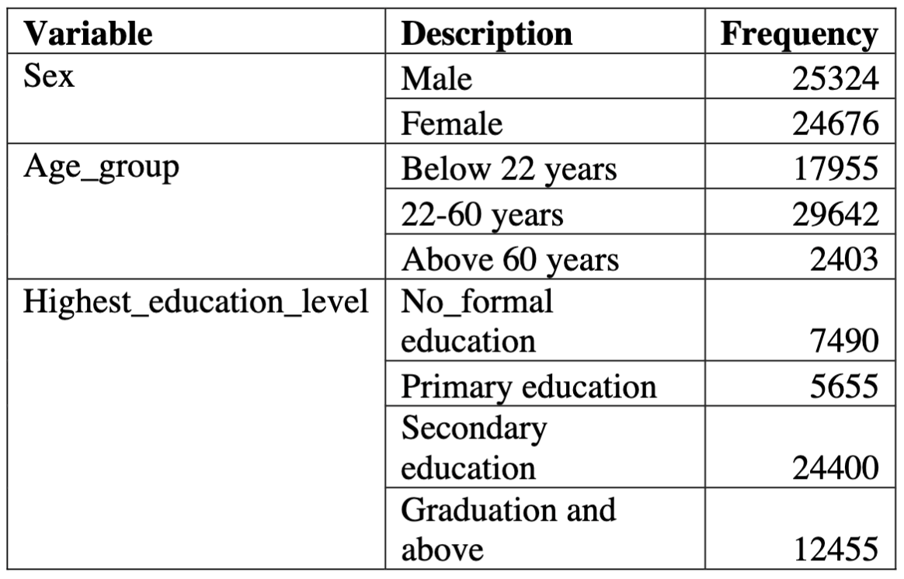
Expected Population

Slide 7
Approach?
Gibbs Sampling
essentially Conditional Probability

Slide 8
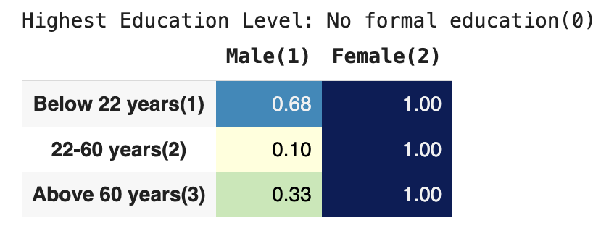
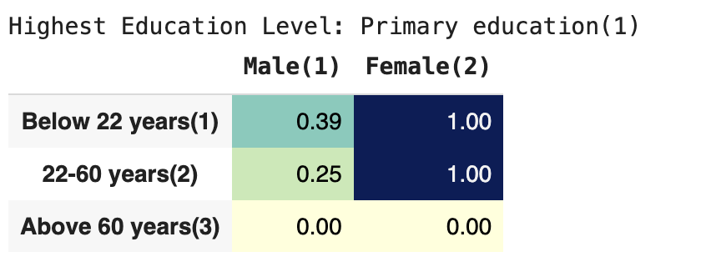
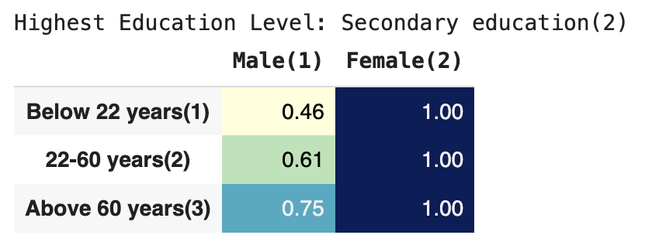
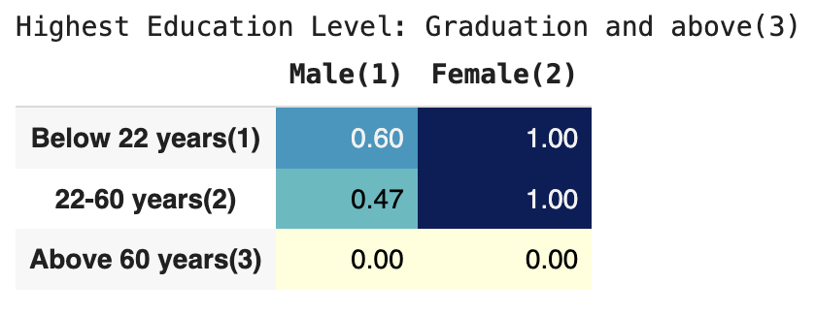
Conditional Probability of Sex given Age and Education level

Slide 9
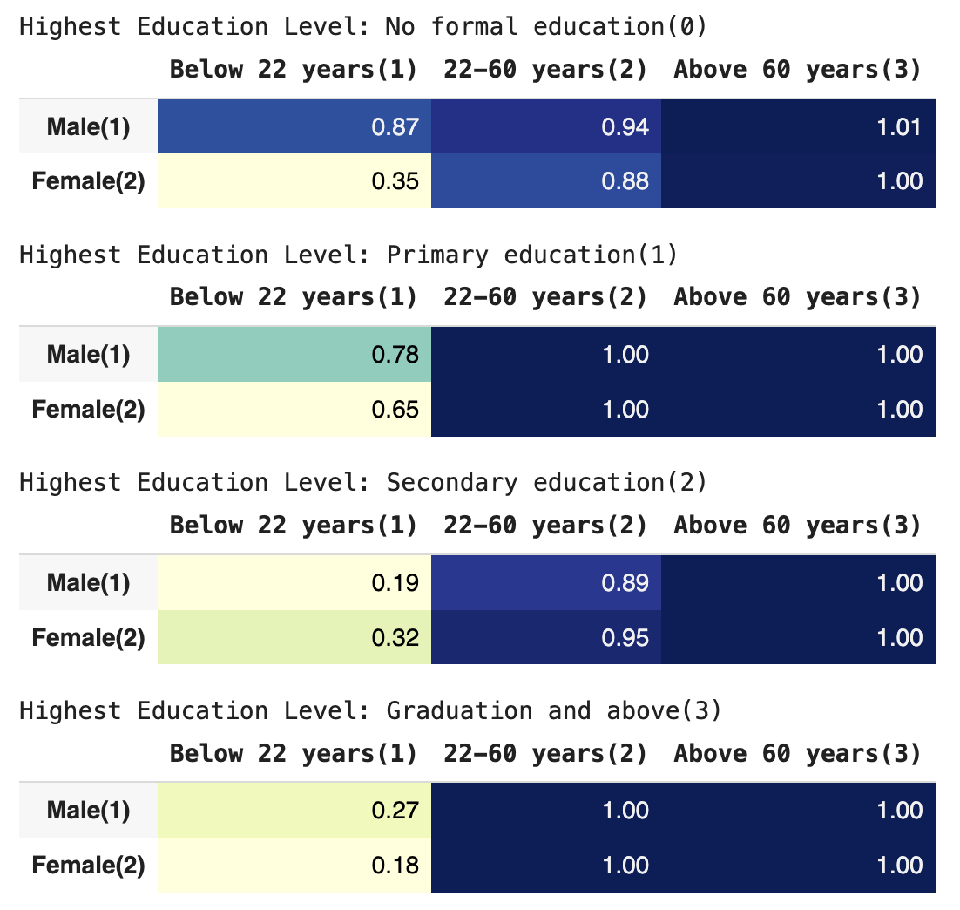
Conditional Probability of Age given Sex and Education level

Slide 10
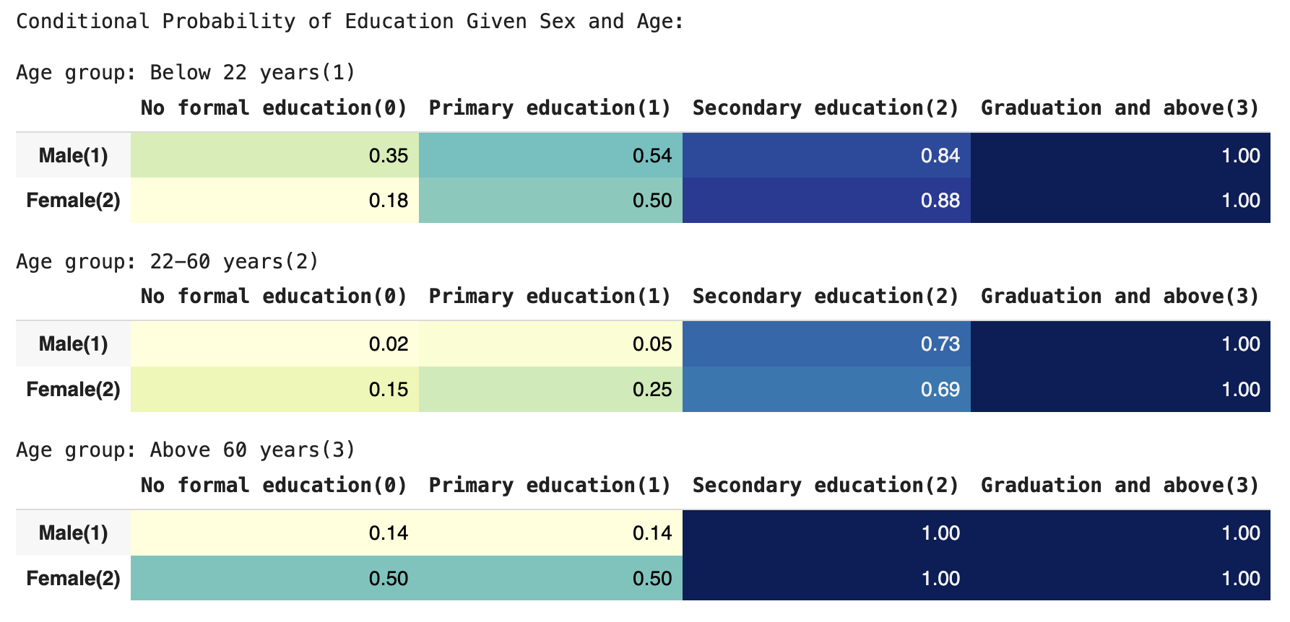
Conditional Probability of Education given Age and Sex

Slide 11
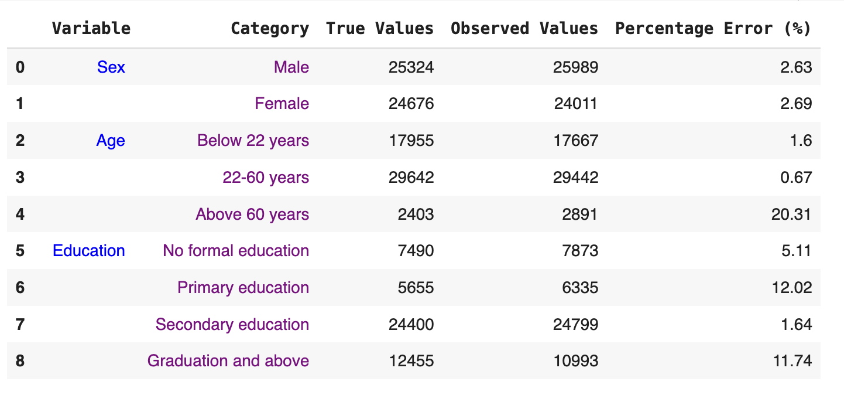
Observed Output VS Expected Output

Slide 12
