Slide 1

Data Preprocessing: The Cornerstone of Data Mastery
In the realm of data warehousing and data mining, data preprocessing stands as a pivotal phase, transforming raw, unwieldy data into a polished, insightful asset. This presentation will guide you through the essential steps and techniques involved in preparing data for analysis, ensuring accuracy, consistency, and relevance. We'll explore methods to clean, transform, and integrate data, ultimately empowering you to extract meaningful knowledge and drive informed decisions.

Slide 2



Data Preprocessing: The Critical Foundation of Data Analytics
Data preprocessing is the backbone of effective data analytics, acting as the gatekeeper that determines the quality and reliability of subsequent analyses. It involves a series of transformations to clean, integrate, and format raw data, preparing it for data warehousing and data mining. Without this crucial step, the insights derived from data can be misleading or completely inaccurate.
Poor data quality can lead to flawed models, biased results, and ultimately, poor decision-making. By investing in robust data preprocessing techniques, organizations can ensure the integrity of their data and unlock its full potential. This process is not merely a preliminary task, but a fundamental requirement for any data-driven initiative.
Accuracy
Consistency
Relevance
Ensuring the data is correct and reliable for analysis.
Maintaining uniformity across datasets.
Selecting only the data that matters for specific analytical goals.

Slide 3
Understanding Data Quality and Common Preprocessing Challenges
Data quality encompasses several dimensions, including accuracy, completeness, consistency, validity, and timeliness. Low data quality often manifests as missing values, outliers, inconsistent formatting, and duplicate records. These issues can arise from various sources, such as human error during data entry, system glitches during data transmission, or inconsistencies in data definitions across different databases.
Common preprocessing challenges include handling missing data, identifying and treating outliers, resolving inconsistencies, and dealing with noisy or irrelevant data. Addressing these challenges requires a combination of domain knowledge, statistical techniques, and specialized tools. Effective data preprocessing is an iterative process that demands careful planning and execution.
Missing Values
Outliers
Inconsistencies
Noisy Data
Gaps in the data that need to be addressed using imputation or removal.
Extreme values that deviate significantly from the norm.
Variations in data representation or formatting.
Random errors or variance in a measured variable.

Slide 4
Data Cleaning Techniques: Handling Missing Values and Outliers
Data cleaning is a critical step in preprocessing, focused on correcting errors, handling missing values, and managing outliers. Several techniques can be employed to address missing values, including imputation (replacing missing values with estimated values), deletion (removing records with missing values), and using algorithms that can handle missing data directly.
Outliers can be detected using statistical methods like z-scores, IQR, or clustering. Once identified, outliers can be treated by trimming (removing the outliers), capping (setting a maximum or minimum threshold), or transformation (applying mathematical functions to reduce their impact). The choice of technique depends on the nature of the data and the goals of the analysis.
1
Imputation
2
Deletion
Replacing missing values with estimated values.
Removing records with missing values.
3
Trimming
4
Capping
Removing the extreme values (outliers).
Setting a maximum/minimum threshold.

Slide 5



Data Transformation Strategies: Normalization and Standardization
Data transformation involves converting data from one format or structure to another to make it suitable for analysis. Two common transformation techniques are normalization and standardization. Normalization scales data to a specific range, typically between 0 and 1, while standardization scales data to have a mean of 0 and a standard deviation of 1.
Normalization is useful when the data has varying scales and the algorithms are sensitive to the magnitude of values. Standardization is beneficial when the data follows a normal distribution or when comparing variables with different units. The choice between normalization and standardization depends on the data distribution, the algorithm used, and the desired outcome.
Normalization
Standardization
Log Transformation
Scaling data to a specific range (0-1).
Scaling data to a mean of 0 and standard deviation of 1.
Apply a logarithmic function to reduce skewness.

Slide 6




Feature Selection and Dimensionality Reduction Methods
Feature selection and dimensionality reduction are techniques used to reduce the number of variables or features in a dataset while retaining the most relevant information. Feature selection involves choosing a subset of the original features based on their importance or relevance to the analysis. Dimensionality reduction transforms the original features into a lower-dimensional space, creating new features that capture the essential patterns in the data.
Common feature selection methods include filtering, wrapper, and embedded techniques. Dimensionality reduction techniques include Principal Component Analysis (PCA), Linear Discriminant Analysis (LDA), and t-distributed Stochastic Neighbor Embedding (t-SNE). These methods are used to simplify models, reduce overfitting, and improve computational efficiency.
Filtering
Wrapper
1
Evaluating feature subsets using a learning algorithm.
Selecting features based on statistical measures.
2
PCA
4
Embedded
Transforms data into a set of linearly uncorrelated variables.
3
Feature selection as part of the learning process.

Slide 7
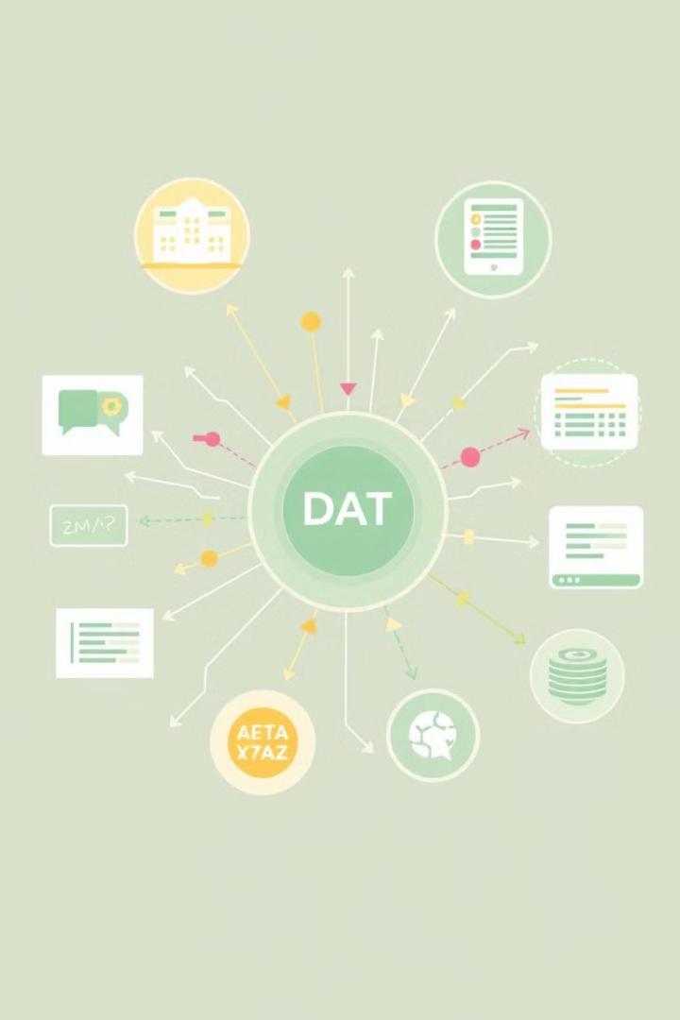
Data Integration and Consolidation in Complex Environments
Data integration involves combining data from multiple sources into a unified dataset. This process often requires resolving inconsistencies in data formats, naming conventions, and data semantics. Data consolidation focuses on aggregating and summarizing data to create a more concise and manageable dataset.
Common data integration challenges include schema matching, entity resolution, and handling data conflicts. Techniques for data consolidation include aggregation, summarization, and data warehousing. Data integration and consolidation are crucial for creating a comprehensive view of the data and enabling cross-functional analysis.
Schema Matching
Entity Resolution
Identifying corresponding elements in different schemas.
Identifying and merging duplicate records.
Data Warehousing
Centralized repository for integrated data.

Slide 8
Advanced Preprocessing Tools and Technologies
Numerous advanced tools and technologies are available to streamline and automate data preprocessing tasks. Data integration platforms offer a range of features for data cleaning, transformation, and integration. Machine learning algorithms can be used for tasks such as missing value imputation, outlier detection, and feature selection.
Cloud-based data preprocessing services provide scalable and cost-effective solutions for handling large datasets. Tools like Python with libraries such as Pandas, Scikit-learn, and TensorFlow are powerful resources for implementing custom preprocessing workflows. Staying current with these tools and technologies is essential for effectively managing and preparing data for analysis.
Data Integration Platforms
1
Tools for data cleaning, transformation, and integration.
2
Machine Learning Algorithms
Automating tasks such as imputation and outlier detection.
Cloud-Based Services
3
Scalable and cost-effective solutions for large datasets.
4
Python Libraries
Pandas, Scikit-learn, TensorFlow, and more.

