Slide 1
Building a Weather App
Thought Process
Understand the Requirements:
Determine what data is needed: current temperature, date, max temp. min temp., condition etc.
Identify the weather API which provide the weather details
Create a simple UI to take location input and display weather in tabular form and graph form.

Slide 2
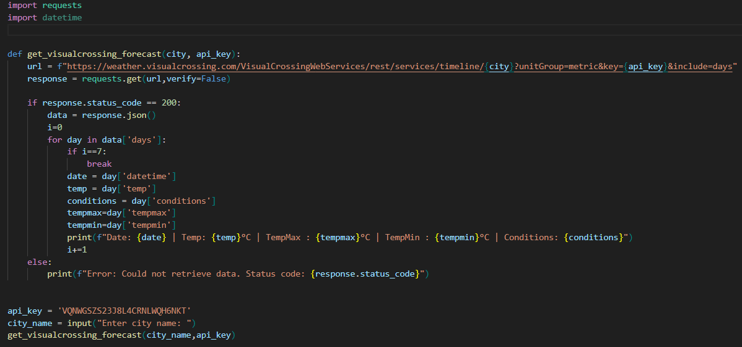
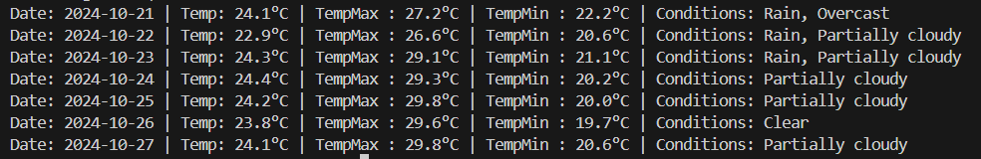
Problem Solving Approach
For weather API, find a free API which provide the 7 days forecast.
Visual Crossing website is provide the weather API, where we get in real time data and also provide the 7 days forecast. For access the weather data need to signup on visual crossing site and getting a API-key to access the API

