Slide 1
Rewiring the Brain Brain-Computer Interface for Stroke Rehabilitation
SUBMITTED TO
Dr. VINAY M
SUBMITTED BY
DELNA M JOSEPH
NAYAN HRIDYA PRAKASH (2348440)

Slide 2
TABLE OF CONTENTS
INTRODUCTION
PROBLEM STATEMENT
OBJECTIVE
BENEFICIARIES
DATASET PREVIEW
SYSTEM ARCHITECTURE
METHODOLOGY
NOVELTY
WEB DEVELOPMENT
CONCLUSION

Slide 3
INTRODUCTION

Slide 4
OBJECTIVE
Recommend Solutions: Propose ways to overcome BCI limitations and improve accessibility.
Review BCI Technologies: Examine current BCI technologies for stroke rehab, including their mechanisms and potential.
Identify Innovations: Highlight key technological advancements that improve rehabilitation outcomes.
Explore Advancements: Analyze major BCI innovations that have enhanced stroke recovery.
Assess Challenges: Investigate limitations in BCI implementation, such as cost and adaptability.
Recommend Solutions: Propose ways to overcome BCI limitations and improve accessibility.
Evaluate Future Impact: Assess the potential for BCI to transform stroke rehabilitation practices and patient outcomes.

Slide 5
PROBLEM STATEMENT
Stroke Impact: Stroke causes significant long-term disabilities, impairing motor functions and complicating daily activities, with traditional rehabilitation often insufficient for full recovery.
BCI Innovations: Brain-Computer Interface (BCI) technology shows potential for enhancing neuroplasticity and motor recovery but faces challenges in clinical adoption due to adaptability issues, patient variability, and high costs.
Study Aim: This study reviews current BCI innovations, identifies limitations in existing practices, and explores ways to improve the efficacy and accessibility of BCI systems for stroke rehabilitation.

Slide 6
Current Research Trends
Non-Invasive BCIs: Advancements in EEG-based systems for more accessible rehabilitation.
AI Integration: Using machine learning to enhance BCI signal processing and personalization.
Neuroplasticity: Promoting brain reorganization through targeted BCI stimulation.
Wearable BCIs: Development of portable devices for home-based therapy.
VR/AR Integration: Combining BCIs with virtual and augmented reality for immersive rehab.
Robotics and Exoskeletons: Integrating BCIs with robotic aids to support motor function recovery.
Real-Time Feedback: Implementing BCIs that provide immediate feedback during exercises
Cost Reduction: Research aimed at lowering BCI costs to increase accessibility.
Long-Term Efficacy: Studying the sustained effectiveness of BCI rehabilitation methods.
Customization: Enhancing adaptability of BCI systems to individual patient needs..

Slide 7
LITERATURE REVIEW

Slide 11
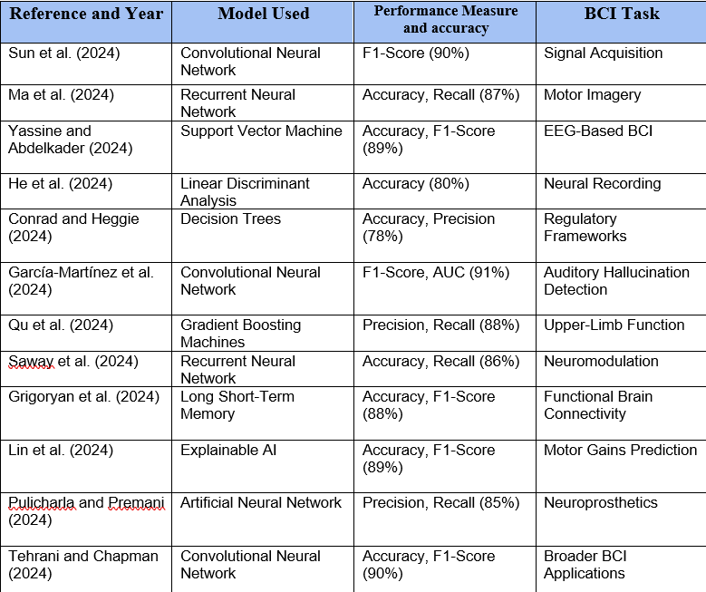
KEY INSIGHTS

Slide 12
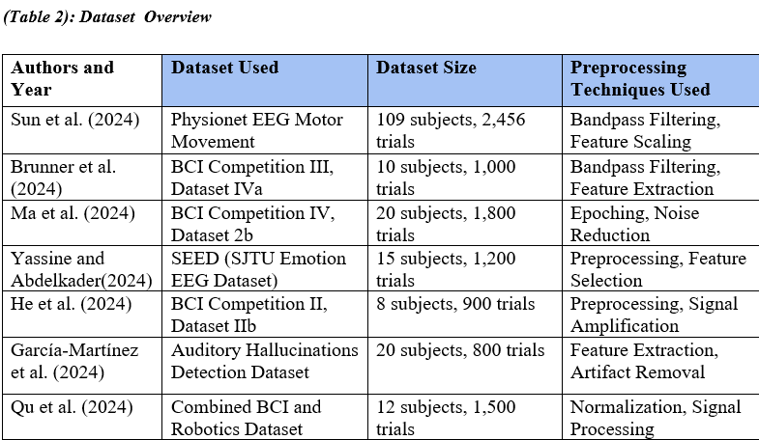

Slide 14
RESEARCH GAP
Signal Acquisition & Processing: Challenges with signal variability and noise require advanced methods and robust algorithms for effective real-time processing.
Personalization & Adaptability: Limited real-time capability in current BCIs necessitates improvements through adaptive neuromodulation and transfer learning to better tailor rehabilitation to individual patients.
Data Availability & Standardization: Small, low-quality datasets and lack of standardized protocols call for the development of larger datasets and uniform research methods to ensure reliability and reproducibility.
Integration with Conventional Therapies: Combining BCIs with traditional rehabilitation methods like FES and robotics could enhance stroke recovery and optimize rehabilitation strategies.
Long-Term Efficacy & Neuroplasticity: More research is needed to determine how BCIs can sustain or improve neuroplasticity and recovery over extended periods, beyond short-term benefits.
Ethical, Privacy, & Accessibility Concerns: Addressing issues related to data security, informed consent, and developing user-friendly, affordable systems is crucial for equitable access and ethical use of BCIs.

Slide 15
FUTURE PLANS
Advance Signal Processing: Improve algorithms for better real-time handling of signal variability and noise.
Enhance Personalization: Develop adaptive BCI systems using neuromodulation and transfer learning.
Expand Data Resources: Create larger, higher-quality datasets and standardized research protocols.
Integrate Therapies: Combine BCIs with traditional methods like FES and robotics for better recovery.
Investigate Long-Term Effects: Study the sustained impact of BCIs on neuroplasticity and recovery.
Address Ethical and Accessibility Issues: Develop guidelines for data privacy and create more affordable, user-friendly systems.

Slide 16
CONCLUSION
Integrating Brain-Computer Interface (BCI) technology with environmental initiatives presents a promising opportunity to enhance both cognitive function and water quality management. While current research highlights significant potential, challenges such as signal processing and system integration need to be addressed. Collaboration across disciplines is essential to leverage these advancements effectively. Future efforts should focus on refining BCI technologies, addressing ethical considerations, and fostering interdisciplinary partnerships to create a holistic approach to water wellness and cognitive health.

Slide 17
THANK YOU
DELNA M JOSEPH
NAYAN HRIDYA PRAKASH (2348440)

