Slide 1
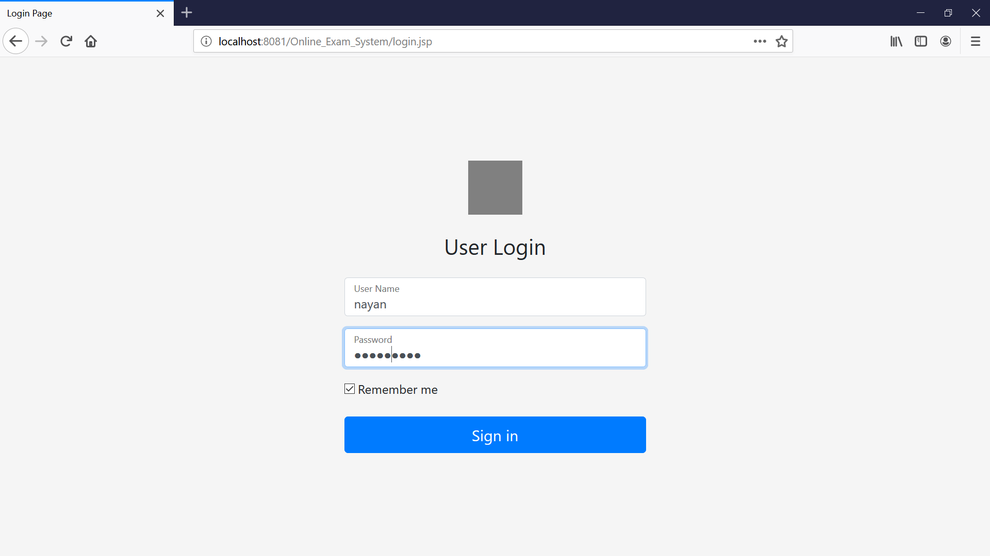
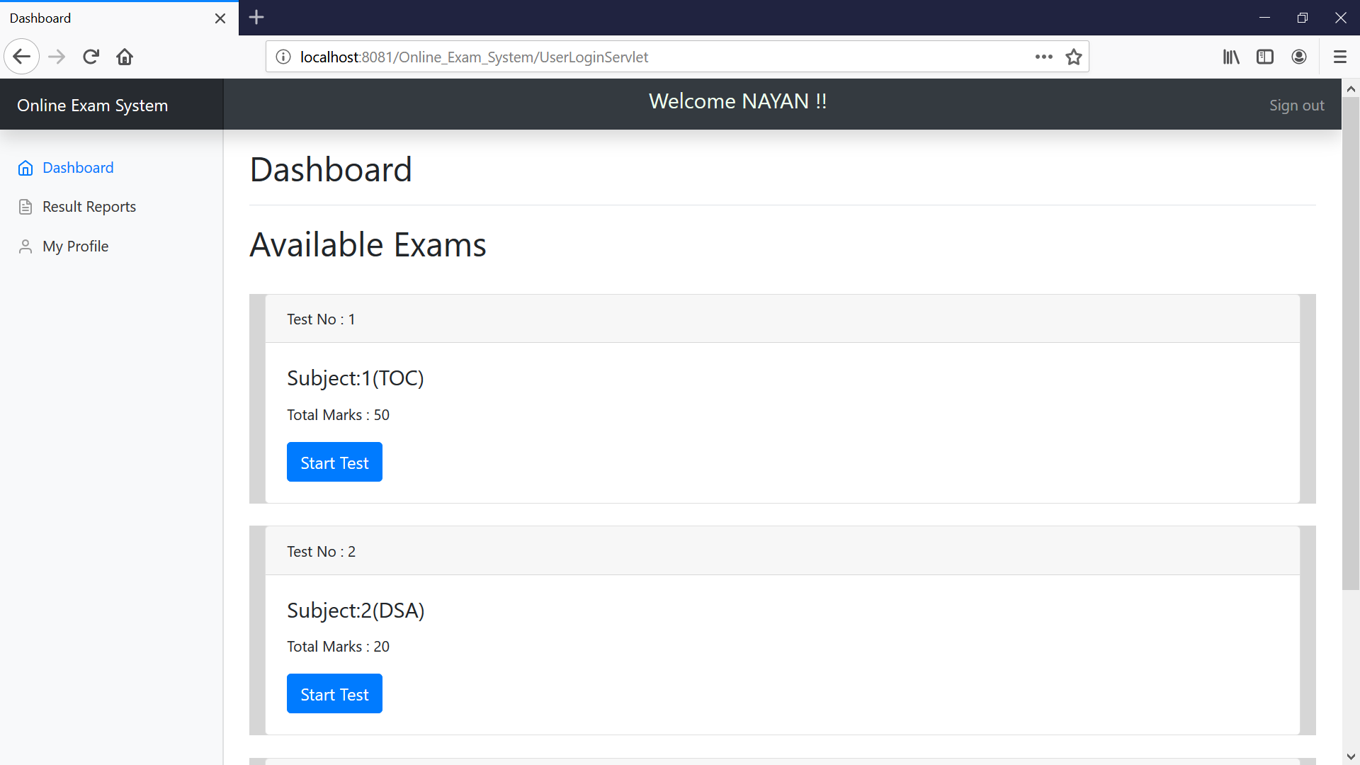
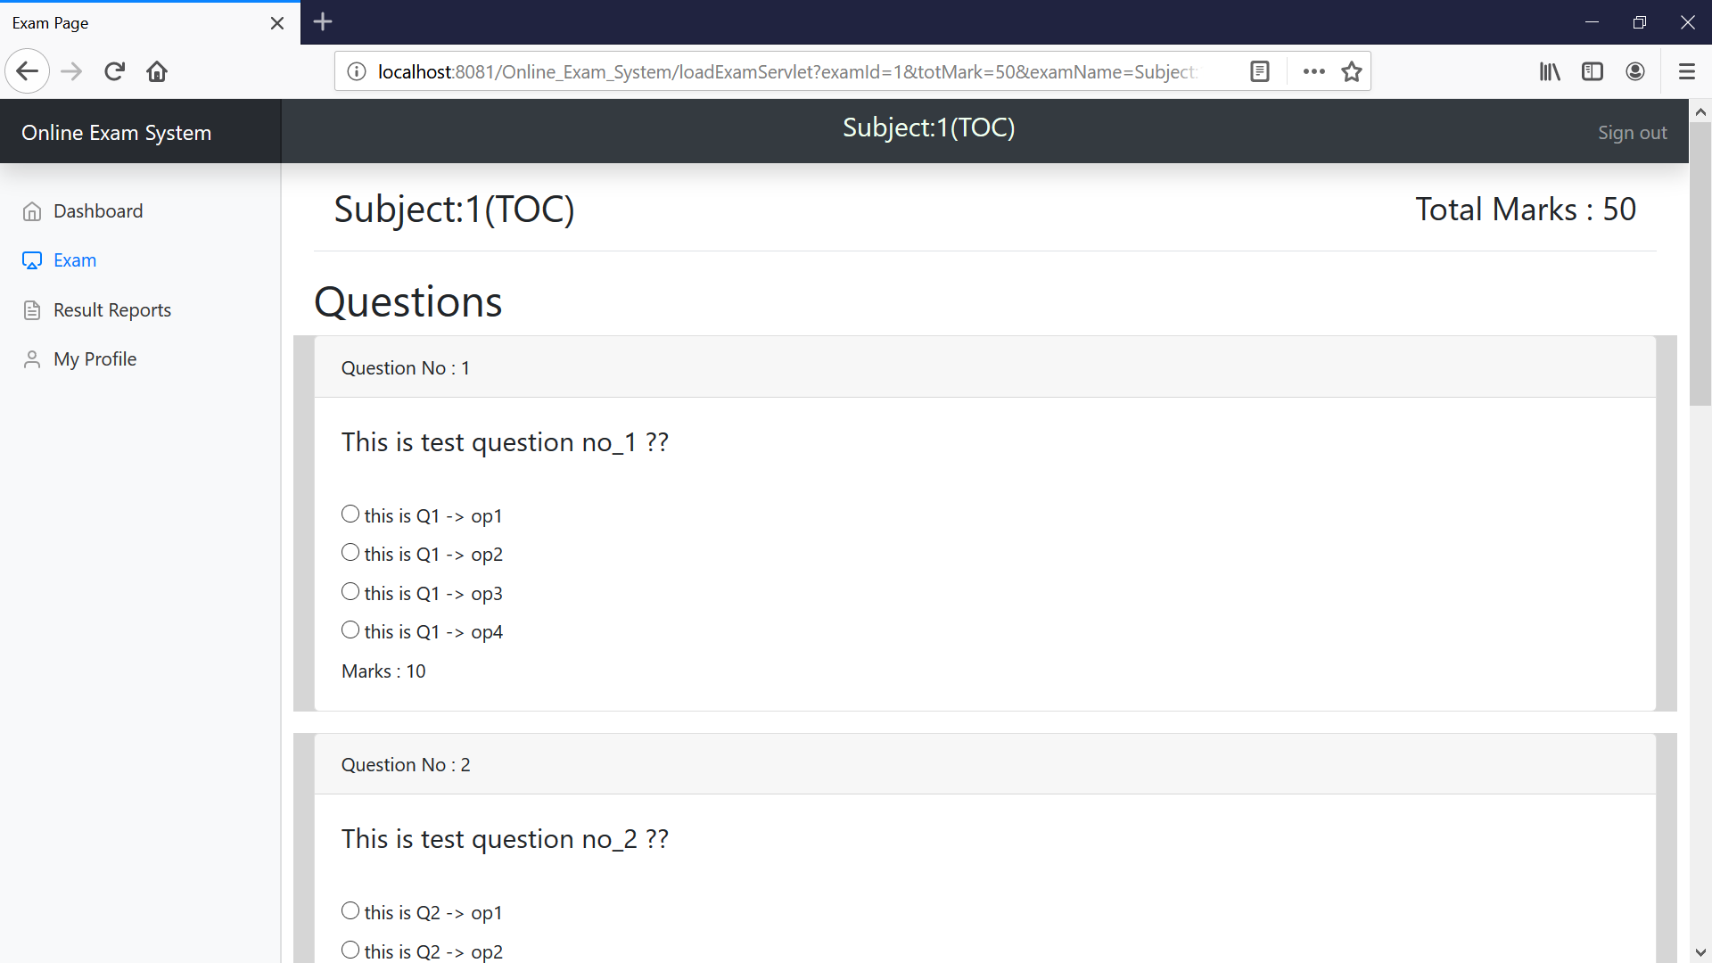
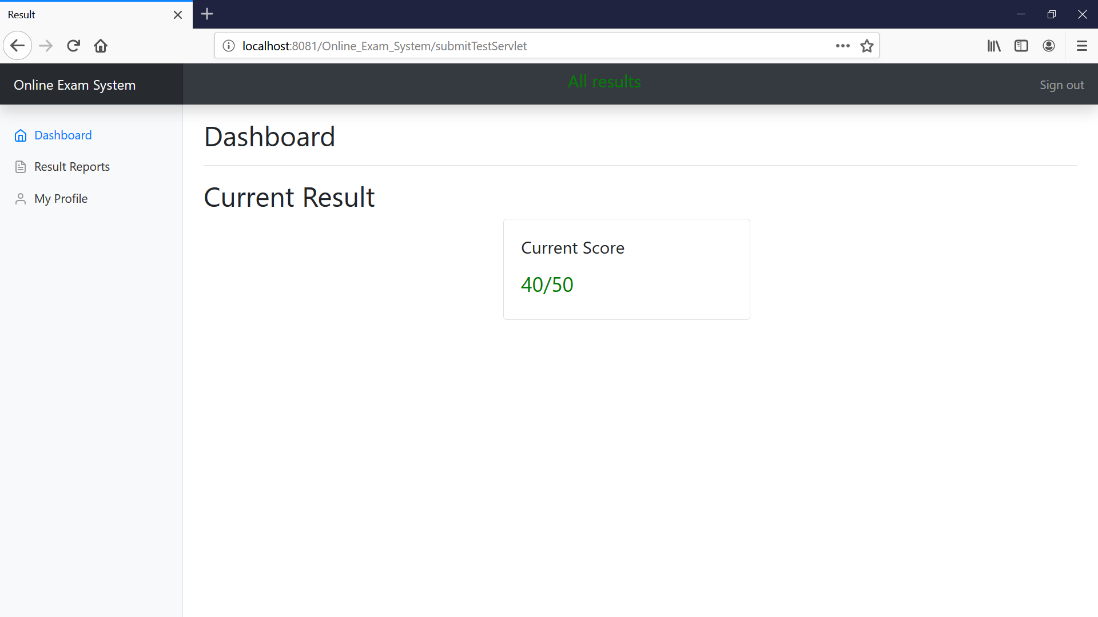
User(Teacher/Student page) Login Page – autoredirect according the user role
- with remember me
Student -home page – all exams displayed here-student can select exam from list
Result page after test completion
Test Page with MCQ Question

Slide 2
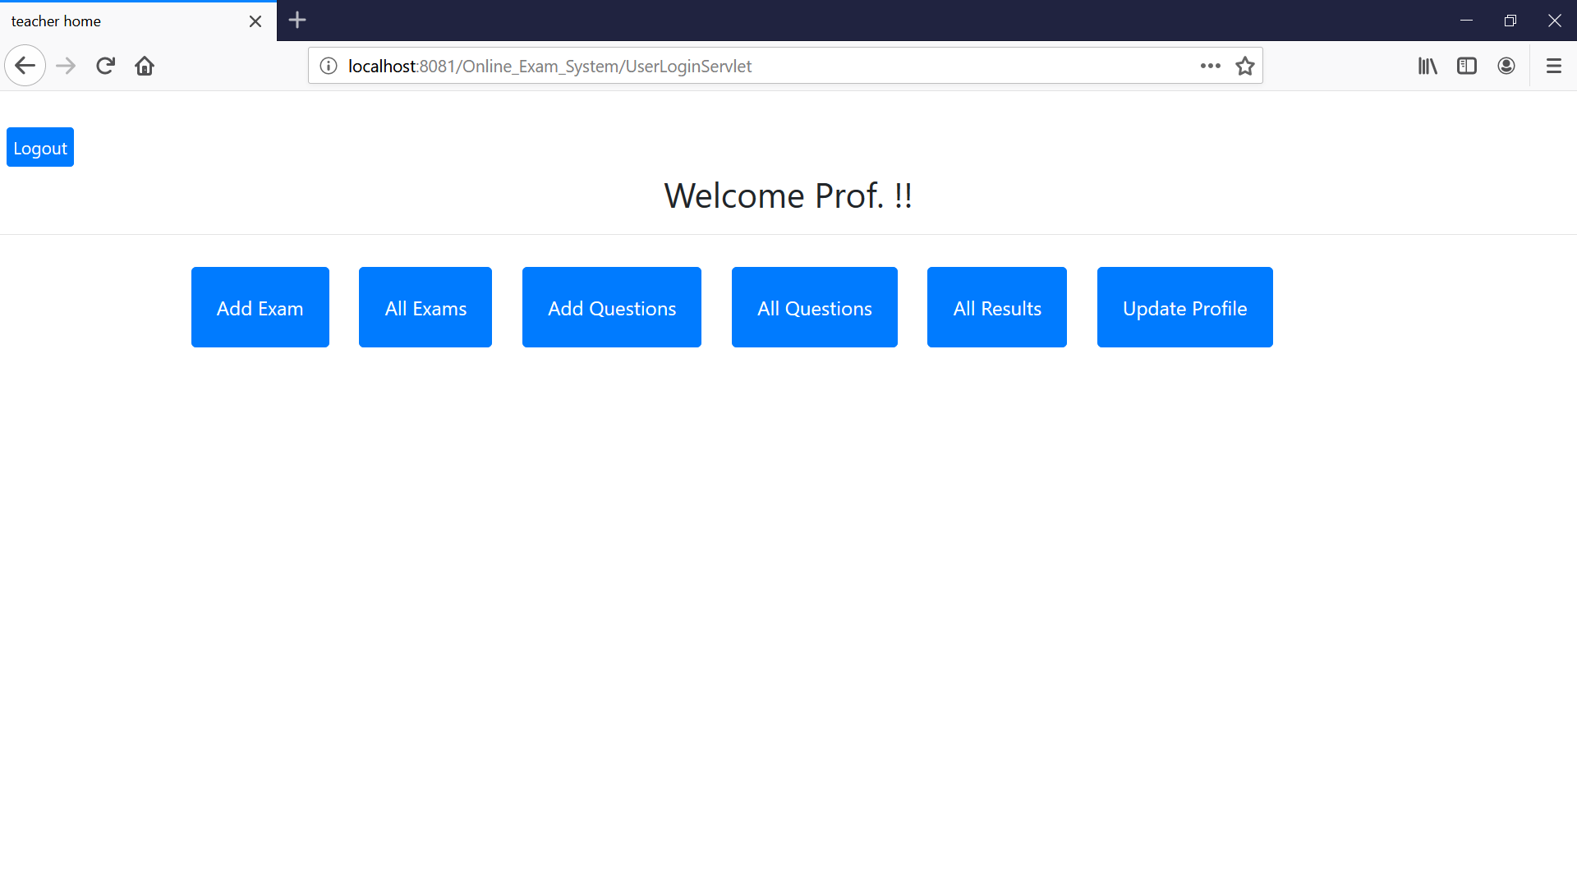
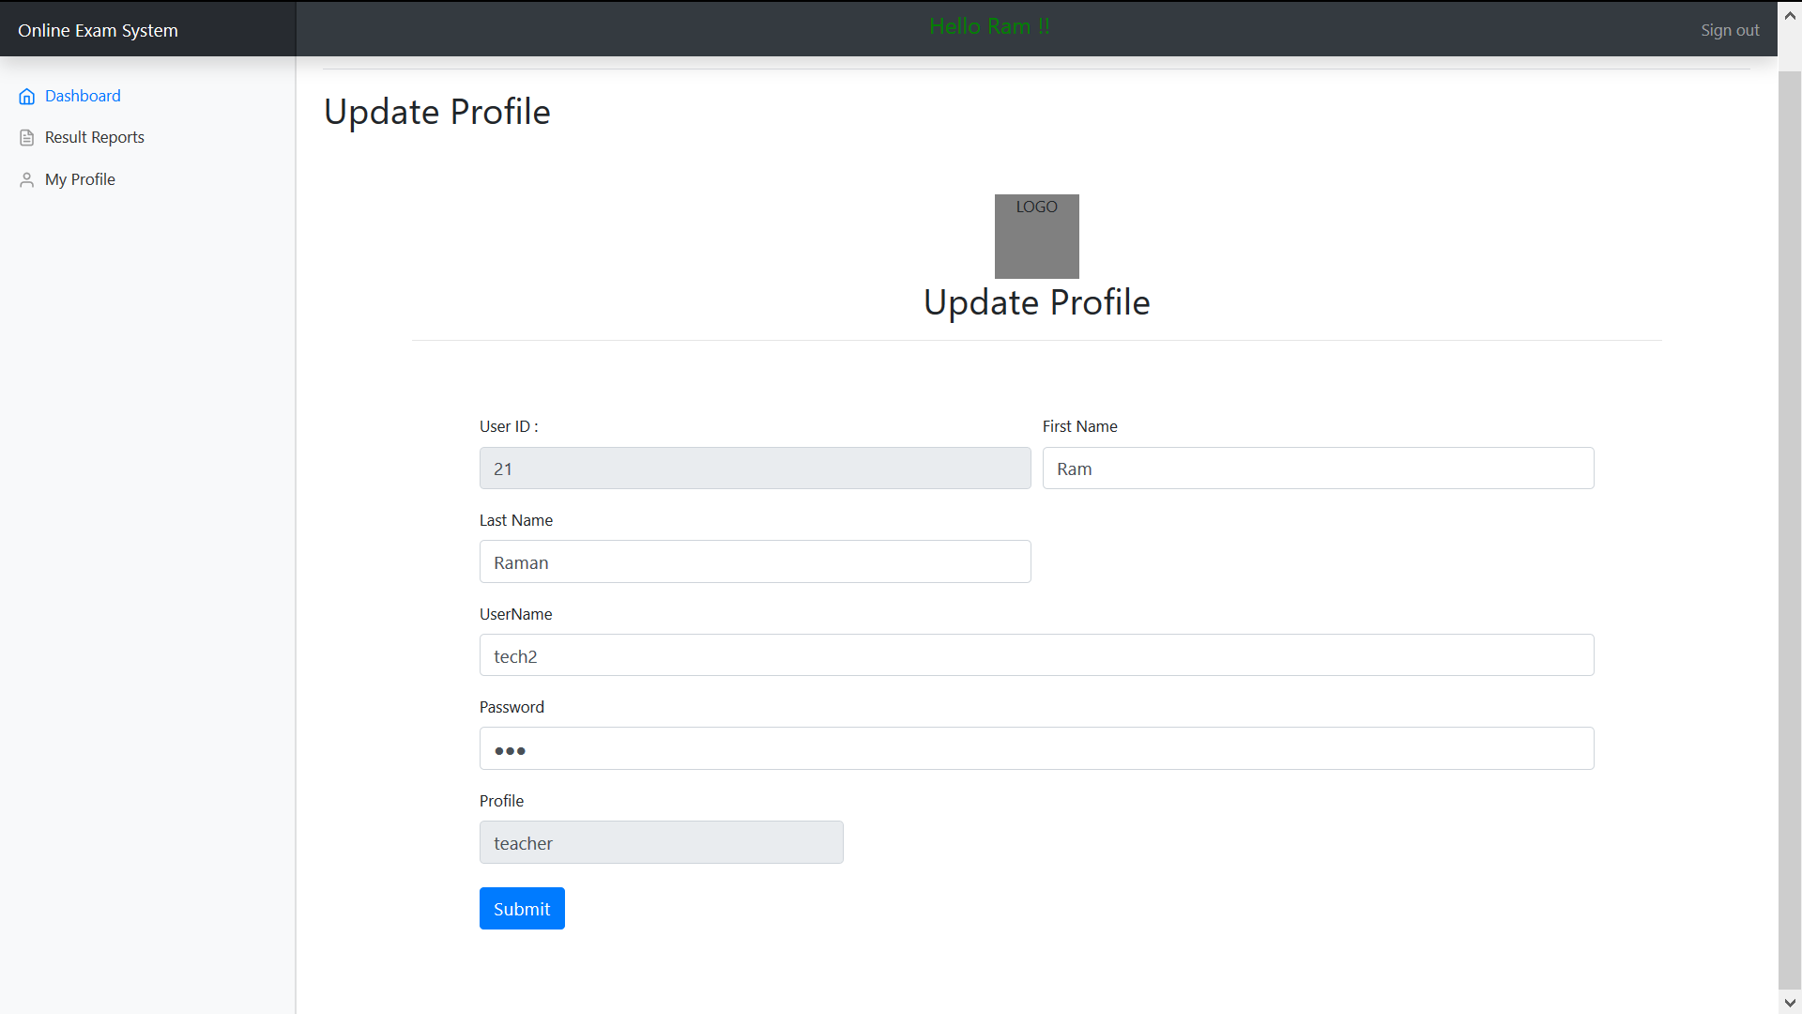
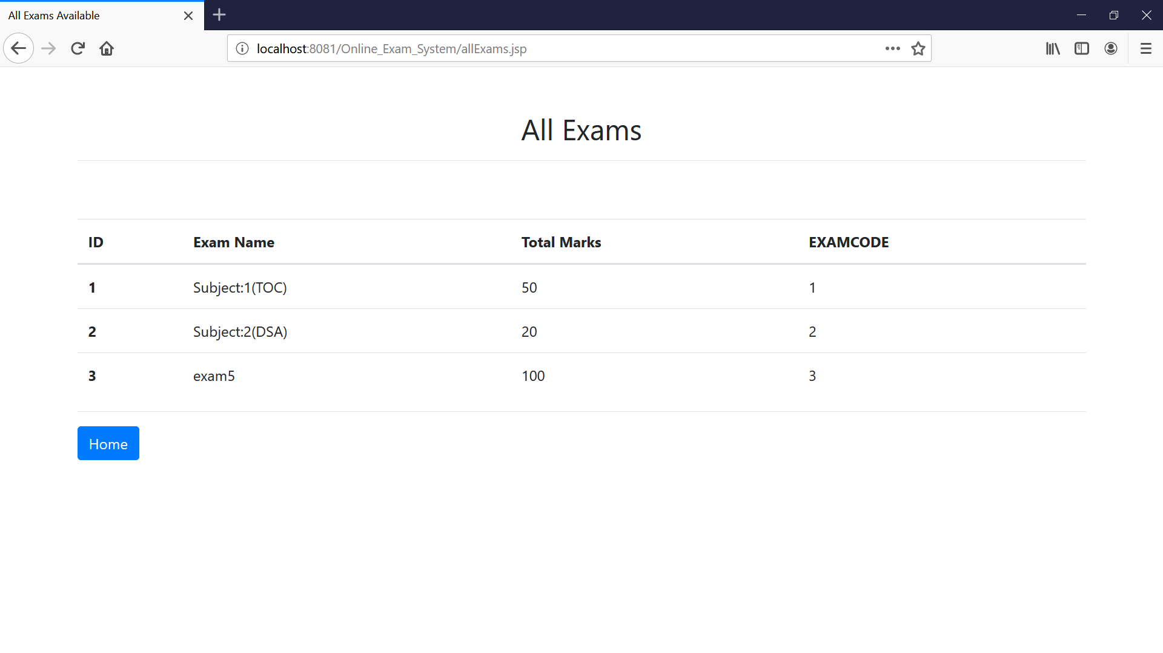
- Home page for teacher with multiple options
- Profile update Page- with auto filled form with old data , user can edit to update.
- All Available Exams –teacher view

Slide 3
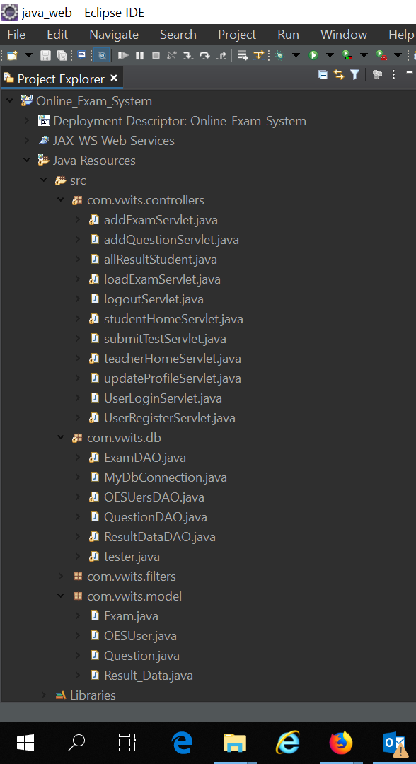
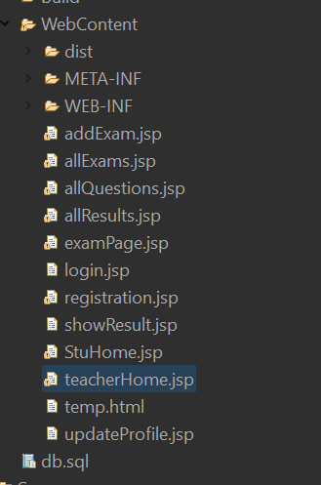
File Structure :
MVC
View

