Slide 1


MADRAS
BY:
NAYAN
MALAV
AAGAM

Slide 2

ENJOY THE PRESENTATION AND LEARN THE NEW THINGS

Slide 3

HISTORY OF MADRAS
Chennai originally known as "Madraspatnam" was located in the province of Tondaimandalam.
The capital of the province was Kancheepuram.
Tondaimandalam was ruled in the 2nd century by Tondaiman Ilam Tiraiyan, who was of the Chola family at Kanchipuram.
Then the region was ruled by the Chola Prince Ilam Killi. .
The Chola occupation of Tondaimandalam was put to an end by the King Pulumayi II of north.
They appointed chieftains to look after the Kanchipuram region.
Bappaswami, who is considered as the first Pallava to rule from Kanchipuram, was himself a chieftain.

Slide 4
DEVELOPMENT OF MADRAS
Francis Day and his superior Andrew Cogan can be considered as the founders of Madras (now Chennai).
They began construction of the Fort St George on 23 April 1640 and houses for their residence.
Their small fortified settlement quickly attracted other East Indian traders. To further consolidate their position, the Company combined the various settlements around an expanded Fort St. George and surrounded it by an additional wall.
This area came to be known as 'White Town'. The modern city of "Chennai" arose from the British settlement of Fort St.George.

Slide 5

BUILDINGS IN MADRAS
The Government Museum
Senate House of the Madras University and the
College of Engineering, Guindy Indo-Saracenic style of architecture.
Ripon Building (now housing the Chennai Corporation) dating from 1913,
The War Memorial,
Vivekanandar Illam,
The Museum Theatre
There are a number of railway stations of interest in Chennai, primarily built throughout the colonial era.
Fort St. George
Built in 1639, Fort St George, used to house the Tamil Nadu Legislative Assembly and Secretariat, which have since moved nearby to a new complex on Anna Salai. Tipu Sultan's cannons decorate the ramparts of the Fort's museum. The Fort has the country's tallest flagstaff at a height of 150 feet.

Slide 6
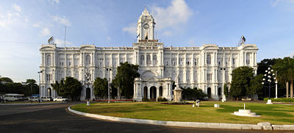
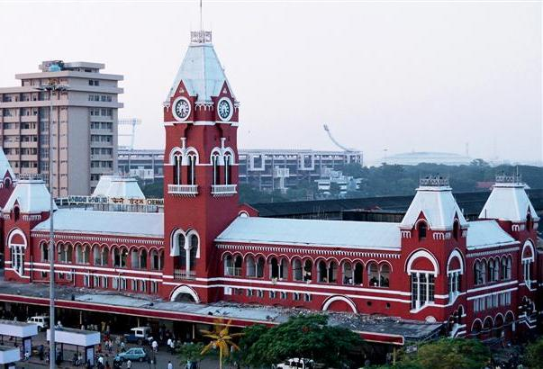
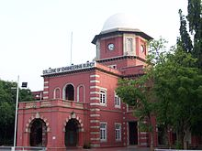
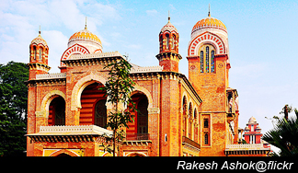
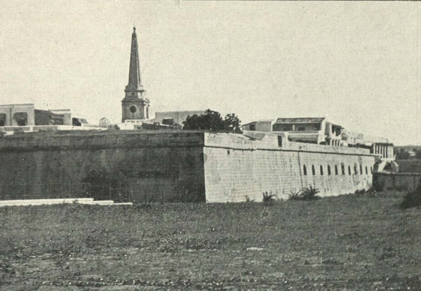
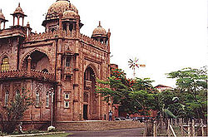
The Ripon Building, Chennai, an example of the Indo-Saracenic architectural
College of Engineering Guindy
Senate House of Chennai
Chennai Central Station
The Government Museum, Egmore
Fort St. George

