Slide 1
CODEGEN-2
Two-Stage LoRA Fine-Tuning of Qwen2.5-Coder
for Natural Language → Java → C# Code Generation
A parameter-efficient model that turns plain-English intent into idiomatic Java and equivalent C#.
Natural Language
user intent
Java
Stage 1 adapter
C#
Stage 2 adapter
Presented By : Taruni Swathi, Sattwik Ayyagari, Shib Sankar, Dhruba Maiti
Date : Sunday, July 05, 2026
Notes:
Good morning. My project fine-tunes Qwen2.5-Coder-1.5B into a two-stage code generator: stage one turns a natural-language request into Java, and stage two translates that Java into equivalent C#. The whole pipeline uses parameter-efficient LoRA fine-tuning and runs on a single 16 GB T4 GPU. Over the next ~12 minutes I'll cover the architecture, training, inference, evaluation results, representative examples, and conclusions with future work.

Slide 2
01 · MOTIVATION & OBJECTIVES
Project Overview
PROBLEM
OBJECTIVES
▸ Teams maintain the same logic twice — once in Java (JVM), once in C# (.NET).
▸ Manual re-implementation is slow, costly, and drifts out of sync.
▸ Large proprietary code LLMs are expensive and hard to self-host.
▸ NL request → idiomatic Java(PL1) → equivalent C#(PL2).
▸ Base Model - unsloth/Qwen2.5-Coder-1.5B-Instruct-bnb-4bit.
▸ Parameter-efficient (LoRA) so it trains faster.
▸ Catastrophic Forgetting
HIGH-LEVEL ARCHITECTURE
Natural Language
user prompt
Stage 1 LoRA
Qwen base (frozen) NL → Java
Stage 2 LoRA
Qwen base (frozen) Java → C#
Outputs
Java + C# + metrics + Hub
Key idea: one shared frozen 4-bit base model + two independent, sequentially-applied LoRA adapters. Stage 1 is never modified when Stage 2 is trained, so the adapters cannot interfere.
Qwen2.5-Coder · NL → Java → C# · Two-Stage LoRA
1
Notes:
The business problem: organizations that ship on both the JVM and .NET re-implement identical logic in Java and C#, which is slow and error-prone. My objective was a self-hostable model that goes from plain English to Java to C# in one flow, trainable on a single commodity T4 using LoRA. The architecture is the crucial design decision on this slide: I use ONE shared, frozen, 4-bit Qwen base and attach TWO separate LoRA adapters. Stage 2 loads a fresh copy of the base, so training it never touches Stage 1. The adapters are applied sequentially at inference, not fused.

Slide 3
02 · DATA, MODEL & FINE-TUNING
Model Architecture & Training
DATASETS & PREPROCESSING
BASE MODEL & PEFT
▸ Stage 1: code_search_net (Java) — doc → code, 5,000 samples.
– Clean javadoc → instruction; append "Write the solution in Java" hint.
▸ Stage 2: Java↔C# corpus with auto-fallback loader.
– XLCoST → CodeTransOcean → CodeXGLUE (selected: CodeXGLUE).
– Filter, de-duplicate, cap at 6k, 95/5 train/val split.
▸ Shared prompt template for train + inference (no format drift).
– EOS appended so the model learns where the answer ends.
▸ Qwen2.5-Coder-1.5B-Instruct, 4-bit (QLoRA) via Unsloth.
▸ LoRA on q,k,v,o + gate/up/down projections.
▸ Only ~1% of parameters trained; base weights frozen.
▸ FP16 + gradient checkpointing + 8-bit paged AdamW.
▸ Fits in ~16 GB.
KEY HYPERPARAMETERS
16
32 / 16
2e-5 / 2e-4
3 / 2
2048
LoRA rank (r)
LoRA α (S1 / S2)
LR (S1 / S2)
Epochs S1 / S2
Max seq len
Design decision: QLoRA + Unsloth cuts VRAM ~4× vs full fine-tuning; a version-tolerant SFTConfig builder keeps training portable across TRL/Transformers releases.
Qwen2.5-Coder · NL → Java → C# · Two-Stage LoRA
2
Notes:
For data: Stage 1 uses code_search_net Java, mapping documentation to code on 5,000 samples. Stage 2 needs parallel Java-to-C#; I built an auto-fallback loader that tries XLCoST, then CodeTransOcean, then CodeXGLUE — CodeXGLUE was selected at run time. Pairs are filtered, de-duplicated, capped, and split 95/5. Crucially, the SAME prompt template is used for training and inference, and I append EOS so the model learns to stop. The model is Qwen2.5-Coder-1.5B loaded in 4-bit via Unsloth; LoRA adapters target the attention and MLP projections, training only about 1% of parameters. With FP16, gradient checkpointing, and an 8-bit paged optimizer it fits in 16 GB. Key hyperparameters are on the chips: rank 16, alpha 32 and 16, learning rates 2e-5 and 2e-4, 3 and 2 epochs, seed 3407 for reproducibility.

Slide 4
03 · CHAINED GENERATION & PROMPTING
Inference Pipeline
NL Prompt
"factorial of n"
Stage 1 model
build_stage1_prompt() + Java hint · greedy
Stage 2 model
build_stage2_prompt() + C# hint · greedy
C# Output
final
↳ intermediate Java
↳ translated C#
PROMPT ENGINEERING
DEPLOYMENT WORKFLOW
### Instruction
<task> + language hint
### Java / ### Response
<code> + <EOS>
▸ Adapters + tokenizer saved to timestamped run folder.
▸ Each stage merged to FP16 and pushed to its own HF Hub repo.
▸ Two adapters can't be fused → two published models.
▸ Public API: generate_java_from_nl · generate_csharp_from_java · generate_csharp_from_nl.
▸ Portable HF-token resolution (Kaggle → env → Colab → prompt).
▸ Identical template at train + inference.
▸ Explicit language hint stops Qwen defaulting to Python.
▸ Prompt echo stripped at the response marker.
Qwen2.5-Coder · NL → Java → C# · Two-Stage LoRA
3
Notes:
At inference the user only supplies natural language. generate_csharp_from_nl internally chains the two stages: Stage 1 produces Java, which is fed straight into Stage 2 to produce C#, and both intermediates are returned. Prompt engineering is deliberate: the same instruction/response template is used for training and inference, and I add an explicit language hint because Qwen-Coder otherwise defaults to Python on generic prompts. The prompt echo is stripped at the response marker. For deployment, both adapters and the tokenizer are saved to a timestamped folder, then each stage is merged to FP16 and pushed to its own Hugging Face repo — they can't be fused because they run sequentially. Three clean public functions expose the whole capability.

Slide 5
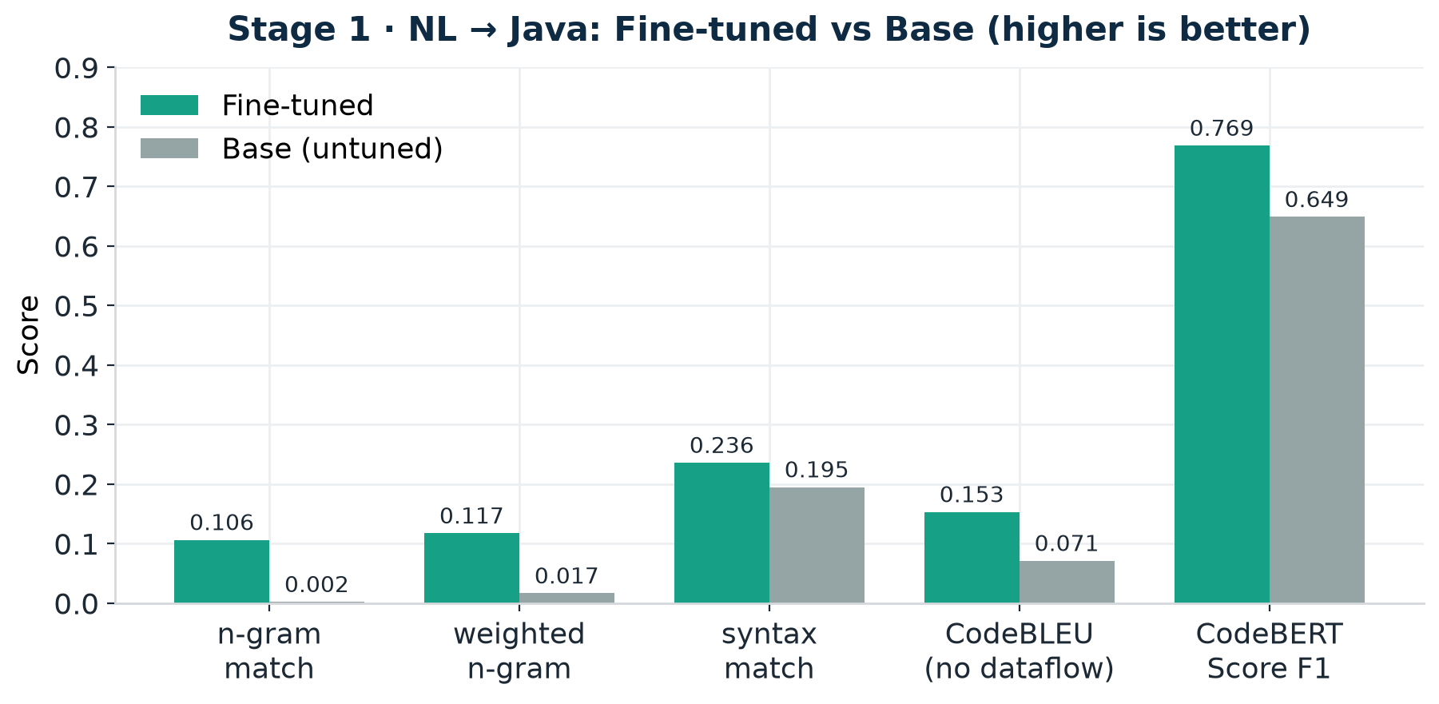
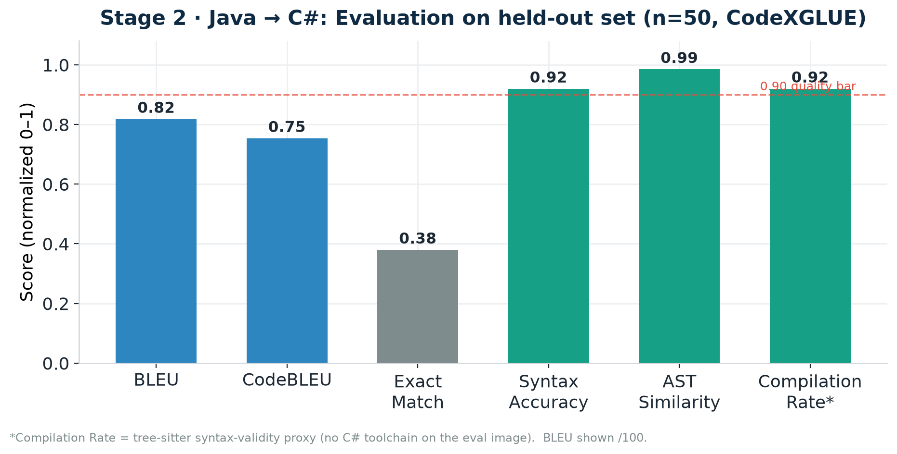
04 · METRICS & BASE VS FINE-TUNED
Evaluation & Results
KEY FINDINGS
▸ Stage 1: fine-tuned wins n-gram, syntax & CodeBERTScore (0.77 vs 0.65).
▸ Base only "wins" raw CodeBLEU via inflated dataflow on near-empty output.
▸ → dataflow-excluded CodeBLEU: 0.153 vs 0.071 (fine-tuned).
▸ Stage 2: BLEU 81.8 · CodeBLEU 0.75 · AST similarity 0.99.
▸ Syntax accuracy & compilation proxy both 0.92.
▸ Strong, faithful Java→C# translation on held-out data.
Qwen2.5-Coder · NL → Java → C# · Two-Stage LoRA
4
Notes:
Evaluation is where the nuance matters. On Stage 1 I compare the fine-tuned adapter against the untuned base. The fine-tuned model clearly wins n-gram, weighted n-gram, and syntax match, and CodeBERTScore rises from 0.65 to 0.77. Interestingly the base model shows a HIGHER raw CodeBLEU — but that is a known artifact: CodeBLEU's dataflow term is normalized by the tiny number of edges in near-empty output, so a degenerate base scores 0.81 on dataflow. Excluding dataflow, the fine-tuned model wins 0.153 to 0.071. This is why I report the component breakdown, not just the aggregate. Stage 2 results are strong across the board: BLEU 81.8, CodeBLEU 0.75, AST similarity 0.99, and both syntax accuracy and the compilation proxy at 0.92. Note the compilation rate uses a tree-sitter syntax proxy because the eval image had no C# toolchain.

Slide 6
05 · QUALITATIVE ANALYSIS
Generated Examples & Analysis
Prompt: "write a function to compute the factorial of a number" → NL → Java → C#
STAGE 1 · Generated Java
STAGE 2 · Translated C#
public static long factorial(int n) {
if (n <= 1) return 1;
long r = 1;
for (int i = 2; i <= n; i++)
r *= i;
return r;
}
public static long Factorial(int n) {
if (n <= 1) return 1;
long r = 1;
for (int i = 2; i <= n; i++)
r *= i;
return r;
}
Note idiomatic C# casing (Factorial, PascalCase) — not a naive copy.
STRENGTHS
LIMITATIONS
▸ Correct, compilable, idiomatic translations on common algorithms.
▸ Reliable Java-anchoring — no accidental Python fallback.
▸ Preserves control flow & semantics (AST similarity 0.99).
▸ 1.5B model struggles with long / highly domain-specific code.
▸ Errors can compound across the two-stage chain.
▸ Compilation measured by syntax proxy, not a real C# compiler.
Qwen2.5-Coder · NL → Java → C# · Two-Stage LoRA
5
Notes:
Here is a representative end-to-end example. The prompt is a plain-English request for a factorial function. Stage 1 emits clean, correct Java; Stage 2 translates it into idiomatic C# — note it uses PascalCase 'Factorial', which shows it learned C# conventions rather than copying the Java verbatim. Strengths: correct, compilable, idiomatic output on common algorithms, reliable language anchoring, and preserved semantics reflected in the 0.99 AST similarity. Honest limitations: a 1.5B model struggles on long or niche code; because the pipeline is sequential, a Stage 1 error can propagate into Stage 2; and my compilation metric is a tree-sitter syntax proxy rather than a real compiler on the eval environment.

Slide 7
06 · CONTRIBUTIONS & ROADMAP
Conclusion & Future Work
KEY ACHIEVEMENTS
Challenges
▸ End-to-end NL → Java → C# pipeline.
▸ Two independent LoRA adapters on one shared frozen base.
▸ Measurable gains over base (CodeBERTScore 0.65 → 0.77).
▸ Strong Stage 2 translation (BLEU 81.8, AST 0.99).
▸ Finding the right dataset for code generation.
▸ Selecting optimal base model for the NL → Java → C# code gen.
▸ Optimizing training configuration to achieve high-quality output.
▸ Training model efficiently with limited GPU & compute resources.
▸ Establishing meaningful evaluation metrics -CodeBLEU, CodeBERTScore, Compilation Rate.
FUTURE WORK
▸ Scale to larger Qwen-Coder variants; more training data.
▸ Real C# compiler + unit-test execution in the loop.
▸ Real Java compiler + unit-test execution in the loop.
▸ RAG / retrieval for domain-specific APIs.
▸ Documentation for generated code
Qwen2.5-Coder · NL → Java → C# · Two-Stage LoRA
6
Notes:
To conclude: I delivered a working end-to-end NL-to-Java-to-C# generator on a single T4, built from two independent LoRA adapters over one shared frozen base, with measurable gains over the base model and strong Stage 2 translation quality. Beyond the model, the contributions are methodological: a reproducible, config-driven, fully-logged pipeline; a fair evaluation that surfaces and corrects the CodeBLEU dataflow artifact; an auto-fallback dataset loader; and strict train/inference prompt parity. Future work: scale the base model and data, put a real C# compiler and unit tests in the evaluation loop, explore a single multitask adapter, add retrieval for domain APIs, and extend to more languages. The takeaway is that disciplined PEFT plus artifact-aware evaluation yields a practical, self-hostable tool and a reusable template for reproducible fine-tuning research. Thank you — I'm happy to take questions.

Slide 8
07 · THANK YOU
THANK YOU
Qwen2.5-Coder · NL → Java → C# · Two-Stage LoRA
6
Notes:
To conclude: I delivered a working end-to-end NL-to-Java-to-C# generator on a single T4, built from two independent LoRA adapters over one shared frozen base, with measurable gains over the base model and strong Stage 2 translation quality. Beyond the model, the contributions are methodological: a reproducible, config-driven, fully-logged pipeline; a fair evaluation that surfaces and corrects the CodeBLEU dataflow artifact; an auto-fallback dataset loader; and strict train/inference prompt parity. Future work: scale the base model and data, put a real C# compiler and unit tests in the evaluation loop, explore a single multitask adapter, add retrieval for domain APIs, and extend to more languages. The takeaway is that disciplined PEFT plus artifact-aware evaluation yields a practical, self-hostable tool and a reusable template for reproducible fine-tuning research. Thank you — I'm happy to take questions.

