Slide 1
CAPSTONE RESULTS
LoRA Fine-Tuning Beats Baseline
CodeGen-350M · Spider Gold · 50 examples · 3 tasks
Text2SQL
SQL2NoSQL
Documentation
Model: Salesforce/codegen-350M-multi
Best adapter: LoRA v3 (full TEND ~8k, r=32+FFN, 10 epochs)
Judge: gemma3:4b · Evaluated with live database execution

Slide 2
The starting point
Zero-shot CodeGen struggles on real database tasks
TEXT2SQL
SQL2NOSQL
EXACT MATCH
14%
22%
0–4%
queries run correctly
queries run correctly
string-perfect output
Baseline = same model with no LoRA adapter
We tested on 50 curated Spider gold examples
Success = generated query actually runs and returns correct results
Goal: show LoRA training improves all three pipeline stages
CodeGen LoRA · Spider Gold Validation · 2026

Slide 3
Training journey
Smoke test → full TEND → wider LoRA (v3)
Baseline
LoRA v1
LoRA v2
LoRA v3
No training
50 samples · smoke test
~8k · r=16 · 5 epochs
~8k · r=32+FFN · 10 ep
→
→
→
14% / 22%
Pipeline check only
60% / 74%
66% / 86%
Insight: Use v2/v3 for capstone numbers. v1 (n=5) only proves the evaluation pipeline works.
CodeGen LoRA · Spider Gold Validation · 2026

Slide 4
Bottom line
LoRA v3 vs baseline on the same 50 examples
TEXT2SQL ACCURACY
SQL2NOSQL ACCURACY
DOC QUALITY (JUDGE)
14% → 66%
22% → 86%
8.33 → 8.82
+52 points
+64 points
+0.49
Version | Training data | Text2SQL | SQL2NoSQL | Doc judge
Baseline | — | 14% | 22% | 8.33
LoRA v2 | Full TEND, r=16, 5 ep | 60% | 74% | 8.41
LoRA v3 ★ | Full TEND, r=32+FFN, 10 ep | 66% | 86% | 8.82
CodeGen LoRA · Spider Gold Validation · 2026

Slide 5
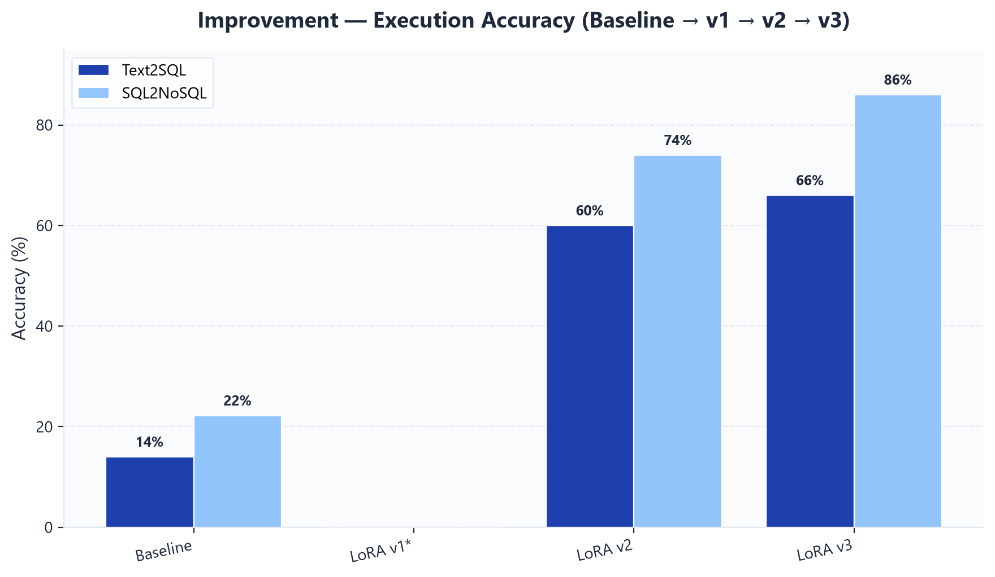
Execution accuracy
Does the generated query run and return correct results?
Insight: Baseline 14% Text2SQL → LoRA v3 66%. SQL2NoSQL jumps from 22% to 86%.
CodeGen LoRA · Spider Gold Validation · 2026

Slide 6
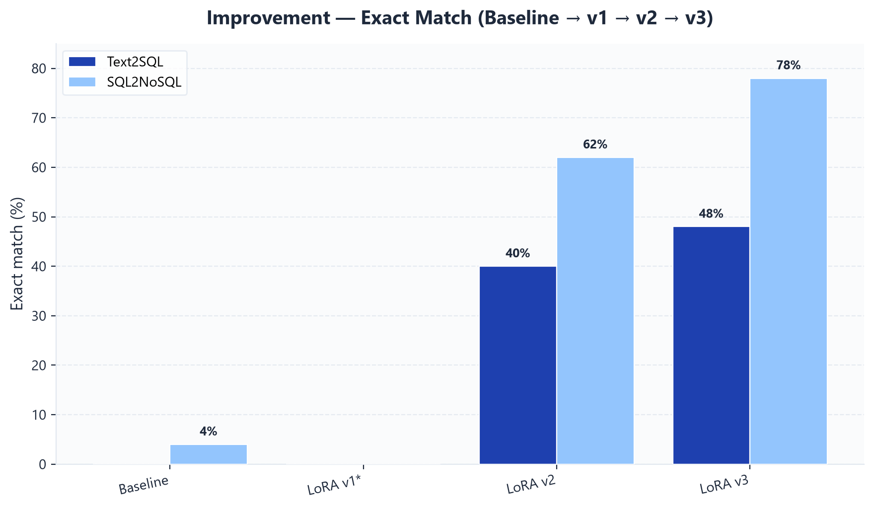
Exact match
How often is the output identical to the gold answer?
Insight: Exact match was near zero for baseline; LoRA v3 reaches 48% (SQL) and 78% (NoSQL).
CodeGen LoRA · Spider Gold Validation · 2026

Slide 7
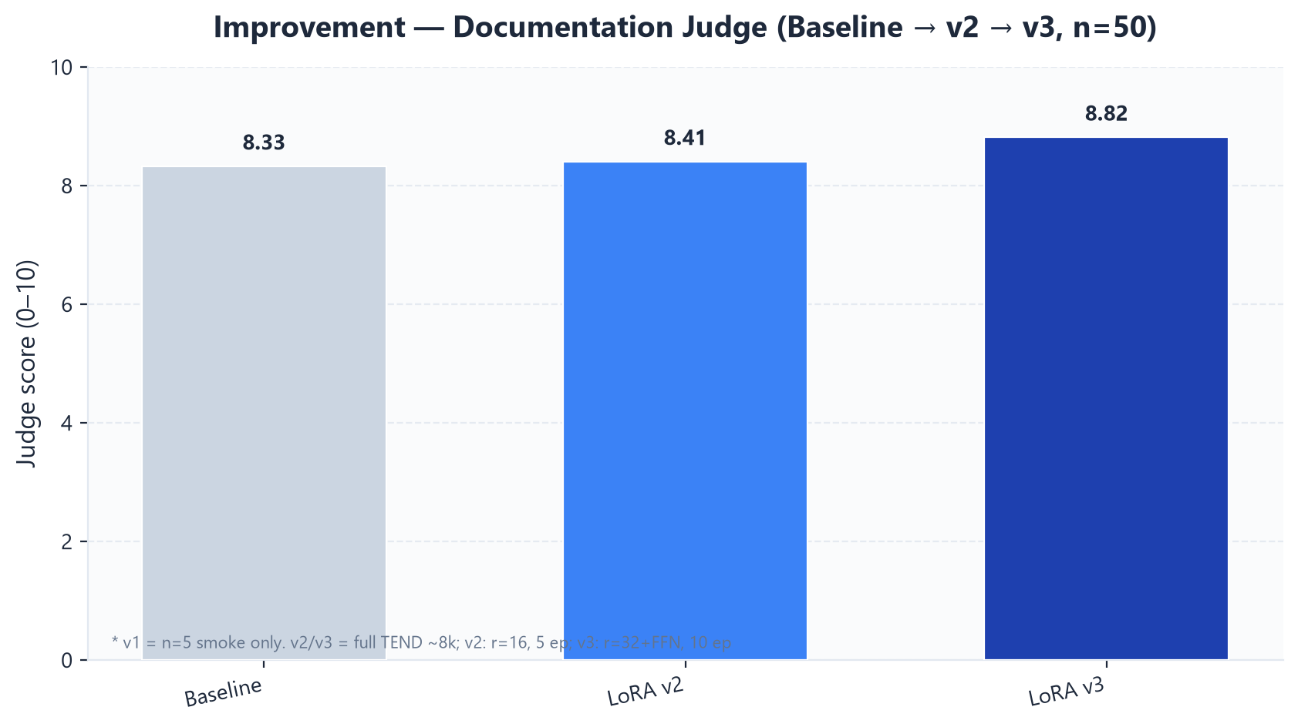
Documentation quality
LLM judge scores documentation on a 0–10 scale
Insight: Documentation improves steadily but modestly — code tasks gain the most from LoRA.
CodeGen LoRA · Spider Gold Validation · 2026

Slide 8
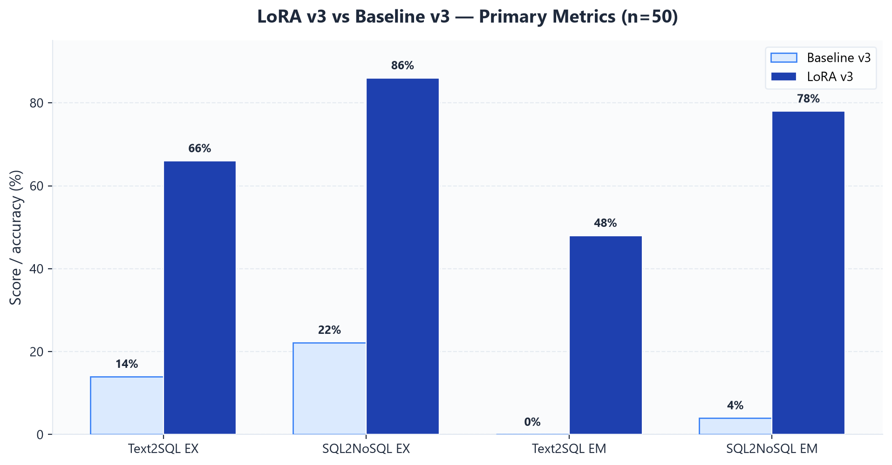
Recommended model: LoRA v3
Deploy to Hugging Face Hub + Cloud Run
✓ Best execution accuracy
✓ Best exact match
✓ Best doc judge score
✓ Trained on full TEND scale
✓ Production-ready adapter
Insight: Set manifest.yaml → checkpoint_version: v3
CodeGen LoRA · Spider Gold Validation · 2026

Slide 9
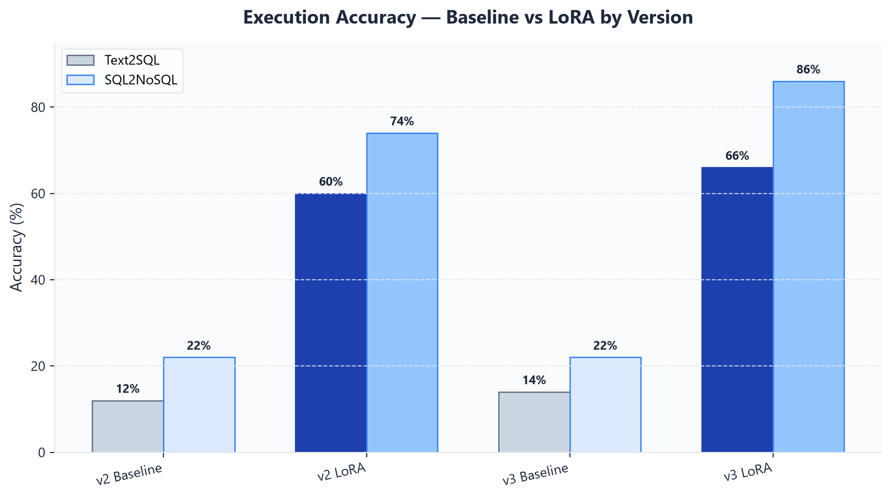
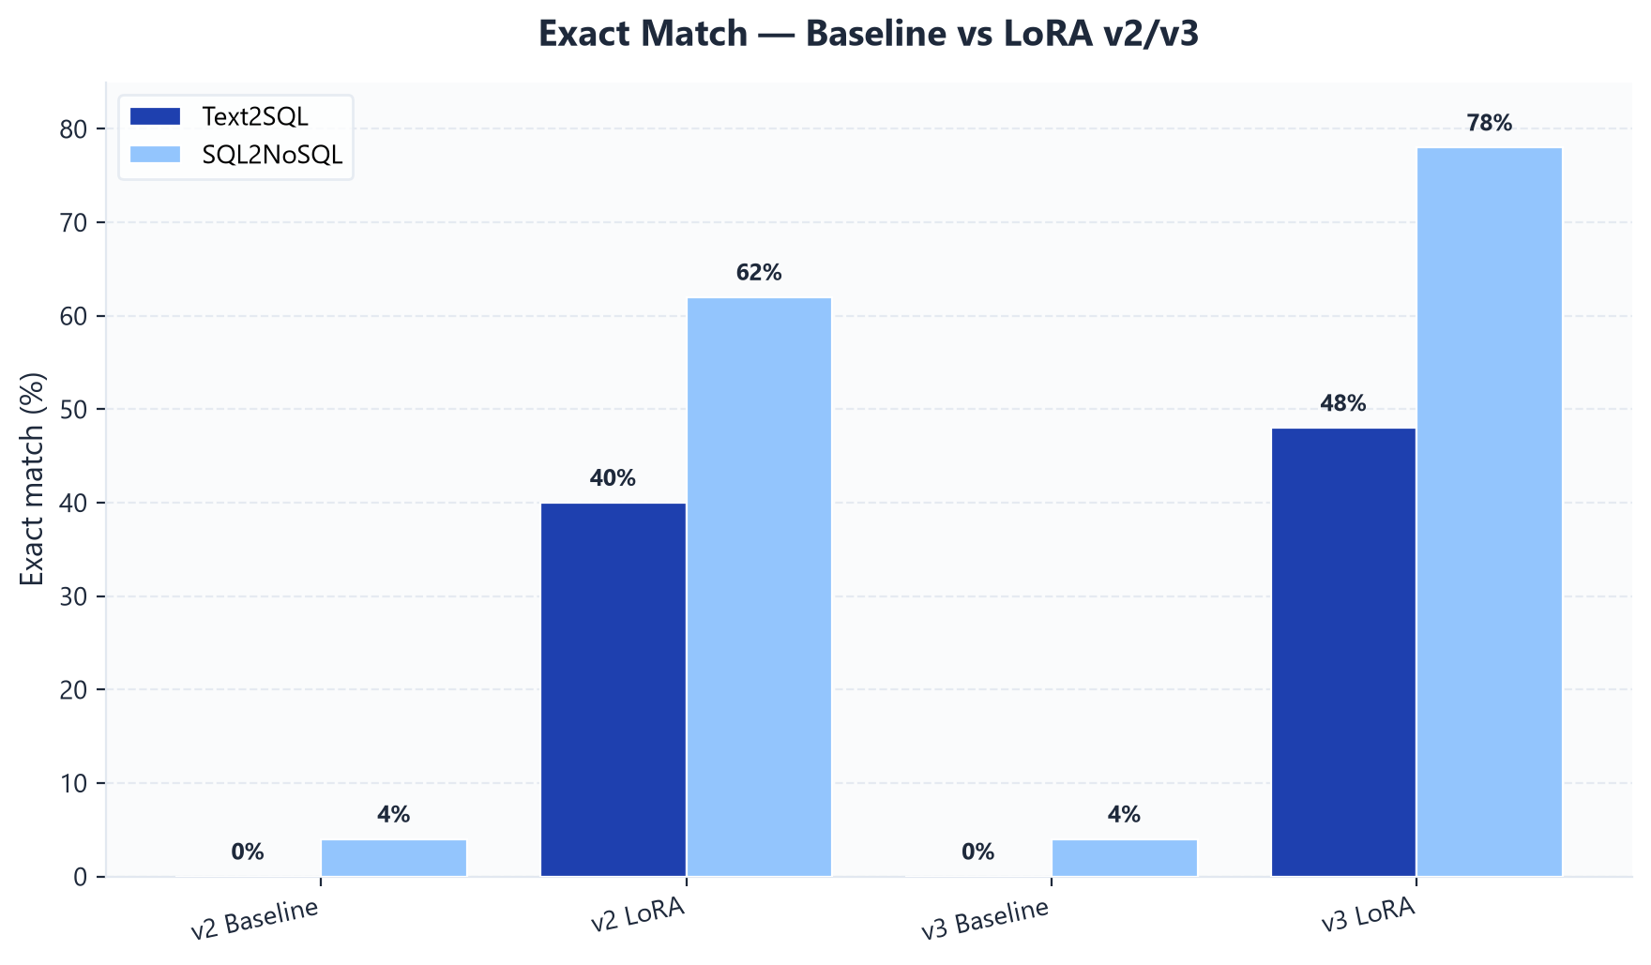
Baseline vs LoRA — side by side
Paired evaluation on v2 and v3 (50 examples each)
CodeGen LoRA · Spider Gold Validation · 2026

Slide 10
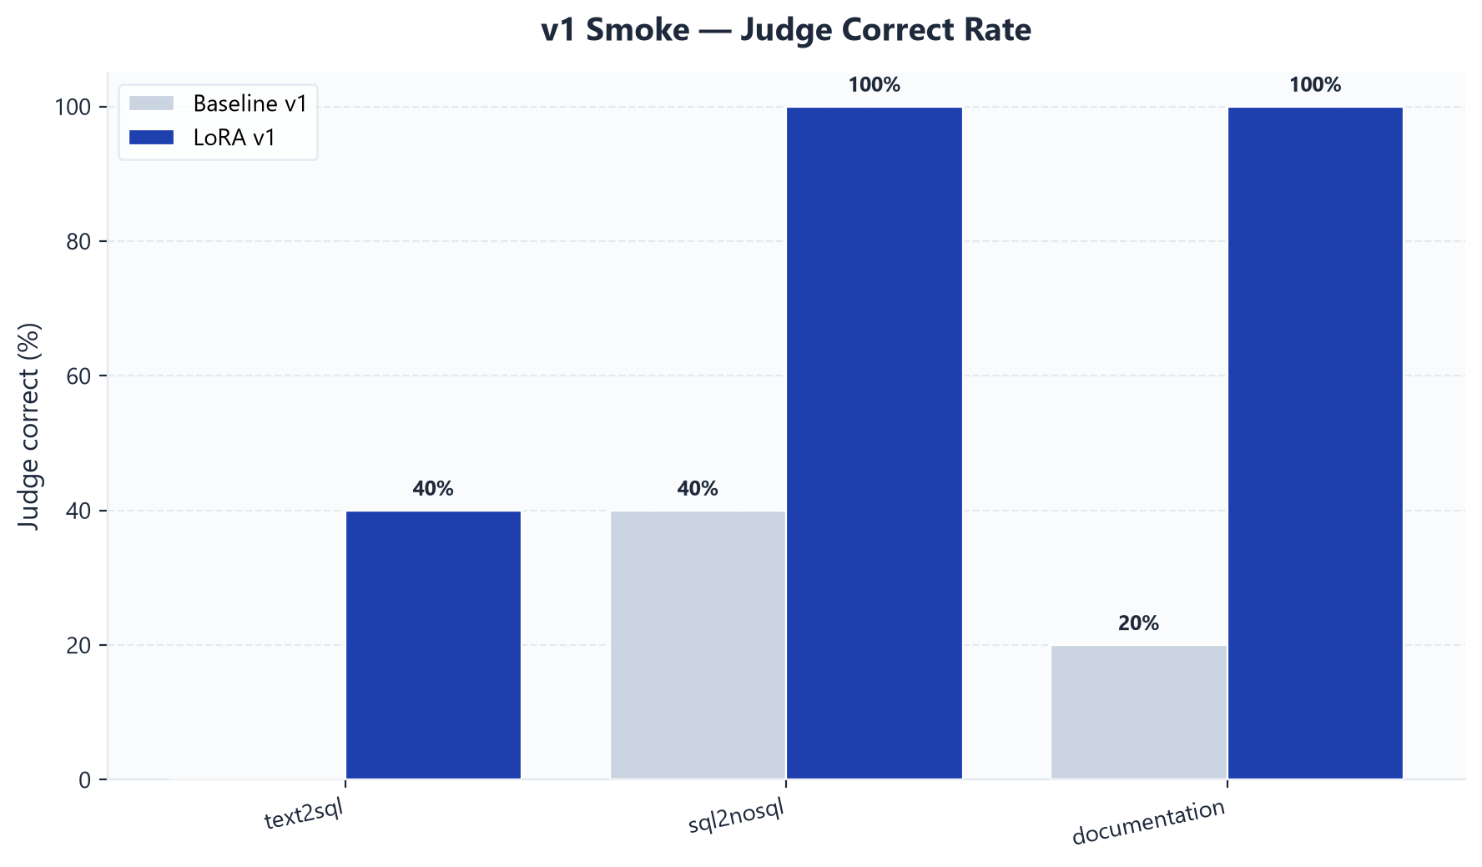
Optional: v1 smoke test
Pipeline validation only — 5 examples, not for final metrics
Insight: Mention v1 only to show the eval pipeline works early in the project.
CodeGen LoRA · Spider Gold Validation · 2026

Slide 11
Key takeaways
What to say in your capstone presentation
1. LoRA clearly beats zero-shot CodeGen — the improvement is large and consistent.
2. Biggest wins: SQL2NoSQL (22% → 86%) and exact match (4% → 78%).
3. Documentation improves modestly; code generation benefits most from fine-tuning.
4. LoRA capacity and schedule: v2 (r=16, 5 epochs) → v3 (r=32 + FFN, 10 epochs) on the same full TEND data.
5. Deploy LoRA v3 as the production adapter for the agent and API.
Recommendation → Promote LoRA v3 to production
CodeGen LoRA · Spider Gold Validation · 2026

