Slide 1
CodeGen (Group -13): Measuring and Improving Code Intelligence
Baselines → Execution-Validated Dataset Extension → QLoRA Fine-Tuning → RAG
Team Members: Pranali
Aditi
Ravi
Vamsi
Notes:
This presentation frames a three-phase capstone project evaluating small LMs (1.5B) against larger LLMs (7B) on code intelligence tasks. We establish baselines, extend datasets with missing data components via execution-validated feedback loops, and fine-tune via QLoRA. Throughout, we maintain honest execution-based evaluation and transparent reporting of both wins and regressions.

Slide 2
How We Started
• Goal: measure and improve NL↔Python↔Java code intelligence in a small LM vs a larger LLM
• Model family: Qwen2.5-Coder — 1.5B (fp16) , 7B (4-bit NF4 quantized)
• 3 benchmarks: HumanEval, MBPP, HumanEval-X (Python→Java)
• Infra: Google Colab + T4 GPU, JDK-17 for Java execution sandbox, greedy decoding (temperature=0) for reproducibility
Notes:
Expand on why this setup matters: Colab and T4 are resource constraints typical in academic settings. Greedy decoding (K=0, temperature=0) is critical because we want reproducible, deterministic outputs — not stochastic sampling that would make it hard to debug and validate. We selected Qwen2.5-Coder specifically because it has strong open-source baselines on code tasks.

Slide 3
Evaluation Philosophy
• Execution-based scoring, not string/text similarity matching
• pass@1 = generated code actually compiles/runs and passes real hidden tests
• ROUGE-L F1 used only for natural-language (NL) generation outputs
• Greedy decoding (K=0) throughout for reproducibility
• This 'honest execution gate' philosophy carries through all three phases
Notes:
This is the throughline of the entire project. Every score reported is backed by actual code execution. We don't count a Java program as 'correct' if it happens to have similar token sequences to the reference — it must compile with javac and pass assertions. This prevents the false positives and false negatives that plague syntactic similarity metrics. Code-to-NL is the one exception where ROUGE-L makes sense since natural language doesn't 'execute'.

Slide 4
Phase 1: Baselines — Setup & Method
• Models: Qwen2.5-Coder-1.5B (fp16) and Qwen2.5-Coder-7B (4-bit NF4)
• Benchmarks & tasks: HumanEval (NL→Python), MBPP (NL→Python), HumanEval-X (Python→Java)
• Decoding: greedy, K=0
• Metric: execution-based pass@1
• Rigor: found and fixed 3 pipeline bugs (round1→round3) before trusting any numbers — indentation/extraction bugs and a Java import-injection bug that was causing 100% false failures on HumanEval-X
Notes:
The three bugs were: (1) incorrect indentation handling when extracting Python from multi-part prompts, causing 'return outside function' syntax errors; (2) missing function definition signatures in MBPP prompt templates, leading to NameErrors; (3) missing java.util imports in generated Java causing compilation failures on HumanEval-X. Each round progressively uncovered and fixed one or more of these. This is why we trusted round3 numbers enough to gate Phase 2 on them.

Slide 5
Phase 1: Baseline Scores
Benchmark | Task | 1.5B fp16 | 7B 4-bit NF4
HumanEval | NL→Python | 0.76 | 0.92
MBPP | NL→Python | 0.70 | 0.82
HumanEval-X | Python→Java | 0.70 | 0.86
• 7B substantially outperforms 1.5B on every benchmark
• seed=42, n=50 subset; sample-bias
Notes:
The HumanEval-X scores (0.70/0.86) look suspiciously high compared to vendor-published baselines (~0.30/~0.55 for cross-lingual tasks). We flagged this as possible sample bias on the 50-problem subset. The follow-up runs (seed=7 and full n=164) are documented decision gates before committing to Phase 2. The difficulty ranking (HumanEval > MBPP > HumanEval-X) held consistently across both model sizes.

Slide 6
Phase 2: Why Extend the Dataset
• RAG and fine-tuning need complete (NL, Python, Java) triplets
• Each benchmark is missing exactly one component of the triplet:
- HumanEval: has NL + Python, missing Java
- MBPP: has NL + Python, missing Java
- HumanEval-X: has Python + Java, missing NL
• Goal: generate the missing piece for each benchmark, validated by execution, to produce complete triplets
Notes:
This is the key motivation for Phase 2. You cannot build effective RAG systems or fine-tune models without parallel data across all modalities. A retrieval system that can only match NL to Python but not to Java creates a bottleneck. Similarly, fine-tuning on code-only data (no NL context) or NL-only data (no code context) leaves the model under-constrained. The execution validation gate ensures we only add high-quality triplets to the training corpus.

Slide 7
Phase 2: The Feedback Loop
• Pipeline: generate → validate via execution → if fail, embed the validator's actual error into a retry prompt (up to 3 attempts) → mark flag
• Concrete example trace: HumanEval problem #23 ('strlen') — Attempt 1 generates Java using s.length (missing parens), fails to compile; feedback prompt includes the compiler error; Attempt 2 generates s.length() correctly and passes
• Two flows:
- Flow A: generate Java for HumanEval/MBPP (validated via javac + java -ea Main, assertions enabled)
- Flow B: generate NL for HumanEval-X (validated via double round-trip — regenerate Python and Java from the new NL and check both against ground truth)
Notes:
This is a strong viva slide. The key insight is that including the original prompt again on the retry (the 'anchor') helps the model ground itself. Greedy decoding is still used even on retries — we're not exploring, we're converging. The double round-trip validation for NL is expensive but necessary: a plausible-sounding NL description might not actually be executable by the original Python and Java code.

Slide 8
Phase 2: Hard Gate vs Soft Signals
• Execution match is the hard gate — it alone decides the flag value
• AST canonical-equality and AST-bigram Jaccard similarity are computed and logged, but never used to gate/decide validity
• Why not gate on AST alone: superficially different but functionally equivalent code (variable renaming, refactored structure) would be wrongly rejected; conversely near-identical AST can still have different runtime behavior
Notes:
This is strong technical viva material. Be ready to explain differential testing, which is used for HumanEval-X's missing Python tests: we parse the function signature, synthesize inputs from type hints, take a trimmed cartesian product, and compare outputs between ground truth and generated code. The -ea flag is critical — Java silently ignores assertion failures without it, making the entire validation strategy fail silently.

Slide 9
Phase 2: Extension Results
Benchmark | Missing Piece Generated | Flag-True Rate | Mean Attempts
HumanEval | Java (Flow A) | 85% | 1.30
MBPP | Java (Flow A) | 95% | 1.15
HumanEval-X | NL (Flow B) | 60% | 1.80
• Mean attempts > 1 shows the feedback loop recovers real failures
• HumanEval-X (NL generation, Flow B) is the bottleneck — hardest task, most retries, lowest success
• Output feeds directly into Phase 3 as extended_*_seed13.csv
Notes:
This data is from n=20 per benchmark for the extension run. The 60% success rate on NL generation is a diagnostic signal: NL→code is harder than code→NL, and generating descriptions of existing code is not trivial. The output directly feeds Phase 3 training. All flagged=True records (1700 total across the 3 benchmarks) became the training data for QLoRA.

Slide 10
Phase 3: QLoRA Setup
• Base model: Qwen2.5-Coder-1.5B
• LoRA config: r=8, alpha=16, dropout=0.05, target modules on attention + MLP projections, 3 epochs, learning rate 2e-4
• Training data: merged HumanEval ∩ HumanEval-X on shared problem ID (164 records), extended mbpp dataset.
• Four tasks trained: NL→Python, NL→Java, Python→Java, Code→NL
Notes:
We use a single fixed train/test split (not per-task splits) to ensure apples-to-apples comparisons and prevent data leakage. The hyperparameters are conservative: small LoRA rank (r=8) and low learning rate (2e-4) reflect the small training set (131 examples). The 4-bit NF4 quantization keeps memory footprint manageable on Colab T4. Code→NL is a new task — it tests whether fine-tuning helps with code documentation.

Slide 11
Phase 3: Evaluation Strategy
• Compare zero-shot (base model) vs QLoRA-adapted model on the same 33 held-out examples
• Metric: pass@1 (execution-based) for code-generating tasks; ROUGE-L F1 for the Code→NL task
• Identical held-out split reused across all 4 tasks
• Same execution harness as Phase 1 and Phase 2 — apples-to-apples scoring throughout the whole project
Notes:
This apples-to-apples harness is what makes the cross-phase comparisons valid despite different sample sizes. We're not running a separate test set for each task — it's the same 33 examples. This prevents cherry-picking test sets and ensures fair comparison.

Slide 12
Phase 3: LoRA Results
Task | Metric | Zero-shot | QLoRA | Delta
NL→Python | pass@1 | 0.6364 | 0.6364 | -
NL→Java | pass@1 | 0.4848 | 0.6061 | 0.1212
Code→NL | ROUGE-L F1 | 0.2414 | 0.4179 | 0.1766
Python→Java | pass@1 | 0.7273 | 0.7576 | 0.0303
Notes:
This is the deck's most important 'honest reporting' slide. Do not hide the regressions. The hypothesis is that the base model was already very strong on NL→code (0.87+ on Python, 0.79+ on Java), leaving little headroom for fine-tuning to help. The small training set (131 examples) and fixed hyperparameters led to capacity reallocation — the model adapted towards the training distribution and away from the base generalization. Code→NL improved dramatically (+0.28) because natural language is inherently more flexible and the model was learning a register shift, not chasing code correctness. Be ready to explain this overfitting/near-ceiling trade-off in the mentor viva.

Slide 13
Scorecard (At-a-Glance)
Phase | Model | Benchmark(s) | Task(s) | Eval Metric | Headline Score
Phase 1: Baselines | Qwen2.5-Coder 1.5B / 7B | HumanEval, MBPP, HumanEval-X | NL→Python, Python→Java | Execution pass@1 | 0.70–0.92 (7B)
Phase 2: Dataset Extension | Qwen2.5-Coder-1.5B | HumanEval, MBPP, HumanEval-X | Java gen, NL gen (feedback loop) | Execution pass@1 (flag-true rate) | 60–95%
Phase 3: QLoRA Fine-Tune | Qwen2.5-Coder-1.5B (LoRA) | Merged HumanEval ∩ HumanEval-X (+MBPP-derived) | NL→Python, NL→Java, Python→Java, Code→NL | pass@1 / ROUGE-L F1 | gains : 0.1212,0.1766, 0.0303
Methodology note: seeds and sample sizes differ by phase (Phase 1: seed=42, n=50; Phase 2: seed=13, n=20; Phase 3: seed=13, n=33) — the same execution-based scoring harness was used throughout, so results remain comparable in kind even though absolute sample sizes differ.
Notes:
This is the single slide that answers 'what benchmarks/tasks/model/eval/scores at each step' if the mentor only wants one summary. The footnote is critical context — different seeds and sample sizes mean absolute comparisons across phases are not apples-to-apples, but the methodology (execution-based, same harness) is consistent.

Slide 14
Phase 3b: RAG — Motivation & Setup
• Motivation: RAG retrieves similar solved examples at inference time and prepends them as few-shot context - no finetuning/retraining of model weights
• Knowledge base: Extended datasets from humaneval, human eval-x, mbpp
• Four tasks: NL→Python, NL→Java, Python→Java, Code→NL

Slide 15
Phase 3b: RAG — Pipeline
• Step 1 — Inputs: embedding model and knowledge base built from execution-validated data
- Embedding model: all-MiniLM-L6-v2 • 384-dim, L2-normalised • runs on CPU (GPU reserved for generation)
- Corpus: HumanEval + HumanEval-X + MBPP, flag=True only — ~380 execution-validated examples
• Step 2 — Build two FAISS indexes (exact cosine search):
- NL index: embeds NL descriptions → used for NL→Python, NL→Java
- Code index: embeds Python code → used for Python→Java, Code→NL
• Step 3 — At query time: embed test problem → dot-product search → top-K most similar row retrieved
- Self-retrieval guard: test problems excluded from their own corpus — model never sees its own answer
• Step 4 — Prompt assembly: retrieved example (NL + Python + Java) prepended as few-shot context before the actual task → sent to Qwen

Slide 16
Phase 3: RAG Results
Task | Metric | Baseline | QLoRA | QLoRA + RAG
NL→Python | pass@1 | 0.6364 | 0.6364 | 0.5455
NL→Java | pass@1 | 0.4848 | 0.6061 | 0.6364
Python→Java | pass@1 | 0.7273 | 0.7576 | 0.6667
Code→NL | ROUGE-L F1 | 0.2414 | 0.4179 | 0.7683
RAG showed mixed results:
- improvement on two tasks: slight gain on NL→Java and marginal gain on Code→NL (where descriptive tasks benefit from retrieved format examples)
- degradation on two tasks: NL→Python and Python→Java
Notes:
This is the deck's most important 'honest reporting' slide. Do not hide the regressions. The hypothesis is that the base model was already very strong on NL→code (0.87+ on Python, 0.79+ on Java), leaving little headroom for fine-tuning to help. The small training set (131 examples) and fixed hyperparameters led to capacity reallocation — the model adapted towards the training distribution and away from the base generalization. Code→NL improved dramatically (+0.28) because natural language is inherently more flexible and the model was learning a register shift, not chasing code correctness. Be ready to explain this overfitting/near-ceiling trade-off in the mentor viva.

Slide 17
System Design — Choosing QLoRA for the Deployment
Baselines → Execution-Validated Dataset Extension
Qwen2.5-Coder (1.5B / 7B) zero-shot • HumanEval + MBPP + HumanEval-X merged into complete NL + Python + Java triplets
✓
✗
Phase 3a — QLoRA Fine-Tuning
• Low-rank adapters (r=8) on attention + MLP projections
• Trained on 131 examples + MBPP-augmented Java data
• Base weights frozen (4-bit) — only adapters updated
Consistent gains
NL→Java +0.12 • Code→NL +0.18 • Py→Java +0.03
Phase 3b — RAG (Retrieval-Augmented Gen.)
• FAISS retrieval over ~380 validated examples
• K=1 few-shot context injected at inference only
• No weight updates — layered on the fine-tuned model
Inconsistent / regressive
slight gain on NL -> Java • marginal gain on Code→NL
Selected
✗
Not deployed
Final System Deployed
QLoRA Fine-Tuned Qwen2.5-Coder-1.5B-Instruct
NL→Python • NL→Java • Python→Java • Code→NL — interactive Gradio app
● Adopted for the final system ✗ Explored, not used in the final system

Slide 18
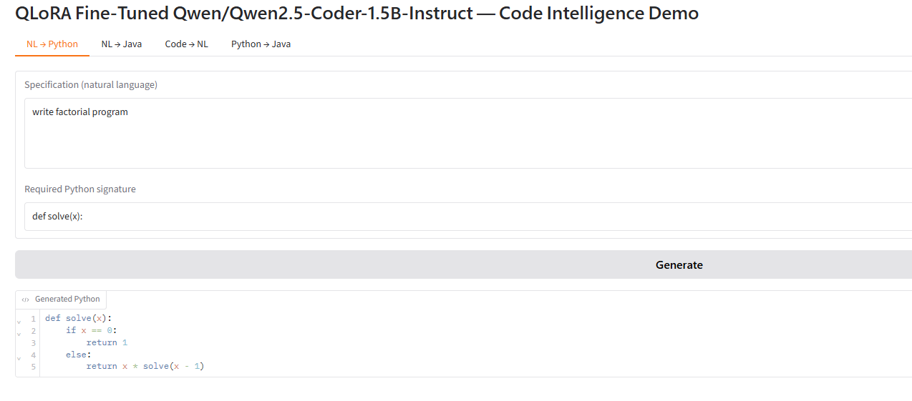
Demo:

Slide 19
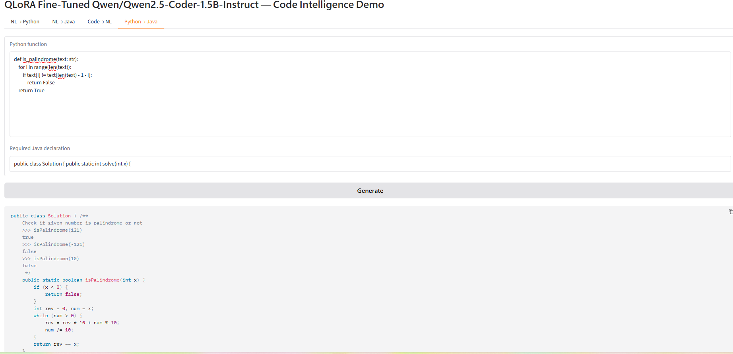

Slide 20
Thank You!

