Slide 1
Code Generation Capstone
Multi-task Code Synthesis & Agentic Pipeline
Executive Presentation

Slide 2
Problem Statement & High-Level Solution
Problem: Developers spend significant time translating code across languages, writing boilerplate, and adding documentation manually.
Solution: A multi-task code synthesis system built on a fine-tuned Qwen2.5-Coder-0.5B-Instruct model.
Approach: A LangGraph-based agentic pipeline that routes, generates, executes, judges, and fixes code autonomously.
Key Capabilities:
Natural Language to Python (NL2Py)
Java to Python Translation (Java2Py)
Code to Documentation & Commenting

Slide 3
What We Built
A unified multi-task model checkpoint handling 4 distinct code generation tasks.
An Agentic Pipeline: NL / Java / pseudocode → Java → Python → Sandbox Execute → LLM Judge → Fix Loop.
Interactive Interfaces: FastAPI backend and a Gradio web application deployed on Hugging Face Spaces.
[ Play Recorded Video Demo Here ]

Slide 4
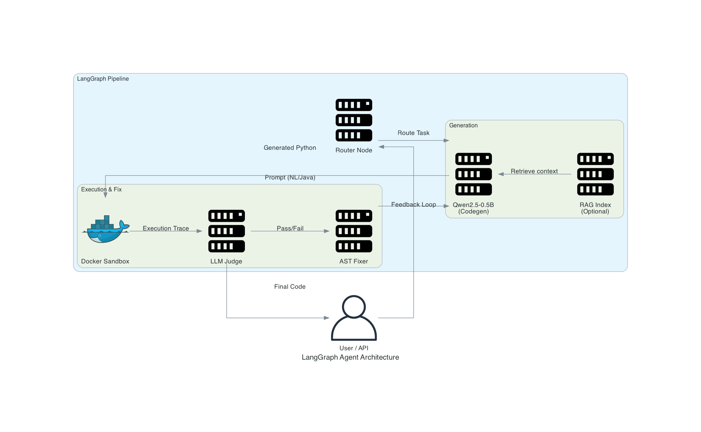
Architecture & Sequence
LangGraph Agent Flow: Route → Retrieve (RAG) → Generate → Execute → Judge → Fix.
Execution Sandbox: Dockerized environment for safe code execution and testing.
Two-Stage LoRA Fine-Tuning:
Stage 1: Specialize on Java to Python (AVATAR-TC).
Stage 2: Multi-task learning (NL2Py, Code2Doc, Comments).

Slide 5
Technical Specifications & Capabilities
Base Model: Qwen2.5-Coder-0.5B-Instruct (Parameter-efficient LoRA fine-tuning).
Datasets:
AVATAR-TC & CoDocBench (Java to Python)
MBPP (Natural Language to Python)
DocuMint (Code to Documentation)
Evaluation Metrics: BLEU, BERTScore, CodeBLEU, CodeBERTScore, and Sandbox Execution Accuracy.
Inference: RAG pipeline integration and MPS/CUDA hardware acceleration.

Slide 6
Learnings & Limitations
Model Size: As a 0.5B parameter model, quality varies by task complexity and input length.
Training Bias: Primarily trained on Python; Java translation quality relies heavily on training dataset coverage.
Agentic Overhead: The execution and fix loop significantly improves accuracy but increases latency.
Future Work: Scaling to larger models (e.g., 7B) and expanding the language support matrix.

Slide 7
Q & A
Thank You!
Questions?

