Slide 1
FINAL CAPSTONE • STAGES 1–5 EXECUTED & EVALUATED
RepoCoder Studio
Repository-Aware AI Analytics & Development Assistant
Six bilingual code tasks • One fine-tuned 0.5B model • Repository retrieval with provenance • Cloud Run deployment
IIIT Hyderabad AIML Certification Program • Group 46 Professor: Anil Nelakanti Mentors: Nayan | Pavan Team: Anupa Viswanath | Mohan Krishna M. | Praveen Kumar CH | Mohan Kumar

Slide 2
PROBLEM & OBJECTIVE
Real software work is repository-specific
General code models know languages — they cannot know your thresholds, conventions and shared rules
THE GAP
SIX SUPERVISED TRANSFORMATIONS — ONE MODEL
A developer's request depends on existing business thresholds, naming conventions and shared validation rules
T1
NL → Python
T2
NL → Java
A pretrained model cannot know this private, local information
T3
Python → Java
T4
Java → Python
Pasting the whole repository into every prompt is impractical — too many tokens, untraceable answers
T5
Python → NL
T6
Java → NL
TWO COMPLEMENTARY ANSWERS
Fine-tuning teaches the six task formats and bilingual transformation behaviour. Repository RAG supplies project-specific facts as evidence at inference time — with scores and provenance.
RESEARCH QUESTION
Can a small code model be adapted for bilingual software-engineering tasks — and can repository retrieval improve it when the correct answer depends on information that is in the repository but absent from the prompt?
RepoCoder Studio • Group 46
2

Slide 3
SYSTEM ARCHITECTURE
One layered pipeline — from raw data to a served, auditable assistant
Three claims kept separate throughout: fine-tuning quality, RAG quality, functional correctness
Raw sources
Normalize + align
Validate + approve
Six task contracts
LoRA fine-tune
Evaluate
→
→
→
→
→
XLCoST + CodeXGLUE / CodeSearchNet
Semantic + structural NL–Py–Java triples
AST • Tree-sitter • dedupe • provenance
Task token • output rules • header
Completion-only loss + EOS supervision
Same held-out rows, both models
Stage 4 — Repository Explorer
Stage 5 — Retrieval + RAG
Verification & serving
AST + Tree-sitter parsing → symbols, imports, calls → MiniLM embeddings → FAISS → dependency graph. Isolated indexes per repository.
Dense + lexical + cross-encoder reranking, dependency expansion, corpus RAG on train-split rows only, evidence-gated abstention.
Output validation, isolated Docker functional tests, Gradio demo, FastAPI browser app — one shared generation contract.
AUDITABILITY BY DESIGN
Every artifact carries manifests and hashes; checkpoints resume only when data, prompts, normalization and settings all match; raw generations are preserved separately from extracted, scored outputs.
RepoCoder Studio • Group 46
3

Slide 4
COMBINED STAGE — DATA & TRAINING
Trustworthy supervision, then efficient adaptation
Public datasets are candidates, not truth — 79 of 616 candidate rows were rejected before training
QUALITY FUNNEL
LORA TRAINING — CORRECTED FULL RUN
616
candidate rows after seeded sampling + semantic alignment
Base model Qwen2.5-Coder-0.5B-Instruct (frozen)
537
approved rows (79 rejected) — every row yields all six tasks
LoRA config rank 16 • alpha 32 • dropout 0.05
3,222
task examples • train 2,430→2,424 retained (99.75%) / val 366 / test 426
Trainable params 8.80M of 502.8M — 1.75% of the model
Schedule 1 epoch • lr 5e-5 • batch 1 × grad-accum 8
PROMPT CONTRACT v2.6 + EOS CORRECTION
Run 303 steps in ~21 min on a Colab T4 GPU
Explicit task token, role, output rules and response header in every prompt
Loss computed on completion tokens only — prompts are never learning targets
Loss 1.66 (step 10) → 1.08 (step 300)
Supervised EOS token fixed the earlier run's repeat-until-limit outputs
Adapter: RepoCoderStudio_FastCorrected_LoRA_v1_0 — a fresh run from the base model. A second, RAG-aware adapter (v1.2) follows in Stage 5.
RepoCoder Studio • Group 46
4

Slide 5
COMBINED STAGE RESULTS
Fine-tuning improved five of six tasks and preserved the sixth
Identical held-out rows, prompts and metrics for both models • official CodeBLEU 0.7.0 validated for Python and Java
40% → 85%
75% → 92.5%
0
Python → Java compile success — the largest gain (+45 pp)
average structural success across the four code tasks
empty predictions from either model in 240 generations
Task | Primary metric | Baseline | Fine-tuned | Delta | Interpretation
T1 NL → Python | Parse success | 90% | 100% | +10 pp | Full structural success
T2 NL → Java | Compile success | 70% | 85% | +15 pp | Clear improvement
T3 Python → Java | Compile success | 40% | 85% | +45 pp | Largest improvement
T4 Java → Python | Parse success | 100% | 100% | 0 pp | Preserved — no forgetting
T5 Python → NL | ROUGE-L | 0.217 | 0.320 | +0.103 | Better explanations
T6 Java → NL | ROUGE-L | 0.209 | 0.282 | +0.073 | Better explanations
20 held-out examples per task, seeded task-wise selection. Parse and compile are structural claims — functional correctness is reserved for trusted Docker tests, reported separately.
RepoCoder Studio • Group 46
5

Slide 6
STAGE 4 — REPOSITORY INTELLIGENCE
Codebases become searchable, dependency-aware evidence
Parse → symbols → embeddings → FAISS → dependency graph — with isolated indexes per repository
LedgerFlow — controlled BFSI fixture
AWS S3 examples — public repository
21 files • 74 functions • 9 classes • 912 lines
Bilingual banking repo with hidden policy rules and Python↔Java migration pairs
170 files • 794 functions • 144 classes • 27,726 lines
Sparse checkout with recorded commit provenance — real-world authenticity at scale
0.970
0.921
0.83 / 0.90
Recall@5 — 50 hand-labelled LedgerFlow queries
MRR@5 — the right symbol is usually ranked first
Top-3 accuracy on external RepoBench-R (Python / Java, 100 rows each)
HONEST EXTERNAL READING + FULL PROVENANCE
RepoBench top-1 sits near candidate chance (0.35 vs 0.32 random for Python; 0.30 vs 0.36 for Java) — the honest claim is strong top-3 candidate retrieval, not solved top-1 ranking. Every result records dense score, lexical score, final score, retrieval method, file path and provenance, so an accepted or rejected retrieval can always be explained.
RepoCoder Studio • Group 46
6

Slide 7
STAGE 5 — RETRIEVAL & RAG DESIGN
Retrieval must earn its place in the prompt
A real three-arm ablation on NL, Python and Java queries — plus safeguards that keep the comparison honest
RETRIEVAL ABLATION — LEDGERFLOW
SAFEGUARDS THAT KEEP RAG HONEST
Configuration | P@5 | R@5 | MRR@5
Dense only | 0.238 | 0.940 | 0.906
+ Lexical hybrid | 0.245 | 0.950 | 0.927
+ Cross-encoder rerank | 0.279 | 0.970 | 0.980
No answer leakage — validation and test rows are excluded from the RAG index
Abstention — weak or ambiguous evidence is rejected, with reason, top score and margin recorded; an empty context is never labelled successful RAG
Every reranked row records reranker_applied=True — reranking was exercised, not merely configured. Misconfigured hybrid weights fall back to dense-only instead of crashing.
Immutable RetrievalOutcome per request — no shared state that a concurrent request could overwrite
MODALITY-ALIGNED CORPUS RAG
Whole evidence blocks only — code is never cut mid-block by the character budget
Three separate corpus indexes over the same 405 train-split rows — natural-language keys for T1/T2, Python keys for T3/T5, Java keys for T4/T6 — so Java queries are never compared against an NL-only vector space.
Secrets redacted before embedding or persistence; mock embeddings fail closed for reported results
RepoCoder Studio • Group 46
7

Slide 8
STAGE 5 — HIDDEN-POLICY EXPERIMENT
The causal test: can retrieval supply what the prompt deliberately omits?
Implement the repository's transfer-risk policy — without being told its thresholds, weights, country list or score cap
Baseline • no RAG
Baseline • + RAG
RETRIEVAL EVIDENCE
Policy recovered: NO
Policy recovered: YES
Structurally valid, but invented plausible thresholds and countries
Recovered repository thresholds, restricted countries and device rule
Decision: evidence_accepted
Top source: transfer_risk_score — policies/transfer_policy.py
Top score: 0.9162 (reranker score 1.0)
Fine-tuned v1.2 • no RAG
Fine-tuned v1.2 • + RAG
Policy recovered: NO
Policy recovered: YES
Method: dense + lexical + cross_encoder
Followed the task shape cleanly, but not the repository policy
Recovered the core repository-specific rules — the intended division of labour
Provenance: repository
All four arms: structural PASS • same request • same immutable retrieval outcome for both RAG arms — isolating fine-tuning benefit from RAG benefit. ‘Fine-tuned’ = the RAG-aware v1.2 adapter (Stage 5’s retrain of v1.0).
Functional verification, reported honestly: Python and Java no-RAG/RAG candidates were generated and saved (generation = COMPLETE). Docker was unavailable in Colab, so functional checks record NOT_FEASIBLE — a standalone non-root, no-network Docker evaluator ships for EC2 execution. Structural PASS is never converted into a functional claim.
RepoCoder Studio • Group 46
8

Slide 9
DEPLOYMENT — GOOGLE CLOUD RUN
A serverless, health-checked service with $0 idle cost
The same adapter, indexes and generation contract as the notebook — packaged as a containerized microservice
1. Source staging
2. Cloud Build
3. Cloud Run deploy
4. Verification
Project root as build context — curated runtime artifacts only
gcloud builds submit → container image in the registry
us-central1 • 4 vCPU / 8 GiB • port 8000 • timeout 600 s
/api/health check → 100% traffic to new revision • old revision spins down
$0
0 → 10
160
< 2 s
idle cost — scales to zero when inactive
instances, demand-driven autoscaling
concurrent requests per instance
single-click revision rollback
CONTAINER
PRODUCTION OPERATIONS
python:3.11-slim + headless JDK for live Java compile checks; non-root user
Permanent HTTPS behind a global load balancer; OS isolation with automated patching
Base, embedding and reranker models pre-baked → fast cold starts, no HF rate limits
Health-monitored revisions — zero-downtime switch, instant rollback in the console
LoRA adapter (RAG-aware v1.2) injected via environment variable; honours Cloud Run's PORT contract
FastAPI serves generate, compare, execute, reindex, health and the browser UI
RepoCoder Studio • Group 46
9

Slide 10
CHALLENGES & LESSONS LEARNED
What Went Wrong — and What It Taught Me
● Data quality beat data quantity: 79 of 616 candidate rows were rejected rather than silently kept
● Fine-tuning and RAG solve different problems — and must share the same prompt contract
● Discovered late: the first adapter had never seen a “Retrieved Context” prompt shape and ignored it
● Fixed it, not deferred it: added grounded RAG-formatted training rows and trained a separate v1.2 adapter
● Compilation and parsing are not correctness — functional claims are reserved for Docker-verified tests
● Docker was unavailable in Colab, so generation and functional verification were deliberately decoupled
RepoCoder Studio · AI/ML Capstone
10
Notes:
I want to be candid about what actually went wrong, because the fixes are as much a part of this project as the final numbers. Early on I learned that data quality matters more than volume — 79 of 616 candidate rows failed validation and were rejected rather than quietly kept to inflate the corpus size. The most important discovery came during manual testing in Gradio: the first fine-tuned adapter had only ever seen a plain instruction-input-response prompt, so when Stage 5 added a 'Retrieved Context' section at inference time, it sometimes ignored it — while the untouched base model handled it better in that one case. That's a real design gap, and I treated it as one: I built a training-time RAG prompt builder, added grounded evidence to about a third of eligible training rows, and trained a separate, versioned adapter rather than patching the first one. I also learned to never equate compiling or parsing with correctness — that claim is reserved strictly for Docker-executed tests, and I kept generation and verification decoupled specifically because Docker wasn't available inside Colab.

Slide 11
SUMMARY & DISCUSSION
A completed, auditable Stage 5 capstone — and a foundation for Stage 6
WHAT WE LEARNED
HONEST LIMITATIONS
STAGE 6 DIRECTION
Data quality matters more than dataset size — a clean small run beats a noisy large one
0.5B model across six heterogeneous tasks — larger models may help
Planner → retriever → generator → validator → repair loop over the served API
Fine-tuning teaches task behaviour; RAG supplies repository facts — different problems
20 examples per task: strong evidence, wider uncertainty than a full study
React frontend on the stable FastAPI contract; live GCP smoke test
Termination (EOS) is part of model quality, not a detail
RepoBench top-1 near chance; the claim is top-3 candidate retrieval
Auth, monitoring, persistent artifact storage
Compilation is not correctness — functional claims need trusted tests
Docker verification is host-dependent — NOT_FEASIBLE in Colab, EC2 evaluator provided
Repeat the larger capstone profile when GPU resources permit
Delivered: executed notebook • validated corpus • trained adapter • evaluation logs • two repository indexes • Docker functional harness • Gradio + FastAPI interfaces • Cloud Run deployment
Next: a live product demo
RepoCoder Studio • Group 46 • IIIT Hyderabad AIML Certification Program

Slide 12
Demo
RepoCoder Studio • Group 46 • IIIT Hyderabad AIML Certification Program

Slide 13
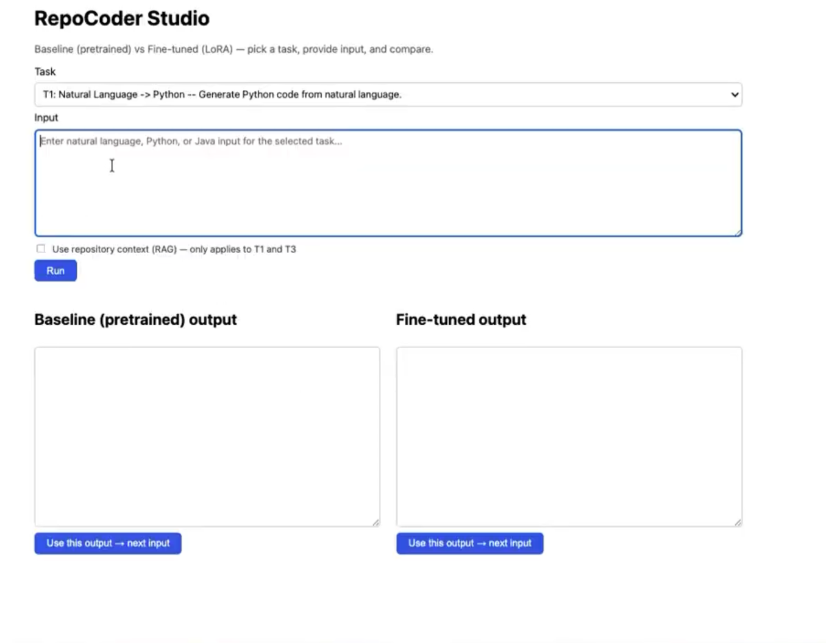
INTERACTIVE DEMO
RepoCoder Studio Portal
localhost:3000/repocoder-studio
https://repocoder-studio-ufasjxwf2q-uc.a.run.app/
RepoCoder Studio • Group 46 • IIIT Hyderabad AIML Certification Program

Slide 14
Thank you — Questions & Discussion
RepoCoder Studio • Group 46 • IIIT Hyderabad AIML Certification Program

