Slide 1
IIIT HYDERABAD CAPSTONE PROJECT — GROUP 30
CodeGen
Cross-Language Code Generation with Fine-Tuned LLMs Natural Language → Python or C++, Python → C++, with Voice-Enabled Interaction
TEAM MEMBERS
PROJECT GUIDANCE
▪ Taran Tripathi
▪ Prakhar Nigam
▪ Kilim Lohitha
▪ Tushnik Chakrabarty
▪ Prof. Anil Neelkanti
▪ Pawan Baswani, Nayan Anand Jha
PG Certification Program in Artificial Intelligence and Machine Learning — Cohort 26

Slide 2
MOTIVATION & SCOPE
Project Overview
02
Problem Statement
LLMs increasingly understand and synthesize code, not just natural language. This project applies and fine-tunes an LLM to translate between natural language and two programming languages (Python, C++) and Python to C++ translation— demonstrating a path to extend code-generation support to languages an LLM was not originally trained on.
BASE WORK
STRETCH GOAL WORK
▪ Baseline accuracy for NL → Python/C++ and Python → C++ generation using Qwen2.5-Coder-7B-Instruct
▪ LoRA fine-tuning in two phases: NL → PL1 (Python/C++) and PL1 → PL2 (Python -> C++)
▪ PL1-> PL2. PL1-> Documentation-> PL2 Code -> Translate to PL1 -> Compare with ground truth PL1
▪ Best documentation selected from 3 generation iterations, scored per record
▪ Evaluation via AST similarity + GraphCodeBERTScore + LLM-as-judge
▪ ASR (Whisper) — speak a natural-language prompt → transcribed → code generated (NL → PL)
▪ Text interface for PL → PL — paste Python, convert directly to C++
▪ Auto task-detection — LLM classifier routes input to the correct LoRA adapter
▪ Delivered as a live, voice-enabled Gradio web application
IIIT Hyderabad Capstone Project — Group 30 : CodeGen

Slide 3
SYSTEM DESIGN
Architecture
03
End-to-End Pipeline
the-stack-dedup Dataset (Python + C++)
Documentation Generator (Qwen2.5-Coder)
Code Generator + LoRA Adapters
AST + GraphCodeBERT Scoring
Best-of-3 Selection → Store
Three-Phase Workflow
Baseline Phase (base model accuracy)
LoRA Fine-Tuning Phase (NL→PL1, PL1→PL2)
Validation Phase (held-out evaluation)
Design Pattern: Singleton Model Management
▪ SingletonMetaEvery heavyweight component —
▪ QwenModelBase, CodeDocumentationGenerator, QwenCodeGenerator, LLMJudge, AST, GraphCodeBERTScorer, FilteredDataset, BaselineData — is implemented as a singleton
▪ Prevents redundant model reloads across pipeline stages — critical for GPU memory efficiency
▪ BaselineData orchestrates the full workflow: loads/unloads models, runs baseline + validation, computes summary statistics
IIIT Hyderabad Capstone Project — Group 30 : CodeGen

Slide 4
DATA PIPELINE
Dataset & Training
04
Data Source
Dataset Split (equal thirds)
▪ (HuggingFace) — deduplicated Python & C++ source filesbigcode/the-stack-dedup
▪ hexsha (id), content (code), lang, max_stars_countFields used:
▪ Streamed, filtered to Python/C++, then enriched (language tag, documentation cache, score placeholders)
Phase | Split | Purpose
Baseline | 1/3 | Base-model accuracy computation
LoRA Training | 1/3 | Fine-tuning the adapters
Validation | 1/3 | Held-out evaluation of fine-tuned model
Why Caching Matters
▪ Streaming from HuggingFace on every pass is slow — caching gives instant reloads
▪ Baseline computation needs multiple passes over the same records
▪ Guarantees consistent records across runs and experiments
Run to Date
▪ Baseline records processed: 167
▪ Language split: 84 Python / 83 C++
▪ GPU memory limits (see Issues & Learnings) constrained full-dataset runs on available T4/L4 hardware
IIIT Hyderabad Capstone Project — Group 30 : CodeGen

Slide 5
MODELS & FINE-TUNING
Model Details
05
Component | Model | Purpose
Base LLM | Qwen/Qwen2.5-Coder-7B-Instruct | Documentation generation, code generation, LLM-judge
Fine-tuning | LoRA (r=16, α=32) + 4-bit NF4 quantization | Two adapters: NL→Python/C++, Python→C++
Semantic similarity | microsoft/graphcodebert-base (via sentence-transformers) | Embedding cosine similarity between code pairs
Structural similarity | tree-sitter (Python & C++ grammars) | AST generation + node-level similarity comparison
Speech-to-text (stretch) | openai/whisper-base | Voice-prompt transcription
Key Notes
▪ PeftModelTwo adapters share one 4-bit quantized base model via PEFT's multi-adapter
▪ — hot-swapped at inference time
▪ Qwen model scores generated C++ code 0–1 LLM-as-judge:
▪ against documentation + reference before it is accepted for back-translation (quality threshold = 0.3)
▪ Tokenizer is shared from the base model — not bundled inside each LoRA adapter
IIIT Hyderabad Capstone Project — Group 30 : CodeGen

Slide 6
DEMO APPLICATION
User Interface
06
Interaction Flow
Text Input or Voice Recording
Whisper ASR (if voice)
Auto-Detect Task (LLM classifier)
Load LoRA Adapter (NL→PY / PY→CPP)
Generate + Syntax- Highlighted Output
Modes Supported
Delivery
▪ NL → Python — generate code from a plain-English description
▪ Python → C++ — paste Python, get an equivalent C++ implementation
▪ Auto — system classifies intent and routes automatically
▪ Voice input — microphone recording transcribed before routing
▪ GradioBuilt with
▪ — shareable public web URL
▪ Runs on Google Colab with T4 / L4 GPU acceleration
▪ Adapters + base model downloaded and 4-bit quantized at startup
▪ Generated code shown with syntax highlighting and a task-status message
IIIT Hyderabad Capstone Project — Group 30 : CodeGen

Slide 7
MEASURING QUALITY
Scoring & Evaluation
07
AST Similarity
tree-sitter parses generated & ground-truth code; node-level tree similarity used (exact-match ASTs are too formatting-sensitive — e.g. spacing in a function signature changes the raw tree)
GraphCodeBERTScore
Cosine similarity between GraphCodeBERT embeddings of the two code snippets — captures semantic equivalence even when structure differs
Average Score
Mean of AST Similarity and GraphCodeBERTScore — the primary per-record quality metric
LLM-as-Judge
Qwen2.5-Coder scores generated C++ (0–1) against documentation + reference before it is accepted for Python back-translation; quality threshold = 0.3
Best-of-3 & Aggregation
▪ 3 timesEach generation step (documentation, code, PL1→PL2) is repeated
▪ ; the highest-scoring attempt is retained per record
▪ compute_summary() aggregates results by language (Python / C++) and by phase (NL→PL, NL→PL1→PL2)
IIIT Hyderabad Capstone Project — Group 30 : CodeGen

Slide 8
BASELINE FINDINGS
Results Summary
08
167
0.7250
0.9127
0.5374
Records Processed
NL → PL Avg Score
GraphCodeBERT Score
AST Similarity
Baseline Summary (n=167)
Reading the Numbers
Metric | Score
Python records (n=84) | 0.7357
C++ records (n=83) | 0.7142
NL → PL AST Score | 0.5374
NL → PL GraphCodeBERTScore | 0.9127
NL → PL1 → PL2 round-trip (n=83) | 0.6857
▪ meaning-equivalent High GraphCodeBERTScore (0.91) vs. lower AST score (0.54) → generated code is often structurally divergent from ground truth (different idioms / formatting)
▪ Python (0.7357) and C++ (0.7142) NL→PL scores are close — base model generalizes reasonably across both languages
▪ Round-trip NL→PL1→PL2 (0.6857) is lower than single-hop NL→PL, as expected — errors compound across two generation steps
IIIT Hyderabad Capstone Project — Group 30 : CodeGen

Slide 9
RETROSPECTIVE
Issues and Learnings from the Capstone
09
Issue Faced | Learning
No dataset had matching Python & C++ code for the same intent | Generate PL2 from the PL1 documentation; treat the original PL1 as ground truth for the reverse check
Python code used packages with no C++ equivalent | Reversed the pipeline — generate documentation from C++, produce Python from it, then convert back to C++
codegen-350M-multi is a completion model — kept repeating documentation instead of generating code | Wrong model choice for NL→PL; switched to Qwen/Qwen2.5-Coder-7B-Instruct
codegen-350M-multi threw index-out-of-bounds errors; CUDA:1 tensors held garbage values — hooks, rope_scaling and token-limit fixes all failed | Pinned to a single GPU (CUDA_VISIBLE_DEVICES) with CUDA_LAUNCH_BLOCKING / TORCH_USE_CUDA_DSA for debugging
7B model's VRAM footprint too large for the available GPUs | 4-bit quantization (BitsAndBytes) cut usage from ~14 GB to ~4 GB
Fine-tuning still hit a hard OOM ceiling — only ~33 records could be processed | Cache-clearing + garbage collection helped marginally; no complete fix found
One Qwen model overloaded with three roles — documentation generation, code generation, and LLM-judge | Accepted as a memory-driven design constraint; no alternative model was available
Judging code correctness without compiling or executing it | Used Qwen as an LLM-judge scoring compiles / logic_correct / edge_cases / verdict, plus a 0–1 score
IIIT Hyderabad Capstone Project — Group 30 : CodeGen

Slide 10
WHAT'S NEXT
Future Work
10
▪ Curate a parallel Python–C++ dataset with shared intent/documentation for more reliable PL1→PL2 evaluation
▪ Add execution-based validation — auto-generate test cases and run code in a sandbox to confirm functional equivalence, not just similarity scores
▪ Scale baseline & validation runs to the full dataset once GPU memory/fragmentation issues are resolved
▪ Tune the relative weighting of AST, GraphCodeBERTScore, and execution accuracy in the final accuracy metric
▪ Text-to-speech readout of generated documentation — extends the voice stretch goal end-to-end
▪ Extend beyond Python/C++ to lower-resource, legacy languages (e.g. Ada95) — real-world need given shrinking specialist workforces
IIIT Hyderabad Capstone Project — Group 30 : CodeGen

Slide 11
ABLATION STUDY
Execution Results
11
Accuracy by model / fine-tuning duration, across the Baseline and Validation splits
Model / Metric | Baseline | Validation
codegen-350m | NA | NA
Qwen-7B — 3 Epochs
NL -> PL | 0.3621 | 0.34935
AST Score | 0.26605 | 0.22825
GCB Score | 0.45815 | 0.4703
NL -> Py | 0.36795 | 0.36345
NL -> C++ | 0.35615 | 0.335
C++ -> Python | 0.3403 | 0.335
Qwen-7B — 30 Epochs
NL -> PL | 0.7242 | 0.6987
AST Score | 0.5321 | 0.4565
GCB Score | 0.9163 | 0.9406
NL -> Py | 0.7359 | 0.7269
NL -> C++ | 0.7123 | 0.67
C++ -> Python | 0.6806 | 0.67
Qwen-0.5B | NA | NA
codegen-350m and Qwen-0.5B were not evaluated for this comparison (NA) — see Issues & Learnings for why codegen-350m was dropped.
IIIT Hyderabad Capstone Project — Group 30 : CodeGen

Slide 12
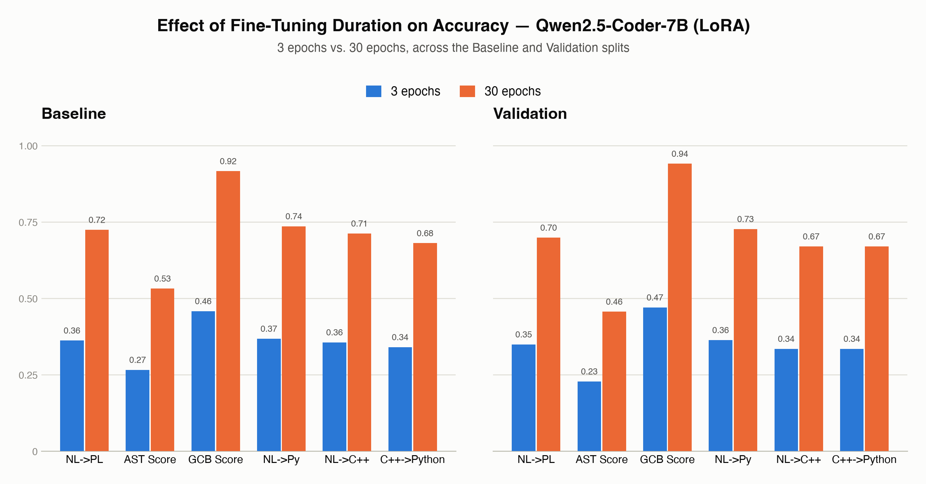
ABLATION STUDY
Execution Results — Visualized
12
More training epochs move every metric up, consistently, on both splits
Qwen2.5-Coder-7B + LoRA. Bars grouped by fine-tuning duration (3 vs. 30 epochs); left panel = Baseline split, right panel = Validation split.
IIIT Hyderabad Capstone Project — Group 30 : CodeGen

Slide 13
Thank You
Questions & Discussion
▪ Taran Tripathi, Prakhar Nigam, Kihim Lohitha, Tushnik Chakrabarty
CodeGen — IIIT Hyderabad Capstone Project, Group 30

