Slide 1
IIIT HYDERABAD CAPSTONE PROJECT —CodeGen Group-8
CodeGen
Cross-Language Code Generation with Fine-Tuned LLMs Natural Language → Python or C++ and C++ -> Python with Voice-Enabled Interaction
TEAM MEMBERS
PROJECT GUIDANCE
▪ Taran Tripathi
▪ Prakhar Nigam
▪ Kilim Lohitha
▪ Tushnik Chakrabarty
▪ Prof. Anil Neelkanti
▪ Pawan Baswani, Nayan Anand Jha
PG Certification Program in Artificial Intelligence and Machine Learning — Cohort 26

Slide 2
MOTIVATION & SCOPE
Project Overview
02
Problem Statement
LLMs increasingly understand and synthesize code, not just natural language. This project applies and fine-tunes an LLM to translate between natural language and two programming languages (Python, C++) and C++ to Python translation— demonstrating a path to extend code-generation support to languages or tasks an LLM was not originally trained on.
BASE WORK
STRETCH GOAL WORK
▪ Baseline accuracy for NL → Python/C++ and C++ → Python translation using Qwen2.5-Coder-7B-Instruct
▪ LoRA fine-tuning in two phases: NL → PL1 (Python/C++) and PL1 → PL2 (C++ -> Python)
▪ PL1-> PL2. PL1-> Documentation-> PL2 Code -> Translate to PL1 -> Compare with ground truth PL1
▪ PL1-> Documentation- Best documentation selected from 3 generation iterations, scored per record
▪ Documentation-> PL2 Code: LLM-as-judge
▪ Evaluation via AST similarity + GraphCodeBERTScore
▪ ASR (Whisper) — speak a natural-language prompt → transcribed → code generated (NL → PL)
▪ Text interface for PL → PL — paste C++, convert directly to Python
▪ Auto task-detection — LLM classifier routes input to the correct LoRA adapter
▪ Delivered as a live, voice-enabled Gradio web application
IIIT Hyderabad Capstone Project — Group 30 : CodeGen

Slide 3
SYSTEM DESIGN
Architecture
03
End-to-End Pipeline
the-stack-dedup Dataset (Python + C++)
Documentation Generator (Qwen2.5-Coder)
Code Generator + LoRA Adapters
AST + GraphCodeBERT Scoring
Best-of-3 Selection → Store
LLM Judge
(doc->python)
Three-Phase Workflow
Baseline Phase (base model accuracy)
LoRA Fine-Tuning Phase (NL→PL1, PL1→PL2)
Validation Phase (held-out evaluation)
Design Pattern: Singleton Model Management
▪ SingletonMeta Every heavyweight component:
▪ QwenModelBase, CodeDocumentationGenerator, QwenCodeGenerator, LLMJudge, AST, GraphCodeBERTScorer, FilteredDataset, BaselineData — is implemented as a singleton
▪ Prevents redundant model reloads across pipeline stages — critical for GPU memory efficiency
▪ BaselineData orchestrates the full workflow: loads/unloads models, runs baseline + validation, computes summary statistics
▪ LLM Judge: Generates Score 0.0 -1.0 and metrics compiles (Y/N), correct logic (Y/N), handling edge cases (Y/N), List of issues and explanation
IIIT Hyderabad Capstone Project — Group 30 : CodeGen

Slide 4
DATA PIPELINE
Dataset & Training
04
Data Source
Dataset Split Allocate more records for trainings
▪ (HuggingFace) — deduplicated Python & C++ source files bigcode/the-stack-dedup
▪ Fileds Used: hexsha (id), content (code), lang, max_stars_count
▪ Streamed, filtered by Python/C++, then enriched (language tag, documentation cache, score placeholders)
Phase | Split | Purpose
Baseline | 1/4 | Base-model accuracy computation
LoRA Training | 1/2 | Fine-tuning the adapters
Validation | 1/4 | Held-out evaluation of fine-tuned model
Why Caching Matters
▪ Streaming from HuggingFace on every pass is slow — caching gives instant reloads
▪ Baseline computation needs multiple passes over the same records
▪ Guarantees consistent records across runs and experiments
Run to Date
▪ Baseline records processed: 250
▪ Language split: 125 Python / 125 C++
▪ GPU memory limits (see Issues & Learnings) constrained full-dataset runs on available T4/L4 hardware
IIIT Hyderabad Capstone Project — Group 30 : CodeGen

Slide 5
MODELS & FINE-TUNING
Model Details
05
Component | Model | Purpose
Base LLM | Qwen/Qwen2.5-Coder-7B-Instruct | Documentation generation, code generation, LLM-judge
Fine-tuning | LoRA (r=16, α=32, dropout=0.1) | Two adapters: NL→Python/C++, C++ -> Python
Semantic similarity | microsoft/graphcodebert-base (via sentence-transformers) | Embedding cosine similarity between code pairs
Structural similarity | tree-sitter (Python & C++ grammars) | AST generation + node-level similarity comparison
Speech-to-text (stretch) | openai/whisper-base | Voice-prompt transcription
Training Arguments | Value
Device batch size | 1
Gradient accumulation steps | 8
Num train epochs | 3/30
Learning rate | 2e⁻⁴
Logging steps | 10
Save strategy | Epoch (save every epoch)
Save total limit | 1 (save the best)
Fp16 | True (save memory)
Key Notes
▪ PeftModel Two adapters share one 4-bit quantized base model via PEFT's multi-adapter
▪ Qwen model scores documentation for generated C++ code 0–1 LLM-as-judge against documentation + reference before it is accepted for back-translation (quality threshold = 0.3)
▪ Tokenizer is shared from the base model — not bundled inside each LoRA adapter
IIIT Hyderabad Capstone Project — Group 30 : CodeGen

Slide 6
DEMO APPLICATION
User Interface
06
Interaction Flow
Text Input or Voice Recording
Whisper ASR (if voice)
Auto-Detect Task (LLM classifier)
Load LoRA Adapter (NL→PY / PY→CPP)
Generate + Syntax- Highlighted Output
Modes Supported
Delivery
▪ NL → Python — generate code from a plain-English description
▪ C++ -> Python— paste C++ and get an equivalent Python implementation
▪ Auto — system classifies intent and routes automatically
▪ Voice input — microphone recording transcribed before routing
▪ Gradio Built with shareable public web URL
▪ Runs on Google Colab with T4 / L4 GPU acceleration
▪ Adapters + base model downloaded and 4-bit quantized at startup
▪ Generated code shown with syntax highlighting and a task-status message
IIIT Hyderabad Capstone Project — Group 30 : CodeGen

Slide 7
MEASURING QUALITY
Scoring & Evaluation
07
AST Similarity
tree-sitter parses generated & ground-truth code; node-level tree similarity used (exact-match ASTs are too formatting-sensitive — e.g. spacing in a function signature changes the raw tree)
GraphCodeBERTScore
Cosine similarity between GraphCodeBERT embeddings of the two code snippets — captures semantic equivalence even when structure differs
Average Score
Mean of AST Similarity and GraphCodeBERTScore — the primary per-record quality metric
LLM-as-Judge
Qwen2.5-Coder scores generated Python (0–1) against documentation + reference before it is accepted for Python back-translation
Best-of-3 & Aggregation
▪ 3 times Each generation step (documentation, code, PL1→PL2) is repeated; the highest-scoring attempt is retained per record
▪ compute_summary() aggregates results by language (Python / C++) and by phase (NL→PL1/PL2 and PL2->NL→PL1→PL2)
IIIT Hyderabad Capstone Project — Group 30 : CodeGen

Slide 8
RETROSPECTIVE
Issues and Learnings from the Capstone
08
Issue Faced | Learning
No dataset had matching Python & C++ code for the same intent | Generate PL2 from the PL1 documentation; treat the original PL1 as ground truth for the reverse check
Python code used packages with no C++ equivalent | Reversed the pipeline — generate documentation from C++, produce Python from it, then convert back to C++
codegen-350M-multi is a completion model — kept repeating documentation instead of generating code | Wrong model choice for NL→PL; switched to Qwen/Qwen2.5-Coder-7B-Instruct. Qwen/Qwen2.5-Coder-0.5B-Instruct had similar prompt reptition problem
Moved to Qwen/Qwen2.5-Coder-0.5B-Instruct | Qwen/Qwen2.5-Coder-0.5B-Instruct had similar prompt reptition problem
codegen-350M-multi threw index-out-of-bounds errors; CUDA:1 tensors held garbage values — hooks, rope_scaling and token-limit fixes all failed | Pinned to a single GPU (CUDA_VISIBLE_DEVICES) with CUDA_LAUNCH_BLOCKING / TORCH_USE_CUDA_DSA for debugging
7B model's VRAM footprint too large for the available GPUs | 4-bit quantization (BitsAndBytes) cut usage from ~14 GB to ~4 GB
One Qwen model overloaded with three roles — documentation generation, code generation, and LLM-judge | Accepted as a memory-driven design constraint; no alternative model was available
Judging code correctness without compiling or executing it | Used Qwen as an LLM-judge scoring compiles / logic_correct / edge_cases / verdict, plus a 0–1 score
IIIT Hyderabad Capstone Project — Group 30 : CodeGen

Slide 9
ABLATION STUDY
Execution Results
10
Accuracy by model / fine-tuning duration, across the Baseline and Validation splits
Model / Metric | Baseline | Validation
codegen-350m* | NA | NA
Qwen-0.5B* | NA | NA
Qwen-7B — 3 Epochs
NL -> PL | 0.7223 | 0.6997
AST Score | 0.5308 | 0.4901
GCB Score | 0.9138 | 0.9092
NL -> Py | 0.7339 | 0.7449
NL -> C++ | 0.7104 | 0.6545
C++ -> Python | 0.6868 | 0.618
Qwen-7B — 30 Epochs
NL -> PL | 0.7242 | 0.6987
AST Score | 0.5321 | 0.4565
GCB Score | 0.9163 | 0.9406
NL -> Py | 0.7359 | 0.7269
NL -> C++ | 0.7123 | 0.67
C++ -> Python | 0.6806 | 0.67
*codegen-350m and Qwen-0.5B were not evaluated for this comparison (NA) — see Issues & Learnings for why codegen-350m was dropped.
IIIT Hyderabad Capstone Project — Group 30 : CodeGen

Slide 10
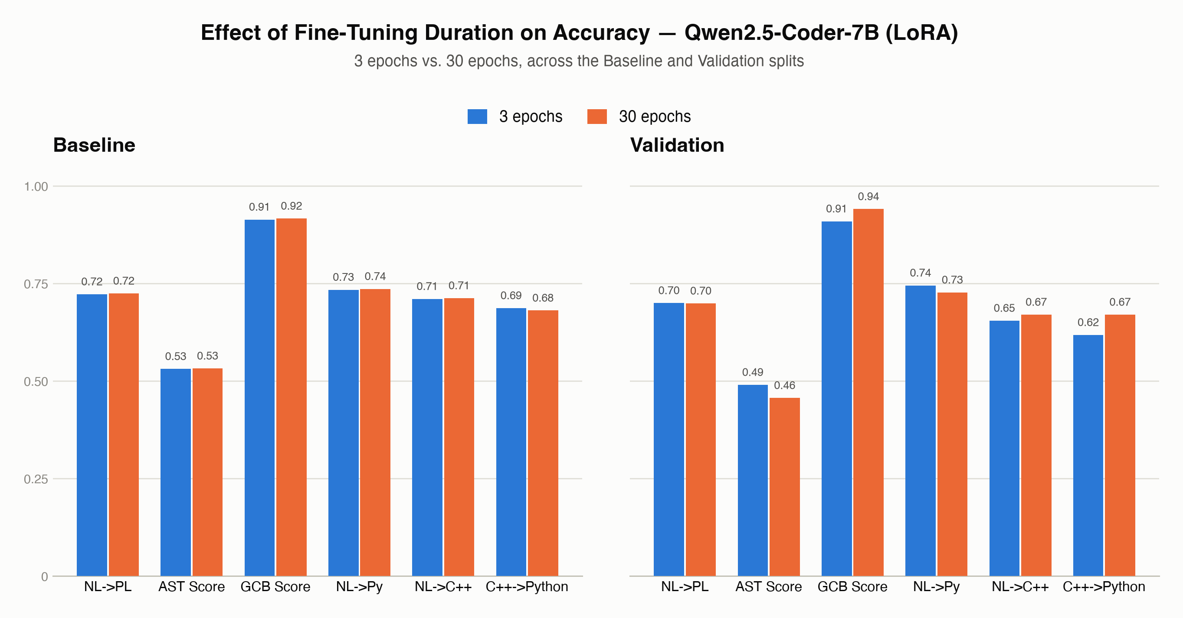
ABLATION STUDY
Execution Results — Visualized
11
More training epochs move every metric up, consistently, on both splits
Qwen2.5-Coder-7B + LoRA. Bars grouped by fine-tuning duration (3 vs. 30 epochs); left panel = Baseline split, right panel = Validation split.
IIIT Hyderabad Capstone Project — Group 30 : CodeGen

Slide 11
Thank You
Questions & Discussion
▪ Taran Tripathi, Prakhar Nigam, Kihim Lohitha, Tushnik Chakrabarty
CodeGen — IIIT Hyderabad Capstone Project, Group 30

