Slide 1




CodeGen
Bridging Language and Data
By Group 6(Capstone Group 18) Batch 25
Utkarsh Sinha
Ramesh Nerella
Kalyani Ankasala
Koushik

Slide 2
What is CodeGen?
Automated Code Generation
Expanding Language Support
Enhanced Software Development
CodeGen harnesses the power of advanced language models to automatically generate, understand, and transform source code. This project explores how these models can be fine-tuned to support new programming paradigms.
Our focus is on adapting these sophisticated models to work effectively with new programming languages and specialized software tasks, significantly broadening their applicability and utility across diverse development environments.
By automating routine coding tasks and facilitating understanding of complex codebases, CodeGen aims to streamline the development process, reduce errors, and accelerate innovation in software engineering.

Slide 3

Paper Selected
Title :
In-depth Analysis of Graph-based RAG in a Unified Framework
The Problem
1
SQL and NoSQL databases are powerful but pose significant querying challenges for non-technical users. Also Existing Text-to-SQL models lack the capability to effectively translate natural language into NoSQL queries.
Proposed Solution
2
Introduction of a novel Text-to-SQL and Text-to-NoSQL Translation framework that seamlessly converts user-friendly natural language inputs into precise NoSQL database queries.

Slide 4





Key Contributions of the Research
Bird bench Dataset
SMART Framework
The first comprehensive benchmark dataset specifically designed for Text-to-NoSQL translation tasks, crucial for training and evaluating models.
A pioneering framework leveraging Small Language Models (SLMs) combined with Retrieval-Augmented Generation (RAG) to enhance translation accuracy and context.
Results & Impact
New Evaluation Metrics
Significant improvements over traditional models in NoSQL query accuracy, paving the way for interactive querying and automated code generation in NoSQL systems.
Development of novel metrics to precisely assess query correctness and execution accuracy for the unique challenges of NoSQL queries.

Slide 5

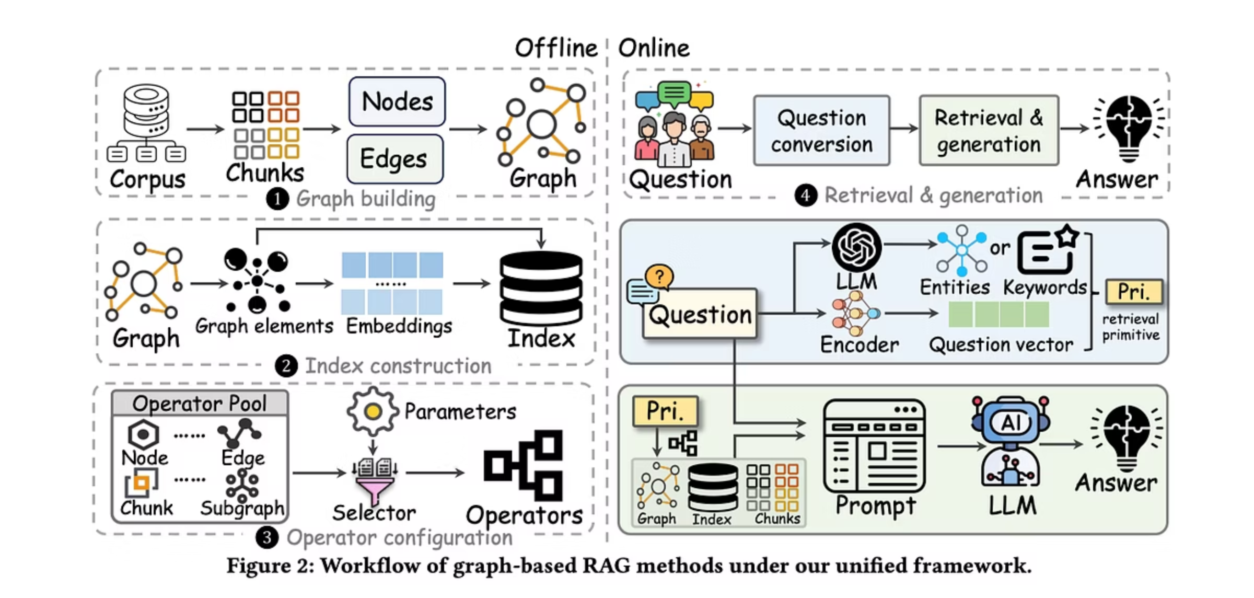
Our Methodology:
Graph RAG Approach
Our project adopts a sophisticated Graph RAG (Retrieval-Augmented Generation) approach to enhance the accuracy and relevance of generated code and queries. This methodology combines the strengths of graph-based data retrieval with advanced language model generation capabilities.
By integrating contextual information from a graph database, our models can access and synthesize highly relevant data, leading to more precise and domain-specific outputs. This is particularly crucial when dealing with complex database schemas and diverse programming language nuances.

Slide 6
Phase 1: Text-to-SQL Translation
The initial phase of our project focused on refining Text-to-SQL translation, a critical step towards handling more complex NoSQL queries.
Dataset: Spider
Model: Phi-3
We utilized the extensive Spider dataset, known for its diversity and complexity, to train and validate our Text-to-SQL models. This dataset provides a robust foundation for evaluating natural language to SQL translation accuracy.
Our base model for this phase was Phi-3, a powerful language model with a considerable parameter count, selected for its strong performance in code generation tasks. The exact number of parameters was optimized during fine-tuning.
Fine-Tuning: Q-LORA
Metrics: Exact Match & Valid SQL
We employed the Q-LORA technique for efficient fine-tuning. This method allows for adapting large models to specific tasks with significantly reduced computational resources, while maintaining high performance.
Performance was rigorously evaluated using two key metrics: Exact Match (EM) to ensure the generated SQL query is identical to the ground truth, and Valid SQL Rate to confirm syntactical correctness and executability.

Slide 7
Phase 2: SQL-to-NoSQL Translation
Building upon the Text-to-SQL foundation, this phase addresses the unique challenges of converting structured SQL queries into NoSQL equivalents.
Dataset: Curated Bird Bench
Model: Qwen2.5-Coder:3B
To tackle the specific requirements of NoSQL, we curated a specialized dataset, "Bird Bench," designed to represent a wide array of NoSQL schemas and query patterns, ensuring comprehensive model training.
For this translation, we selected Qwen2.5-Coder:3B, a 3-billion parameter model, chosen for its proficiency in code translation and generation tasks, making it ideal for the complexities of NoSQL structures.
Metrics: Exact Match & Valid No-SQL
Evaluation maintained strict criteria, using Exact Match and Semantic Validation on Valid SQL Rate to verify the accuracy and functionality of the generated NoSQL queries, ensuring they are both syntactically correct and semantically equivalent.

Slide 8
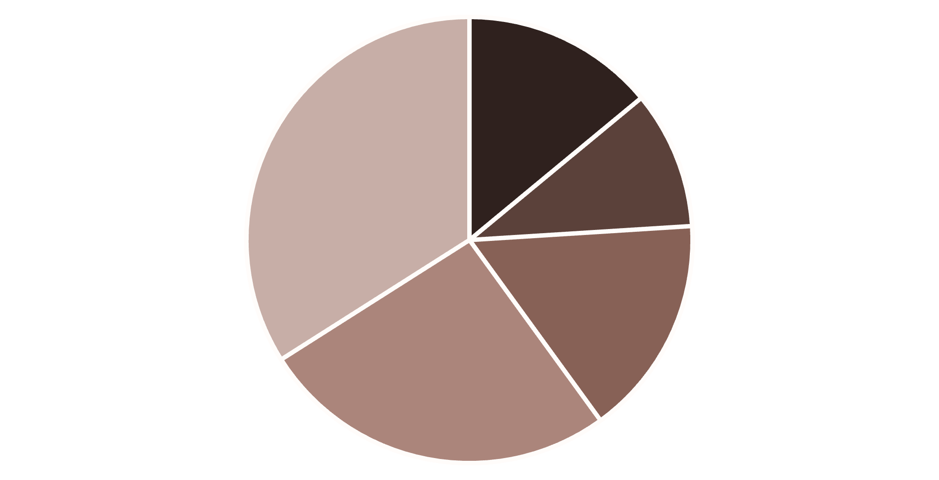
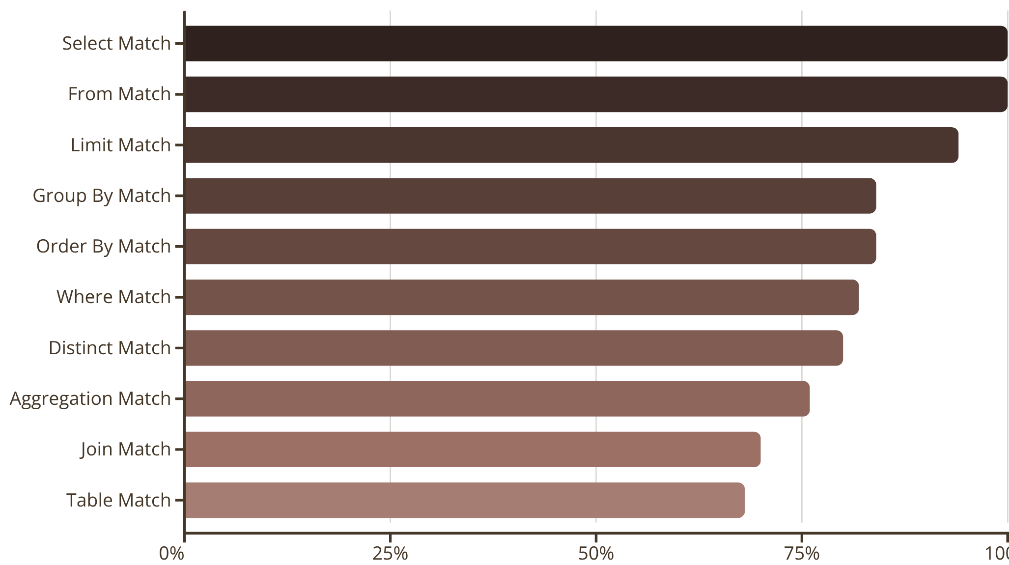
Text-to-SQL: Evaluation Results
KEY METRICS
50
62.33%
83.80%
24.0%
Total Queries
Average Similarity Score
Average Component Accuracy
Acceptable Accuracy (Exact + Semantic)
ACCURACY DISTRIBUTION
EXACT_MATCH (14.0%)
SEMANTICALLY_EQUIVALENT (10...
MINOR_DIFFERENCES (16.0%)
MAJOR_DIFFERENCES (26.0%)
INCORRECT (34.0%)
This pie chart illustrates the distribution of accuracy levels across 50 Text-to-SQL queries, highlighting areas for improvement.
COMPONENT ACCURACY BREAKDOWN
This bar chart details the accuracy percentages for the top 10 SQL components, indicating strong performance in basic constructs like Select and From, but room for improvement in more complex elements like Joins and Table recognition.

Slide 9
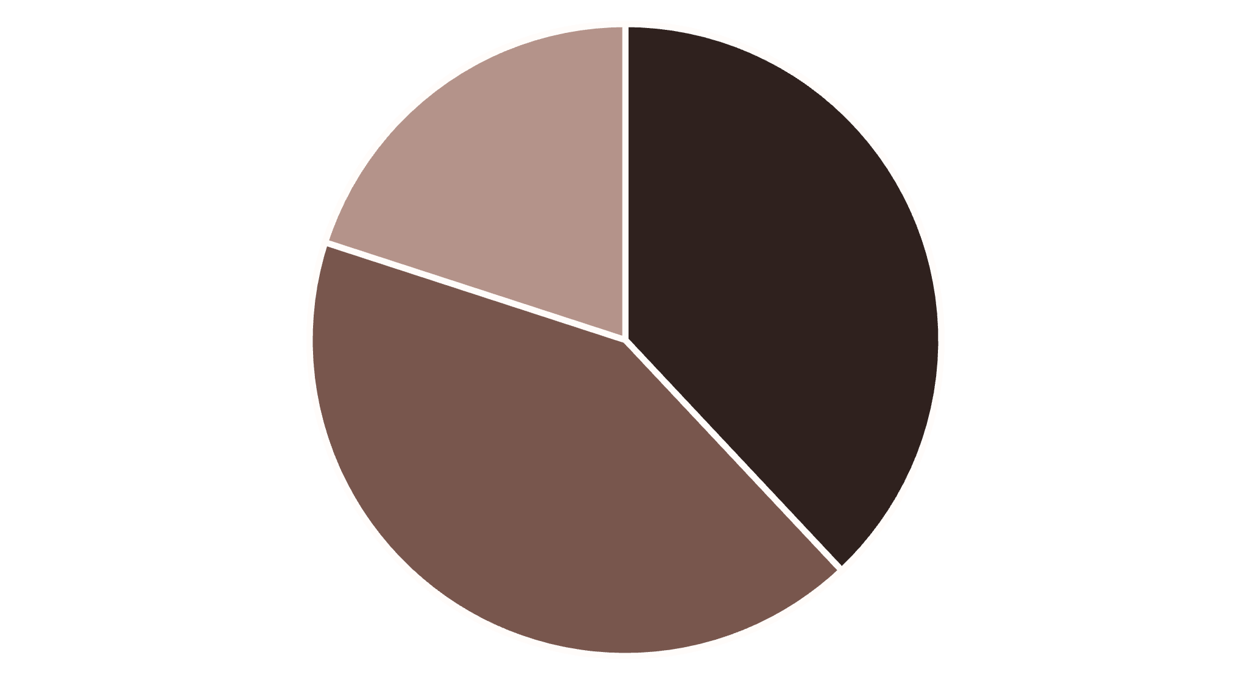
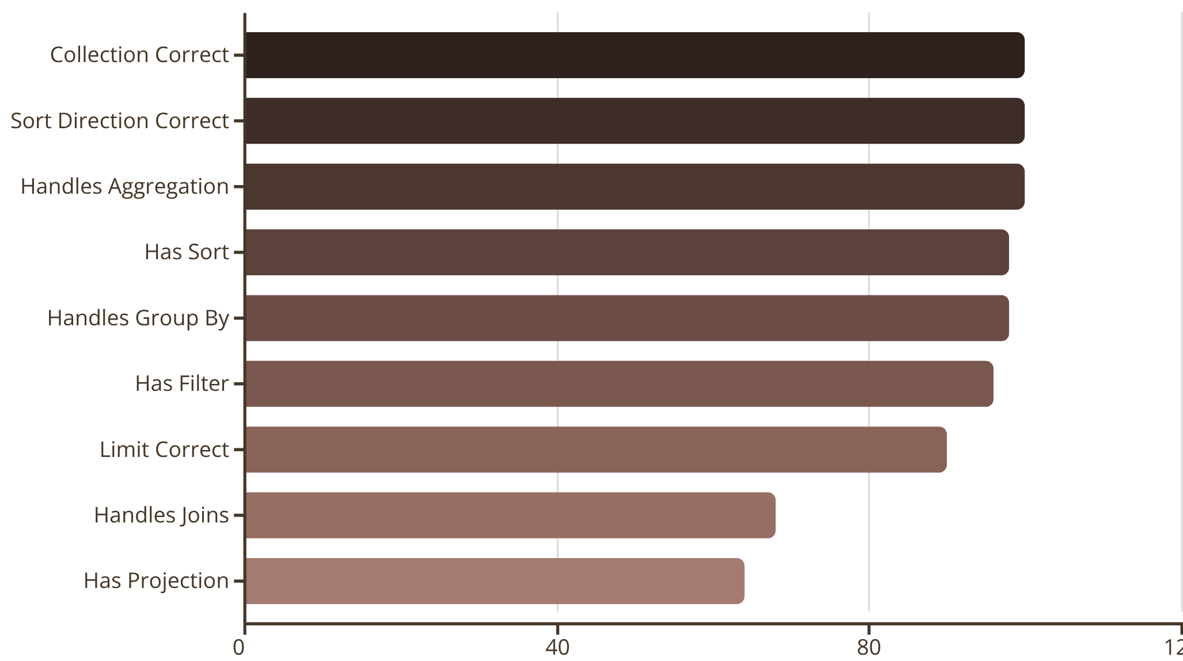
NoSQL: Evaluation Results
KEY METRICS
50
90.44%
38.0%
80.0%
Total Queries
Average Validation Score
Correct Rate
Acceptable Rate
VALIDATION LEVEL DISTRIBUTION
CORRECT (38.0%)
MOSTLY_CORRECT (42.0%)
MINOR_ISSUES (20.0%)
This chart illustrates the distribution of NoSQL queries across different validation levels, from fully correct to those with minor issues.
COMPONENT ACCURACY BREAKDOWN
Collection, Sort Direction, and Aggregation handling achieved perfect 100% accuracy, while Joins and Projection are areas for improvement.

Slide 10

Evaluation Methodology
Accuracy Levels
Our evaluation categorizes queries into five distinct accuracy levels based on their similarity to the gold standard.
EXACT_MATCH
Generated query exactly matches gold SQL and noSQL.
SEMANTICALLY_EQUIVALENT
Similarity ≥ 95%.
MINOR_DIFFERENCES
Similarity 80-95%.
MAJOR_DIFFERENCES
Similarity 50-80%.
INCORRECT
Similarity < 50%.
Similarity Score Mechanism
The evaluation approach utilizes string similarity to quantify the correctness of generated SQL and no SQL queries. This provides a granular score for precise assessment.
String similarity using difflib.SequenceMatcher.
Compares normalized SQL and noSQL queries (e.g., standardized casing, whitespace).
Produces a score ranging from 0.0 (no similarity) to 1.0 (perfect match).
Component-wise Accuracy
We perform a detailed component-wise evaluation across 13 distinct elements of an SQL query to pinpoint specific areas of strength and weakness.
SELECT clauses
DISTINCT keywords
FROM clauses
Aggregations: COUNT
WHERE conditions
Aggregations: SUM
JOIN operations
Aggregations: AVG
GROUP BY clauses
Aggregations: MAX
ORDER BY clauses
Aggregations: MIN
LIMIT clauses
Table names
Column names
Key Metrics Reported
Strict Accuracy
Acceptable Accuracy
Percentage of Exact Match only.
Percentage of Exact Match + Semantically Equivalent queries.
Average Similarity Score
Component Accuracy
Mean string similarity score across all queries.
Average accuracy across all 13 SQL components.

Slide 11

Conclusion
Key Achievements
Successfully fine-tuned SLMs for complex database query translation.
Demonstrated the effectiveness of Q-LORA in adapting models to specific tasks.
Achieved competitive accuracy in both Text-to-SQL and SQL-to-NoSQL transformations.
Laid groundwork for more accessible database interactions for non-technical users.

Slide 12
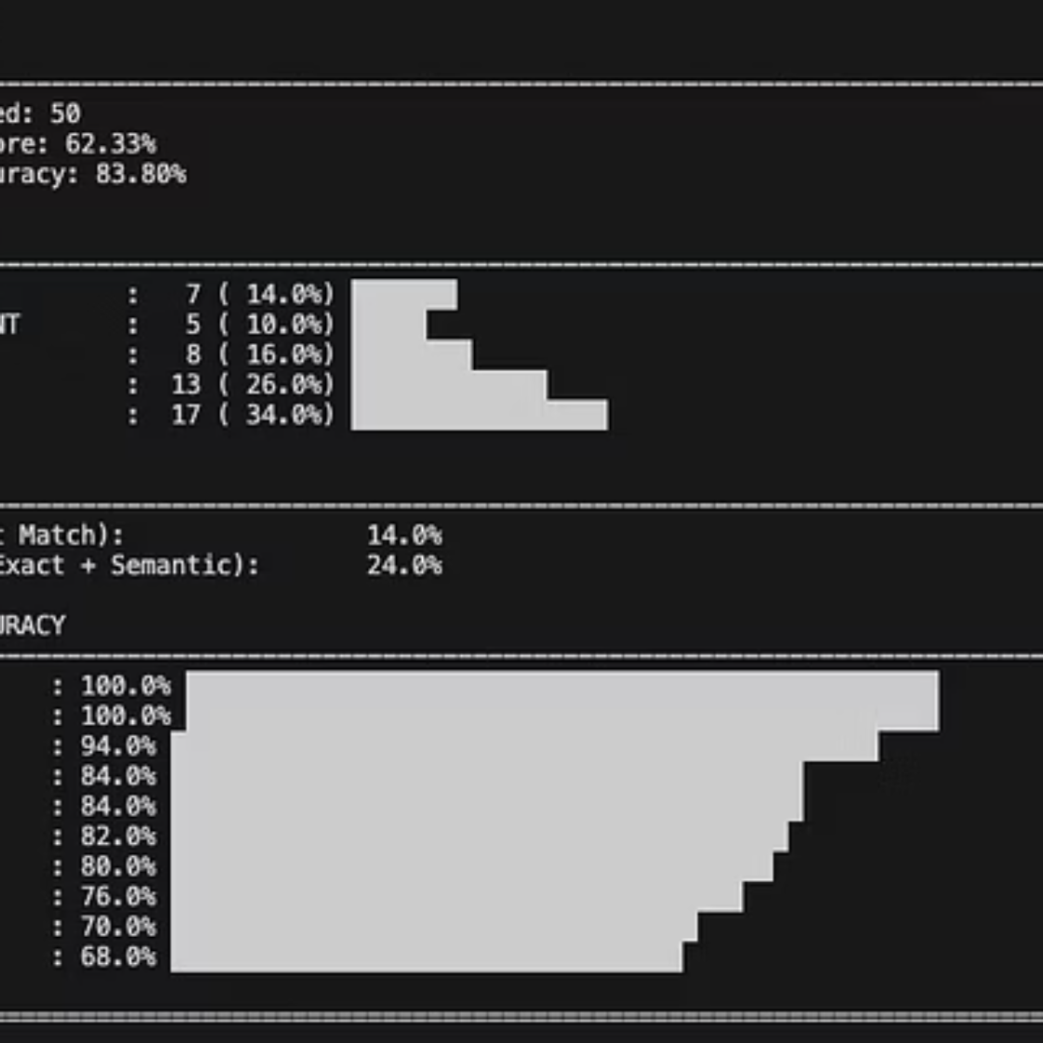
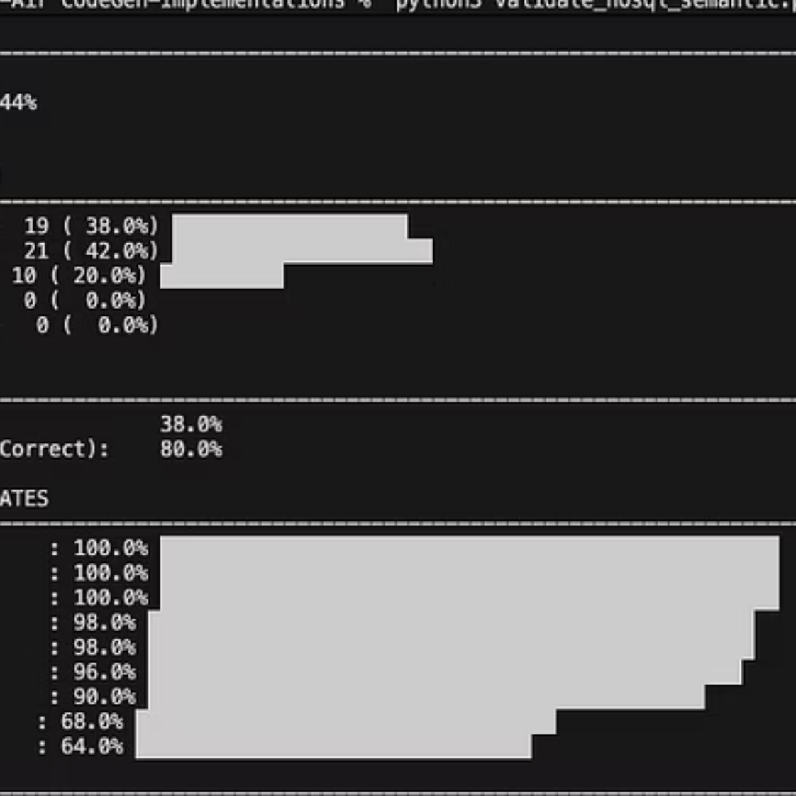
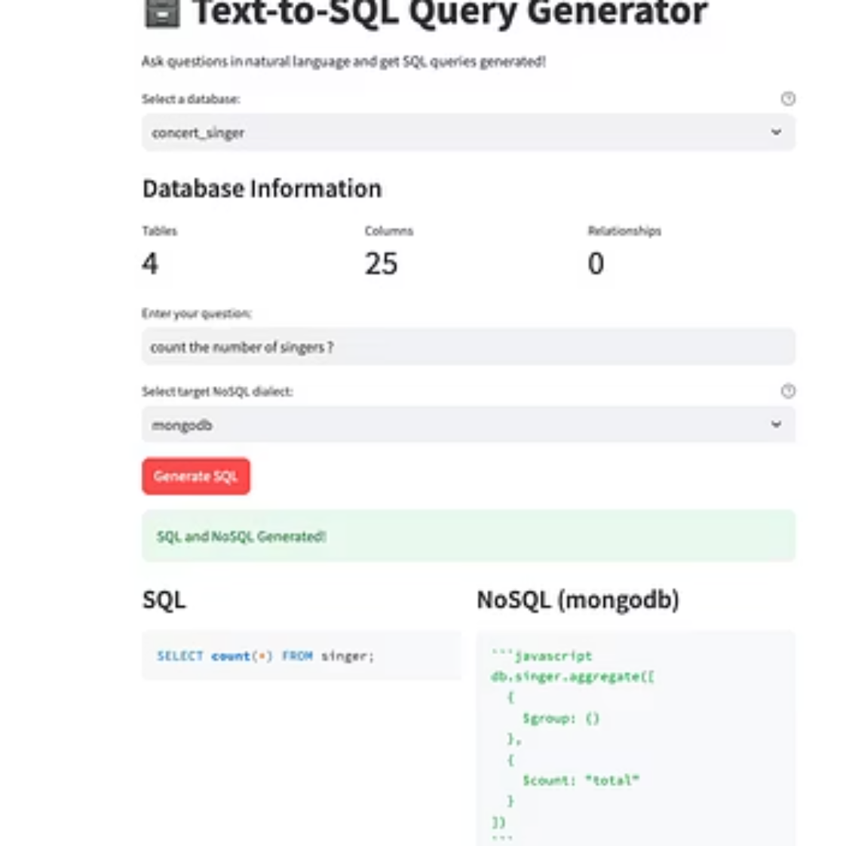
Code Snippets and Demonstration
Here are some examples of our generated code and a glimpse into our project's user interface.
These snippets highlight the ability of our models to produce syntactically correct and semantically accurate queries, alongside the interactive capabilities being developed for practical application.
Sources:https://github.com/nayanjha16/CodeGen-Implementations/tree/group18

Slide 13

Thank you

