Slide 1
AIML Batch 25 Project CodeGen (text2SQL - sql2NoSql)
Group 12 (CodeGen3)
Anant Joshi
Srivalli Janapati
Sai Madishetty
Saurabh Sinha
https://github.com/nayanjha16/CodeGen-Implementations.git (Branch Group12)
Hugging Face Space : https://huggingface.co/spaces/Saurabh2107/nl-to-sql-to-nosql-bridge

Slide 2

Agenda
Problem Statement
Project Methodology
Approaches :
Traditional Methods
LLM Based Methods
Problem 1 : Text2SQL
Problem 2 : SQL2NoSQL
Future Work
Appendix
Additional Concepts
Dataset(Spider vs WikiSQL)
Graph(RAT) vs AST
Evaluation metrics

Slide 3

Problem Statement
Saurabh
01
02
Text->SQL
Design an intelligent system that converts natural-language questions into accurate SQL queries, enabling users to retrieve information from relational databases without writing SQL
SQL->NoSQL
Develop a system that translates SQL queries and relational data structures into equivalent NoSQL operations to support scalable, schema-flexible databases
A
Features
Understand natural language questions
Understand the database schema (tables, columns, PK/FK)
Reason over relationships
Generate syntactically correct and executable SQL queries
B
Features
Convert SQL queries into equivalent NoSQL (MongoDB) queries
Map relational schemas to NoSQL document structures
Handle JOINs, nested queries, aggregations, and filters
Enable migration from RDBMS → NoSQL

Slide 4
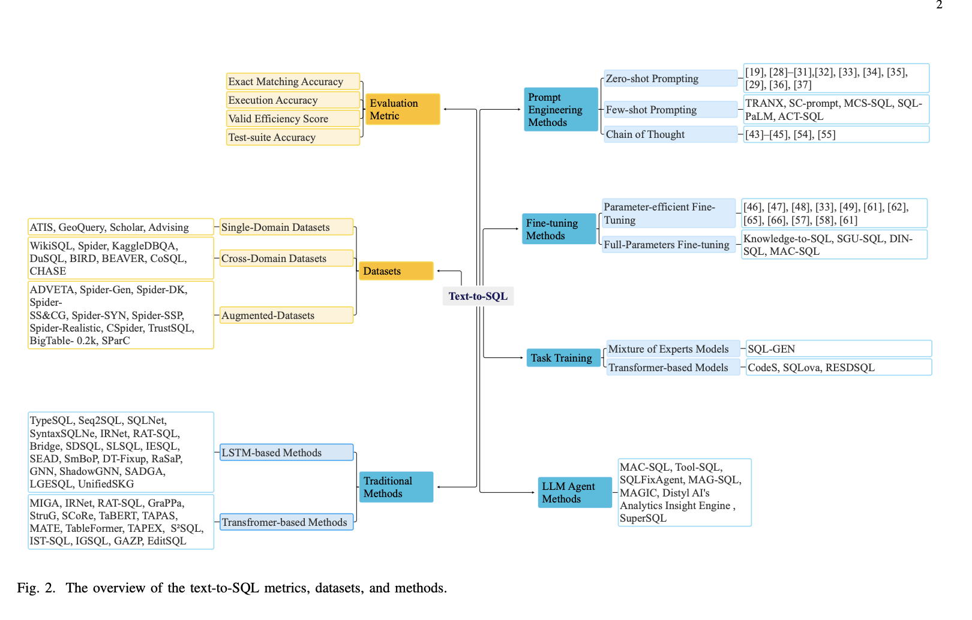
Project Methodology
Saurabh
Project Methodology: Dual Approach
LLM-Based Approach: Utilizing Large Language Models for advanced semantic understanding.
Traditional Methods: Establishing benchmarks via architectural baselines.
LSTM-Based: Sequence modelling via Long Short-Term Memory.
Transformer-Based: Implementation of standard attention mechanisms.
Link to paper : https://arxiv.org/pdf/2410.06011

Slide 5
Traditional Methods

Slide 6




Our Approach – Text->SQL
Saurabh
Problem Understanding
Enable users to query databases using natural language instead of SQL.
Requires understanding:
User intent
Database schema (tables, columns, PK/FK relations)
Query structure (joins, filters, grouping, nesting)
Must generalize across unseen schemas, not just memorize queries.
Model Build
SQLNet (LSTM baseline) — implemented from scratch
T5-Base Fine-Tuned — trained from scratch on Spider
GaussAlgo T5-Large — HuggingFace SOTA benchmark
⭐ RAT-SQL-Lite-T5 (Custom Model) — schema graph + PK/FK + T5 decoder
Dataset Curation
Used Spider (10,181 NL ↔ SQL pairs across 200 databases).
Per example, extracted:
Natural language question
Ground truth SQL query
Database schema (tables, columns, constraints)
SQLite database for actual execution
Built custom loaders to:
Parse schema JSON
Map PK/FK relationships
Prepare inputs for each model (flat text vs. graph-based)
Handle batching, tokenization, and truncation
Evaluation & Benchmarking
Computed:
Exact Match (EM) → strict match with gold SQL
Execution Accuracy (EX) → output equivalence using SQLite
Test-Suite Accuracy (TSA) → functional SQL correctness
Valid Efficiency Score (VES) → correctness + compactness
Benchmarked all 4 models under identical conditions.
RAT-SQL-T5 achieved the best EM and Execution Accuracy, proving that schema graphs significantly improve performance.

Slide 7
Our Approach – SQL->NoSQL
Saurabh
Problem Understanding
Enable users to query databases using natural language instead of SQL.
Requires understanding:
User intent
Database schema (tables, columns, PK/FK relations)
Query structure (joins, filters, grouping, nesting)
Must generalize across unseen schemas, not just memorize queries.
Spider dataset chosen because it reflects real enterprise SQL complexity.
Model Build
Model 1 — Rule-Based SQL → MongoDB Converter (Baseline)
T5-Small Finetuned for SQL → MongoDB
Dataset Curation
Dataset v1 – Minimal Base Dataset (500 samples)
Dataset v2 – Expanded SQL2Mongo (7,000 samples)
Source: Fully synthetic dataset generated by our custom Python generator
Dataset v3 – Large High-Quality Dataset (9,386 samples)
Source: Our new synthetic generator designed to produce more realistic, diverse queries.
Future Dataset v4 (Planned) – SOTA-Quality Dataset (~15k samples)
Evaluation & Benchmarking
Automatic Evaluation:
BLEU Score
Exact Match Accuracy
Stage-Level Accuracy
Structural Evaluation (Important for MongoDB)
Semantic Equivalence (Execution-Based)
Human Evaluation

Slide 8
LLM Based Methods

Slide 9
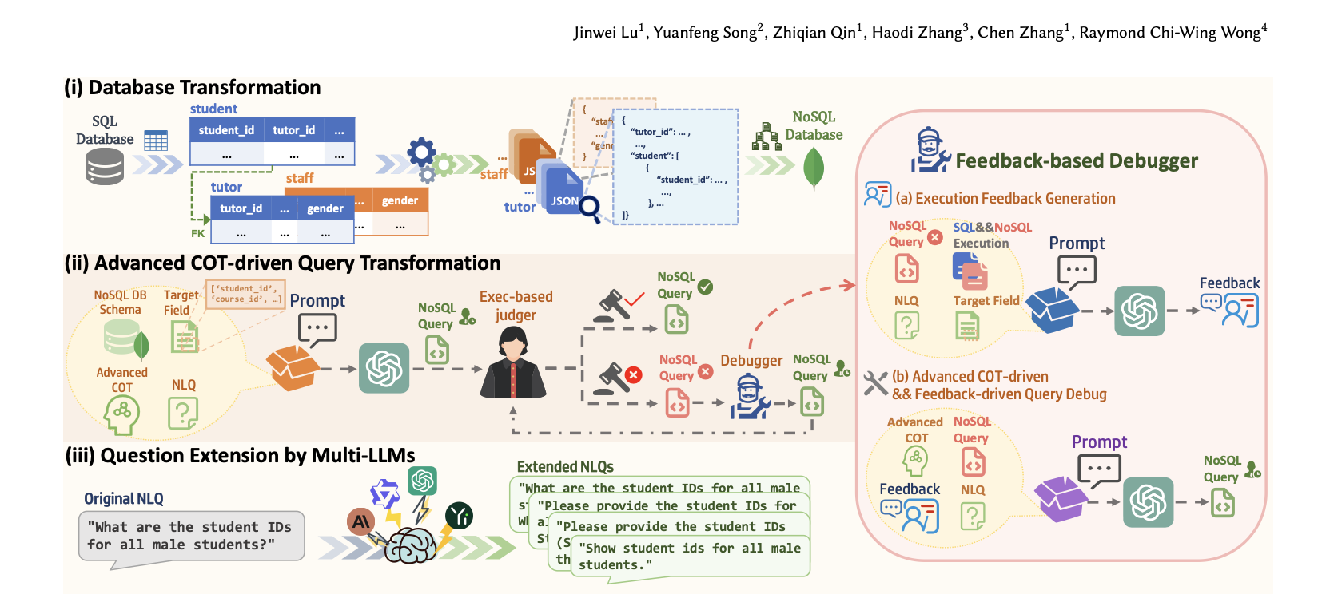
Motivation
Saurabh
System uses schema-aware RAG to guide an LLM in generating MongoDB queries and validates correctness through execution-guided feedback.
Link to paper : https://arxiv.org/pdf/2502.11201

Slide 10
Our Approach – SQL->NoSQL
Saurabh
Model 1 : LLM Baseline( No RAG)
Model 2 : LLM + RAG (Schema Awareness)
Description
Prompt-based LLM
Input: SQL query only
Output: MongoDB aggregation pipeline
No schema, no joins, no execution context
Characteristics
No awareness of:
Database schema
Primary / foreign keys
Join paths
Relies entirely on model prior knowledge
Baseline Model + RAG as LLM fails without database context
RAG Adds
Retrieve database-specific information from SQL
Inject schema and join knowledge into prompts and Loads Database schema (PK- FK relationships)
Guide LLM reasoning without fine-tuning
Model 3 : LLM + RAG (Schema + Join Template Injection)
Motivation
MongoDB requires explicit $lookup
LLMs frequently reference joined tables without defining them
FK information must be operationalized
RAG v3 Enhancement
Automatically build $lookup + $unwind templates
Inject JOIN pipeline stages directly into prompt
LLM completes remaining aggregation logic

Slide 11
Text2SQL

Slide 12
Model 1: SQLNet (LSTM Baseline)
Sai
User Questions
Schema as Flattened text
Tokenization (T5 tokenizer
SentencePiece)
& Embedding
Encoder (Bi-LSTM)
Decoder(LSTM)
Output as SQL Query
Motivation
Text→SQL is basically translation from English → SQL. So an LSTM with encoder–decoder architecture was a natural starting point.
To understand core seq2seq mechanics
Historically used in early Text→SQL research
Process
The Training dataset pairs English -> SQL
Decoder Vocabulary contains SQL tokens
Teacher forcing trains SQL grammar step-by-step
Cross Entropy loss punishes SQL tokens
Pattern repeats so model learns SQL Structure
Decoder hidden state encodes SQL grammar convention
How it worked
Model-1 is a classic sequence-to-sequence model (encoder–decoder) built with LSTMs, using T5 tokenizer.
Input text is tokenized → embedded → encoded by LSTM → decoded into SQL tokens step-by-step
Model-1 uses an embedding layer, LSTM encoder, LSTM decoder, and a SoftMax head
Why It failed
Cannot handle Spider’s complexity
No schema understanding
Bottleneck compression
No pretraining
No global attention
weak long-range reasoning

Slide 13
Model 2: T5 Base (Fine Tuned on Spider)
Sai
User Questions
Questions + Schema Text
Tokenization (T5 tokenizer
SentencePiece)
T5 Encoder
Self Attention Layer
Question – Schema Mapping
T5 Decoder
Autoregressive SQL generation
Output as SQL Query
Motivation
Fully Transformer-based, Uses self-attention + cross-attention. Pretrained on massive datasets (C4 corpus)
Encoder: 12 Transformer layers , Decoder: 12 Transformer layers , Hidden size: 768 , Attention heads: 12
Standard T5-base architecture
Pretrained on Colossal Clean Crawled Corpus (C4) so we are not starting at any random weights
Process
The Training dataset pairs English -> SQL (we train entire layer of T5-base AdamW optimizer was used )
Decoder Vocabulary contains SQL tokens
Teacher forcing trains SQL grammar step-by-step
Cross Entropy loss punishes SQL tokens
Pattern repeats so model learns SQL Structure
Decoder hidden state encodes SQL grammar convention
How it worked
Encoder
Reads Entire input
Builds a contextual representation for every token
All token attend to each other
Decoder
Generates SQL token. Uses Cross attention to look at all encoder states
Why It failed
T5 does NOT understand database schema
T5 does NOT build schema graph embeddings

Slide 14
Model 3: RAT-SQL Lite (Relation Aware Node Based Model)
Sai
User Questions
Node Construction
Relation Transformer
Encoder
Decoder
LSTM
Output as SQL Query
Question Tokens
Table Nodes
Column Nodes
Relation matrix (PK ->FK, table -> Column)
Multi Head Attention + Relation bias
Motivation
Relation-Aware Transformer for Text-to-SQL
Teach the model to understand database schema structure and relationships between tables and columns — something normal Transformers and LSTMs cannot do.
Build a schema graph
Nodes = tables + columns
Edges = PK-FK relationships, same-table, foreign-key, column-type
Encode relationships using Relation-Aware Attention (RAT)
Combine schema graph + question → joint representation
Use a decoder (in our case T5) to generate SQL
How it worked
Tokenizer : T5 Sentencepiece
Pretrained T5 embeddings
T5-base pretrained embeddings (768-dim)
Input to encoder includes:
Natural language question
Schema linearization
Graph edges encoded as special relation tokens
Column/table type tags

Slide 15
Model 3: RAT-SQL Lite (Relation Aware Node Based Model)
Sai
User Questions
Node Construction
Relation Transformer
Encoder
Decoder
Output as SQL Query
Question Tokens
Table Nodes
Column Nodes
Relation matrix (PK ->FK, table -> Column)
Multi Head Attention + Relation bias
Process Flow
Schema Graph extraction : Parse database schema:
Build table nodes
Build column nodes
Build PK–FK edges
Capture data types
Graph-to-Text Encoding
Input concatenation
T5 Encoder reads all token
T5 Decoder generates SQL
Why it failed
Lite RAT = Still not full graph neural network
We built a simplified graph encoder and not a full graph neural network(too heavy to replicate)
We use T5-base is still too small

Slide 16
Model 3: RAT-SQL Lite (Relation Aware Node Based Model)
Sai
User Questions
Node Construction
Relation Transformer
Encoder
Decoder
LSTM
Output as SQL Query
Question Tokens
Table Nodes
Column Nodes
Relation matrix (PK ->FK, table -> Column)
Multi Head Attention + Relation bias
SOTA PUBLIC RAT Models
Official RAT-SQL (from Yale NLP)
→ Checkpoint is available only by email request
→NOT on HuggingFace
→Cannot be downloaded programmatically
GRAPPA (RAT-SQL + BERT)
→Also requires manual request
→NOT public
Babelscape text-to-sql-spider
→Also private
→We cannot clone without authentication
Notes:
Send an email “ mention for Academic purpose “ . Check for Papers and compare the scores against the best model we have(RAT_SQL_LITE)

Slide 17
Sai
Model 4: GaussAlgo (T5 Large - Hugging Face SOTA Model)
User Questions
T5 Larger
Tokenizer
Pre-Trained T5 large Encoder
Pre-Trained T5 large Decoder
Output as SQL Query
Very deep Transformer Layer
Multi beam SQL generator
Motivation
GaussAlgo T5-Large is a pretrained T5-Large model fine-tuned on Text-to-SQL tasks by the GaussAlgo team and released on HuggingFace
It is one of the strongest ready-to-use SOTA Text2SQL models, because:
It is based on T5-Large (770M parameters)
Fine-tuned on multiple Text-to-SQL datasets
Trained with SQL-specific decoding constraints
Exposes an inference-only pipeline for Text→SQL translation
GaussAlgo uses the standard T5-Large architecture:
Encoder
24 Transformer layers , Hidden size: 1024 , Attention heads: 16
Decoder
24 Transformer layers , Auto-regressive SQL generator, Cross-attention with encoder states
Embeddings
T5-Large embeddings (1024-dimensional) , Pretrained on massive text corpus, Further refined during SQL fine-tuning
Tokenizer
SentencePiece tokenizer (same family as your other T5 models), Handles SQL keywords well
Process
Load model from HuggingFace (gausalgo/t5-large-text2sql)
Provide Natural Language Input
Tokenization
Inference
Why It failed
GaussAlgo is trained on general Text→SQL datasets, unseen schema generalization , PK–FK reasoning and complex join mappings

Slide 18
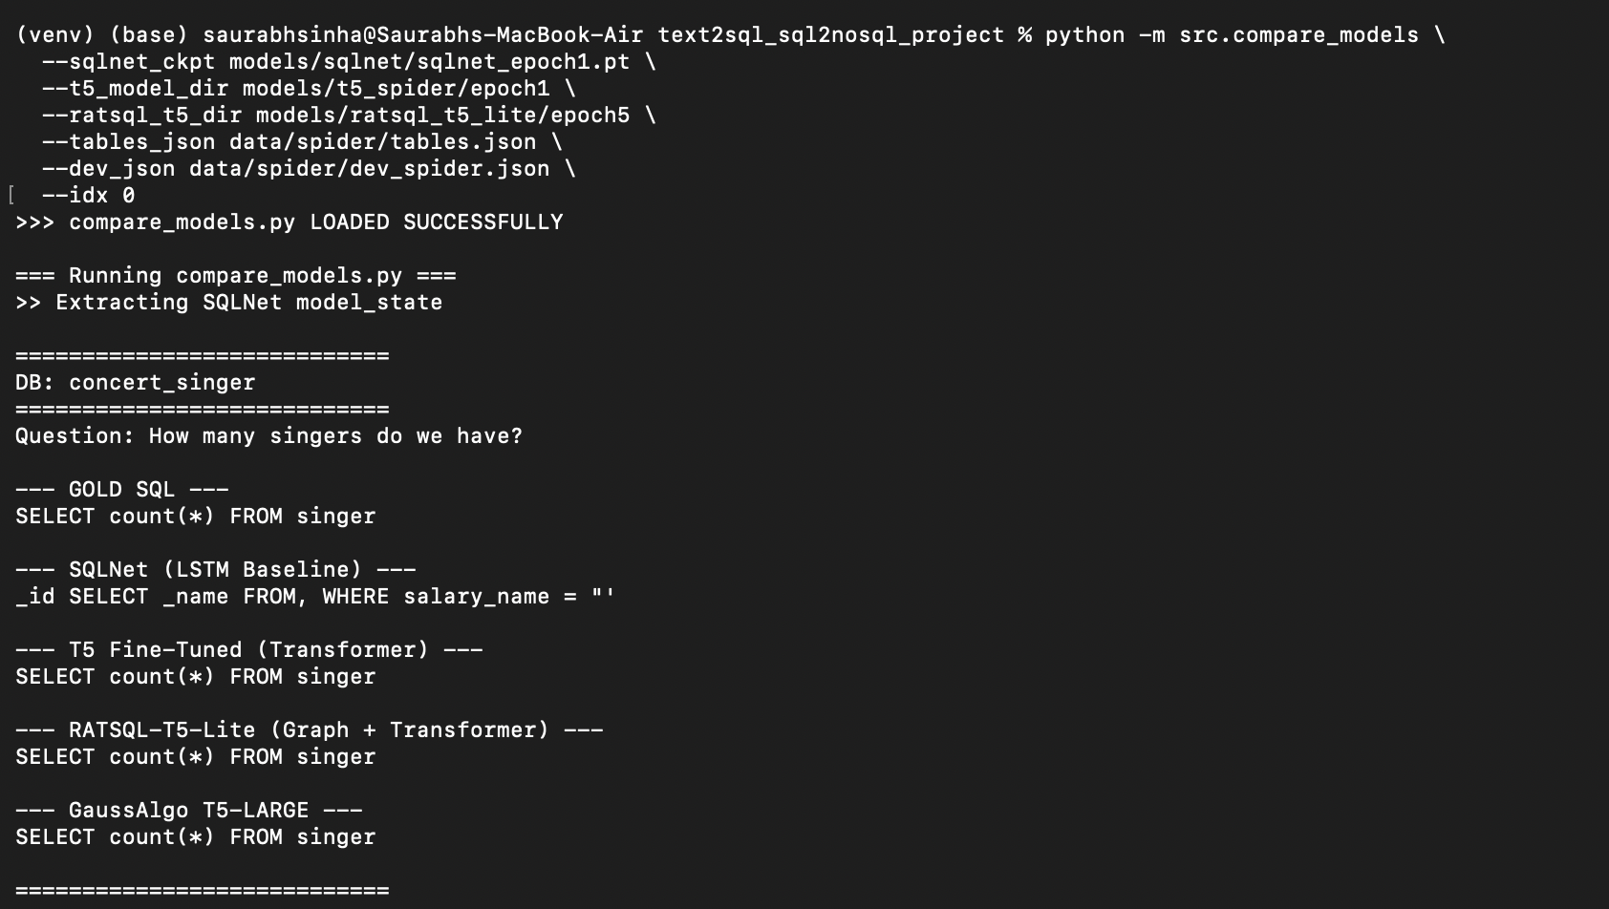
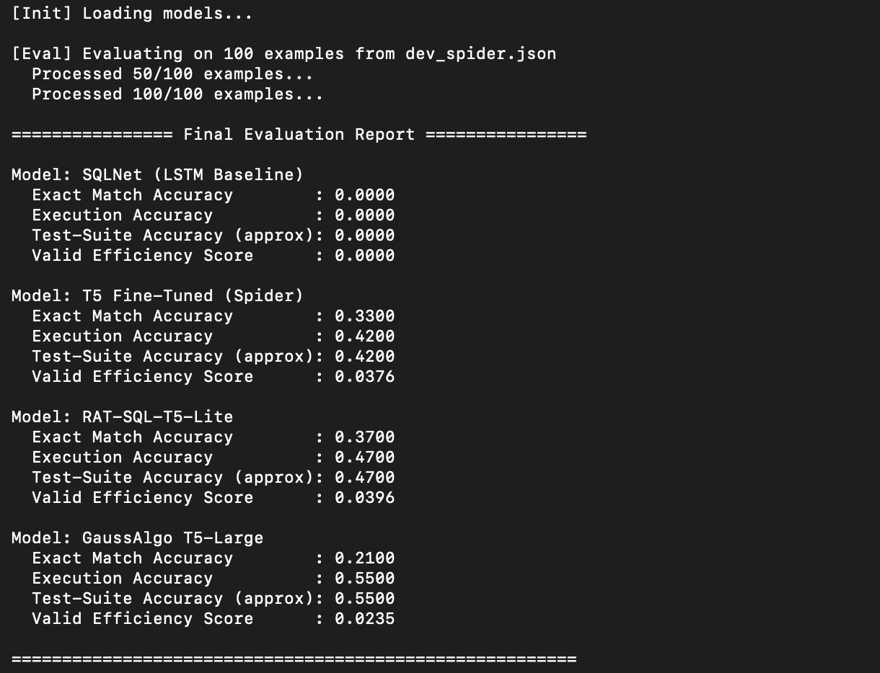
Evaluation Metrics - Outcomes
Sai
One Sample output
Evaluation on 100 test data

Slide 19
Evaluation Metrics - Outcomes
Sai
SQLNet (LSTM Baseline)
T5 Fine-Tuned (Spider)
GaussAlgo T5-Large
Exact Match Accuracy : 0.0100 (0%)
Execution Accuracy : 0.0100 (0%)
Test-Suite Accuracy : 0.0200 (0%)
Valid Efficiency Score : 0.0010 (0%)
Exact Match Accuracy : 0.2400 (24%)
Execution Accuracy : 0.3750 (38%)
Test-Suite Accuracy : 0.3750 (38%)
Valid Efficiency Score : 0.0313 (3%)
Exact Match Accuracy : 0.1450(15%)
Execution Accuracy : 0.4050(41%)
Test-Suite Accuracy : 0.4050(41%)
Valid Efficiency Score : 0.0204(2%)
RAT-SQL-T5-Lite
Exact Match Accuracy : 0.2850(29%)
Execution Accuracy : 0.4200(42%)
Test-Suite Accuracy : 0.4200(42%)
Valid Efficiency Score : 0.0346(3%)

Slide 20
Model Architectures
Sai
SQLNet (LSTM Baseline)
Component | Technical Detail | Parameter / Value
Parameters | ~52 million
Architecture Type | Recurrent Neural Network (RNN) | Encoder-Decoder with Attention
Tokenizer | T5 Tokenizer (Fast) | Used only for vocabulary mapping
Embedding Dim | emb_dim | 256 (Default)
Hidden Dimension | hid_dim | 256 (Default)
Optimizer | Adam | Learning Rate: 3e-4
T5 Fine-Tuned (Spider)
Component | Technical Detail | Parameter / Value
Parameters | ~220 Million | Total learnable weights.
Architecture | Encoder-Decoder | 12 Encoder layers + 12 Decoder layers.
Hidden Size (d_{model}) | 768 | The dimension of the vector representations.
Attention Heads | 12 | Number of parallel attention heads per layer.
Feed-Forward Dim | 3072 | Size of the inner feed-forward layer (d_{ff}).

Slide 21
Model Architectures
Sai
RAT-SQL-T5-Lite
Category | Parameter / Spec | Value / Description
Model Architecture | Base Model | T5 (Text-to-Text Transfer Transformer), specifically t5-base.
 | Task Type | Seq2Seq (Sequence-to-Sequence): Translates Natural Language + Text Schema → SQL.
Data Processing | Max Source Length | 512 tokens (Input: Question + Schema Text).
 | Max Target Length | 160 tokens (Output: SQL Query).
 | Padding Label | -100 (Used to mask padding tokens in the loss calculation).
Training Config | Optimizer | AdamW.
 | Learning Rate | 3e-5 (0.00003).
 | Batch Size | 2 (Default setting).
 | Scheduler | Linear schedule with warm-up (10% of total steps).
Inference Config | Search Algorithm | Beam Search.
 | Beam Width | 4 (Explores the 4 most probable sequences simultaneously).
 | Early Stopping | True (Stops generation when all beams reach the end-of-sentence token).

Slide 22
Sql2NoSQL

Slide 23
Model 1: Rule-Based SQL → Mongo
Anant
Motivation
Establish a deterministic baseline for SQL → MongoDB translation
Understand core mapping rules between SQL and MongoDB
Generate weakly supervised training data for neural models
Avoid dependency on large models initially
Serve as a teacher model for later learning-based approaches
Process
Input SQL query
Parse SQL into Abstract Syntax Tree (AST)
Apply hardcoded mapping rules:
SELECT → $project
WHERE → $match
JOIN → $lookup
Assemble MongoDB aggregation pipeline
Output MongoDB query
How it worked
Parsed SQL queries using an AST-based SQL parser
Identified SQL clauses (SELECT, WHERE, JOIN, ORDER BY, LIMIT)
Mapped each clause to a corresponding MongoDB operator
Constructed MongoDB aggregation pipelines programmatically
Returned deterministic MongoDB queries without learning
Why It failed
Could not handle complex SQL constructs (GROUP BY, HAVING)
Failed on nested queries and subqueries
Required manual rules for every SQL pattern
Did not generalize to unseen schemas or queries
Scaling rule coverage became unmanageable and brittle

Slide 24
Anant
Model 2: T5-Small Fine-Tuned for SQL→Mongo
Motivation
Overcome rigidity of rule-based systems
Learn SQL → MongoDB translation automatically from data
Handle complex SQL patterns without manual rules
Leverage pretrained language understanding
Build a scalable neural translator
Process
Generate SQL → MongoDB pairs using rule-based model
Train T5 on these pairs (teacher–student setup)
Model learns to predict MongoDB pipeline tokens
Inference generates MongoDB JSON directly
Output evaluated via execution or comparison
How it worked
Used T5 encoder–decoder architecture
Input: SQL query as text
Output: MongoDB aggregation pipeline as JSON
Fine-tuned on SQL → MongoDB pairs
Learned transformation patterns end-to-end
Why It failed
Training data was weak and noisy (empty pipelines)
Model learned to output trivial solutions
No schema awareness during generation
Low loss did not imply semantic correctness
Required better grounding and execution feedback

Slide 25
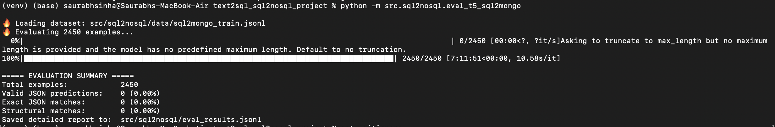
Evaluation Metrics - Outcomes
Anant
T5 Fine-Tuned (Spider)
Component | Technical Detail | Parameter / Value
Parameters | ~220 Million | Total learnable weights.
Architecture | Encoder-Decoder | 12 Encoder layers + 12 Decoder layers.
Hidden Size (d_{model}) | 768 | The dimension of the vector representations.
Attention Heads | 12 | Number of parallel attention heads per layer.
Feed-Forward Dim | 3072 | Size of the inner feed-forward layer (d_{ff}).

Slide 26
Motivation
Saurabh
System uses schema-aware RAG to guide an LLM in generating MongoDB queries and validates correctness through execution-guided feedback.
Link to paper : https://arxiv.org/pdf/2502.11201

Slide 27
Saurabh
LLM Based Models
Input SQL Query
(BirdBench Ground SQL)
Schema Extraction
RAG Context & Prompt Augmented
LLM Generates Mongo DB Pipeline & Executes is on local Mongo DB Client
Result Comparison SQL Result vs Mongo
Feedback loop & LLM Correction
Motivation
Rule Based system fails on complex joins and aggregations
LLM can reason about query structure and transformations
Process
Model 1 : LLM Baseline ( NO RAG )
Input SQL → LLM generate Mongo DB without Schema Context
Model 2 : LLM + RAG(Schema Awareness)
Retrieves table names and Foreign – key relations
Inject Schema Information into prompt
Model3 :LLM + RAG (Schema + Join Template Injection)
Additionally Inject Join Templates into prompt
How it worked
Using an LLM to generate MongoDB aggregation pipeline → Augment the LLM prompt with database schema → Execute generated queries on MongoDB → Compare Mongo DB results with SQL execution results → Use execution feedback to iteratively correct the MongoDB query
Why It failed
Non Foreign key joins are difficult to infer automatically
Complex Aggregations (Group By , Case , Nested Logic) remains challenging
LLM guessing join conditions when schema is insufficient

Slide 28
Model Evaluation
Saurabh
LLM Baseline
LLM + RAG (Schema Awareness)
Total Queries : 20
Success Count : 1
Execution Accuracy : 0.05 (5%)
Avg Retries : 4
Total Queries : 20
Success Count : 5
Execution Accuracy : 0.25 (25%)
Avg Retries : 0.4
LLM + RAG (Schema + Join Template Injection)
Total Queries : 20
Success Count : 6
Execution Accuracy : 0.3 (30%)
Avg Retries : 0.3

Slide 29
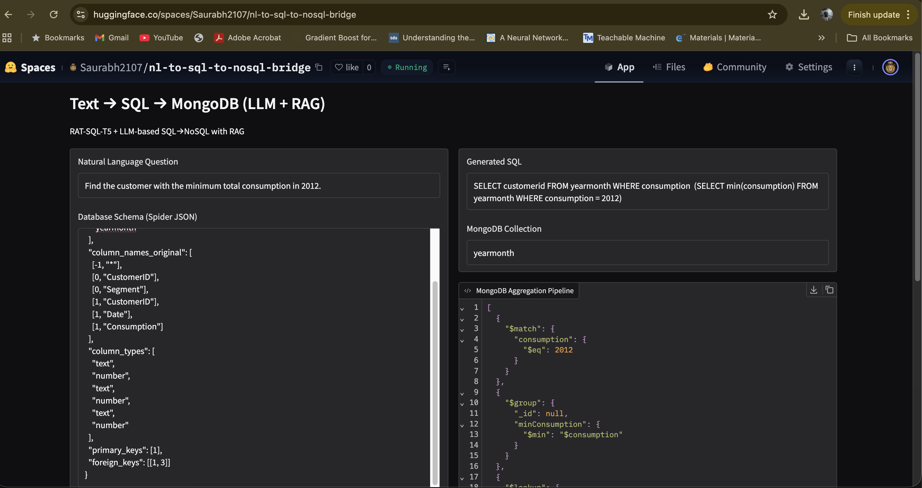
Model Outcome
Saurabh
Screenshot 2026-01-24 at 7.33.06 PM
Saurabh2107/nl-to-sql-to-nosql-bridge

Slide 30
Future Work
Saurabh
Our system is not SQL-specific. It implements a general execution-guided LLM + RAG framework that can be adapted to other structured translation problems by changing the retrieval context and validation signal
D
C
B
A
Key Idea
The proposed system is task-agnostic and can be adapted to other structured translation problems by changing only the RAG context and validation signal
Framework Generalizes
LLM handles reasoning and generation, independent of domain
RAG injects task-specific structure and constraints
Feedback loop enforces correctness via execution or validation
No task-specific fine-tuning required
What Changes Across Tasks
Retrieved context (schema, APIs, type rules)
Validation mechanism (DB execution, compiler, tests)
What Remains the Same
LLM orchestration
RAG + prompt augmentation pattern
Execution-guided correction loop
Proposed Architecture
Structured Input => Target Language => Execution => Validation => Feedback

Slide 31
Thank You !

Slide 32
Additional Concepts : Graph vs AST
Saurabh
D Usage in Capstone
AST: SQL2NoSQL
Graph: text2SQL
A Definition
AST represents syntactic structure of SQL — the grammar. Focusses on syntactic hierarchy
Graph = Semantic relationships
C Information Encoding
AST:
Encodes expression-level meaning
Captures order, nesting, precedence
Good for understanding how a query is constructed
Graph:
Encodes relational meaning
Which table relates to which
Which column belongs to which table
Relationship types matter (PK/FK)
Graph
G
Graph
B Structure
AST is always a tree , Single parent per node , No Cycles, Strict hierarchical order
Graph General Graph structure, Nodes can have many connections , Support cycles , No fixed hierarchy

Slide 33
Additional Concepts : Evaluation Metrics text2SQL
Saurabh
01
02
03
04
Exact Match Accuracy
Percentage of predictions where the generated SQL string exactly matches the gold SQL (token-by-token)
Execution Accuracy
Percentage of cases where the execution result of the predicted SQL is the same as the result of the gold SQL on the database
Test Suite Accuracy
Accuracy when the predicted query is run on a distilled suite of test databases and must match the gold query’s outputs on all of them i.e. If two queries behave the same on many diverse DB variants, they are likely semantically equivalent
Valid Efficiency Score
A composite metric that measures (1) correctness and validity of the generated SQL and (2) its execution efficiency, typically based on execution time compared to the gold query. i.e. Scores only valid queries, then rewards those that run faster / use fewer resources than the gold SQL
A
Pros
Simple, easy to compare across models
A
Pros
Ignores superficial differences in SQL text, focuses on answer correctness.
A
Pros
Best-known automatic proxy for true semantic correctness
A
Pros
Very realistic for production / BI scenarios where performance matters, not just correctness
B
Cons
Penalizes semantically correct but syntactically different queries → overly strict, low realism
B
Cons
Can have false positives (different logic, same result on this DB) and false negatives (correct query but corner-case DB)
B
Cons
More expensive to compute; requires pre-built test suites

Slide 34
Additional Concepts : Evaluation Metrics SQL2NoSQL
Saurabh
01
02
03
Pipeline Structure Match
Equivalent to Exact Match
Checks if the predicted Mongo aggregation pipeline has the same sequence of stages and same JSON structure as the gold pipeline
Execution Accuracy
Whether the predicted Mongo pipeline returns the same result set as the SQL query (gold)
Efficiency Ratio
Equivalent to Valid Efficiency Score
How efficient the generated Mongo pipeline is compared to a reference pipeline
ER = (Gold Execution Time) / (Predicted Execution Time)
A
Pros
Checks if the pipeline is logically aligned
A
Pros
Semantic correctness
Ignores formatting differences
Very realistic.
A
Pros
Best-known automatic proxy for true semantic correctness
B
Cons
Does not verify execution correctness
B
Cons
Can have false positives (different logic, same result on this DB) and false negatives (correct query but corner-case DB)
B
Cons
More expensive to compute; requires pre-built test suites

Slide 35
Additional Concepts : Evaluation Metrics SQL2NoSQL – LLM Based Models
Saurabh
01
Execution Accuracy
Whether the predicted Mongo pipeline returns the same result set as the SQL query (gold)
A
Pros
Semantic correctness
Ignores formatting differences
Very realistic.
B
Cons
Can have false positives (different logic, same result on this DB) and false negatives (correct query but corner-case DB)

Slide 36
Additional Concepts : Datasets
Saurabh
Spider Dataset
WikiSQL
Cross-database, Cross-domain (Very Realistic).
Spider contains >200 databases, each with different schemas.
Complex SQLs. Spider queries include:
Multiple JOINs
Nested queries
GROUP BY
Self-joins
Subqueries
Industry-standard benchmark. All modern research papers benchmark on Spider:
RATSQL
BRIDGE
Picard-T5
Fine-tuned LLMs
WikiSQL contains only SINGLE-TABLE queries
Simple SQLs. There is: No JOIN ,No GROUP BY, No HAVING, No nested queries
Industry-standard benchmark. All modern research papers benchmark on Spider:
RATSQL
BRIDGE
Picard-T5
Fine-tuned LLMs
BirdBench Dataset
Execution-first evaluation — compares query results, not SQL text
Real-world query complexity — JOINs, aggregations, filters, dates
Cross-database support — SQLite, PostgreSQL, MySQL etc.
Production-aligned benchmark
Designed for modern LLM systems — execution-guided, agentic pipelines
Why BirdBench Is Better Than Spider ?
Beyond SQL correctness — validates semantic execution accuracy
Exposes real system failures — joins, types, engine-specific behaviour
Closer to production reality — tests full NL → DB answer pipeline

