Slide 1

AIML C25 - PGCP
CodeGen - Text-to-NoSQL
Group - 6
Vidyasagar Parupati
Ramakrishna Rajidi
Amit Sethi
Ashok
Project Mentors: Nayan, Himanshu
Project Supervisor: Anil Nelakanti

Slide 2
Text-to-NoSQL: NL to MongoDB Translation
Capstone Stage 2 Final Report
SMART Framework + RAG Optimization
January 1, 2026

Slide 3
Project Aim: NL to NoSQL
Phase: Capstone Stage 2
Goal: Translate Natural Language Questions into executable MongoDB queries.
Target Baseline: 83% Execution Success Rate.
Dataset: Spider Dev (1,034 MongoDB samples).
Models Tested: Llama 3.2 (3B), Llama 3.1 (8B), Mistral 7B.
Challenge: Diverse database schemas (~14 distinct types) and complex aggregations.

Slide 4
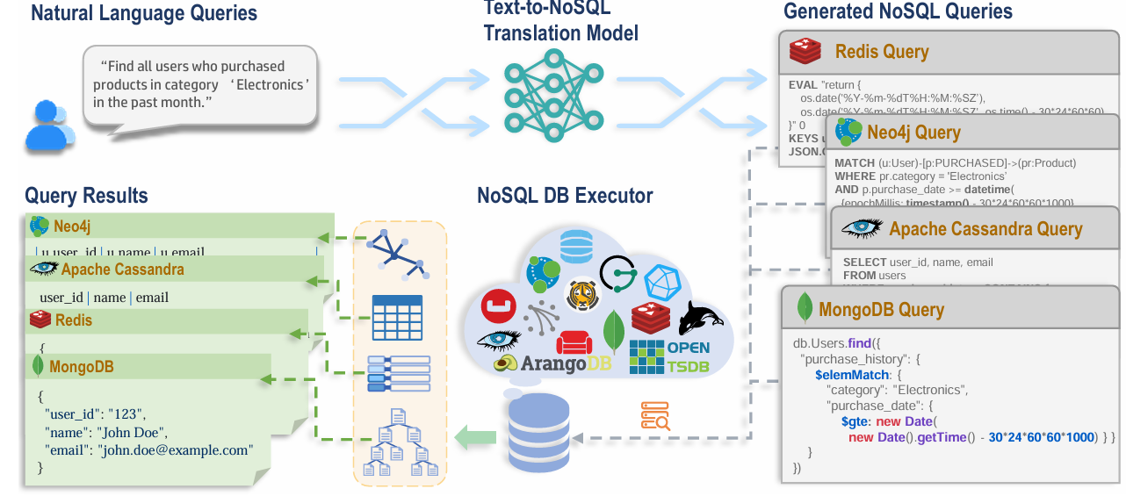
SQL to No SQL overview

Slide 5
SMART Architecture Implementation
S: Semantically Enhanced Retrieval (RAG)
M: Multi-turn Refinement
A: Abstract Syntax Tree Validation (Execution Optimizer)
R: Ranking & Selection
T: Translation to Final Query
Key Innovation: Integrated RAG to 'teach' the model syntax patterns dynamically.

Slide 6
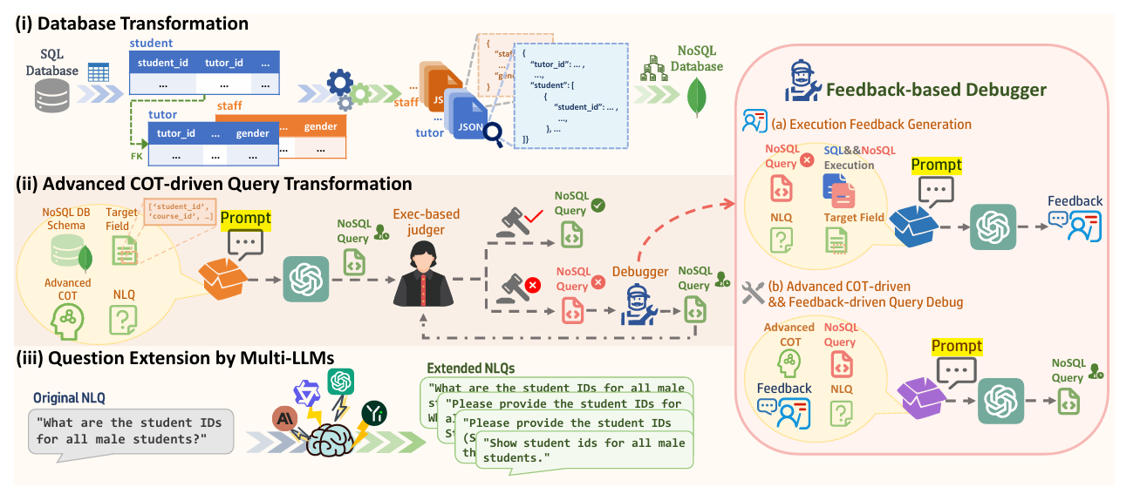
Architecture

Slide 7
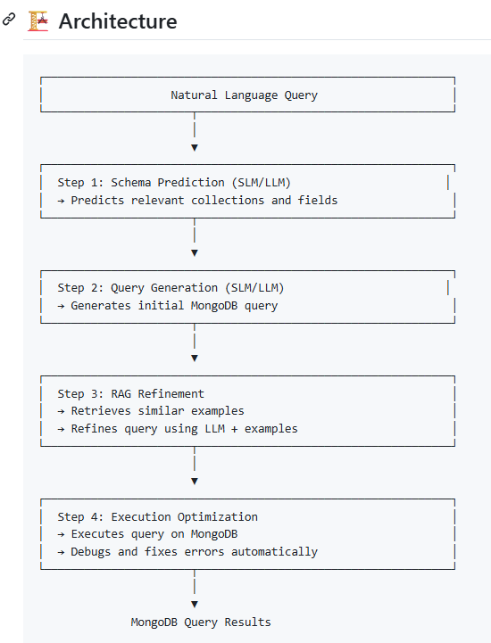
│

Slide 8
Methodology: Prompt Engineering & RAG
Evolution of Prompt Strategy:
❌ Verbose (~60 lines): Overwhelmed the model (50% success).
❌ Minimal (~10 lines): Led to hallucinations (30% success).
✅ Balanced (~25 lines): Strict syntax rules + RAG examples.
RAG Implementation:
- Indexed 100 training examples (indices 0-99).
- Retriever: 'all-MiniLM-L6-v2' embeddings.
- Refiner: Appends 3 most similar verified queries.

Slide 9
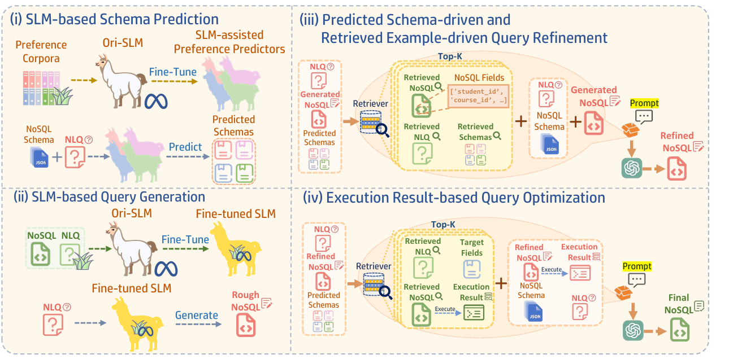
SMART FRAMEWORK

Slide 10
Phase 1: Critical Bug Fixes (0% -> 60%)
Initial State: 0% Success (System Crashes).
1. Foundational Fixes:
- Fixed MongoDB 'Phantom Connection' bug.
- Fixed Schema Prediction format mismatch.
2. The 'JavaScript Crisis':
- Issue: Llama generates JS 'true/null'; Python crashes.
- Fix: Context-aware Regex Normalization.
- Result: Boolean errors reduced from 23 to 0.

Slide 11
Model Comparison: Llama vs Mistral
Tested on 50 Diverse Samples (14 databases):
1. Llama 3.2 (3B):
- Stability: 52%
- Strength: Schema guessing (48% match).
2. Mistral 7B:
- Stability: 68%
- Weakness: Syntax errors (unbalanced brackets).
3. Llama 3.1 (8B) [WINNER]:
- Stability: 98% (Production Grade)
- Weakness: Verbose schema output (36% match).

Slide 12
Validation: Large Scale Testing
Sample Size: 139 Queries (Full Dataset subset).
Model: Llama 3.1 8B.
Results:
✅ Pipeline Success: 79/139 (57%)
✅ Stability: Consistent with small-scale tests.
Conclusion:
System is stable and proof-of-concept is validated.
57% is a strong baseline for diverse, unseen schemas.

Slide 13
Key Metrics & Improvements
Pipeline Stability:
0% (Start) -> 98% (Final/8B)
Homogeneous Accuracy (1 DB):
70% Success.
Diverse Accuracy (14 DBs):
57% Success (Stable).
Boolean/Null Errors:
100% Eliminated.

Slide 14
Roadmap to 83% Baseline
Phase 1: Stratified Training (Week 1)
- Expand RAG from 100 -> 300 examples.
- Ensure all 14 database types are represented.
Phase 2: Operational Specialization (Week 2)
- Split RAG into 'Aggregate' vs 'Find' stores.
- Teach model specifically for complex GroupBy.
Phase 3: Edge Case Hardening
- Add 'Self-Correction' loop for invalid syntax.

Slide 15
Conclusion
1. Successfully established a functional NL-to-NoSQL pipeline.
2. Proved the 'Balanced Prompt + RAG' strategy works.
3. Identified Llama 3.1 8B as the ideal local model.
4. Clear, data-driven path to reach the 83% target.
Ready for Phase 3: Advanced Optimization.

