Slide 1

AIML C25 - PGCP
CodeGen - Text-to-SQL
Group - 6
Vidyasagar Parupati
Ramakrishna Rajidi
Amit Sethi
Ashok
Project Mentors: Nayan, Himanshu
Project Supervisor: Anil Nelakanti

Slide 2
Gen-SQL Text-to-SQL Project
Proposal-driven implementation based on Gen-SQL on Apple Silicon
Gen-SQL Text-to-SQL Project | AIML C25

Slide 3
Agenda
Problem and motivation
Gen-SQL paper overview (generate-ground-regenerate)
Pipeline implementation on Apple Silicon
Datasets and evaluation metrics
Local LLM results: pre vs post fine-tuning
Limitations and improvement scope
Gen-SQL Text-to-SQL Project | AIML C25

Slide 4
Problem & Motivation
Text-to-SQL bridges natural language and database schemas
Full-schema prompting is costly and often exceeds context limits
Pure retrieval can miss relevant tables/columns
Goal: reduce cost while preserving accuracy using Gen-SQL
Gen-SQL Text-to-SQL Project | AIML C25

Slide 5
Gen-SQL Core Idea
Generate: LLM creates a pseudo-schema from the question
Ground: pseudo-schema guides embedding-based retrieval
Regenerate: LLM writes SQL using grounded schema
Optional: iterative refinement for error correction
Gen-SQL Text-to-SQL Project | AIML C25

Slide 6
Pipeline We Implemented
Step 1: LLM generates pseudo-schema (via pseudo-SQL)
Step 2: Hybrid retrieval grounds tables/columns
Step 3: SQL regeneration with grounded schema
Step 4: (optional) post-processing / refinement
Gen-SQL Text-to-SQL Project | AIML C25

Slide 7
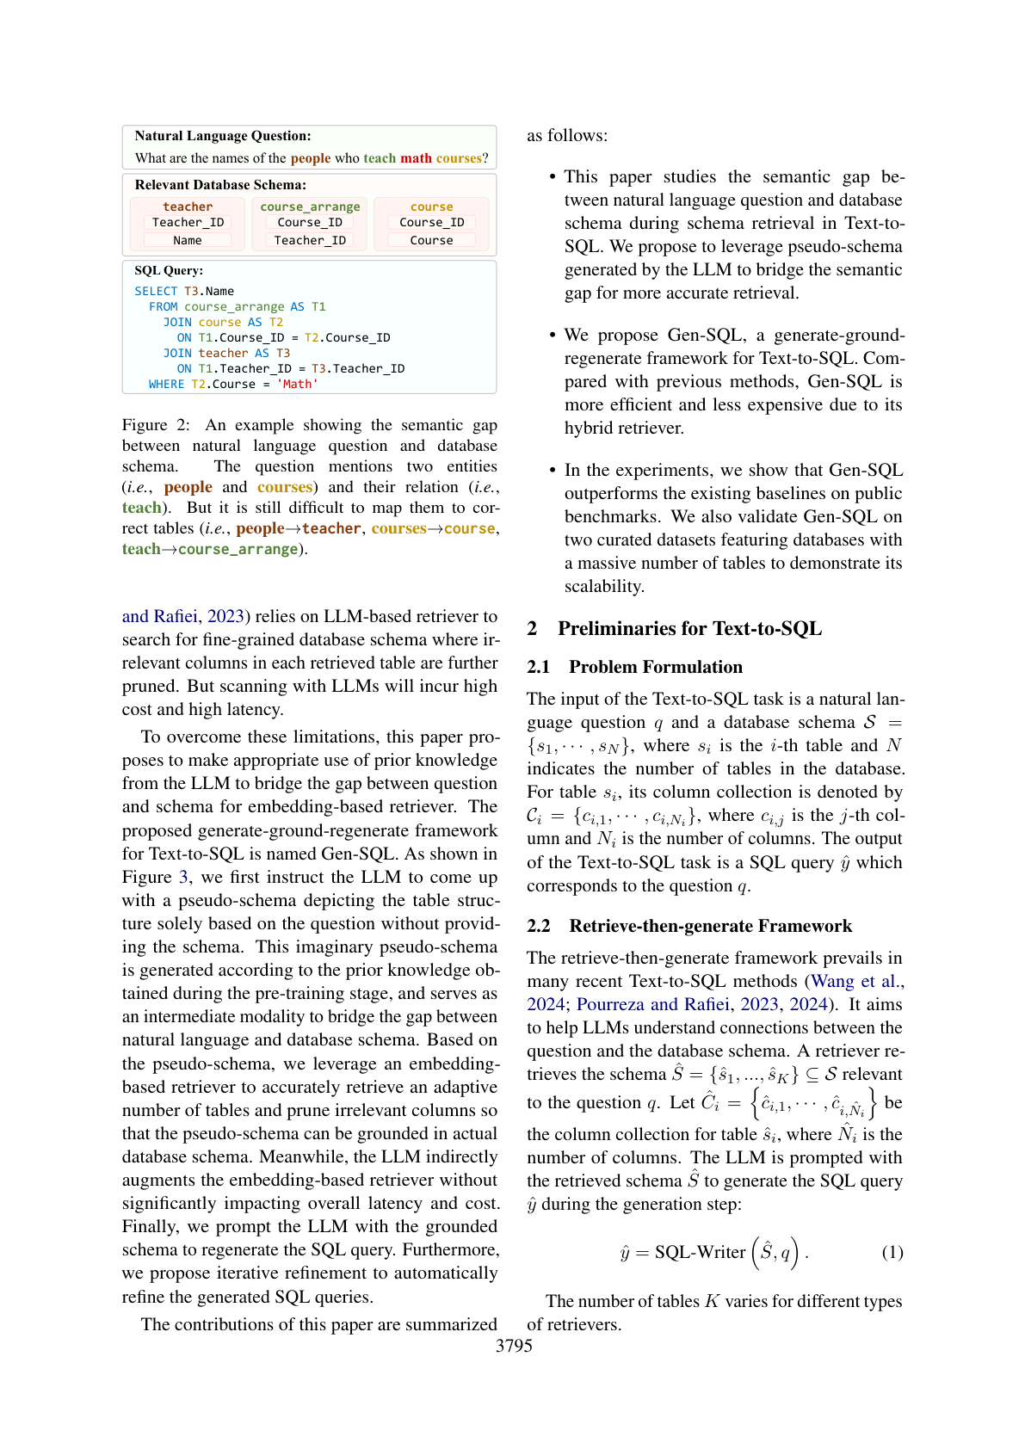
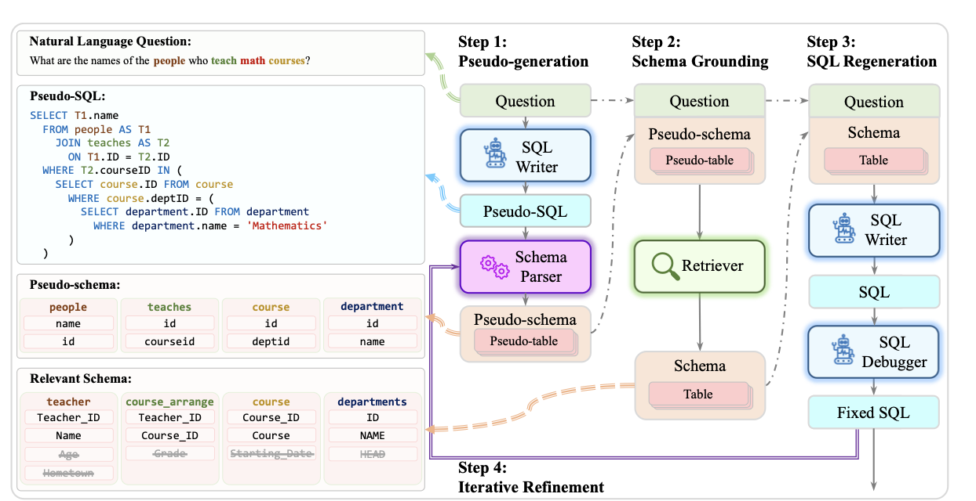
Gen-SQL Paper Diagram (Figure 3)
Source: COLING 2025 Gen-SQL paper (Figure 3)
Gen-SQL Text-to-SQL Project | AIML C25

Slide 8
Datasets & Benchmarks
Spider: cross-domain complex Text-to-SQL benchmark
BIRD: large schemas and value-based reasoning (planned)
Primary metrics: Execution Accuracy (EX), Exact Match (EM)
Gen-SQL Text-to-SQL Project | AIML C25

Slide 9
Infrastructure: Apple Silicon
Local LLM serving via Ollama (OpenAI-compatible API)
Fine-tuning with MLX LoRA on Apple Silicon
Pipeline orchestration in Python
Evaluation via official Spider test-suite scripts
Gen-SQL Text-to-SQL Project | AIML C25

Slide 10
Evaluation Setup
Full Spider dev set (1034 samples)
Models: Llama2 7B, Mistral, Llama3.1 8B, Llama3.1 8B + LoRA
All runs executed locally (Ollama + MLX server)
Metrics: EX/EM; average latency per query
Gen-SQL Text-to-SQL Project | AIML C25

Slide 11
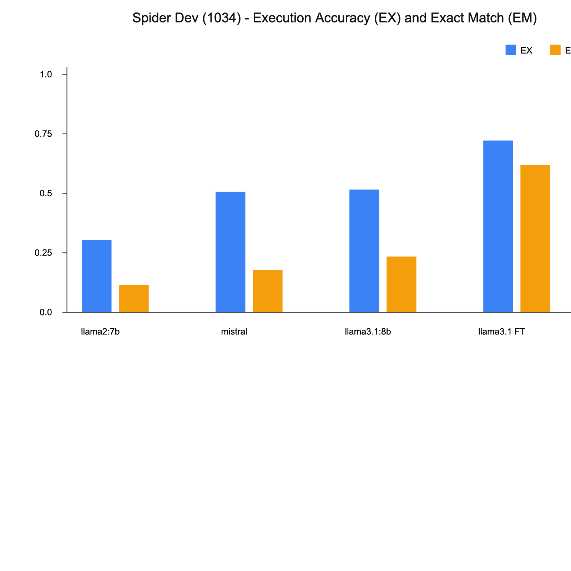
Full-Dev Results (EX/EM)
Spider dev (1034), zero-shot chat
Gen-SQL Text-to-SQL Project | AIML C25

Slide 12
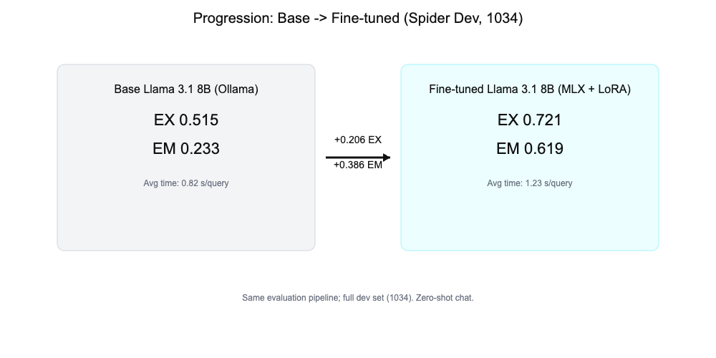
Pre vs Post Optimization
Base vs fine-tuned Llama 3.1 8B
Gen-SQL Text-to-SQL Project | AIML C25

Slide 13
Fine-Tuning Summary
LoRA fine-tuning with MLX on Llama 3.1 8B (4-bit)
Adapters saved every 100 iterations; best checkpoint selected
Served via MLX OpenAI-compatible server
Improved EX/EM on full dev set
Gen-SQL Text-to-SQL Project | AIML C25

Slide 14
Limitations & Risks
Fine-tuned adapters available only for Llama 3.1 8B
Retrieval errors still propagate to SQL generation
Local hardware limits larger models and longer contexts
Execution-based evaluation ignores query efficiency
Gen-SQL Text-to-SQL Project | AIML C25

Slide 15
Improvement Scope (Proposal-Driven)
Structured pseudo-schema output (JSON / function-calling)
Hybrid retrieval: dense + BM25 + graph expansion
Iterative grounding verification and refinement
Model specialization to cut cost (small for Step 1)
Evaluate on BIRD benchmark evaluation.
Gen-SQL Text-to-SQL Project | AIML C25

Slide 16
Conclusion
Gen-SQL pipeline implemented locally on Apple Silicon
Full-dev evaluation completed for multiple LLMs
Fine-tuning yields significant improvement
Clear roadmap for future enhancements
Achieved 72.1% Execution Accuracy with Fine-tuned Llama 3.1 8B.
Outperformed base Llama 3.1 8B (51.5%) by over 20%.
Proven feasibility of privacy-first, local text-to-SQL on consumer hardware.
Gen-SQL Text-to-SQL Project | AIML C25

Slide 17
Full-Dev Results Table
Model | Type | EX | EM | Avg time
llama2:7b | Base (Ollama) | 0.303 | 0.116 | 0.73s
mistral:latest | Base (Ollama) | 0.505 | 0.178 | 0.89s
llama3.1:8b | Base (Ollama) | 0.515 | 0.233 | 0.82s
Llama 3.1 8B | Fine-tuned (MLX + LoRA) | 0.721 | 0.619 | 1.23s
Spider dev (1034), zero-shot chat, local evaluation
Gen-SQL Text-to-SQL Project | AIML C25

Slide 18
Thank You & Questions
Project code and results available at https://github.com/nayanjha16/CodeGen-Implementations/tree/group6
https://github.com/nayanjha16/CodeGen-Implementations/tree/feat/group6_customised

Slide 19
Appendix: Error Analysis (Spider)
Common Failure Modes:
1. Schema Hallucination
- Pred: SELECT ... FROM singer_in_concert ... WHERE concert_Name LIKE ...
- Gold: ... WHERE song_name LIKE ...
- Issue: Misinterpreting schema column names.
2. Complex Set Operations (INTERSECT/EXCEPT)
- Pred: SELECT ... WHERE Year IN ('2014', '2015')
- Gold: ... WHERE Year = 2014 INTERSECT ... WHERE Year = 2015
- Issue: LLM prefers logical simplification over structural exactness.

Slide 20
Future Work: BIRD Benchmark
Planned Evaluation on BIRD (Big Instruction-Reference Database):
Status: Dataset Integration Pending
- BIRD resources (`dev.json`, databases) not currently in repository.
Goal:
- Evaluate generalizability on larger, more dirty real-world databases.
- Comparison with Spider performance.

Slide 21
Q & A
Thank you!

