Slide 1
SQL → MongoDB Conversion using SLMs
Execution-Based Evaluation | Text-to-SQL + SQL-to-MongoDB
Team: Chandrashekar, Jaya Krishna, Pavan Y, Swathi
Professor: Dr. Anil Neelkanti | Mentors: Nayan, Himanshu
Institution: IIIT Hyderabad | Date: Jan 2026
Models: Qwen2.5 (Ollama) + Hybrid RAG + LoRA Adapter (optional)

Slide 2
Problem Statement
Goal: Translate relational SQL into equivalent MongoDB pipelines
Hard because SQL and MongoDB differ in: joins, grouping semantics, nested queries, set ops
Exact string match is brittle: multiple pipelines can be correct
Solution: Execution-based correctness using SQLite + MongoDB runtime comparison

Slide 3
Datasets & Inputs
Spider (Text → SQL)
BIRD / Bird-Bench (SQL → MongoDB)
Train: 9,428 text-to-SQL samples
69 DB schemas + per-DB SQLite files
DB descriptions as CSVs for retrieval
Local setup
SQLite: ground-truth execution
MongoDB 7.x: pipeline execution
macOS M4 Pro + Ollama local inference
Outputs: Mongo JSONL + execution reports

Slide 4
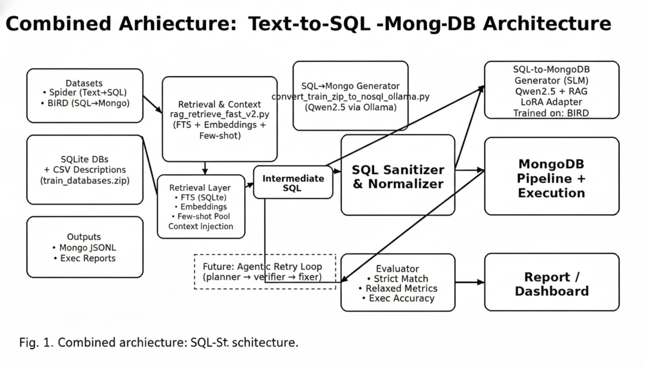
End-to-End Architecture (Clean)
Combined architecture: Text→SQL + SQL→MongoDB with Hybrid RAG, Sanitizer, Execution-based Evaluation

Slide 5
Phase I: Text-to-SQL (Spider)
User question → Qwen2.5 (Ollama) → SQL
Execute SQL on SQLite (per-db .sqlite) for validation
Benefit: produces clean intermediate SQL and isolates errors early
Observed (sample runs): SQL executability ≈ 96%, exec accuracy ≈ 75% (subset)

Slide 6
Hybrid Retrieval (RAG) for SQL→Mongo
Goal: reduce schema hallucination & improve operator mapping
FTS5 (SQLite): exact match for table/column names & keywords
Embeddings: semantic schema retrieval + descriptions
Few-shot pool: canonical operator patterns ($lookup, $group, $unwind, $unionWith)
Context injection into prompt before generation

Slide 7
Phase II: SQL-to-MongoDB Generation
Inputs: intermediate SQL + db_id + retrieved context
SLM outputs: find() or aggregate() pipeline JSON
SQL Sanitizer & Normalizer: blocks unsafe/unsupported patterns, enforces canonical structure
Execute pipeline in MongoDB with maxTimeMS for safety
Store outputs as JSONL + errors + execution report

Slide 8
Execution-Based Verification (REA)
Why not exact match? Many different pipelines produce same result
REA compares SQL result vs Mongo result at runtime
Scalar agreement: exact single value
Cardinality agreement: same count for COUNT-like queries
High-overlap agreement: Jaccard similarity on result sets

Slide 9
Metrics & Results (1–2500 samples)
Successful conversions: 2,362
Mongo executable queries: 2,114
REA matches: 1,483
REA accuracy: 70.12%
Strict match accuracy: ~19% (too conservative)

Slide 10
LoRA Fine-Tuning (Optional Upgrade)
Base model: Qwen2.5-Coder-3B-Instruct | Framework: MLX-LM (Apple Silicon)
Total params: ~3.1B | Trainable LoRA params: ~6.6M (0.216%)
Training data: ~3,200 prompt–completion JSONL samples (execution-correct pairs)
SFT config: 2 epochs, lr=5e-5, batch=1
Effect: improved instruction-following + fewer invalid JSON outputs

Slide 11
Gradio UI Demo (Local)
Interactive inputs: SQL + DB ID (or question → SQL → Mongo)
Runs local conversion with Hybrid RAG enabled
Shows generated Mongo pipeline + execution status + diff metrics
Port-based launch (e.g., 7861 / 7863) for easy demos

Slide 12
Future Work: Agentic Retry Loop
Move from one-shot generation to self-correcting translation
Planner: choose join/group strategy
Generator: produce candidate pipeline
Verifier: run execution + REA comparison
Fixer: apply error feedback & retry until valid/executable

