Slide 1
Case Study: An AI-driven verification model to flag and address potential check fraud.
We are going to manage analytics and data science of above case study through CRISP-DM framework.
CRISP-DM methodology considers the analytical activities as a cyclical set of phases to be repeated until a satisfactory result is obtained.

Slide 2
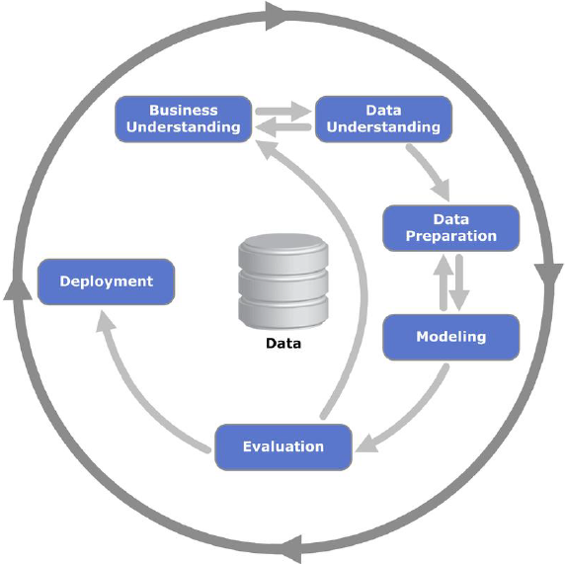
Cross-Industry Standard Process for Data Mining, CRISP-DM’s analytics process is broken into six major phases:
Business Understanding
Data Understanding
Data Preparation
Modeling
Evaluation
Deployment

Slide 3
Step 1 – Business Understanding
What are the objectives of the business where the data mining problem comes from?
Business Objectives: Analyzes images of previously considered fraudulent check with current check to be process to confirm all necessary information is present and delivers a confidence score almost instantaneously regarding whether a check is good, is manifestly fraudulent, or needs further review.

Slide 4
Step 1 – Business Understanding
2. What are the data mining goals for this project?
Data mining objectives:
Conduct analysis of attributes and their subsets.
Use appropriate data mining tools to identify the underlying patterns.

Slide 5
Step 2 – Data Understanding
Dataset:
The view of the original database was created, excluding all sensitive information.
Contains records of fraudulent checks seeking guidance and support for filtering fraudulent checks in large global bank for a 12 months period that includes 3 attributes and 5 millions rows (before any pre-processing).

Slide 6
Step 2 – Data Understanding
Exploratory Statistics:
Automate manual process of handwritten checks.
Automate the process of comparing various factors on scans of deposited checks to a growing database of checks previously identified as fraudulent, to flag potential counterfeits in near real time.

Slide 7
Step 2 – Data Understanding
Data Visualization:
The Cognizant Digital Business model was trained to parse a historical database of previously scanned checks, including ones known as fraudulent.
It analyzes images to confirm all necessary information is present and delivers a confidence score almost instantaneously regarding whether a check is good, is manifestly fraudulent, or needs further review

Slide 8
Step 3 – Data Preparation
Data Quality/Sanity Check:
Attributes that are obsolete belongs to payroll which is easy to parse.
Handwritten checks should be analyzed with previously scanned checks, including ones known as fraudulent.

Slide 9
Step 3 – Data Preparation
Data Cleaning and Pre-Processing:
Identified many missing and incorrect values such as zeros, multiple zeros, ‘none,’ ‘no,’ spaces, various spaces, NULLs, etc.
Retained the informational value of some variables by converting them into binomial attributes (Y, N).
Append the latest fraudulent checks details to the Fraudulent database.

Slide 10
Step 4 – Modelling
Classification:
Model demonstrated a 50% reduction in fraudulent transactions.
Processing as many as 20 million checks a day, with end-to-end response times of less than 70 milliseconds and processing up to 1,200 checks per second.
The model forecasts up to $20 million in annual savings on fraud losses, while significantly reduces the operational cost of manual check validation.

Slide 11
Step 5 – Evaluation
Data mining techniques and CRISP-DM methodology confirmed 50% reduction in fraudulent transactions.
It forecasts up to $20 million in annual savings on fraud losses.
Significantly reduces the operational cost of manual check validation.

Slide 12
Step 6 – Deployment
Develop and document a plan for deploying the model. (SOP/Project Charter)
Develop a thorough monitoring and maintenance plan to avoid issues during the operational phases of the model. (Work Breakdown Structure)
The project team documents a project summary, which might include a final presentation of data mining results. (Project Scope)
Conduct a project retrospective about what went well, what could have been better, and how to improve in the future. (Logs & Registers)

