Slide 1

Online Book Review System
234 Java SL KK batch : Group number - 03

Slide 2

Team
2582844 Jayasurya M
2582872 Km Rupalee
2583033 Kondi Boyina Dilip
2582567 Kothamasu Naga Vaishnavi
2584104 Kunal Ahlawat
2583575 Madala Mounika
2583649 Moropant Rajaram Patil (Team Lead)

Slide 3


Contents
Abstract
Introduction
Objective
Technology Stack
Database Schema
Home Page
Admin Login
User Login
Conclusion

Slide 4

1. Abstract
The Book Review System offers a solution to the common issue of purchasing books that may not meet expectations. Admins have the flexibility to manage books effectively by adding, deleting, and editing entries. Users enjoy a seamless experience, exploring reviews and ratings, registering, logging in, and contributing their own insights. The Book Review System simplifies book management and discovery with easy-to-use admin tools and user-friendly features.

Slide 5

2. Introduction
The Online Book Review System is a web-based platform designed to facilitate the review and rating of books by users.
It lets users share their thoughts and experiences about different books. This helps others decide which books to read.
Book reviews help validate the worthiness of a book and establish its audience.
Positive reviews make others want to read the same book, based on their peers’ recommendations.

Slide 6

3.Objective
To develop a customer web-based review system, where the reader can give the ratings and the reviews.
To inform the administrator about the books that readers are interested in and publish as required.
Help readers save time by giving them an idea of what to expect from a book, increasing their chances of connecting with it, even before they start reading

Slide 7








4. Technology Stack
Front-End: Angular , Bootstrap , Node JS
Server-side: Spring Boot
Back-end: MYSQL, Hibernate, Java
IDE – Spring Tool Suite
Server: Tomcat
Testing: Postman , JUnit

Slide 8
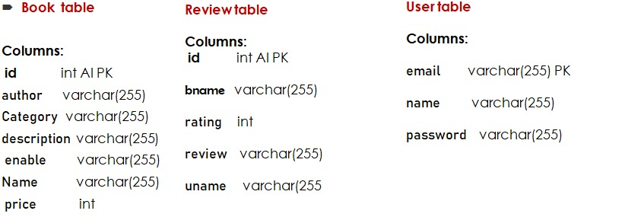
5. Database Schema
Figure 5.1) Database Schema

Slide 9
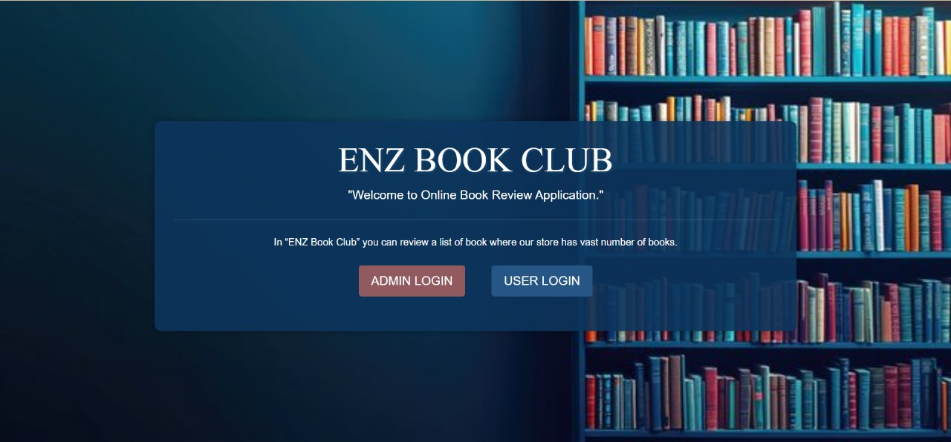
6. Home Page
Figure 6.1) Home Page

Slide 10
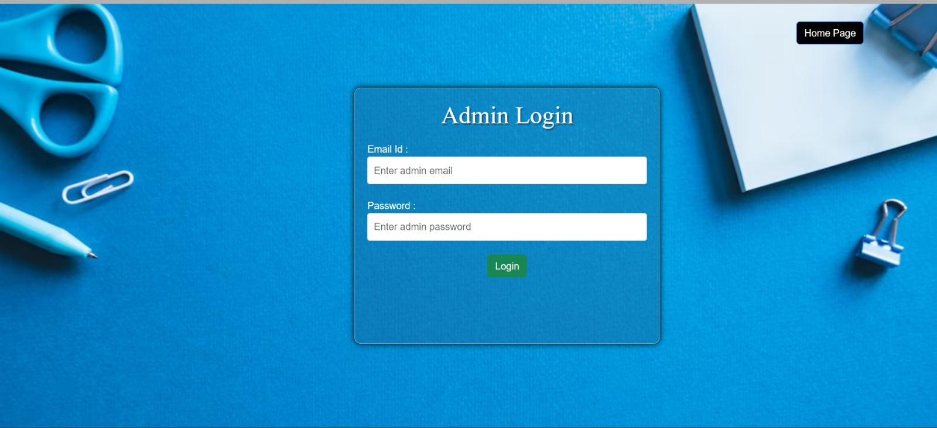
7. Admin Login
Admin can login with email and password
Figure 7.1) Admin Login Page

Slide 11
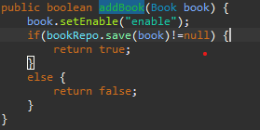
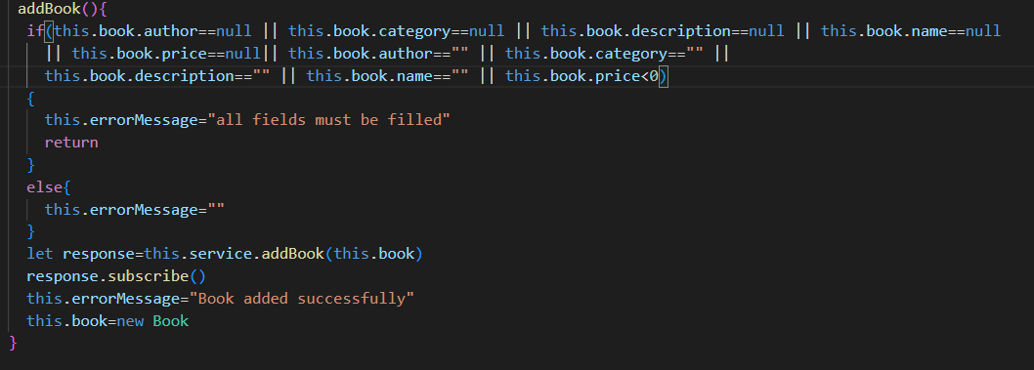
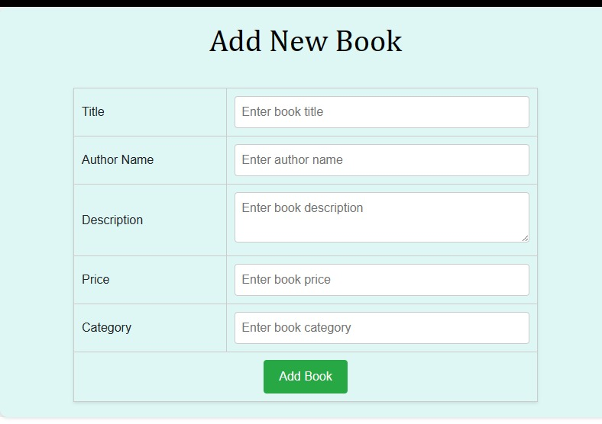
- Add New Book
Post Man API request - Post- http://localhost:8086/addBook
Spring boot code –
Book is added to the data based on
only if all book details are filled
Figure 7.2) Add New Book – Code Snippet
Figure 7.3) Typescript Validation (Add New Book)
Figure 7.4) “Add New Book” Page

Slide 12
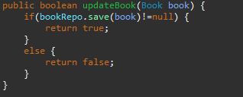
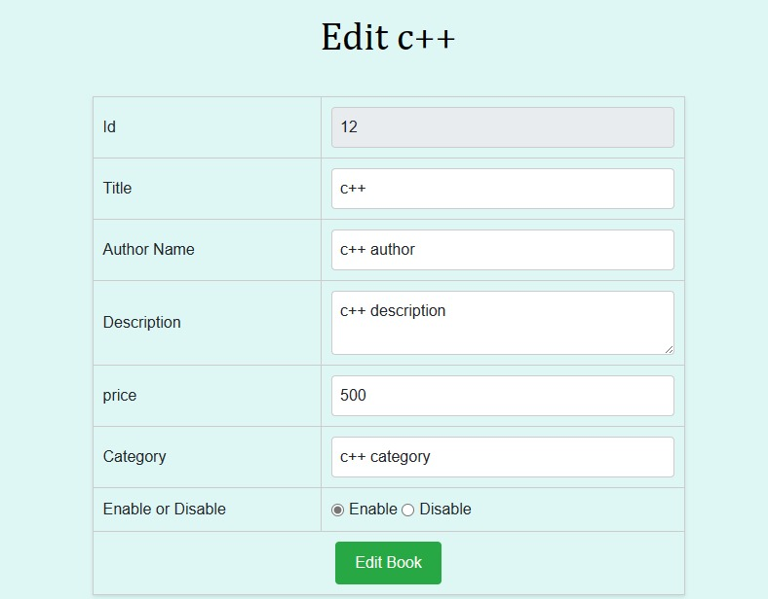
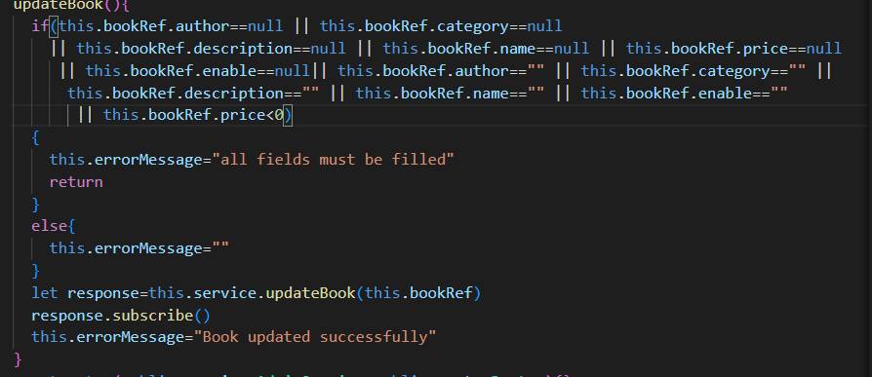
- Update Book Details
Post Man API request - Put- http://localhost:8086/updateBook
Spring boot code –
Book is updated in the database
Figure 7.5) Update Book Details – Code Snippet
Figure 7.6) Typescript Validation (Update)
Figure 7.7) “Update Book Details” Page

Slide 13
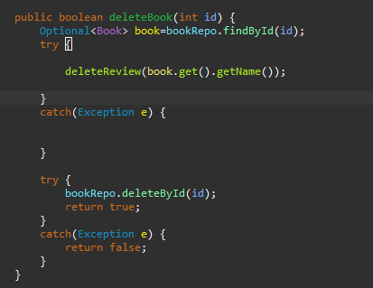

- Remove Book Details
Post Man API request - Delete - http://localhost:8086/deleteBook/{id}
Spring boot code
Book is deleted along with all reviews given to that book.
Figure 7.8) Remove Book Details - Code Snippet

Slide 14

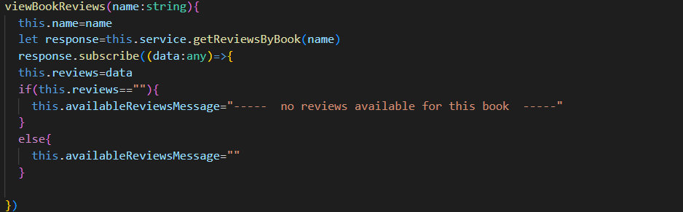
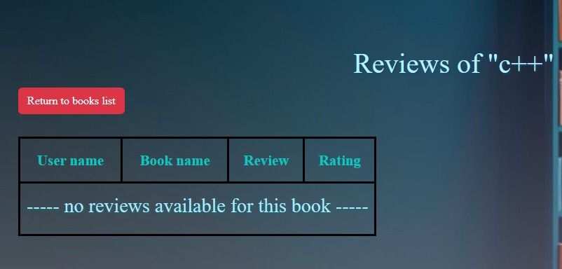
- User Ratings for Specific Book
Post Man API request - Get- http://localhost:8086/getReviewByBook/{bookName}
Spring boot code –
All reviews for a particular book
is retrieved in reviews table
Figure 7.9) Retrieving Reviews – Code Snippet
Figure 7.10) Typescript Validation (Reviews)
Figure 7.11) “Reviews of Specific Book” Page

Slide 15
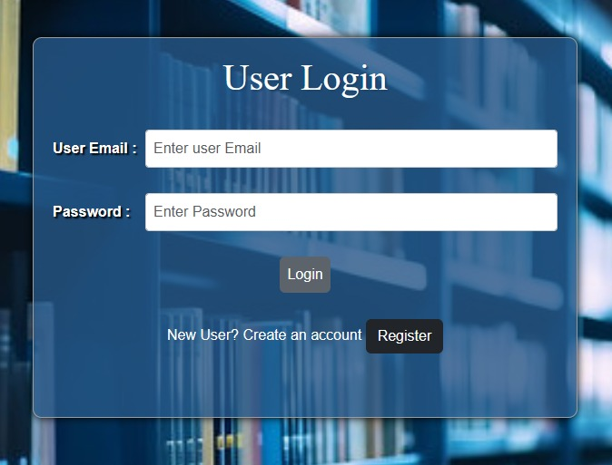
8. User Login
User can login with email and password
Figure 8.1) User Login Page

Slide 16
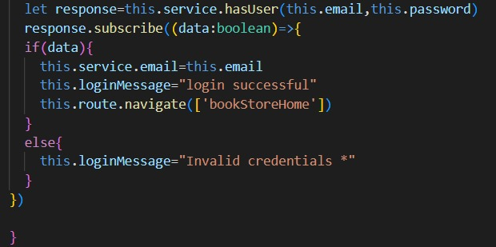
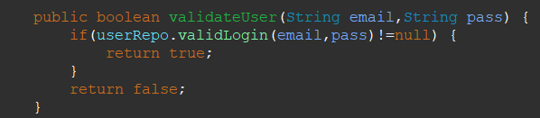
- User Login (Continue)
Post Man API request - Get - http://localhost:8086/validUserLogin/{email}/{password}
Spring boot code –
Check whether given details are mapped with that email are correct.
Figure 8.2) validateUser Code Snippet
Figure 8.3) Typescript Validation (Validate User)

Slide 17
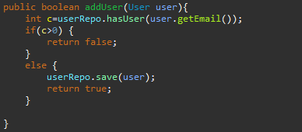
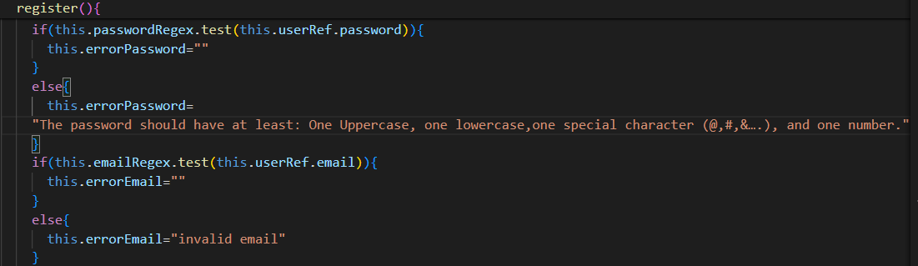
- User Registration
Post Man API request - Post- http://localhost:8086/addUser
Spring book code -
Users are registered only if their email is not already existing in the database.
Figure 8.4) Code Snippet (addUser)
Figure 8.5) Typescript Validation (Register User)

Slide 18
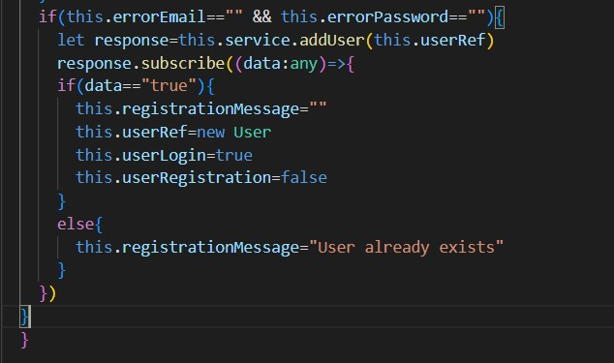
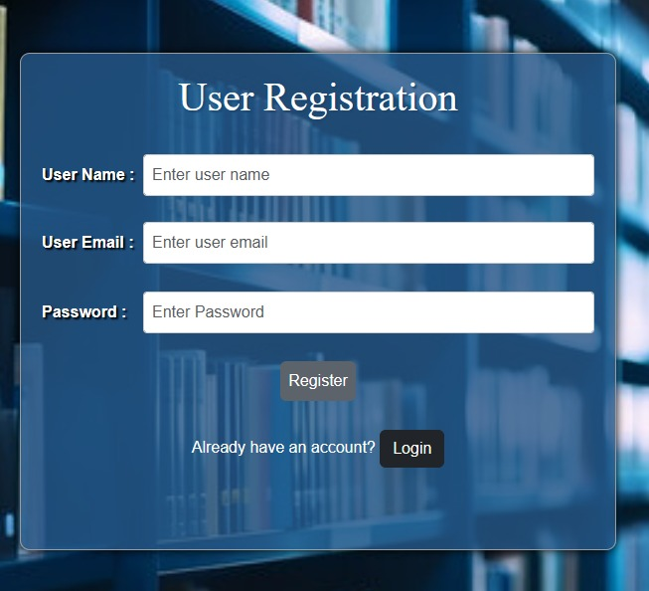
- User Registration (continue)
Figure 8.6) Typescript Code (Register User)
Figure 8.7) User Registration Page

Slide 19
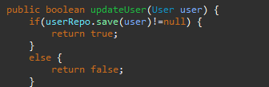
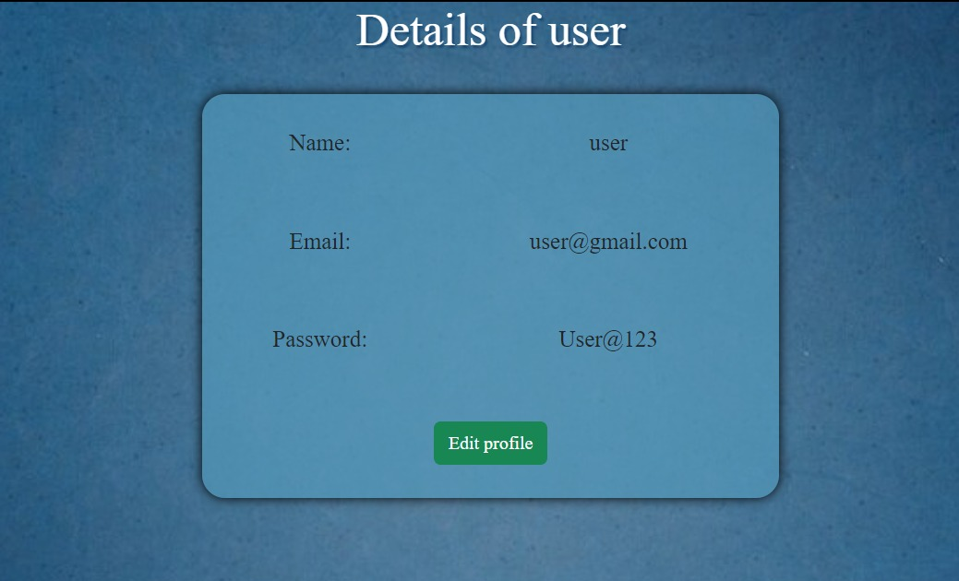
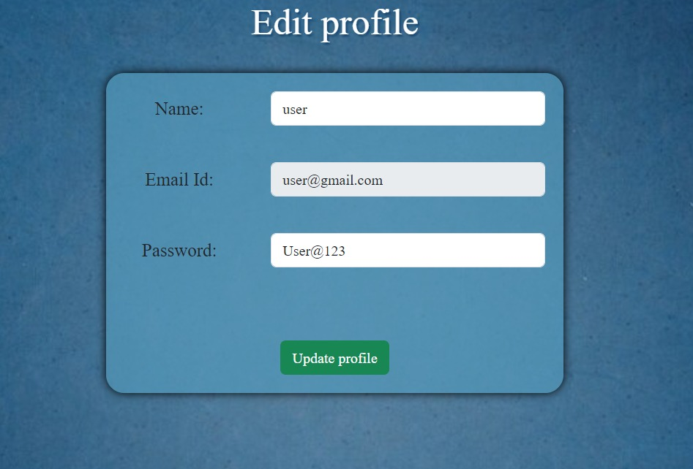
- Update Profile
Post Man API request - Put - http://localhost:8086/updateUser
Spring boot code –
User is updated with a new password
Figure 8.8) Code Snippet - updateUser
Figure 8.9) Update Profile

Slide 20
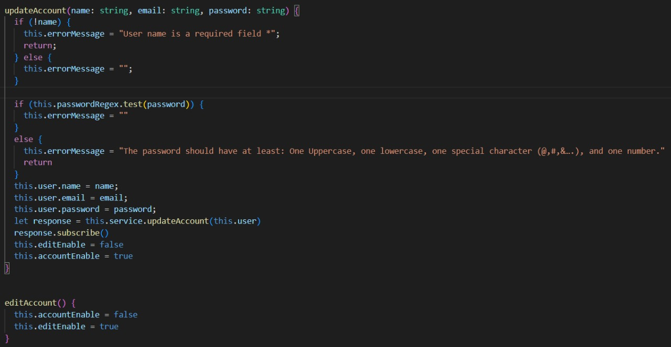
- Update Profile (Continue)
Figure 8.10) Transcript Validation (Update Profile)

Slide 21

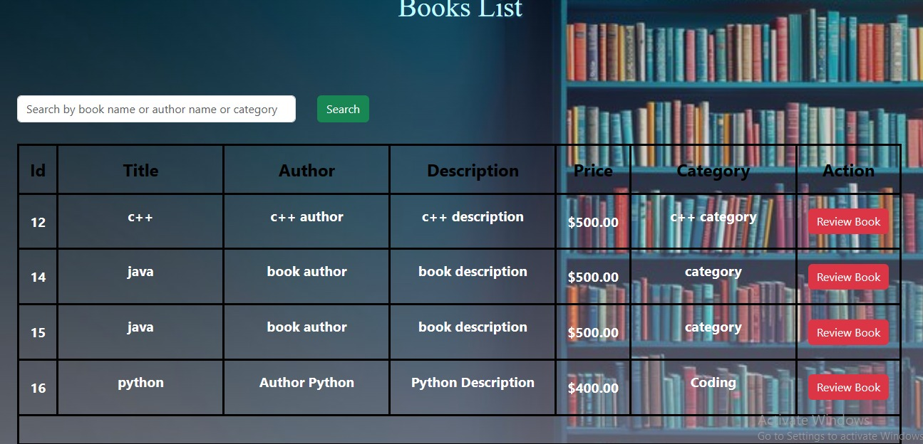
- User Book List
Post Man API request - Get - http://localhost:8086/getEnabledBooks
Spring boot code –
Book are displayed to the users that are enabled by admin.
Figure 8.11) Code Snippet - getEnabledBooks
Figure 8.12) Book List Page

Slide 22
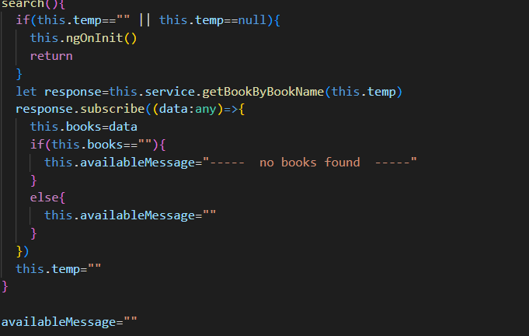


- Book Search by Book Name, Author, and Category
Post Man API request - Get - http://localhost:8086/getBookByBookName/{bookName}
Spring boot code –
Figure 8.13) Code Snippet - getBookByName
Figure 8.14) Typescript Validation (Search)

Slide 23
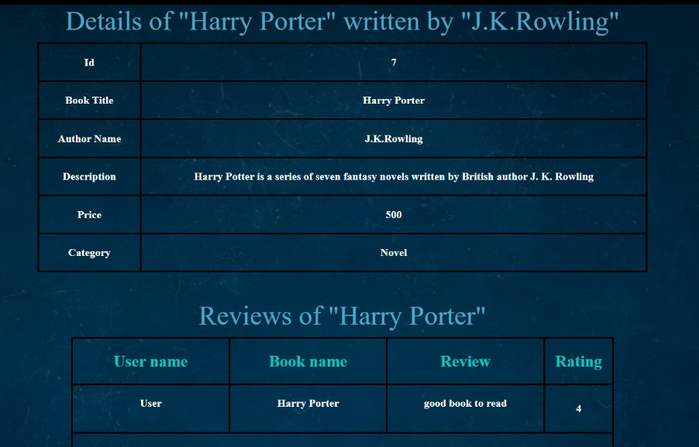
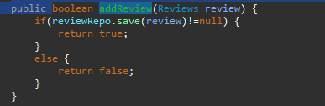
- Reviewing Available Books and Accessing Past Reviews
Post Man API request - Get - http://localhost:8086/getReviewByBook/{bookName}
Spring boot code -
Before the user reviews a book , user can see
the past reviews for the book.
Figure 8.15) Code Snippet - addReview
Figure 8.16) Review Page

Slide 24
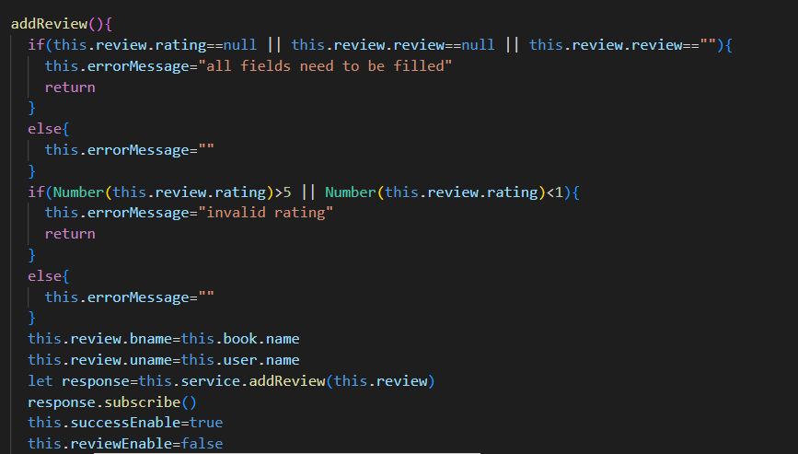
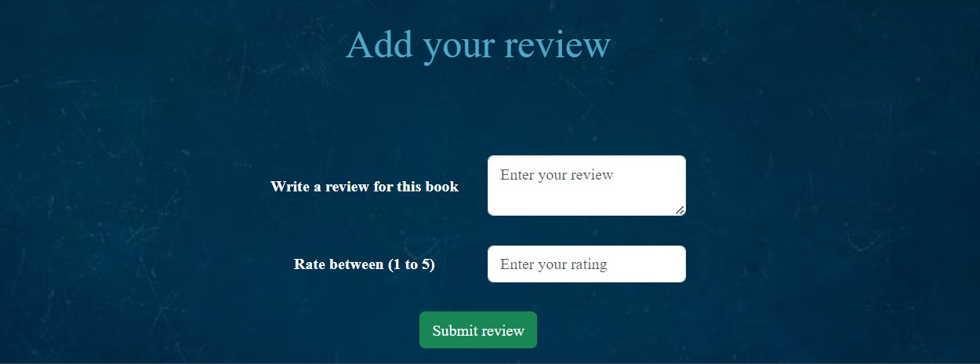
- Reviewing Available Books and Accessing Past Reviews
Figure 8.16) Typescript Code (addReview)
Figure 8.17) Add Review Page

Slide 25

9. Conclusion
A book review system enhances readers' understanding of books while providing admins insights into readers' preferences. This increased visibility improves the chances of books being discovered by more readers. Users benefit by easily finding books of interest, saving time, and gaining insight into what they'll discover, thereby increasing the likelihood of connecting with a book even before reading the first page.

Slide 26


