Slide 1
Differential Drive Robot Targeting a waypoint and a pose - Using Kinematic Models and a Closed Loop Feedback Controller
Project Update & Lesson Learned
Course: ECE 544-002, Winter 2023 By: Nayan Patel UoM ID: 27900573
Notes:
Changgeng Li , and other researchers (Xia Huang *, Jun Ding , Kun Song , Shiqing Lu) from College of Mechanical Engineering, Chongqing University of Technology, Banan 400054, China conducted a research to improve the A* search algorithm for better performance of a mobile robot in path planning step.

Slide 2
Project overview
Main goal is to drive a differential robot to a desired waypoint (x, y) and stop there with a desired pose (θ)
The robot system uses a feedback controller, inverse kinematics model, sensors and actuators
Following HW components are used:
Arduino UNO WiFi Microcontroller Board (1 No.)
L298N Motor Control Drive (1 No.)
BNO055 9-Axis Absolute Orientation IMU Sensor (1 No.)
DC Motor with Magnetic Rotary Encoder (2 Nos.)
Wheels (2 Nos.)
2004 20x4 LCD Display (1 No.)
6V DC Power Bank (1.5Vx4 AA Batteries) (1 No.)
Breadboard (1 No.)

Slide 3
System block diagram

Slide 4
Hardware schematic

Slide 5
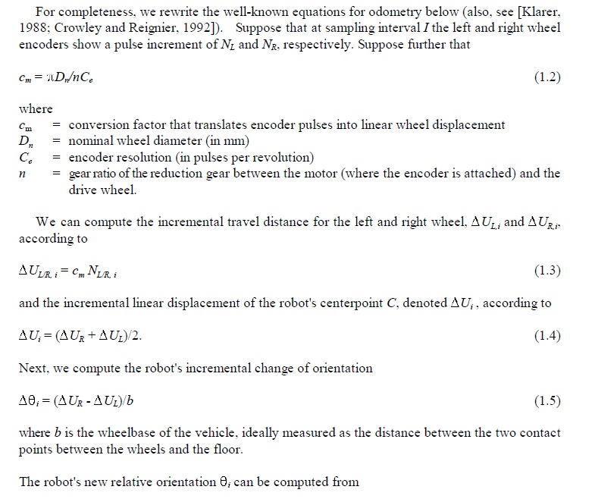
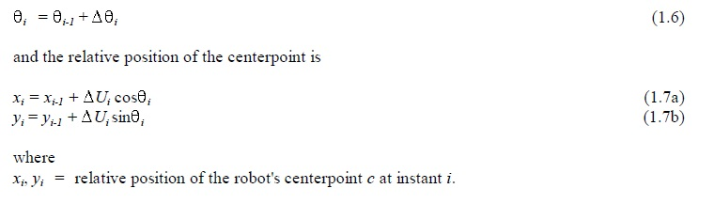
Odometry formulas used in the project
https://robotics.stackexchange.com/questions/4384/translation-the-shaft-encoder-data

Slide 6
problem faced and solved
Problem: When calculated the angular position by integrating the acceleration value from Arduino’s in-built IMU over time, an erroneous value was observed which wasn’t usable at all. That was due to the noise in the sensor output.
Solution: Added BNO055 9-Axis Absolute Accelerometer that directly provides angular positions and it’s pretty accurate for this application
Problem: The default I2C address for the BNO055 did not work at first
Solution: Several attempts were made to debug the issue but later found that the I2C ports were incorrectly defined in the code
Problem: The gear ratio of the DC motor wasn’t available from the supplier. Without gear ration, no. of revolution cannot be calculated and hence, no linear wheel displacement will be known
Solution: Reverse engineering was done to find out the exact gear ratio. The motor was rotated for one exact revolution and the pulse counts received from encoder was used in following formula to find the gear ratio:
Gear Ratio = Current Pulse Counts from Encoder / No of Pulses In One Revolution

Slide 7
Lesson learned
The system constraints (sensor noise, non-synchronous behavior of the motors, physical non-similarity of the wheels, unbalanced weight etc.) bring unpredictable motion of the robot. Feedback controller should be capable enough to take care of the system constraints
The oscillations during the traveling of the robot seems imminent due to various noise in the system
Driving PWM of the motor has to be limited as to avoid too much oscillations and overshoot. Hence, an upper limit has to be used
Continuous monitoring of robot’s position and pose is essential during the feedback controller tune up process

