Slide 1
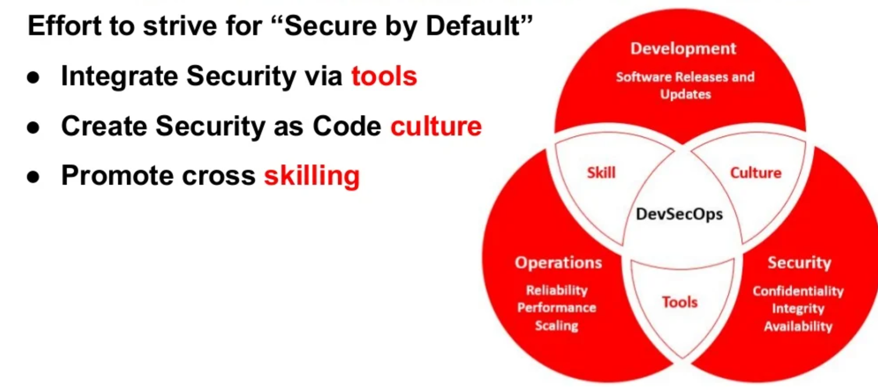
What is a DevSecOps? DevSecOps stands for development, security, and operations. It's an approach to culture, automation, and platform design that integrates security as a shared responsibility throughout the entire IT lifecycle.

Slide 2
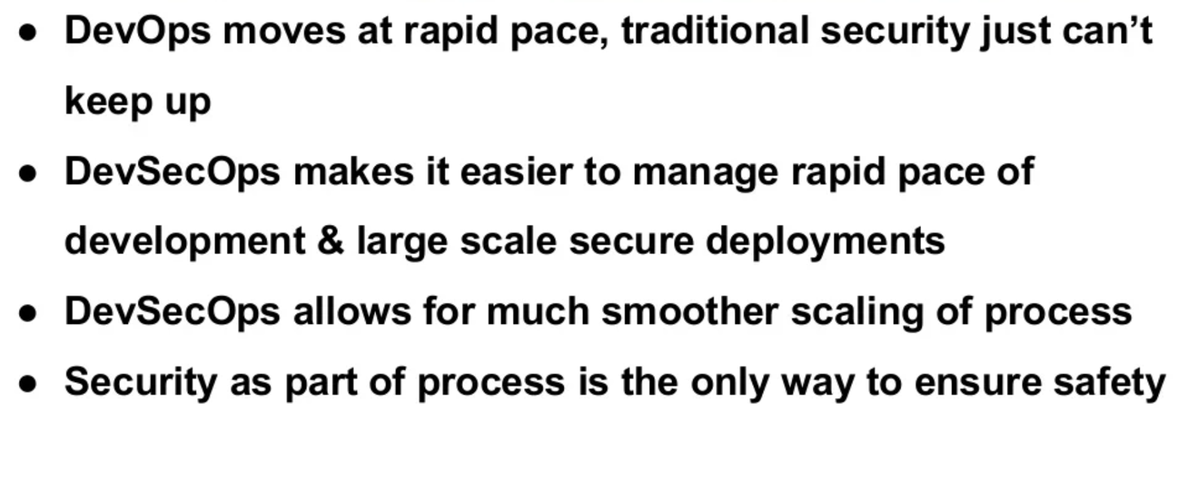
Why Do you we need DevSecOps

Slide 3
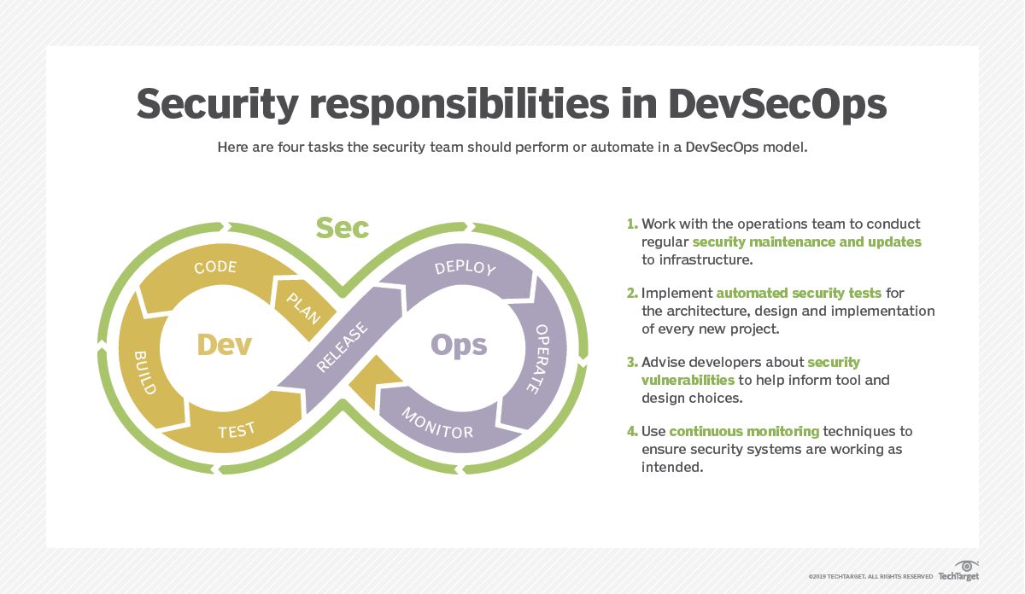
DevSecOps

Slide 4
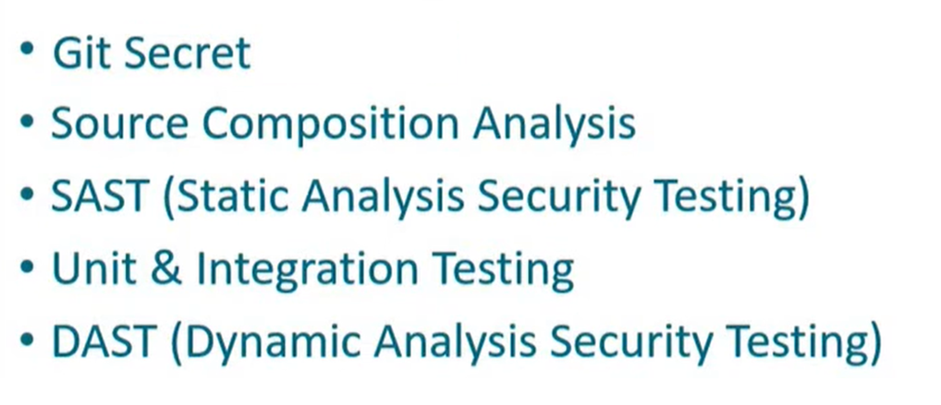
What will we learn

Slide 5




Developer
CI-CD Pipeline with Jenkins Diagram
Code Commit
Continuous Deployment
Code Checkout from Github repo
Push build artifacts
Github
Build War/jar File
Prod
1
2
3
4
5
Trigger Jenkins Pipeline

Slide 6
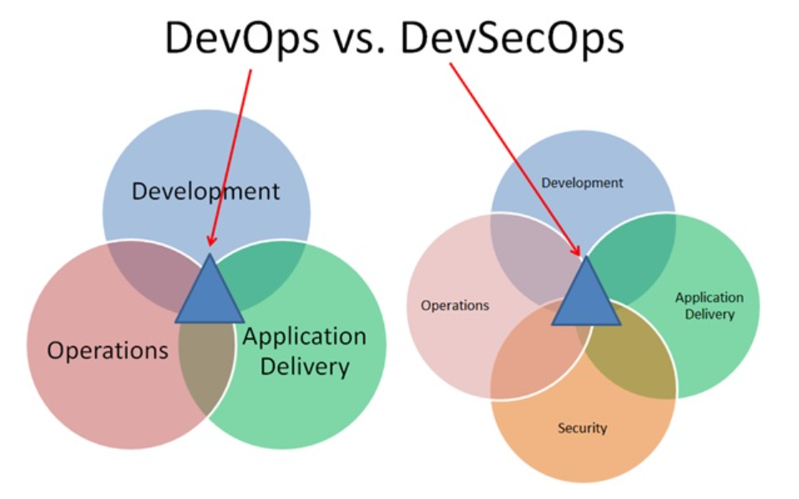
DevOps vs DevSecOps

Slide 7

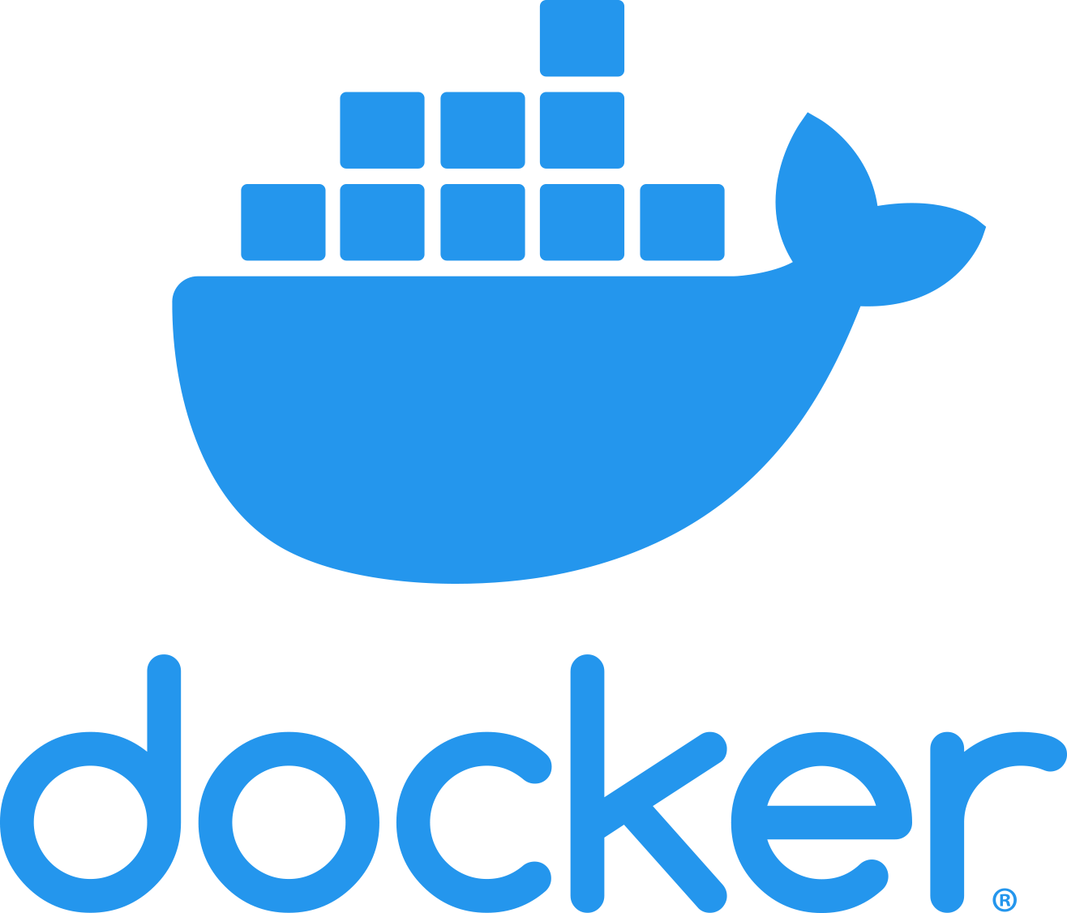
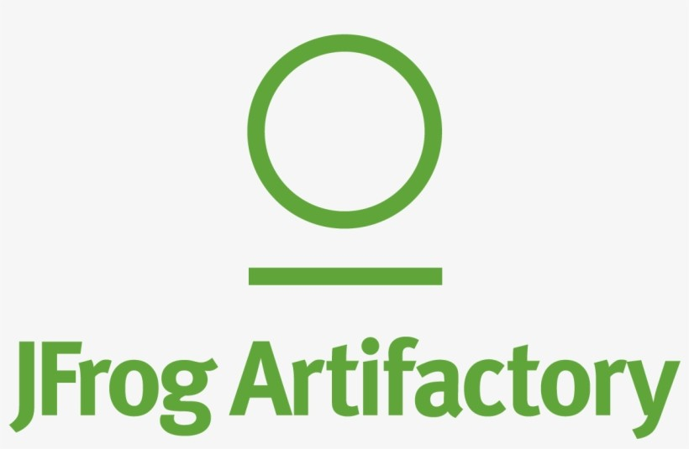





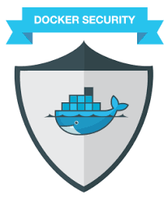
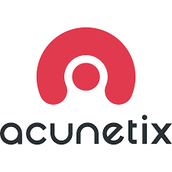
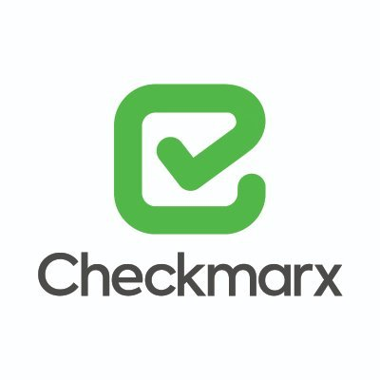


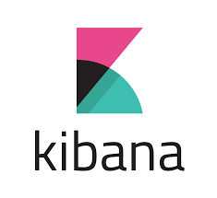

Developer
DevSecOps Pipeline with Jenkins Diagram
Amazon Container Insights
Code Commit
Pull Docker Image
Bit Bucket
Build Docker Image
Push Docker Image
Cluster Monitoring
Pre-Prod
Production
1
2
3
4
5
6
7
8
9
Static Code Analysis
Image Scan
Image Signing
Logging
Amazon EKS
Key & Secret Management
Amazon EKS
Web App Security Testing
SecOps Toolset
Run-time Container Scanning

Slide 8
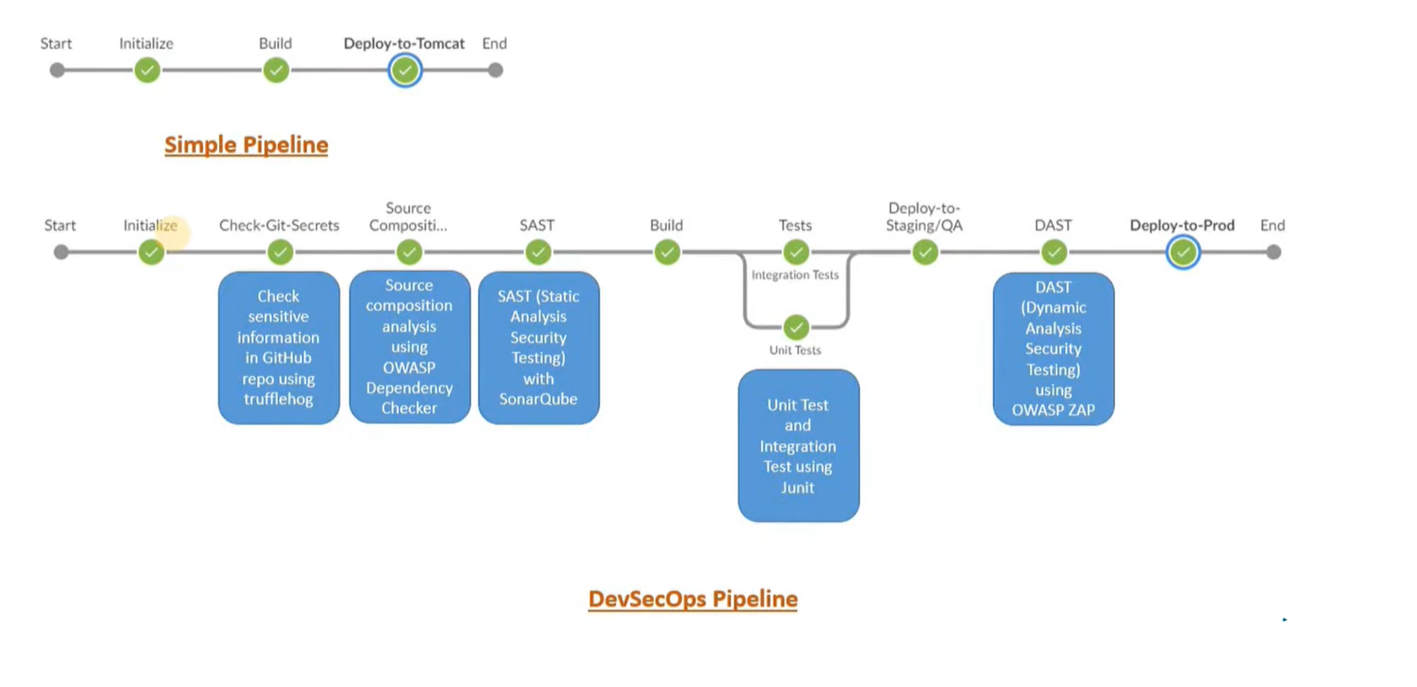
Pipeline with DevSecOps Process

Slide 9
SAST & DAST
SAST | DAST
White box security testingThe tester has access to the underlying framework, design, and implementation. The application is tested from the inside out. This type of testing represents the developer approach. | Black box security testingThe tester has no knowledge of the technologies or frameworks that the application is built on. The application is tested from the outside in. This type of testing represents the hacker approach.
Requires source codeSAST doesn’t require a deployed application. It analyzes the sources code or binary without executing the application. | Requires a running applicationDAST doesn’t require source code or binaries. It analyzes by executing the application.
Finds vulnerabilities earlier in the SDLCThe scan can be executed as soon as code is deemed feature-complete. | Finds vulnerabilities toward the end of the SDLCVulnerabilities can be discovered after the development cycle is complete.
Less expensive to fix vulnerabilitiesSince vulnerabilities are found earlier in the SDLC, it’s easier and faster to remediate them. Findings can often be fixed before the code enters the QA cycle. | More expensive to fix vulnerabilitiesSince vulnerabilities are found toward the end of the SDLC, remediation often gets pushed into the next cycle. Critical vulnerabilities may be fixed as an emergency release.
Can’t discover run-time and environment-related issuesSince the tool scans static code, it can’t discover run-time vulnerabilities. | Can discover run-time and environment-related issuesSince the tool uses dynamic analysis on an application, it is able to find run-time vulnerabilities.
Typically supports all kinds of softwareExamples include web applications, web services, and thick clients. | Typically scans only apps like web applications and web servicesDAST is not useful for other types of software.

Slide 10
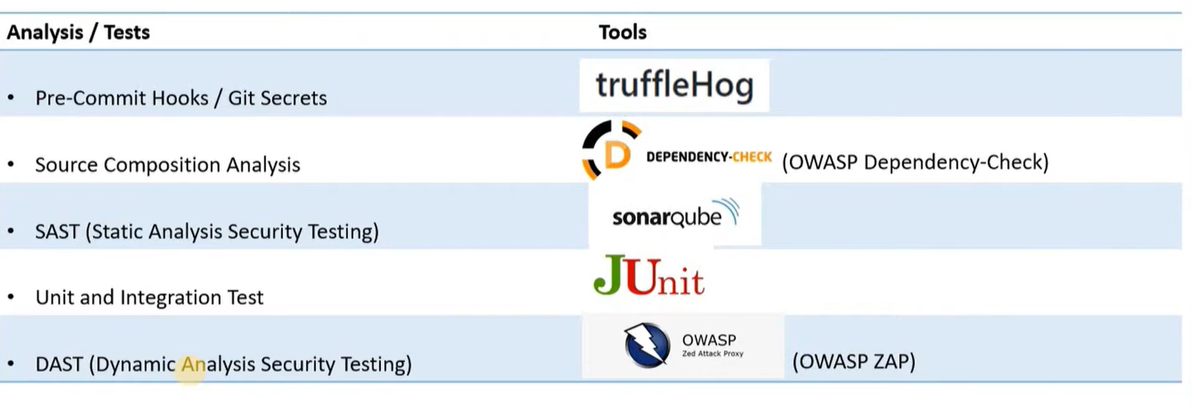
Tools Used for DevSecOps (OpenSource)

Slide 11
Developer
DevSecOps Pipeline with Jenkins Diagram
Amazon Container Insights
Code Commit
Pull Docker Image
Bit Bucket
Build Docker Image
Push Docker Image
Cluster Monitoring
Pre-Prod
Production
1
2
3
4
5
6
7
8
9
Static Code Analysis
Image Scan
Image Signing
Logging
Amazon EKS
Key & Secret Management
Amazon EKS
Web App Security Testing
SecOps Toolset
Run-time Container Scanning

