Slide 1
Naphtha
Comprehensive Market Analysis
Index:
About Naphtha
Use Cases of Naphtha
About Naphthalene
Naphtha VS Naphthalene
Naphtha – Distillation Process
Global Market Share
Market Share by Product
Players - Competitive Landscape
Major Players – Categorised by Demography
Pricing Data & Gross spread

Slide 2
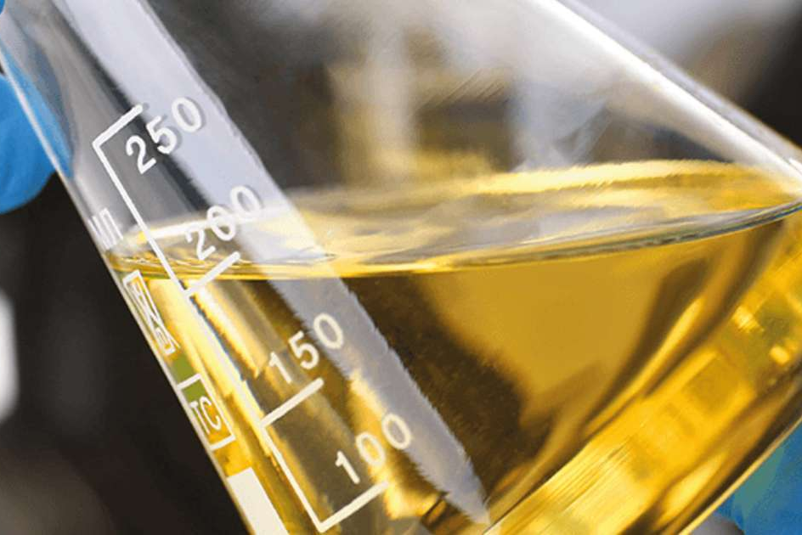
1. About Naphtha
Naphtha is a volatile, flammable liquid hydrocarbon mixture used as fuel and solvent (e.g., in camping stoves and cleaners).
Composition: Naphtha is a complex mixture of hydrocarbon compounds.
Common Usage: Naphtha is used as a solvent, dry cleaning agent, and in fuel production.
Volatility: Naphtha is highly volatile.
Derived: Petroleum refining, coal tar, or natural gas condensate
Key Grades and Classifications:
Light Naphtha (Paraffinic)
Heavy Naphtha (Naphthenic/Aromatic)
Full-Range Naphtha: A mixture covering a broader boiling range, often used as a direct feedstock for crackers.
Open-Spec Naphtha: A standard grade commonly traded for petrochemical, and chemical applications.
Straight-Run Naphtha: Derived directly from crude oil distillation.
Cracked Naphtha: Produced from refining processes like fluid catalytic cracking (FCC) or delayed coking.

Slide 3
1. About Naphtha
Understanding Naphtha Analysis
A naphtha analysis typically includes several components such as Research Octane Number (RON), Motor Octane Number (MON), Anti-Knock Index (AKI) based on that used in Naphtha Analysis and Classify it as Light or Heavy
RON (Research Octane Number): Determined at low speeds and low temperatures. It represents city driving conditions.
MON (Motor Octane Number): Determined at high speeds and high temperatures. It represents highway or heavy-load conditions.
AKI (Anti-Knock Index): The average of the two: {RON + MON}/{2}. This is the standard "Octane" rating seen on pumps in North America.

Slide 4
2. Use Cases of Naphtha
Petrochemical Feedstock (Most Important Use) | Ethylene → plastics like polyethylene Propylene → polypropylene Butadiene → synthetic rubber Aromatics (benzene, toluene, xylene) → plastics, fibers, resins
Fuel Applications | Blending component in gasoline (petrol) Used as lighter fluid Camp stove and lantern fuel
Industrial Solvent | Paints and coatings Cleaning and degreasing Rubber processing Printing inks
Hydrogen Production | Hydrogen (used in oil refineries) Synthesis gas (for ammonia and methanol production)
Others | Reforming to Produce Aromatics Chemical Manufacturing Special Applications

Slide 5
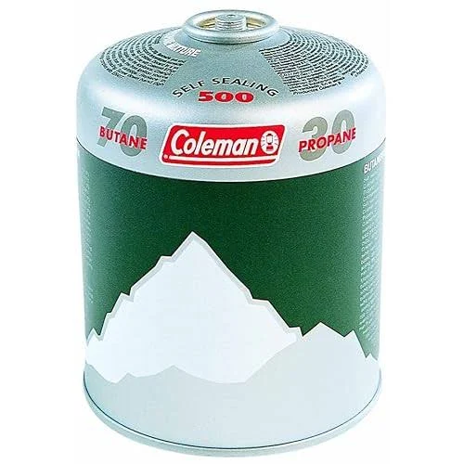
End Products of Naphtha // Support doc
Petrochemicals/Olefins & Aromatics: Ethylene, propylene, butadiene, benzene, toluene, and xylene (BTX)
Downstream Consumer Goods: Plastics, packaging, automobile components, synthetic rubber, textile fibers, detergents, medicines, cosmetics, and paints.
Energy/Fuel: High-octane gasoline blending components.
Solvents: Industrial cleaning agents, solvent for heavy crude oil, and specialized applications like shoe polish.

Slide 6
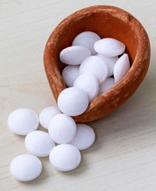
3. About Naphthalene /Not our area of concern
Naphthalene is an organic compound with the chemical formula C10H8. It is the simplest polycyclic aromatic hydrocarbon and is a white crystalline solid.
Historical Timeline (Born to Death)
  1821: John Kidd isolates naphthalene from coal tar; names “naphthaline”.
  1855: Benjamin Silliman obtains naphthalene via petroleum distillation.
  20th century: Industrial scale-up (dyes, plastics, mothballs)
  Production Lifecycle
Coal tar (71.8%) | Steel coke production | Crude (90-95%) - Intermediate processing Technical (95-98%) -General industrial uses Refined (96-98%) - Phthalic anhydride production Pure (≥99%) - Specialty applications
Petroleum (28.2%) | Fractional Distillation → Crystallization → Acid/Alkali Wash → Re-distillation.
Primary Feedstock | Refining Process | Market Grade

Slide 7
4. Naphtha VS Naphthalene
Feature | Naphtha | Naphthalene
Type | Mixture of hydrocarbons | Single chemical compound
State | Liquid | White Christal Solid
Boiling Point | 30-200 degree c | Melting Point: 78.2 degree c
Formula | Mixture of hydrocarbons (C5-C12) | C₁₀H₈
Source | Petroleum refining | Coal tar or petroleum
Main use | Fuel & petrochemical feedstock | Mothballs & chemical synthesis

Slide 8
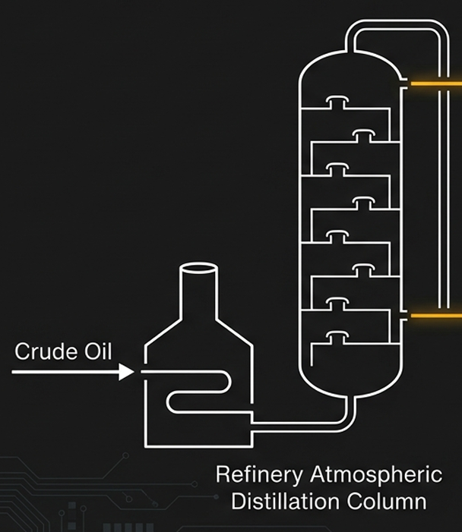
5. Naphtha – Distillation Process
LIGHT NAPHTHA (Paraffinic)
Burning Point: 30°C – 90°C
Chemistry: C5–C6 (High Paraffin)
Destiny: Steam Crackers
End Product: Olefins (Plastics)
STEAM CRACKING
Ethylene, Propylene
Market Share: ~61%
HEAVY NAPHTHA (N+A)
Burning Point: 90°C – 200°C
Chemistry: Naphthenes & Aromatics
Destiny: Catalytic Reformers
End Product: Gasoline / Aromatics (BTX)
CATALYTIC REFORMING
Reformate (High-Octane Gasoline), Aromatics (BTX)

Slide 9
Technical Analysis of Fuel and Naphtha
Understanding the Benchmarks: RON, MON, and AKI of fuels
Fuel Grade | RON | MON | AKI/Octane Ratin
Naphtha | 40 – 60 | 35 – 55 | 37 – 57
Regular Petrol | 91 – 92 | 82 – 83 | 87
Premium / High Grade | 95 – 98 | 85 – 88 | 91 – 93

Slide 10
6. Global Market Share
Naphtha Market Report Scope
Report Attribute | Details
Market size value in 2025 | USD 198.43 billion
Growth rate | CAGR of 4.4% from 2025 to 2030
Region | Market Share (2024)
Asia Pacific | 43%
North America | 23%
Europe | 21%
Middle East & Africa | 18%

Slide 11
7. Market Share by Product
Application Sector | Market Share | Primary Naphtha Type | Key Derivative Products
Petrochemicals | 34% | Light & Heavy | Ethylene, Propylene, Aromatics (BTX)
Chemicals | 26% | Light | Industrial Solvents, Chemical Intermediates
Gasoline Blending | 18% | Full-range | Reformate, Gasoline Components
Fertilizers | 14% | Heavy | Ammonia, Urea, Nitrates
Other (Energy, Specialty) | 8% | Various | Fuel, Cleaning Agents, Specialty Products

Slide 12
8. Players - Competitive Landscape
Visionaries | Leaders
Niche Players | Challengers
Shell
Exxon Mobil
Neste
TotalEnergies SE
SABIC
Reliance
BP
UPM
Chevron
Sinopec
Formosa Petrochemical
LG Chem
Mitsubishi Chemical
Completeness of Vision
Vitol
Ability to Execute

Slide 13
9. Major Players - Demography
Reliance Industries Limited (RIL)
Oil and Natural Gas Corporation (ONGC)
Indian Oil Corporation (IOCL)
Bharat Petroleum (BPCL) & Hindustan Petroleum (HPCL)
Nayara Energy
Haldia Petrochemicals Ltd (HPL)
Shell (UK)
BP (UK)
ExxonMobil
LG Chem & Lotte Chemical (South Korea)
TotalEnergies (France)
Sinopec & CNPC (China)
Saudi Aramco / SABIC
PT Pertamina (Persero)
Chandra Asri Group
Lotte Chemical Indonesia
TPPI (Trans-Pacific Petrochemical Indotama)
Keywords: maps, globe

Slide 14
10. Pricing Data
Product | Price Type | Market Name | Prices
Naphtha | CFR | Japan | $565.25/MT
Naphtha | FOB | Rotterdam | $529.50/MT
Naphtha | CFR | Far East Asia | $560.00/MT
Naphtha | FOB | Mediterranean | $485.00/MT
Naphtha | FOB | Arabian Gulf | $510.50/MT
Region | Naphtha (Feedstock) | Petrol/Gasoline (Market) | Gross Spread
Asia (Singapore/India) | ~$580 / tonne | ~$740 / tonne | $160 / tonne
Europe (ARA) | ~$560 / tonne | ~$710 / tonne | $150 / tonne
US (Gulf Coast) | ~$530 / tonne | ~$680 / tonne | $150 / tonne

Slide 15
Crude Oil
Crude oil is an unrefined yellowish-black liquid composed primarily of hydrocarbons and organic materials.
Key Methods of Classification
1. By Density (API Gravity) Measures how light or heavy the petroleum is relative to water (10° API).Light: Above 31.1° API (less than 870 kg/m³).
Medium: 22.3° – 31.1° API (870–920 kg/m³).
Heavy: Below 22.3° API (920–1000 kg/m³).
Extra Heavy (Bitumen): Below 10.0° API (greater than 1000 kg/m³).
2. By Sulfur Content (Sweet vs. Sour):
  Sweet: Low sulfur content (0.5% or less), making it easier and cheaper to refine.
  Sour: High sulfur content (1% or more), requiring more extensive processing.
3. By Chemical Composition (Base Type):
  Paraffinic: Contains little or no asphaltic material; high wax, low sulfur, high pour point.
  Naphthenic: Less wax, low pour point, higher in density than paraffinic.
  Asphaltic: High sulfur and nitrogen; suitable for road construction.

Slide 16
Crude Oil
Industry Benchmarks
West Texas Intermediate (WTI): US, light/sweet (approx. 39.6° API, 0.27% sulfur).
Brent Blend: North Sea, light/sweet (approx. 38.3° API, 0.37% sulfur).
Dubai/Oman: Middle East, medium/sour.
Classification Indicators: API Gravity - a standard, dimensionless measure of how heavy or light a petroleum liquid is compared to water.

Slide 17
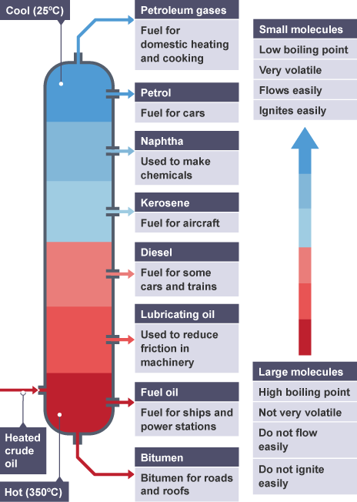
Fractional Distillation
Technical Difference: Petroleum vs Naphtha
Feature | Naphtha (Straight-Run) | Petroleum (Finished Gasoline)
Market Role | The Industrial Raw Material | The Consumer End-Product
Engine Status | "Unstable" (Pre-detonates under pressure) | "Stable" (Controlled combustion)
RON (City Driving) | 40 – 70 (Very Low) | 91 – 100+ (High)
MON (Highway Load) | 35 – 65 | 82 – 92
AKI (Average Index) | 37 – 68 | 87 – 94
Primary Use | Fuel & petrochemical feedstock | Fuel for passenger cars and bikes
Commercial Value | Commodity Price: Sold in bulk to factories | Premium Price: Sold with taxes & brand margins
Global Pricing (Est. 2026) | ~$520 – $560 per Metric Ton | ~$750 – $900 per Metric Ton

Slide 18
Crude Oil after refining
Component | Boiling Range (°C) | Density (kg/m³ @15°C) | RON | Flash Point (°C) | Engine/Application
Liquefied Petroleum Gas (LPG) | < 0°C (Propane −42°C, Butane −0.5°C) | ~500–580 (liquid) | 100–110 | −104 to −60 | Spark Ignition Engines (Cars, LPG systems)
Motor Spirit (Petrol) | 30 – 210°C | 720–780 | 91–98 | −40 | Spark Ignition Engines (Cars, Motorcycles, Small Engines)
Naphtha | 30 – 200°C | 650–750 | 60–90 (depends type) | −20 to 30 | Limited engine use; Mainly Petrochemical Feedstock
Aviation Turbine Fuel (Jet A-1) | 150 – 250°C | 775–840 | — | >38 | Gas Turbine Engines (Aircraft Jet Engines)
Kerosene | 150 – 275°C | 780–850 | — | 38–72 | Gas Turbine Engines / Heating Applications
High Speed Diesel (HSD) | 200 – 350°C | 820–860 | — | >52 | Compression Ignition Engines (Trucks, Buses, Locomotives, Generators)
Low Diesel Oil (LDO) | 250 – 380°C | 850–900 | — | >66 | Compression Ignition Engines (Industrial Diesel Engines, Boilers)
Lube Oils (Base Oil) | 300 – 400+°C | 870–950 | — | >150 | Used in All Engine Types (Lubrication – Not a Fuel)
Petroleum Coke | > 500°C (residue) | Solid | — | Not applicable | Not Used in Engines; Used in Industrial Furnaces & Kilns

Slide 19
World Energy Outlook
Metric | Value | Metric | Value
Primary Energy Consumption (Exajoules) |  | Refining Capacity (Thousand barrels/day)
World | 620 | World | 103800
Top Five Countries |  | Top Five Countries
China | 162 | China | 18484
United States of America | 94 | US | 18429
India (Rank 3) | 45.5 | Russian Federation | 6800
Russian Federation | 30.5 | India (Rank 4) | 5198
Japan | 18.5 | South Korea | 3570
Production - Oil (Thousand barrels/day) | India (Rank 21) |  | Consumption- Oil (Thousand barrels/day)
World | 101810 | World | 101420
Top Five Countries |  | Top Five Countries
US | 21910 | US | 18990
Saudi Arabia | 11130 | China | 16370
Russian Federation | 10750 | India (Rank 3) | 5620
Canada | 5760 | Saudi Arabia | 3960
China | 5260 | Russian Federation | 3850
Notes:
Onshore field(Land Extraction Oil) , Offshore field (Ocean Extraction Oil), Import; Notice: Consumption capability > refining capacity

Slide 20
India – Import Export data points
India's Top 5 Crude Oil Import Sources (by Volume)
 | 25-26 | 24-25 | 23-24
IMPORT
Crude oil | 185155 | 243225 | 234262
LPG | 16625 | 20667 | 18514
Naphtha | 824 | 941 | 1211
EXPORT
LPG | 423 | 551 | 525
Naphtha | 4776 | 5169 | 5275
Country | FY 2022–23 (MMT) | FY 2023–24 (MMT) | FY 2024–25 (Est. MMT)
Russia | 50.85 | 83.02 | 87.54
Iraq | 48.05 | 42.13 | 44.01
Saudi Arabia | 38.86 | 33.10 | 34.47
UAE | 21.19 | 18.75 | 19.56
USA | 16.02 | 10.65 | 19.80
Total (All Sources) | 235.52 | 231.46 | 244.50
('000 Metric Tonnes)
Million Metric Tonnes (MMT)
2025-2026FY: India imported 185.15 MMT (till December 25)
Source: Ministry of Commerce and Industry (specifically the DGCIS and PPAC)

