Slide 1
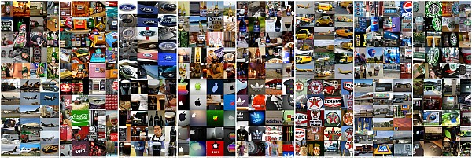
Brand logo recognition methods

Slide 2
Goal of the project
To enable recognition of brand logo of companies in a video stream.
To calculate the effectiveness of the detected logo in the video stream.

Slide 3
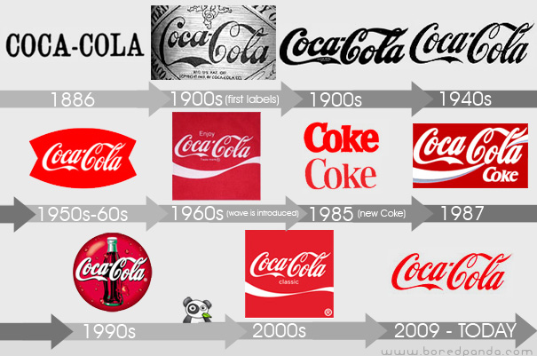
Challenges
Large number of logo belonging to various companies in different flavors, shapes, texture and sizes.
Presence of occlusion, blurring,scaling, rotation and affine transformed logos in the video stream.

Slide 4
Computer vision - Recognition
Task of recognition is composed of
Object recognition – Recognition of learned objects in an image.
Identification – Process of correctly identifying the object in an image.
Detection – Process of detecting a pre defined condition in a image.

Slide 5
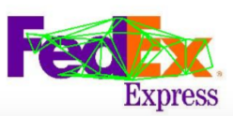
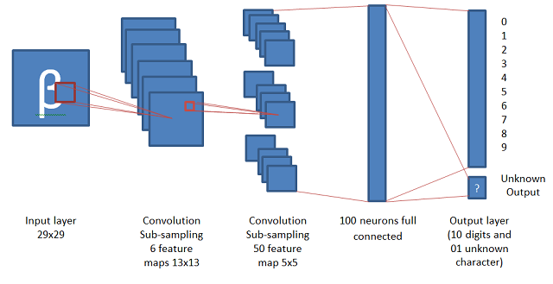
Methods for recognition task
Geometrical methods (Based on handcrafted features)
- SIFT descriptor matching method.
- Delaunay triangle based method.
Convolutional neural network method for recognition
- Obtaining feature vector from CNN network for further
- Based on learning a CNN to classify an input image into one of the output classes.

Slide 6
Geometrical methods
1. SIFT descriptor matching method
Steps:
a) Database creation – Pre processing step
1. SIFT feature extraction of brand logo images.
2. Using K-means clustering to obtain a centroid for future comparison.
3. Learning SVM to classify (one vs all) for each logo.
b) Recognition of logo
1. Using sliding window technique to search for the logo in entire image frame by extracting the SIFT descriptors.
2. Classifying the obtained SIFT descriptor to recognize the detected logo in an image frame.

Slide 7
Geometrical methods
2. Delaunay triangle based method
Steps:
a) Database creation – Pre processing step
1. SIFT key-points extraction of brand logo images.
2. Creation of delaunay triangles using obtained SIFT key-points for a brand logo.
3. Creating a unique signature for each of the delaunay triangles.
4. Storing the created signature in an inverted file for fast look up during detection.
b) Recognition of logo in an image frame
1. Using sliding window technique to search for the logo in entire image frame by extracting the SIFT key-points
2. Creation of delaunay triangles in the given window, and creation of signature and comparing with the database.
3. If there is a match of pre defined threshold number of triangles, the logo is said to be detected.
3. One more method is by using BoW (Bag of visual words) for logo detection.

Slide 8
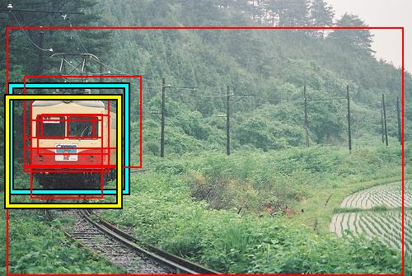
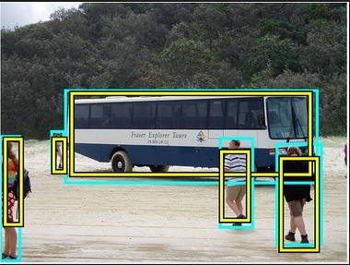
Convolution neural network method
Step 1 : Object localization
Extra step of object localization is required to reduce the search area of logos in an image frame.
Objectness and selective search methods - predict the presence of objects in an image frame.

Slide 9
Convolution neural network method
Step 2 : Deep neural network based classification and recognition.
a. Training: Train the network to classify a pre determined size of image patch to one of the output classes.
b. Detection : Predicting bounding boxes for objects and then detecting logo using Deep neural network.

Slide 10
Popular implementations of CNN
Krizhevsky architecture (2012)
Computational resources :
1. For training : One week with 2 GPUs having 3GB RAM.
GoogleNet architecture (2014) – Highest accuracy so far in CNN.
Computational resources :
1. For training : One week with two GPUs, each having 12GB RAM.

Slide 11
Comparison of various methods
Logo Detection methods (----->) | Delanauy triangle based method | BoW methods | Deep neural networks
Features
Training required | No | Yes | Yes
Comparison during detection | Yes | Yes | No
Database required | Yes (Huge DB) | Yes | No
Scalable method | Yes | Yes | Yes
Retraining to add more logos | No | Yes | Yes
Training time | No | Yes (Less) | Yes(min. One week)
Labeling the dataset | No | Yes | Yes
Acceleration on GPUs | Mediocre data parallelism | Less data parallel layers | Highly data parallel layers to exploit on GPUs

Slide 12
Comparison of various methods contd.
Logo Detection methods (----->) | Delanauy triangle based method | BoW methods | Deep neural networks
Features
Pros | No training required, Less accuracy | Less training time, Good accuracy | Detection accuracy depends on training, best methods for object recognition so far.
Cons | Large DB, online comparison | DB required, online comparison, good for retrieval task. | Highly resolution dependent, shape dependent.

Slide 13
Any suggestions for the future step ?
Questions ?

