Slide 1
Remote Team Collaboration Platform
SOEN 6841
Group #6
GitHub Link : https://github.com/nayansorarhiya/SOEN6841_Project.git
Team Members:
Siddharth Bharat Oza (40230155)
Urvilkumar Patel (40230630)
Sachin Prakash (40218678)
Nayankumar Rajeshbhai Sorathiya (40227432)

Slide 2
Introduction
In the era of remote work, how can we bridge the gap between teams spread across the globe?
Transition to remote work has introduced challenges in communication and task management. Existing platforms may not provide a comprehensive solution.
There’s a significant opportunity to develop a software solution that addresses these unique challenges.

Slide 3
CollabHQ
A comprehensive platform integrating various collaboration tools, leveraging AI for intelligent features.

Slide 4
Value Proposition for Potential Users
Enhanced Cooperation: Regardless of time zones or location barriers, our platform for remote team collaboration facilitates easy coordination, communication, and cooperation between dispersed teams.
Enhanced Productivity: Our platform's capabilities, which include version control, activity tracking, and real-time collaboration, minimize delays, cut down on errors, and streamline processes to increase productivity.
Cost savings: We assist companies in reducing the expenses of software licensing, infrastructure, and IT overheads related to juggling various systems by combining several collaborative tools into a single platform and providing flexible pricing options.
Increased Employee Engagement: Our platform's features, which include social media channels, virtual team building exercises, and recognition programs, let remote workers feel like they belong and are a team.

Slide 5
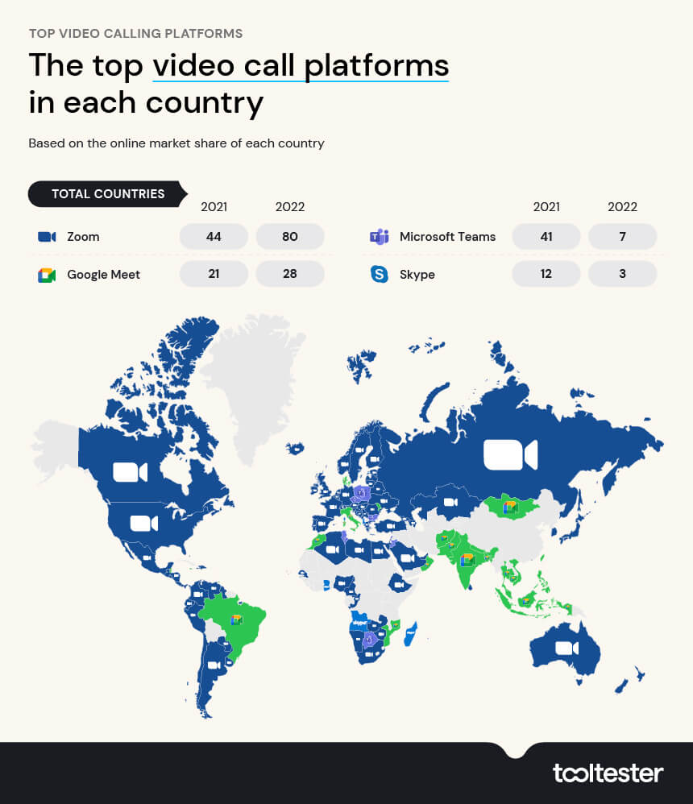
Market Analysis
Competitors:
Google Meet
Slack
Microsoft Teams
Trello
GitHub
Zoom

Slide 6
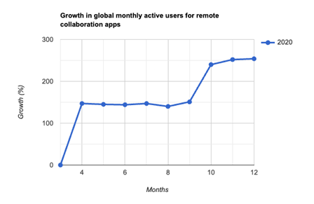
Market Analysis
Target Audience:
Audience: SMEs, big businesses, remote workers, freelancers, educational institutions.
Demographics: Working professionals aged 25-55, dispersed globally, across various industries.
Psychographics: Tech-savvy, flexible, collaboration-oriented, innovative, efficiency-driven.

Slide 7
Feasibility and Viability:
Technical Feasibility:
CollabHQ Infrastructure Needs: CollabHQ requires robust infrastructure capable of supporting high-definition video conferencing, real-time collaboration features, and AI-powered functionalities.
Compatibility and Integration: Assessing the compatibility of CollabHQ with existing platforms and tools commonly used by remote teams is crucial.
Scalability and Performance: Performance testing should be conducted to ensure smooth operation under varying loads and user interactions.
Technological Risks: Identifying potential risks associated with the implementation of advanced features such as AI-powered transcriber, sentiment analysis, and real-time collaboration tools.
Security Measures: Ensuring compliance with industry standards and regulations regarding data security and privacy.

Slide 8
Feasibility and Viability:
Operational Feasibility:
Workflow Integration: Assessing how ColabHQ will integrate into the existing workflows of remote teams.
Training and Adoption: Analyzing the readiness of remote team members to adopt new collaboration tools and technologies.
Change Management: Identifying key stakeholders and change champions within organizations to drive adoption and overcome resistance to change.
Economic Feasibility:
Skilled development team: Availability of experienced developers proficient in web development and collaboration technologies.
Technology infrastructure: Access to reliable hosting services and cloud platforms for deploying and scaling the platform.
Financial resources: Adequate funding for development, marketing, and ongoing maintenance of the platform.

Slide 9
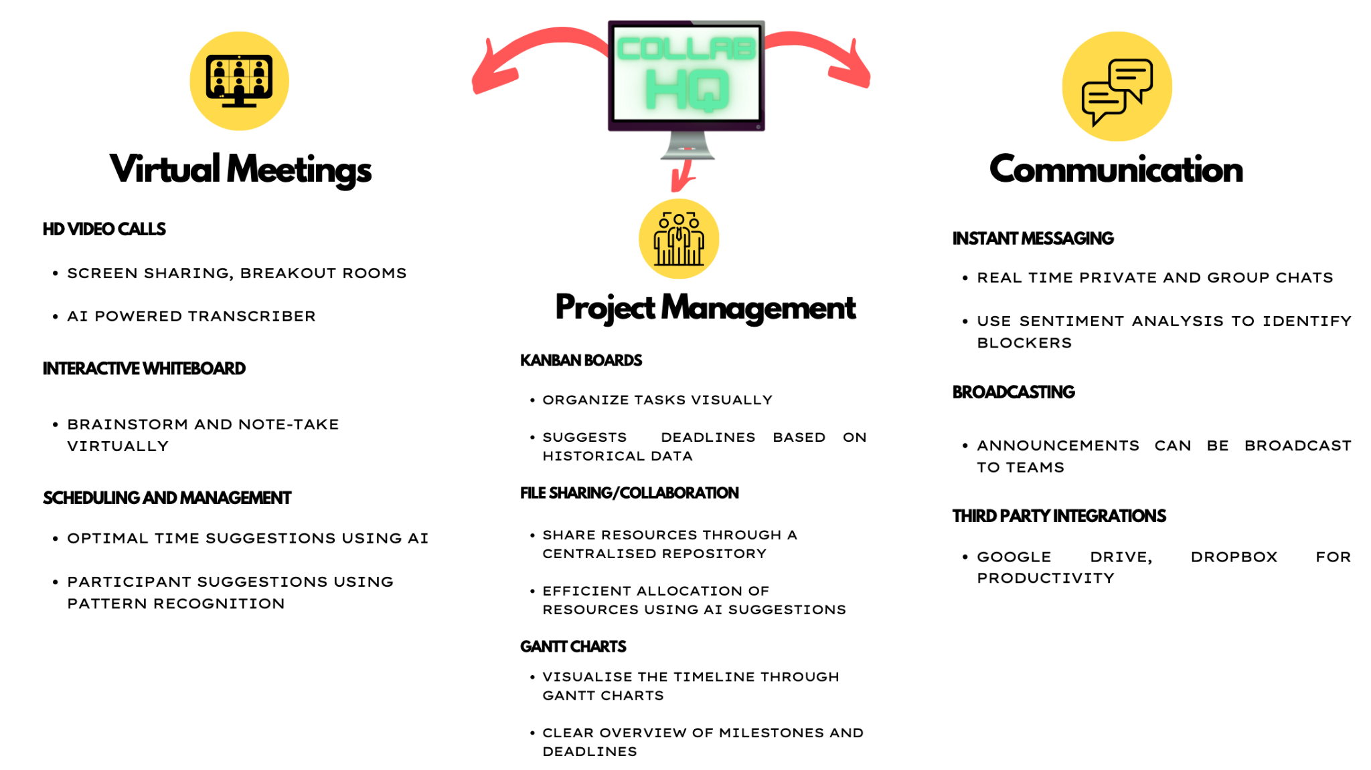
Solution Highlights

Slide 10
Project Plan Overview
Phase 1 - Requirements Gathering and Analysis (4 weeks)
REQUIREMENTS DOCUMENT OUTLINING FUNCTIONAL AND NON-FUNCTIONAL NEEDS.
PROJECT DOCUMENTATION WITH TIMELINE, RESOURCE ALLOCATION, AND MILESTONES FOR ALL PHASES.
BUSINESS ANALYST (BA) - LEADS REQUIREMENTS GATHERING, FACILITATING WORKSHOPS AND MEETINGS WITH STAKEHOLDERS TO UNDERSTAND THEIR NEEDS.
Phase 2 - System Design and Architecture (6 weeks)
ARCHITECTURAL DESIGN DOCUMENT OUTLINING COMPONENTS, INTERACTIONS, AND STRUCTURE.
UI/UX PROTOTYPES (WIREFRAMES, MOCKUPS) FOR USER INTERFACE DESIGN.
SOLUTION ARCHITECT - DESIGNS THE SYSTEM'S OVERALL ARCHITECTURE, DEFINING COMPONENTS, INTERACTIONS, AND DATA FLOW. CREATES THE ARCHITECTURAL DESIGN DOCUMENT.
Phase 3 - Development (10 weeks)
FRONTEND CODEBASE WITH IMPLEMENTED FEATURES.
FUNCTIONAL BACKEND COMPONENTS, APIS, AND SERVICES.
DATABASE SCHEMA DEFINING TABLE STRUCTURE FOR THE APPLICATION
FULL-STACK DEVELOPER - A FULL-STACK DEVELOPER WOULD HANDLE BOTH THE FRONTEND AND BACKEND ASPECTS OF THE APPLICATION.
Phase 4 - Testing and Integration (4 weeks)
TEST REPORTS SUMMARIZING TEST RESULTS, IDENTIFIED ISSUES, BUGS, AND RESOLUTIONS.
RESOLVED BUG LIST WITH DETAILS ON ADDRESSED BUGS AND ISSUES.
QA TESTER - EXECUTES VARIOUS TESTS (FUNCTIONAL, PERFORMANCE, SECURITY) TO IDENTIFY BUGS AND ENSURE THE SOFTWARE MEETS REQUIREMENTS.
Phase 5 - Deployment and Hypercare Support (12 weeks)
FULLY FUNCTIONAL SOFTWARE DEPLOYED TO PRODUCTION ENVIRONMENT.
TRAINING MATERIALS (DOCUMENTATION, TUTORIALS, OR TRAINING SESSIONS) FOR CUSTOMER ADOPTION.

Slide 11
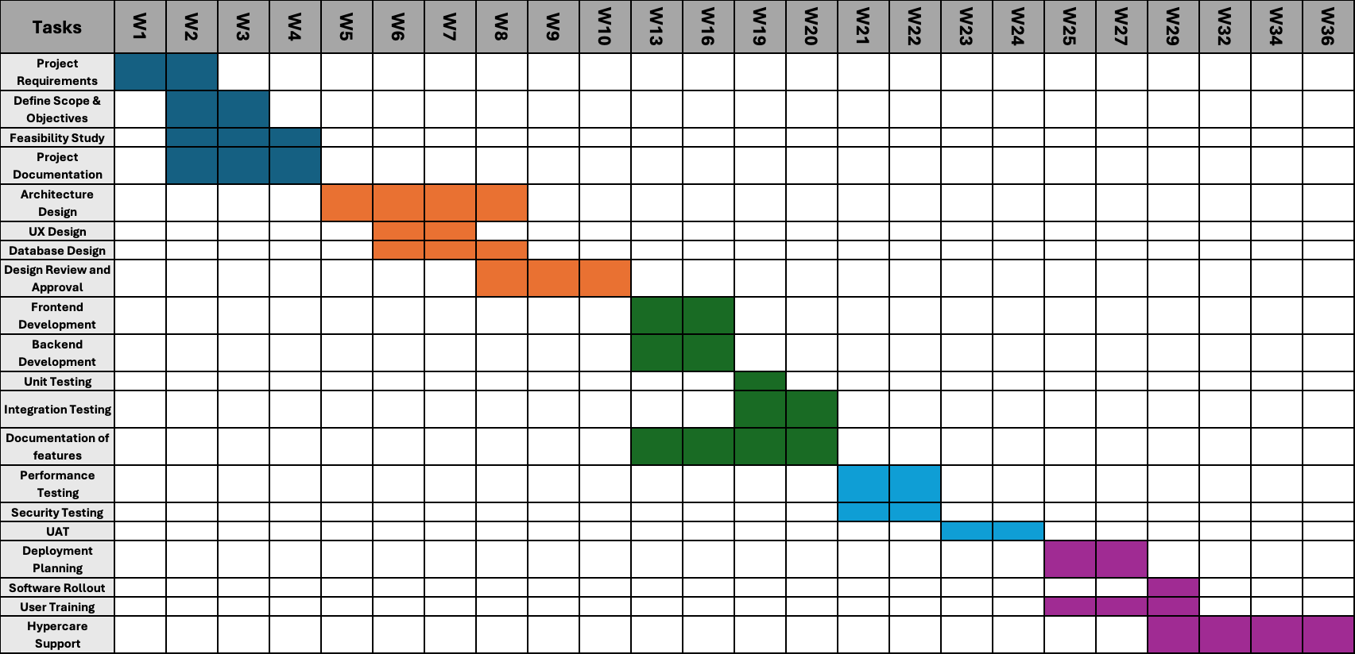
Project Timeline

Slide 12
Risk Assessment
Risk Identification:
Initiation Phase
Requirement Changes : High impact
Resource Constraints : Medium impact
2. Planning Phase
Budget Overruns : High impact
Communication Breakdown : Medium impact
3. Executing Phase
Technology Dependencies : High impact
Security Vulnerabilities : High impact
Quality Assurance : High impact
Integration Challenges : Medium impact
Monitoring and Control Phase
Scope Creep : High impact
Deployment Risks : High impact

Slide 13
Mitigation Plan
Requirement Changes
Establish a change management process with clear guidelines.
Regularly communicate with stakeholders to manage expectations.
Resource Constraints
Crosstrain team members for skill redundancy.
Maintain a flexible staffing strategy.
Technology Dependencies
Conduct thorough research and testing.
Identify backup solutions or alternative technologies.
Security Vulnerabilities
Implement robust security measures.
Stay updated on security best practices.
Integration Challenges
Collaborate closely with third-party vendors.
Develop contingency plans and fallback mechanisms.

Slide 14
Mitigation Plan
Scope Creep
Establish a formal change control process.
Educate stakeholders on the impact of scope changes.
Budget Overruns
Regularly monitor project expenses.
Maintain a contingency fund.
Communication Breakdown
Implement robust communication channels.
Conduct regular project status meetings.
Quality Assurance
Implement automated testing frameworks.
Allocate sufficient time and resources for testing.
Deployment Risks
Conduct thorough deployment rehearsals.
Develop rollback plans and communication strategies.

Slide 15
Mitigation Plan
Contingency Plan:
Establish a dedicated crisis management team.
Maintain regular project status updates to stakeholders.
Document lessons learned from previous projects.

Slide 16
Budgeting
Budgeting Breakdown:
Development:
Salaries
Licensing,
Infrastructure
2. Testing:
Salaries
Testing Tools
Infrastructure
3. Marketing :
Digital Marketing
Website Development
Campaigns/Events
Ongoing Maintenance:
Salaries
Subscriptions
Infrastructure
5. Contingency Budget:
Allocation: 10% of the total budget
Rationale: Provides a buffer for unforeseen expenses.

Slide 17
Budgeting
Budgeting Breakdown:
Development:
Salaries
Licensing,
Infrastructure
2. Testing:
Salaries
Testing Tools
Infrastructure
3. Marketing :
Digital Marketing
Website Development
Campaigns/Events
Ongoing Maintenance:
Salaries
Subscriptions
Infrastructure
5. Contingency Budget:
Allocation: 10% of the total budget
Rationale: Provides a buffer for unforeseen expenses.

Slide 18
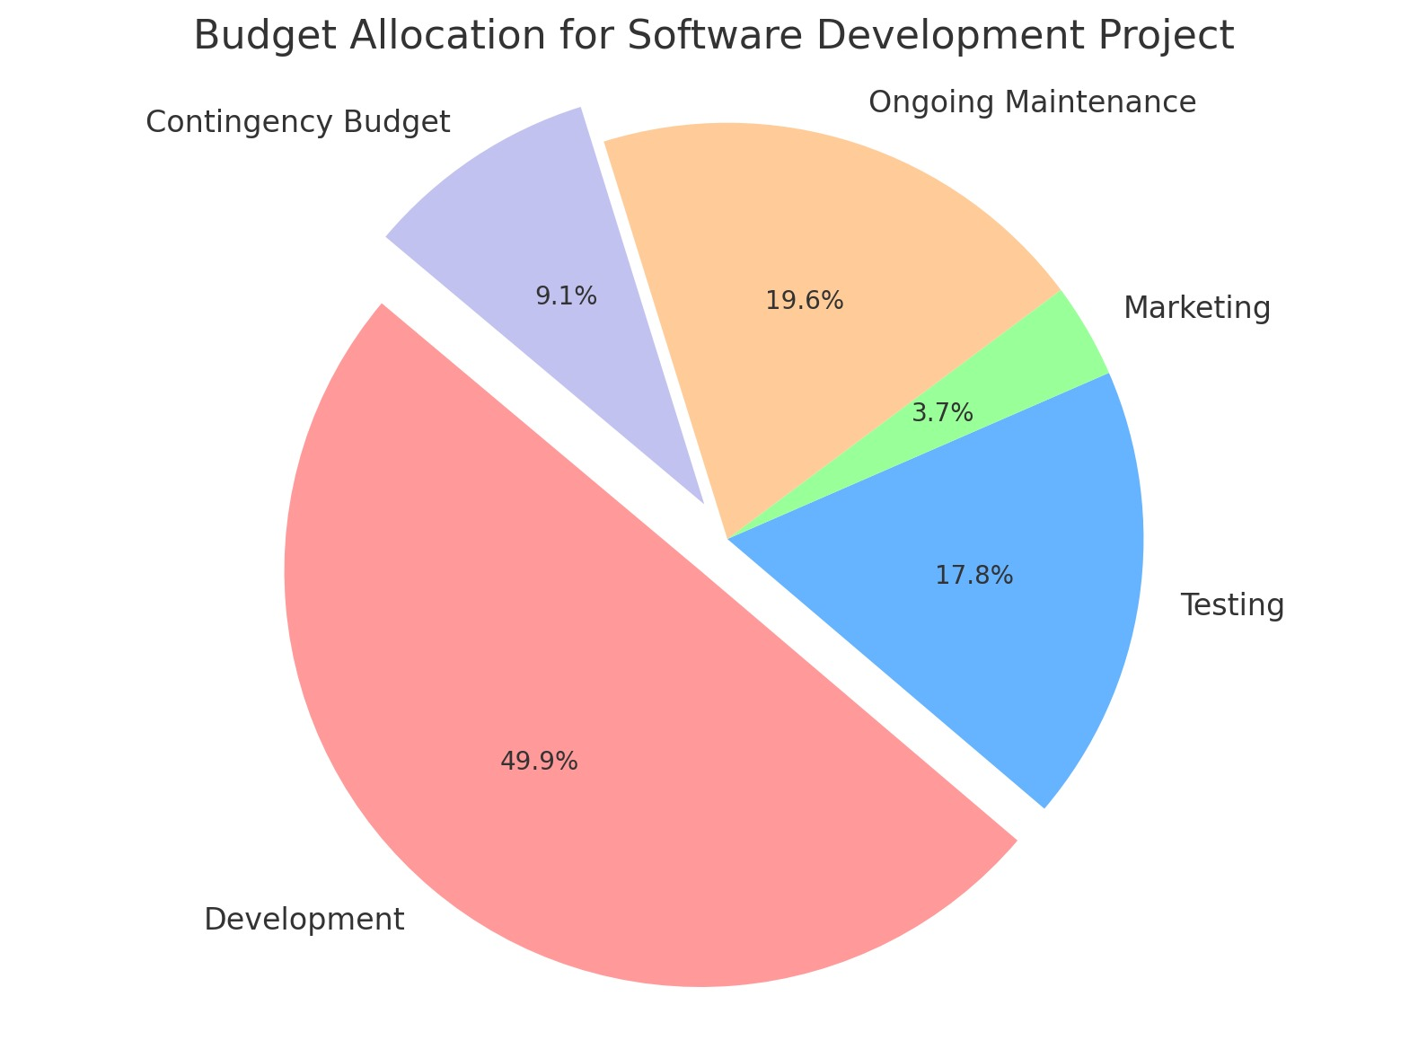
Budgeting

Slide 19
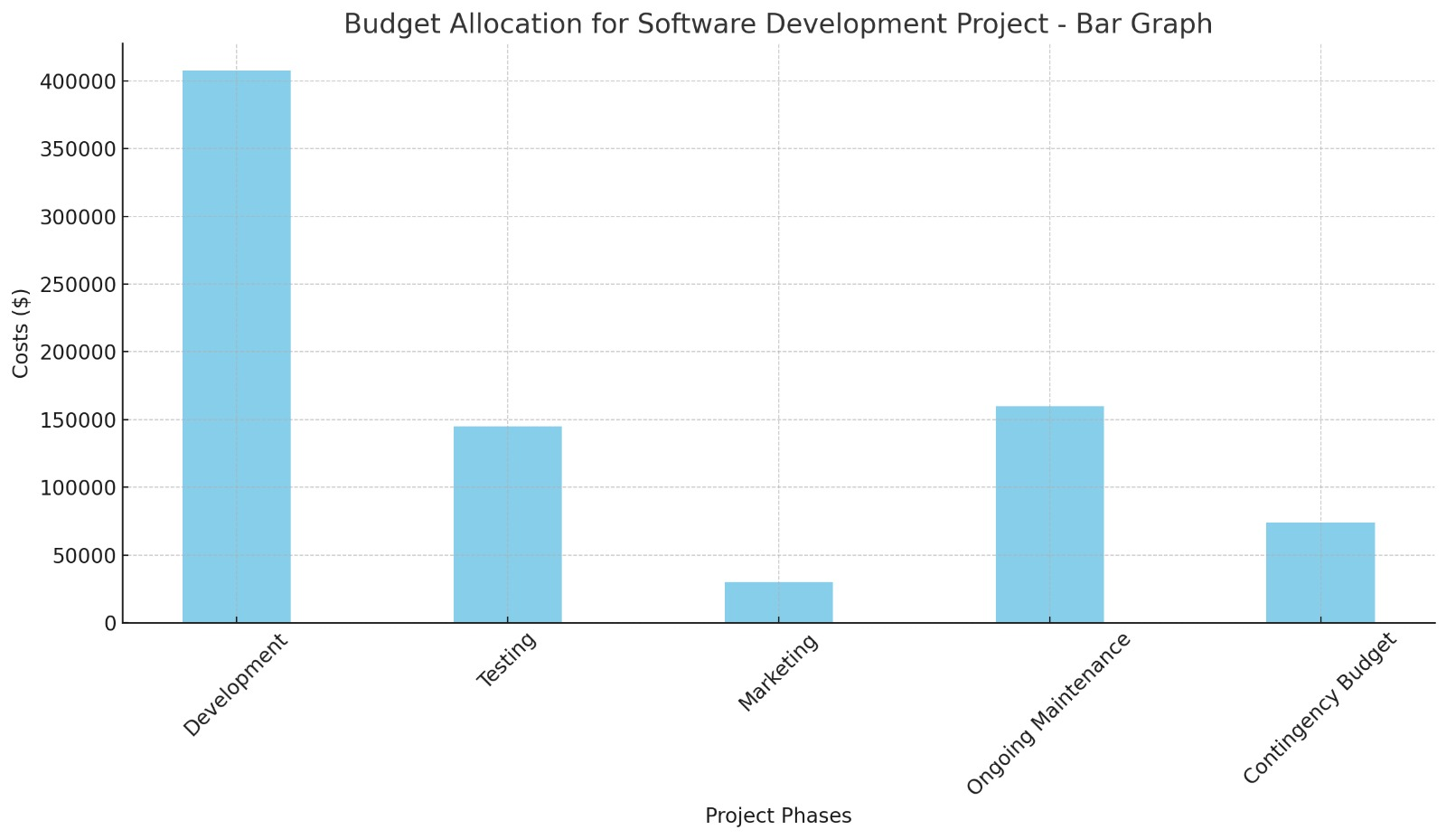
Budgeting

Slide 20
Conclusion
Recap of Project Objectives
We set out to develop CollabHQ, a comprehensive remote collaboration platform designed to empower teams to work seamlessly regardless of location.
Key Features and Benefits
CollabHQ integrates essential features for virtual meetings, project management, and team communication, fostering a unified and productive work environment.
Project Plan and Timeline
Our project plan spans from requirements gathering to deployment, ensuring a structured approach to project execution.
Risk Assessment and Mitigation
We've identified potential risks such as requirement changes and security vulnerabilities, and developed mitigation strategies to ensure project success.
Budgeting Overview
Budget allocation includes salaries, licensing, infrastructure, marketing, and ongoing maintenance, with a contingency budget to handle unforeseen expenses.
Next Steps
Moving forward, we'll proceed with development, testing, and delivery, aiming to revolutionize remote collaboration with CollabHQ.

Slide 21
Question & Answer
GitHub Link : https://github.com/nayansorarhiya/SOEN6841_Project.git

