Slide 1
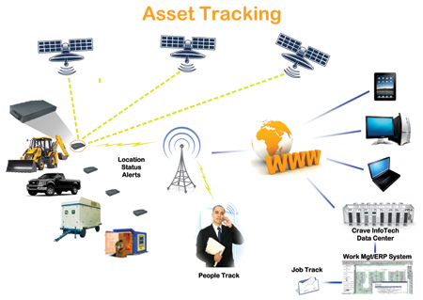
Valuable Asset Tracking
Image source: http://www.utilityproducts.com/content/dam/up/print-articles/volume-17/issue-6/Asset-Tracking.jpg

Slide 2
Table Of Contents
Definition
Applications of Asset Tracking.
Characteristics of Asset Tracking Systems.
Popular Asset Tracking Technologies
  QR Code Technology
  RFID Technology.
Problems with RFID
References.

Slide 3
Valuable Aseet Tracking
Definition
  Asset tracking can be defined as the concept of tracking the physical asset movement and by calculating their location position and there after broadcasting this information for a purpose.
Asset tracking types
Global asset tracking (GPS tracking)
    For example : Cargo / Fleet management.
Local asset tracking. (Indoor tracking)
    Used primarily when in places where GPS signals are not available.
Combination technologies.
Notes:
Global asset tracking : Fleet management

Slide 4
Valuable Asset Tracking
Applications
  Monitoring hospital asset Inventories
  Cargo fleet management.
  Tracking of high value confidential systems.
  Tracking business commodities in commercial establishments.
  Tracking high value targets for security establishments.
  Used for tracking objects via assembly line in factories.
  Pets and animal identification.
  RFID tags used in Electronic toll collection.
Notes:
Hospitals has significant amount of asset invetories if not tracked can be misplaced or stolen.

Slide 5
Characteristics of asset tracking system.
Location:
  Area where the tracking system shall need to operate. For ex: Indoor or outdoor.
Technology:
  Volume and type of assets.
Report
  Type of reporting needed supported by asset tracking software.

Slide 6
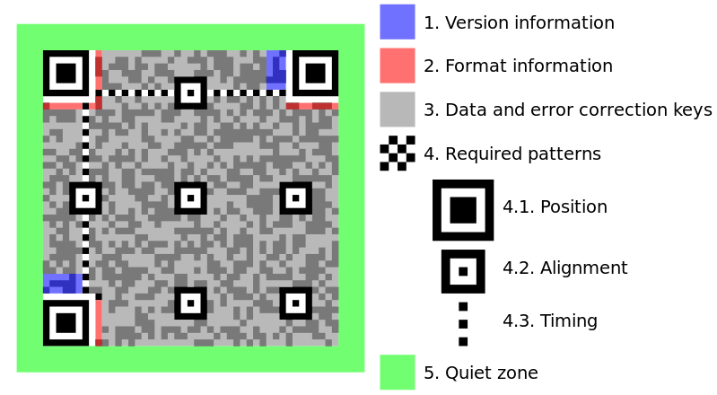
Asset tracking technologies
  Quick Response Code (QRCode)
    Initially pioneered by Japanese automobile companies for component asset tracking along the assembly lines.
    Currently widely used for many commercial applications . For ex: asset identification , time tracking ,mobile tagging, etc..
    QRCode is machine readable optical label that contains information on the asset that is supposed to be tracked.
    Anatomy of QR Code
Notes:
QR Code
A QR code consists of black modules (square dots) arranged in a square grid on a white background, which can be read by an imaging device (such as a camera) and processed using Reed–Solomon error correction until the image can be appropriately interpreted. The required data are then extracted from patterns present in both horizontal and vertical components of the image.

Slide 7
QR Code Applications
QR Code Applications
  Initially target was to track assets in the assembly line , but now QR technology is increasingly finding its use in commercial applications.
  Object hyperlinking.
  Consumer advertising
  Commercial tracking.
  Entertainment ticketing.
  Product labeling and information display.
  Mobile couponing.
Notes:
QR codes storing addresses and Uniform Resource Locators (URLs) may appear in magazines, on signs, on buses, on business cards, or on almost any object about which users might want information. Users with a camera phone equipped with the correct reader application can scan the image of the QR code to display text, contact information, connect to a wireless network, or open a web page in the telephone's browser.

Slide 8
RFID Technology.
RFID Technology
  RFID technology uses wireless radio-frequency electromagnetic fields to transfer data (tagID), for the purposes of identifying and tracking tags attached to valuable objects.
RFID system components.
  Antenna for scanning out for RF signals.
  Transceiver with decoder for data analysis.
  RFID tag which embedded data (programmed in it).
Notes:
The scanning antenna puts out radio-frequency signals in a relatively short range.
The RF radiation does two things:
It provides a means of communicating with the transponder (the RFID tag) AND
It provides the RFID tag with the energy to communicate (in the case of passive RFID tags).
This is an absolutely key part of the technology; RFID tags do not need to contain batteries, and can therefore remain usable for very long periods of time (maybe decades).

Slide 9
RFID technology
The scanning antennas can be permanently fixed to a stationary object.
  In a typical asset tracking , these reader are placed at exit points from the building or in the path ways to intercept data from objects passing.
When ever RFID tags pass though these designated points , they get activated and exchange information programmed in them with the readers
Two types of RFID tags
  Active tags
  Passive tags

Slide 10
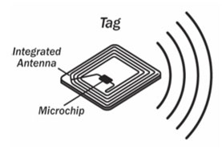
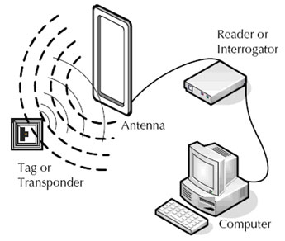
RFID Technology
Source : http://www.barcodesinc.com/info/buying-guides/rfid.htm

Slide 11
RFID Technology
Active ID tags:
  These tags comes with their own power sources and reader/antennas can be pick up these tags from distances.
  Life span can be as long as 10 years , but nevertheless they come with a defined life span as they use internal power source.
  Range can be tens of meters
  Typically more expensive to manufacture and are bigger in sizes.
  Can accommodate extra circuitry as there is power source.
Passive ID Tags:
  These tags does not have operate have power source internally but instead get activated once they come in contact with radio signals from the reader.
  Can operate for virtually for ever (Usual life span is 20 or more years).
  Less expensive and can be as small as a grain of rice.
  Can work only in short distances , mostly under few feet.

Slide 12
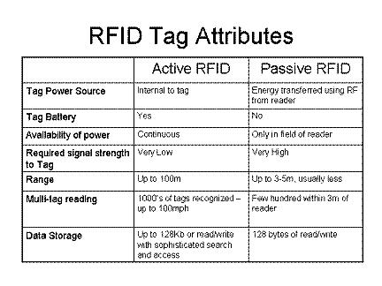
RFID Technology
RFID ranges
  Source :http://www.csa.com/discoveryguides/rfid/review2.php#v2

Slide 13
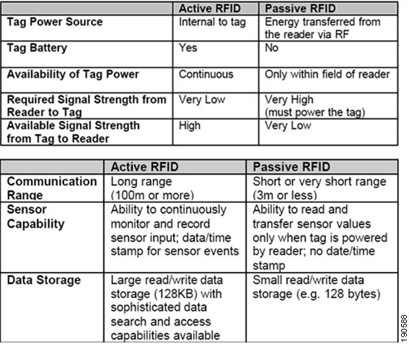
Acitive vs Passive tags
Surce:http://www.cisco.com/c/dam/en/us/td/i/100001-200000/190001-200000/190001-191000/190588.tif/_jcr_content/renditions/190588.jpg

Slide 14
Problems with RFID technology
Technical issues
  Global standards are still yet to worked and implemented.
  RFID systems can be easily disrupted.
  RFID Reader and tag collusions.
Security and privacy problems
  RFID tags can be read with out user knowledge.
  RFID tags are difficult to remove from the product/users.
  RFID tags can be read from distance by high power/gain antennas which could lead to privacy issues.
Notes:
Reader Collision:
Reader collision occurs when the signals from two or more readers overlap. The tag is unable to respond to simultaneous queries. Systems must be carefully set up to avoid this problem; many systems use an anti-collision protocol (also called a singulation protocol. Anti-collision protocols enable the tags to take turns in transmitting to a reader.
Tag collution:
Tag collision occurs when many tags are present in a small area; but since the read time is very fast, it is easier for vendors to develop systems that ensure that tags respond one at a time
RFID tags diffcult to remove
RFID tags are difficult to for consumers to remove; some are very small (less than a half-millimeter square, and as thin as a sheet of paper) - others may be hidden or embedded inside a product where consumers cannot see them. New technologies allow RFID tags to be "printed" right on a product and may not be removable at all.
RFID cards can be read with out user knowledge:
Since the tags can be read without being swiped or obviously scanned (as is the case with magnetic strips or barcodes), anyone with an RFID tag reader can read the tags embedded in your clothes and other consumer products without your knowledge. For example, you could be scanned before you enter the store, just to see what you are carrying. You might then be approached by a clerk who knows what you have in your backpack or purse, and can suggest accessories or other items.

Slide 15
References
http://en.wikipedia.org/wiki/RFID
http://www.csa.com/discoveryguides/rfid/review2.php
http://www.technovelgy.com/ct/Technology-Article.asp?ArtNum=2
http://www.barcodesinc.com/info/buying-guides/rfid.htm

Slide 16


