Slide 1
Annual Motorola Project Review:
Analysis of Third Generation Mobile Security
Principal Investigators: Roy Campbell, DennisMckunas
Research Assistants: Suvda Myagmar, Vineet Gupta
Motorola Contact: Bruce Briley
Computer Science Department
University of Illinois at Urbana-Champaign
June 28, 2002

Slide 2
Motivation for 3G Security
Multibillion dollar industry, millions of potential subscribers worldwide ($3B to setup a network)
Boom of handset devices and wireless technology
Users want richer content for their mobile devices (multimedia messaging, video conferencing, voice-over-IP, m-business)
Need security features to ensure user and data confidentiality, QoS, billing, protection against intruders

Slide 3
Motorola Interest
A major provider of wireless solutions (cdma2000 network, i.300 chipset)
3G devices are required to have built-in security per 3GPP specs
Evaluate current security protocols
Cost and feasibility of security features
Are the authentication and encryption algorithms strong?
Is the key length sufficient?
Possible risks and threats
What’s the impact of security upon the network performance?
Service setup delay
End-to-end packet delay
Network load variation

Slide 4
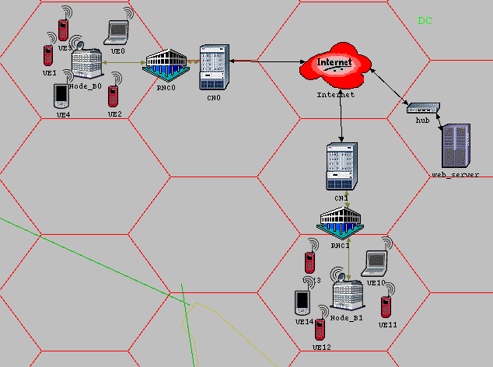
3G Network Architecture
Serving Core Network
Base Station
Radio Network Controller
Mobile Station

Slide 5
Problems with GSM Security
Weak authentication and encryption algorithms (COMP128 has a weakness allowing user impersonation; A5 can be broken to reveal the cipher key)
Short key length (32 bits)
No data integrity (allows certain denial of service attacks)
No network authentication (false base station attack possible)
Limited encryption scope (Encryption terminated at the base station, in clear on microwave links)
Insecure key transmission (Cipher keys and authentication parameters are transmitted in clear between and within networks)

Slide 6
3G Security Features
Mutual Authentication
The mobile user and the serving network authenticate each other
Data Integrity
Signaling messages between the mobile station and RNC protected by integrity code
Network to Network Security
Secure communication between serving networks. IPsec suggested
Wider Security Scope
Security is based within the RNC rather than the base station
Secure IMSI (International Mobile Subscriber Identity) Usage
The user is assigned a temporary IMSI by the serving network

Slide 7
3G Security Features
User – Mobile Station Authentication
The user and the mobile station share a secret key, PIN
Secure Services
Protect against misuse of services provided by the home network and the serving network
Secure Applications
Provide security for applications resident on mobile station
Fraud Detection
Mechanisms to combating fraud in roaming situations
Flexibility
Security features can be extended and enhanced as required by new threats and services

Slide 8
3G Security Features
Visibility and Configurability
Users are notified whether security is on and what level of security is available
Multiple Cipher and Integrity Algorithms
The user and the network negotiate and agree on cipher and integrity algorithms. At least one encryption algorithm exported on world-wide basis (KASUMI)
Lawful Interception
Mechanisms to provide authorized agencies with certain information about subscribers
GSM Compatibility
GSM subscribers roaming in 3G network are supported by GSM security context (vulnerable to false base station)

Slide 9
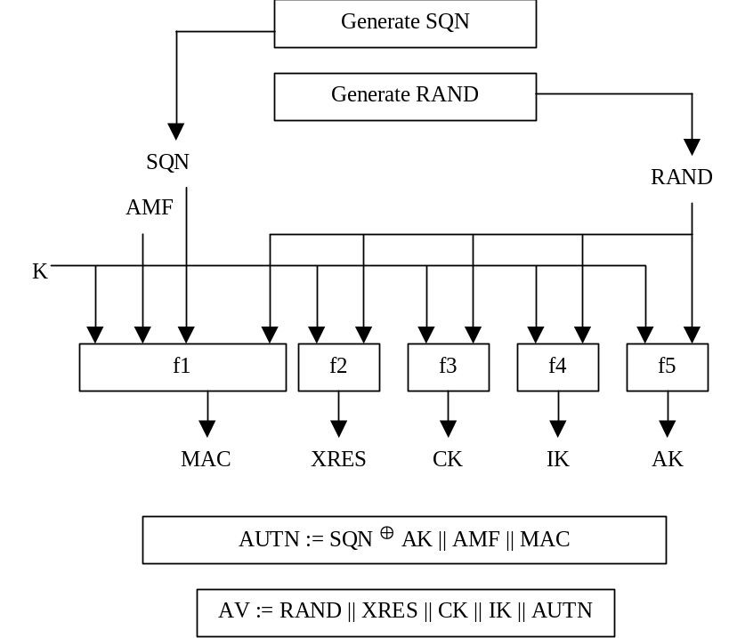
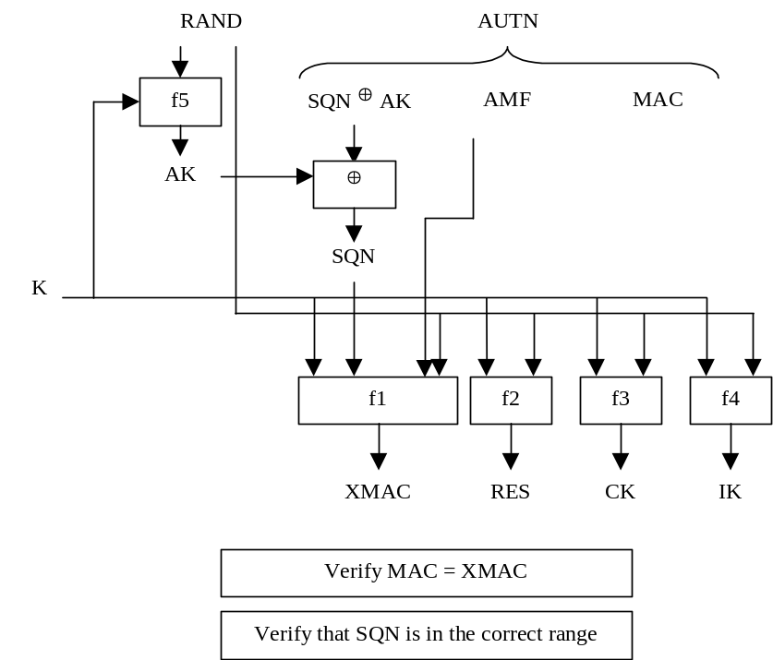
Authentication and Key Agreement
128 bit secret key K is shared between the home network and the mobile user
Home Network
Mobile station
Serving Network
AV
RAND, AUTH
RES

Slide 10
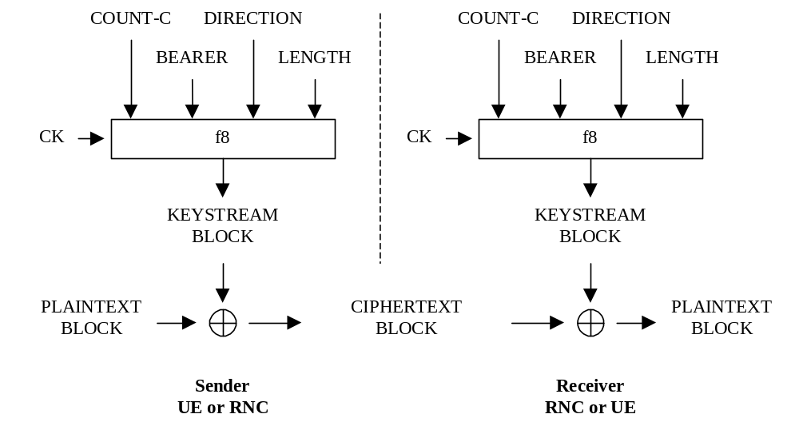
Encryption
Signaling and user data protected from eavesdropping. Secret key, block cipher algorithm (KASUMI) uses 128 bit cipher key.
At the mobile station and RNC (radio network controller)

Slide 11
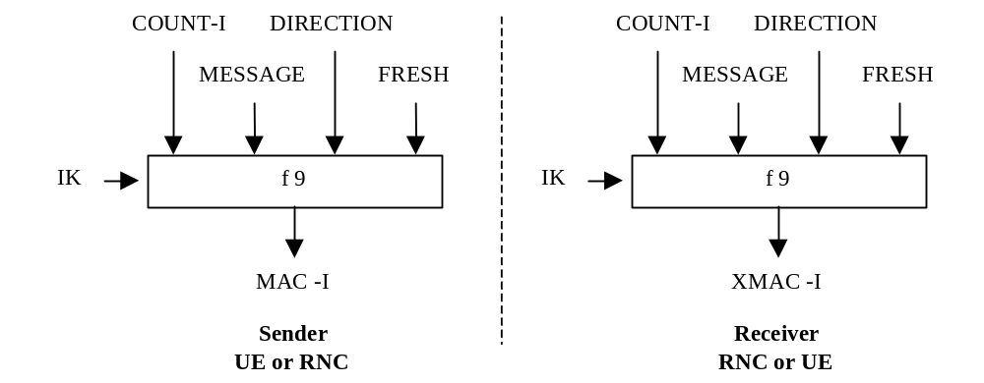
Integrity Check
Integrity and authentication of origin of signalling data provided. The integrity algorithm (KASUMI) uses 128 bit key and generates 64 bit message authentication code.
At the mobile station and RNC (radio network controller)

Slide 12
OPNET Simulation
Two small networks connected by Internet
Mobile station: 300MHz processor, 16MB memory
Similar to Motorola i.300 platform chipset
Traffic:
Light web browsing, and voice-over-IP conversations
Compare statistics for two different scenarios:
1. No security features
2. Security features in place
(this time, authentication and encryption only)

Slide 13
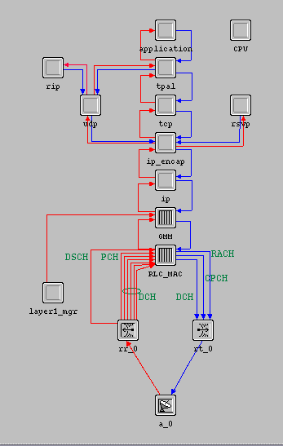
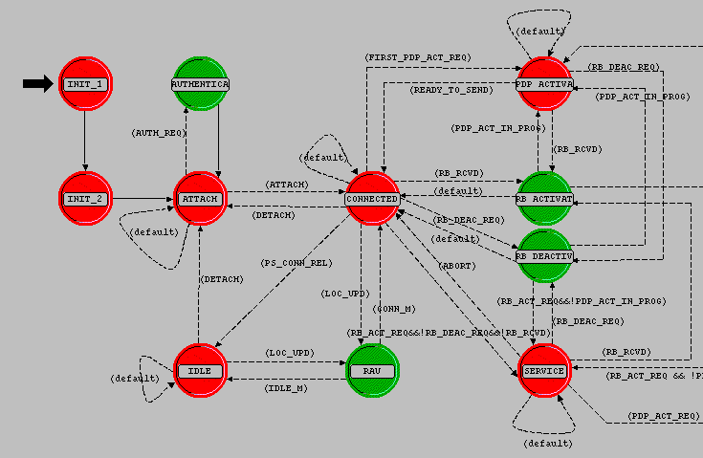
Inside OPNET
Protocol stack at mobile station
State machine of GMM layer at mobile station

Slide 14
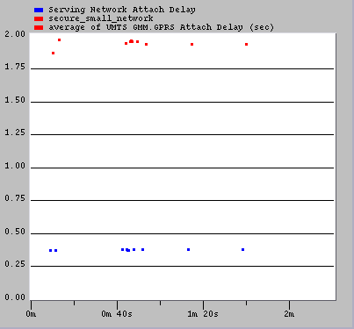
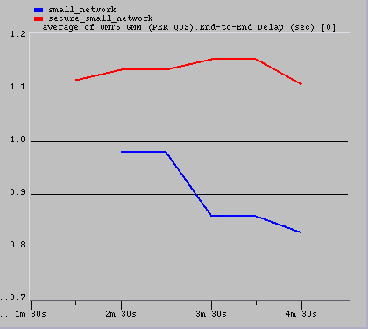
Performance Results
End-to-end packet delay per QoS Voice-over-IP conversations
Serving network attach delay

Slide 15
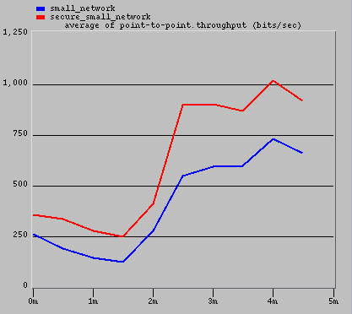
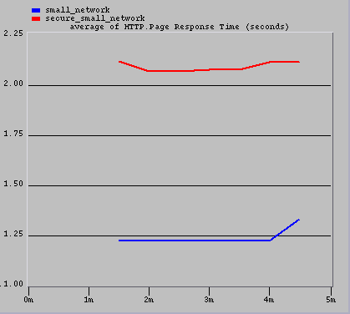
Performance Results
Point-to-point link throughput Base station to RNC
HTTP page response time Light web browsing

Slide 16
Problems with 3G Security
All that can happen to a fixed host attached to the Internet could happen to a 3G terminal
IMSI is sent in cleartext when the user is registering for the first time in the serving network (trusted third party can be a solution)
A user can be enticed to camp on a false BS. Once the user camps on the radio channels of a false BS, the user is out of reach of the paging signals of SN
Hijacking outgoing/incoming calls in networks with disabled encryption is possible. The intruder poses as a man-in-the-middle and drops the user once the call is set-up

Slide 17
Future Research Direction
Extend current simulation implementation
More complicated, perhaps fully loaded, network scenario
Add video conferencing and multimedia streaming traffic
Observe variations in bit error rate and packet drop rate, among other things
Network-to-network security
How to establish trust between different operators?
    Is IPsec a feasible solution for secure communication between networks?
End-to-end security
    Can two mobile nodes establish secure communication channel without relying too much on their serving network?
    How can they exchange certificates or shared secret keys?
Possible solution to existing 3G security problems

Slide 18
References
3G TS 33.120 Security Principles and Objectives
http://www.3gpp.org/ftp/tsg_sa/WG3_Security/_Specs/33120-300.pdf
3G TS 33.120 Security Threats and Requirements
http://www.arib.or.jp/IMT-2000/ARIB-spec/ARIB/21133-310.PDF
Michael Walker “On the Security of 3GPP Networks”
http://www.esat.kuleuven.ac.be/cosic/eurocrypt2000/mike_walker.pdf
3G TR 33.900 A Guide to 3rd Generation Security
ftp://ftp.3gpp.org/TSG_SA/WG3_Security/_Specs/33900-120.pdf
3G TS 33.102 Security Architecture
ftp://ftp.3gpp.org/Specs/2000-12/R1999/33_series/33102-370.zip
3G TS 33.105 Cryptographic Algorithm Requirements
ftp://ftp.3gpp.org/Specs/2000-12/R1999/33_series/33105-360.zip

