Slide 1
Chapter 10
Code Optimization

Slide 2
A main goal is to achieve a better performance
Front End
Code Gen
source
Code
Intermediate
Code
target
Code
user
Machine-independent Compiler optimizer
Machine-dependent Compiler optimizer

Slide 3
Two levels
  Machine independent code opt
    Control Flow analysis
    Data Flow analysis
    Transformation
  Machine dependent code-op
    Register allocation
    Utilization of special instructions.

Slide 4
Basic Block
BB is a sequence of consecutive statements in which the flow control enters at the beginning and leaves at the end w/o halt or possible branching except at the end

Slide 5
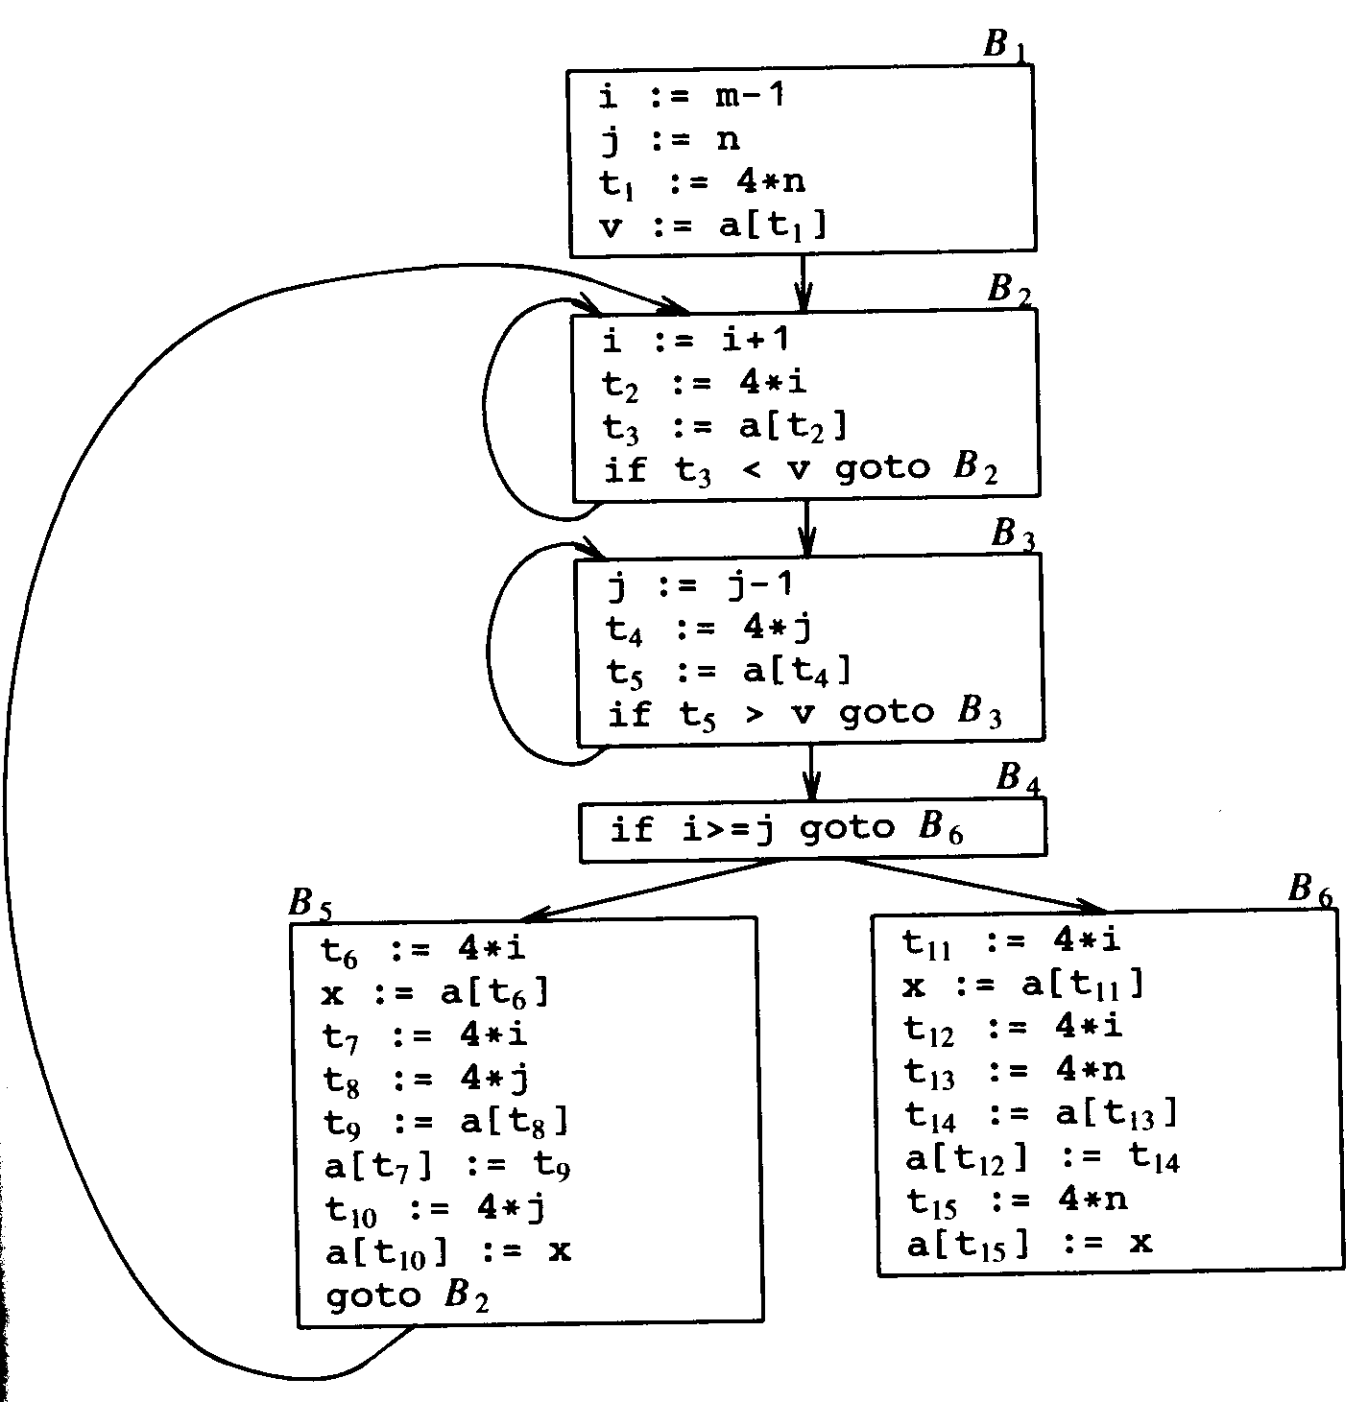
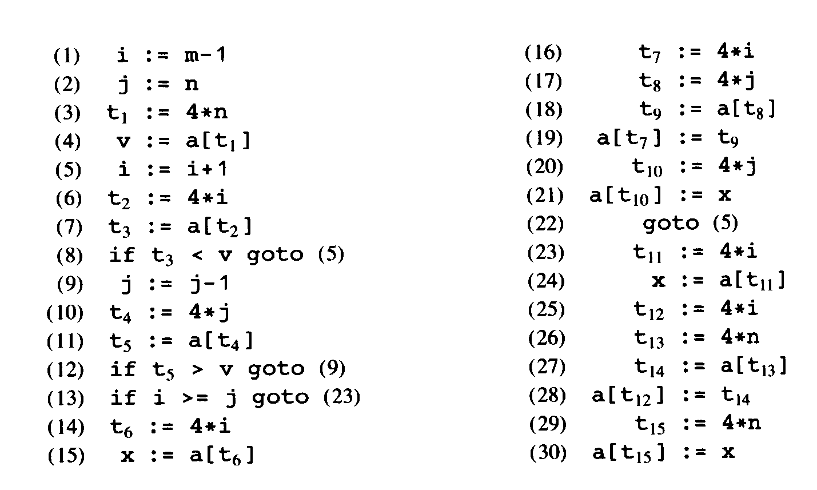
Basic Block

Slide 6
Principle sources of optimization
Local optimization: within a basic block
Global optimization: otherwise
Mixed

Slide 7
Function-Preserving Transformation
Improving performance w/o changing fn.
Techniques
  Common subexpression Elimination
  Copy Propagation
  Dead-code elimination
  Constant folding

Slide 8
Common subexpression Elimination
An occurrence of an expression E is common subexpression if E was previously computed and the values of variables in E have not changed since.

Slide 9
Copy Propagation
An idea behind this technique is to use g for f whenever possible after the copy of
f := g
before
x := t3
a[t7] := t5
a[t10] := x
Goto b2
After
x := t3
a[t7] := t5
a[t10] := t3
Goto b2

Slide 10
Dead code elimination
Remove unreachable code
If (debug) print …
Many times, debug := false

Slide 11
Loop optimizations
Beyond basic block
Three important techniques
  Code motion
  Induction-variable elimination
  Reduction in strength

Slide 12
Code motion
Move code outside the loop since there are potential many iterations
Look for expressions that yeild the same result independent of the iterations.
before
While ( I <= limit – 2).
after
T = limit – 2
While ( I <= t)

Slide 13
Induction-variable elimination & Reduction in strength
Look for induction variables for strength reductions
E.g. a pattern of changes in a lock step
B3:
j = j - 1
t4 = 4 *j
t5 = a [ t4]
If t5 > v goto B3
B3:
j = j - 1
t4 = t4 -4
t5 = a [ t4]
If t5 > v goto B3

Slide 14
Others optimizations
Optimizations for Basic blocks
Reducible flow graph
Global Data flow analysis
Machine dependent Optimizations

