Slide 1


Slide 2
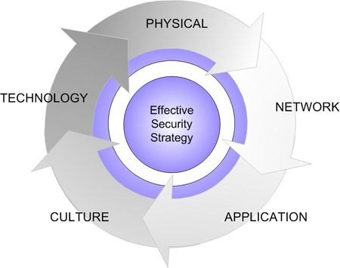


Conference Day 2 “EASY IT”
Network Security and Linux Security
“Rizky Ariestiyansyah”
“Institut Sains Dan Tekhnologi Nasional”

Slide 3
Who am I ?
Rizky Ariestiyansyah ( ONTO )
CEO / Founder EVONE
github.com/ariestiyansyah
twitter.com/ariestiyansyah
ariestiyansyah.rizky@gmail.com

Slide 4
Conference Focus
Introduction to Security, Computer Security, Network Security and Linux Security
Why do we need Security
Who is Vulnerable
Security Model
Common Security Attack
Linux Security
Cyber crime report (ID-CERT)
Summary

Slide 5
Introduction to Security, Computer Security, Network Security and Linux Security

Slide 6
Security
The state of being free from danger or threat.
Security is the degree of protection to safeguard a nation, union of nations, persons or person against danger, damage, loss, and crime. (Wikipedia).
freedom from care, anxiety, or doubt; well-founded confidence.
Freedom from danger, risk.

Slide 7
Computer Security
Computer security is the process of preventing and detecting unauthorized use of your computer. (armor2net)
The protection of computer systems and information from harm, theft, and unauthorized use.

Slide 8
Network Security
Network security consists of the provisions and policies adopted by a network administrator to prevent and monitor unauthorized access, misuse, modification, or denial of a computer network and network-accessible resources.
Network security is typically handled by a network administrator or system administrator who implements the security policy, network software and hardware needed to protect a network and the resources accessed through the network from unauthorized access and also ensure that employees have adequate access to the network and resources to work.

Slide 9
Linux Security
Protect your linux distribution
By default linux is not secure
Linux is optimized for convenience and doesn’t make security easy or nature

Slide 10
Why do we need Security ?

Slide 11
Known the Security Threats
1. Malware
2. Backdoor, Exploiting software bugs, Buffer overflow (BOF)
3. Denial of services and DDOS
4. Sniffing attack, TCP Hijacking
5. Unprotected Linux/Windows Shares
6. LFI, SQLI, RFI, Social Problems
7. Cross-site scripting (XSS)
8. TCP Attack
9. Email Attack

Slide 12
Reason why need security
Your computer isn't secure as you think.
Protect data and all vital information from intruders, because everybody has a right to privacy.
Security is now a basic requirement because global computing is inherently insecure.
Provide authentication and access control for resources.

Slide 13
Who is Vulnerable

Slide 14
Vulnerable !!!
Security is low or down

Slide 15
Who is vulnerable ?
Bank
Goverment
Defensive agencies
Companies
University and Institutions
Multinational Corporation
Anyone on the Internet Network

Slide 16
Security Model

Slide 17
Old Security Model
Mainframe
Controller
Terminal
Terminal

Slide 18


New “old” Security Model
Internal network
Internet
Protocols : TCP, HTTP
ICMP, FTP, SMTP

Slide 19

New Model
ActiveX
Malware
Java Trojans
HTTP
Internal network
Internet
VPN
SMTP
SSL
DMZ
Web Server
Server
Database app

Slide 20
Common Security Attack

Slide 21
Common Network security attack
Dictionary Attack (Explain in this session)
Denial of services (Explain in this session)
TCP Attack (Explain in this session)
Sniffing attack (Self Study)
SQLi, XSS, RFI, LFI attack (Self Study)
Social Engineering (Self study)
More..

Slide 22
Dictionary attack
Dictionary attack is a technique for defeating a cipher or authentication mechanism by trying to determine its decryption key or passphrase by trying likely possibilities, such as words in a dictionary.
Dictionary attack accuracy is 90% (dictionary word good),
The Linux password store at /etc/passwd are encrypted with crypt(3) function, it mean one way hash
To secure from this attack use randomly password like “jU5bu4h@p@y4n94kuSuk@” ( 4l4y password ).
I

Slide 23
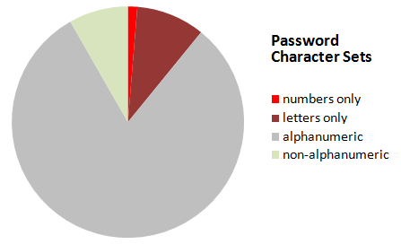
Fact of human password
Source : Codinghorror.com

Slide 24
Denial of services
Denial of service or DOS is overloading the server or network to make the service in the network unusable and overflow
DOS have diferent kinds like ;
SYN Flooding
Distribute DOS
SMURF

Slide 25
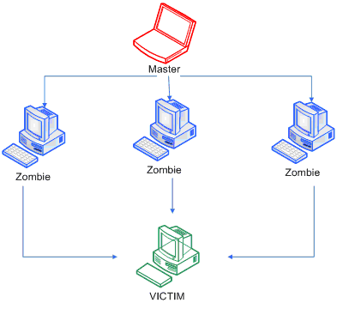

Slide 26
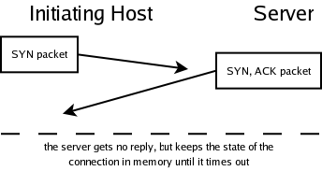
SYN Flooding
SYN is one of TCP packet.
SYN Flood is a form of denial-of-service attack in which an attacker sends a succession of SYN requests to a target's system in an attempt to consume enough server resources to make the system unresponsive to legitimate traffic (Wikipedia).

Slide 27
DDoS
# DDOS is a type of DOS attack where multiple compromised systems, which are usually infected with a Trojan, are used to target a single system causing a Denial of Service (DOS) attack.
# DDOS is same with DOS but in large scale.
# Make machine or network resource unavailable.
# Anonymous in their OP use DDOS attack and Defacement.

Slide 28
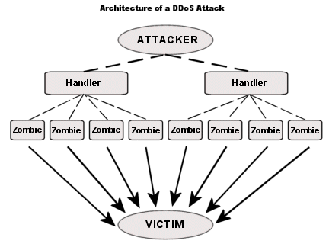

Slide 29
SMURF
The Smurf Attack is a denial-of-service attack in which large amounts of ICMP packets with the intended victim's spoofed source IP are broadcast to a computer network using an IP Broadcast address (Wikipedia).
Source ip addrees of broadcast ping is forget.

Slide 30
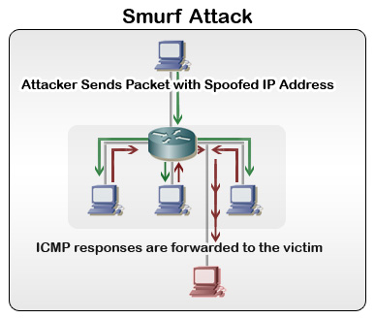

Slide 31
TCP Attack
TCP = Transmission Control Protocol
Part of the IP netw. Protocol
Connection-based protocol
Point-to-point protocol
Data transfer
More define at RFC 793

Slide 32



TCP Attack Concept
Please Welcome to Nabilah, Rizky and Mr. Big Ears

Slide 33
Nabilah and Rizky have TCP Connection

Slide 34
Mr. Big Ears lies on the path between Nabilah and Rizky Network

Slide 35
When Nabilah send packet to Rizky, Mr. Big ears drop all packet
And the packet not delivery to Rizky
VOID

Slide 36
Mr.Big ears send malicious packet to Rizky and Pawned

Slide 37

Nabilah and Rizky fall out cause the malicous packet from big ears

Slide 38
TCP Attack (Hijacking)
"TCP hijacking" is a technique that involves intercepting a TCP session initiated between two machines in order to hijack it.
If an attacker learns the associated TCP state for the connection, then the connection can be hijacked !
More TCP Attack example ; spoofing, MITM, sniffing and more.

Slide 39
Packet Sniffing
Packet sniffer programs capture the contents of packets that may include passwords and other sensitive information that could later be used for compromising the client computer
For example, a sniffer installed on a cable modem in one cable trunk may be able to sniff the password from other users on the same trunk
Encryption of network traffic provides one of the defenses against sniffing

Slide 40
Break for 5 Minutes..

Slide 41
Linux Security

Slide 42
Known the Linux architecture
Hardware : Mouse, Monitor, Keyboard, PC, Etc
Hardware Controller : connect between Linux kernel and Hardware
Linux Kernel : the heart of linux, connect hardware resource and application
User Applications : user application like browser. Photo editor, calculator, ect.
OS Service : like X windows, web server, command shell

Slide 43
User Applications
OS Service
LINUX KERNEL
HARDWARE CONTROLLER
HARDWARE

Slide 44
Linux Kernel
Kernel uses modul, and you can dinamically loaded it
You can configure kernel and unnecessary component can be removed
Recompiled feature – not like windows
Kernel have bugs
Buffer overflow vulnerabilties (very critically)

Slide 45
Kernel Security
To make your linux secure is always patch your kernel
Update the kernel, to check linux kernel version use ;
- # uname -a
To enhanced your linux security :
- LIDS – Linux Intrusion Detection System
- SELinux – Security Enhanced Linux
- Secure Linux Patch
- Linux Kernel Modul config

Slide 46
Linux Instrusion Detection System (LIDS)
# LIDS web http://www.lids.org/
# LIDS is a tool to make kernel security powerfull
# LIDS is a patch to the Linux kernel; it implements access control and a reference monitor. LIDS is configured with its two admin tools, lidsconf and lidsadm
# LIDS is a complete security model implementation for the Linux kernel.

Slide 47
Local Linux Security
Linux can be attacked from local user,
Linux
Attacker
user
user

Slide 48
Protect from local attack
Give them the minimal amount of privileges they need.
Be aware when/where they login from, or should be logging in from.
The creation of group user-id's should be absolutely prohibited. User accounts also provide accountability, and this is not possible with group accounts

Slide 49
File and Filesystem Security
# Known Linux User group and permission
# File permission and ownership
# Configure your users file-creation umask to be as restrictive as possible
START LIVE DEMO !!!

Slide 50
Password Security and Encryption
PGP and Public Key Cryptography
Linux IPSEC Implementation
PAM
Shadow passwords
Secure shell and Stelnet
SSL, S-HTTP

Slide 51
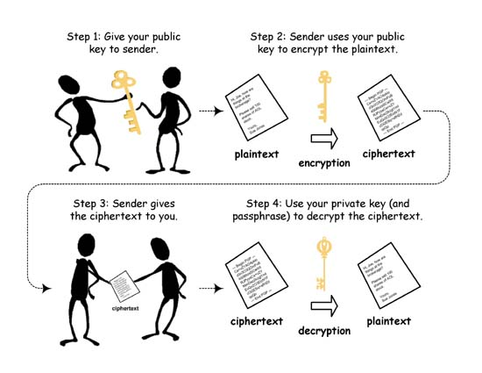
Public Key Encryption works

Slide 52
IPSEC Implementation
IPSEC
Internet Network
Key management
Secutiy gateways
Security Policy
IPSEC Developed by Internet Engineering Task Force (IETF)

Slide 53
IPSEC give solution to create cryptographically-secure communications at the IP network level (Network layer), and to provide authentication, integrity, access control, and confidentiality.
Some exploitation in network layer to secure using IPSEC is ;
- Eavesdropping
- MITM ( Man in the middle attack)
- Masquerading

Slide 54
Linux-PAM
# The concept of Linux-PAM: programs that require authentication only need to know that there is a module available that will perform the authentication for them.
# PAM is set up so that modules can be added,deleted, and reconfigured at any time- it is not necessary for modules to be linked in at the time a utility is compiled
# Set resource limits on all your users so they can't perform denial-of-service attacks (number of processes, amount of memory, etc)
# Use encryption other than DES for your passwords. (Making them harder to brute-force decode) !! effective

Slide 55
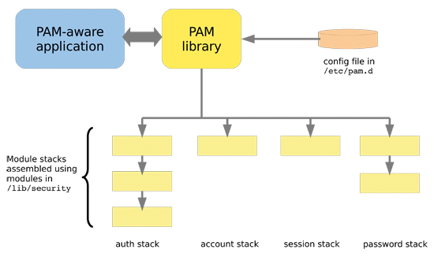

Slide 56
Linux Network Security
# System services
# Packet sniffer
# DOS Attack
# NFS (Network File System) Security
# Firewall
# Network information Services
# NIDS
# IP Chains
# VPNs
# Netfilter

Slide 57
System services
# if you are join the internet network be carefull of your linux services, dont try to offer services you dont need to use or run in internet network,
# some services most usefull like ; FTP, Mail, SSH, identd, telnet
# Possibly not required services like ; nscd, smb, dhcp, cups, ldap, rhnsd

Slide 58
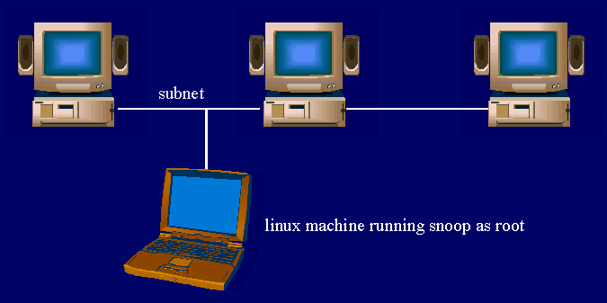
Packet Sniffer

Slide 59
NFS
# NFS stands for Network File System, a file system developed by Sun Microsystems, Inc. It is a client/server system that allows users to access files across a network and treat them as if they resided in a local file directory.
client
Network
NFS server
client
client

Slide 60
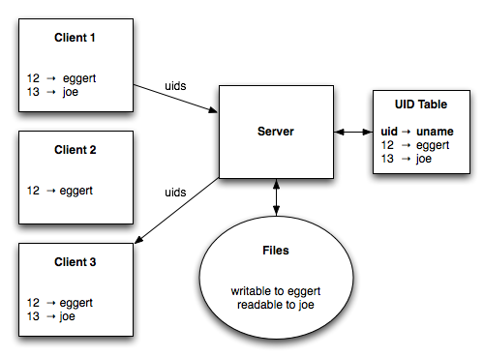
NFS Security ( Explain in the image )

Slide 61
Firewall
# Firewalls are means of controlling what information is allowed into and out of your local network.
# Linux Firewalls are ;
- IPTables
- SELinux
- Scalable
- Robus

Slide 62
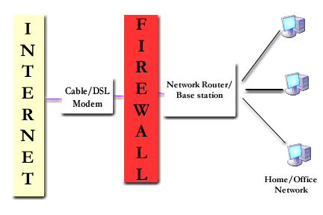
Firewall concept

Slide 63
NIS
# NIS is a client–server directory service protocol for distributing system configuration data such as user and host names between computers on a computer network.
# all the information in a standard /etc/passwd file

Slide 64
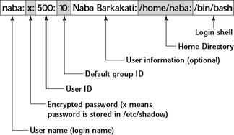
Understand the /etc/passwd

Slide 65
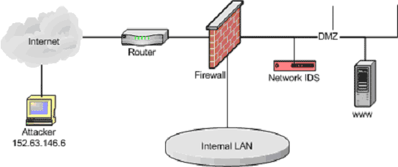
Linux Network IDS
# Network Intrusion Detection System (NIDS) is an intrusion detection system that attempts to discover unauthorized access to a computer network by analyzing traffic on the network for signs of malicious activity.

Slide 66
Linux Application Security
Remember to protect your Linux application security like :
- File Server
- Web Server
- Print Servers –lpd, cups, etc.
- Mail Server – Sendmail (historically insecure), Qmail, Postfix
- VPN Server – FreeS/WAN
- Databases – PostgreSQL, MySQL (free), Oracle, Sybase, DB2)
- DNS Servers – BIND
- LDAP Servers
- Time Servers

Slide 67
Cyber Crime Report (ID-CERT)

Slide 68
Summary

Slide 69
Summary
- Linux is not secure by default
- Always updated for linux patch
- Use only required services in linux
- Network service keep on minimum uses
- Balanced security level and funcionality
- Take care on internet network actually public network (wifi)
- There is no system secure ^_^

Slide 70
Reference
- http://forum.explorecrew.org/
- http://www.tldp.org/HOWTO/Security-HOWTO/
- http://www.cyberciti.biz/faq/understanding-etcpasswd-file-format
- http://www.lids.org/
- http://proceedings.esri.com/library/userconf/proc00/professional/papers/pap197/p197.htm
- http://www.kecoak.or.id/sarang/TOKET_4/0x01-fun-ipsec.txt
- http://www.linuxsecurity.com/docs/SecurityAdminGuide/SecurityAdminGuide-8.html
- http://http://en.wikipedia.org/wiki
- http://kodokimut.wordpress.com/
- http://google.com (use at your own risk)

Slide 71

The End
See You Next EVENT !!!!

