Slide 1
Embedded systems Security
Graciela Saunders

Slide 2
overview
Introduction / Review
Challenges to Embedded Security
Approaches to Embedded Security
Security Analysis & Attack Taxonomy
Role of the OS in Embedded Security

Slide 3
Introduction
Industrial Trends:
Automotive Electronics
Telecommunications
Avionics
Railways
Healthcare
Monitor & control of plants & equipment
Why is security so important?
The role of embedded systems
The damage caused by attacks

Slide 4
Challenges to security
Resource Limitations
Processing gap
Battery gap
Memory constraints
Deployment Scale
Size/complexity of code
Cost
No “correct” solution

Slide 5
Risk assessment¹
Nothing is ever 100% Secure
Given enough time, resources, and motivation, an attacker can break any system
Secure your product/system against a specific threat
What needs to be protected?
Why is it being protected?
Who are you protecting against? (define the enemy)
1 https://www.blackhat.com/presentations/bh-usa-04/bh-us-04-grand/grand_embedded_security_US04.pdf

Slide 6
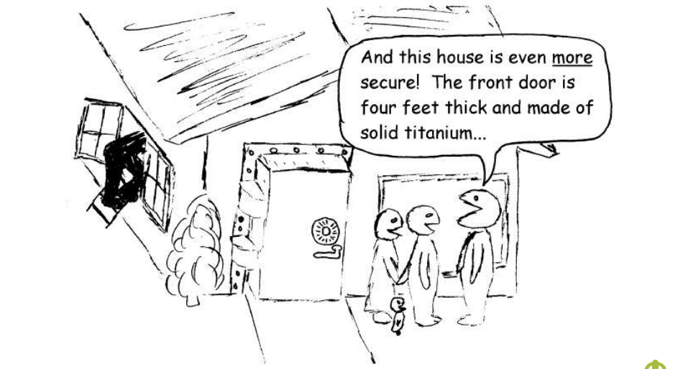
Risk assessment¹
1 https://www.blackhat.com/presentations/bh-usa-04/bh-us-04-grand/grand_embedded_security_US04.pdf

Slide 7
Approaches
Design, design, design!
Security Analysis:
What are the main causes of successful attacks?
What type of attack are embedded system open to?
What type of attacker am I up against?
What are my attackers goals?
What are the main vulnerabilities of embedded systems?
What are the main threat vectors?
What effect will an attack have?
How can we use this knowledge to improve security?

Slide 8
ATTACK TYPES¹
Insider Attack
Significant percentage of breaches
Disgruntled employees
Lunchtime Attack
Take place during a small window of opportunity
Focused Attack
Time, money, and resources not an issue
Hardware
Software
Communication Stack
1 https://www.blackhat.com/presentations/bh-usa-04/bh-us-04-grand/grand_embedded_security_US04.pdf

Slide 9
Attacker classification¹
Class I: Clever Outsiders
Intelligent, but have limited system knowledge
Try to take advantage of an existing weakness
Class II: Knowledgeable Insiders
Substantial specialized technical experience
Highly sophisticated tools and instruments
Class III: Funded Organizations
Specialists backed by great funding resources
In-depth analysis, sophisticated attacks, highly advanced analysis tools
1 https://www.blackhat.com/presentations/bh-usa-04/bh-us-04-grand/grand_embedded_security_US04.pdf

Slide 10
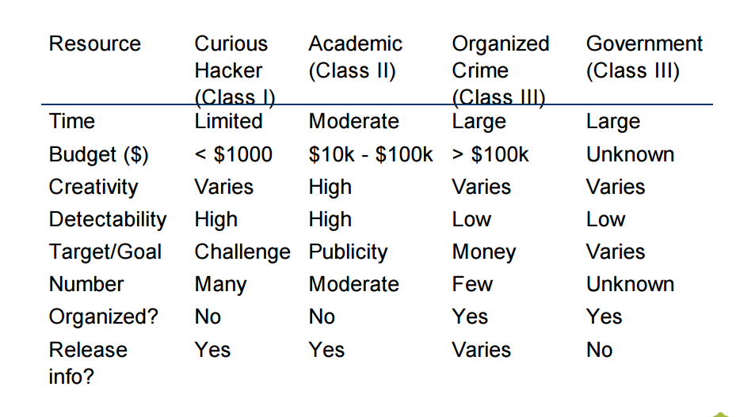
Attacker classification 2 ¹
1 https://www.blackhat.com/presentations/bh-usa-04/bh-us-04-grand/grand_embedded_security_US04.pdf

Slide 11
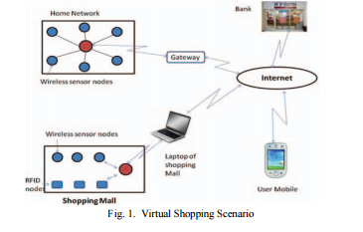
Attack preconditions
Internet facing device
Discover the device and send message to it over the network

Slide 12
Attacker preconditions 2
Local or remote access to the device
Attacker needs privileges for logical access to device services or functions
Direct physical access to the device
Physical proximity of the attacker
Wireless devices may only require attacker to be within the radio range

Slide 13
Main vulnerabilities of embedded systems
Programming errors
Control flow attacks
Web based vulnerability
Exploitation of unpatched vulnerabilities in the web based interface
Weak access control or authentication
Default/weak/hard-coded passwords
Improper use of cryptography:
Weak random number generation

Slide 14
Threat Vectors
Control hijacking attacks
Reverse engineering
Malware
Injecting crafted packets or input
Eavesdropping
Brute-force search attacks
Normal use

Slide 15
Effects of attacks
Denial-of-Service
Code execution
Integrity violation
Information leakage
Illegitimate access
Financial loss
Degraded level of protection
Miscellaneous

Slide 16
The role of the os
Key Point:
The Operating system bears a tremendous burden in achieving safety and security via resource control
Trusted Computing Base (TCB)
The portions of a system (hardware and software) that are critical to security and therefore must be trustworthy

Slide 17
Types of operating systems
Monolithic OS
System software shares a single memory space and executes in privileged (supervisor) mode
Large TCB – maximizes opportunities for hackers
Microkernel OS
Runs a minimal set of critical system services in supervisor mode
Small TCB – security is easier to verify and assure

Slide 18
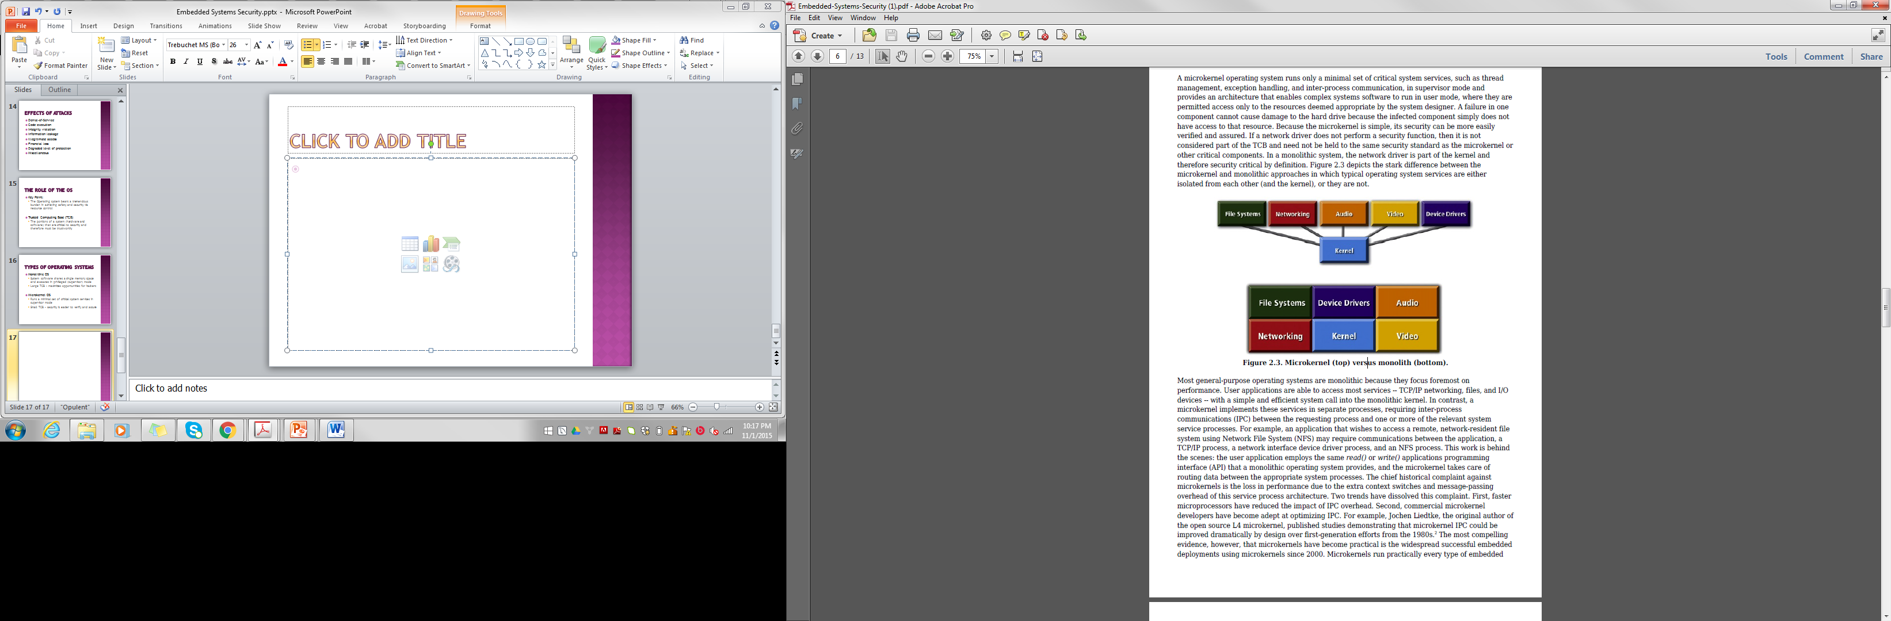
Types of operating systems 2
Monolithic OS
Microkernel OS

Slide 19
Multiple independent levels of security (mils)
Key Point: the foundation of a MILS-based embedded system is the separation kernel, a small microkernel that implements a limited set of critical function security policies
Security Policies:
Information Flow
Data Isolation
Damage Limitation
Periods Processing

Slide 20
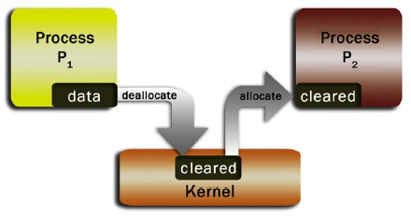
Periods processing
A policy that ensures information within one component is not leaked into another component through reused resources
Without periods processing the confidentiality of P₁’s information would be violated by disclosure to P₂ via shared resources

Slide 21
MILS AS A REFEReNCE MONITOR
Key Point: a separation kernel is considered a reference monitor when the kernel’s MILS policy enforcement mechanisms are N.E.A.T.
Non-bypassable
Evaluable
Always invoked
Tamper-proof

Slide 22
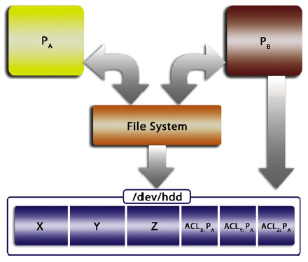
MILS AS A Reference MONITOR 2
Bypassing file system policy via direct media access

Slide 23
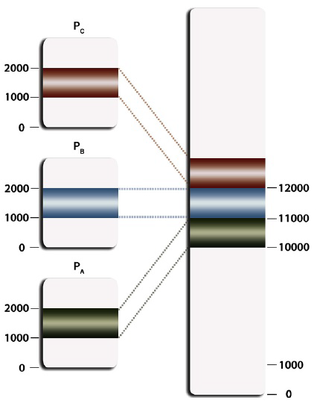
Core embedded OS system security requirements
Memory Protection
Malicious code is unable to crash an application or the operating system by corrupting its memory
Virtual Memory
Ability to map and unmap
pages into a virtual address space
Guard pages
Location obfuscation

Slide 24
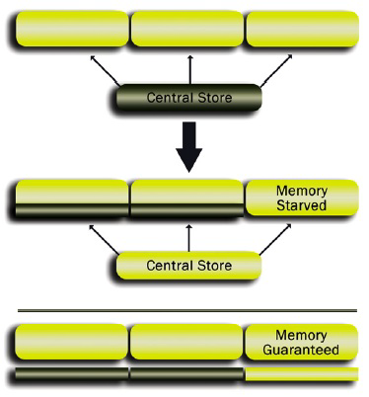
Core embedded OS system security requirements 2
Fault Recovery
Kernel must provide a mechanism enabling a supervisor process to close down a faulted process and for restarting an application
Guaranteed Resources
Despite memory protection
and virtual memory, malicious
code can still take down a
critical application by
starving it of resources

Slide 25
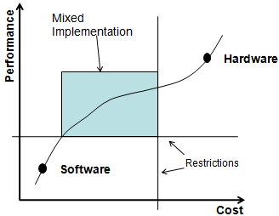
conclusion
Perform security analysis – know the enemy
Manage tradeoffs between performance, cost and security
Take advantage of the MILS concept and the recursive nature of MILS security policies

Slide 26
references
Embedded Systems Security: Threats, Vulnerabilities, and Attack Taxonomy
http://ieeexplore.ieee.org/stamp/stamp.jsp?tp=&arnumber=7232966
Introduction to Embedded Security; Black Hat USA Briefings; July, 2014
https://www.blackhat.com/presentations/bh-usa-04/bh-us-04-grand/grand_embedded_security_US04.pdf
The Two Software Updates and See Me in the Morning: The Case for Software Security Evaluations of Medical Devices
http://www.contrib.andrew.cmu.edu/~ppoosank/papers/hanna-aed-healthsec11.pdf
Embedded Systems Security, Kliedermacher and Kliedermacher; Chapter 2; Feb, 2013
http://www.edn.com/design/systems-design/4406387/1/Embedded-Systems-Security
Proposed Embedded Security Framework for Internet of Things (IoT) – graphics only
http://ieeexplore.ieee.org/stamp/stamp.jsp?tp=&arnumber=5940923

