Slide 1
Wireless Sensor Networks
Project work

Slide 2
Background
In the coming years there will be project periods (= no traditional courses in the period)
One of the projects will make a sensor network implementation
There is urgent need to find suitable hardware and software to make the project happen.

Slide 3
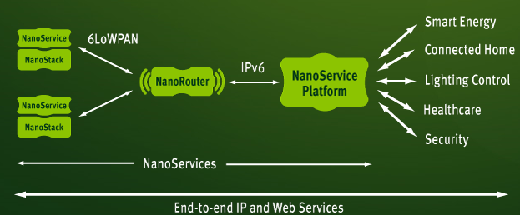
Goals
Get familiar with main components of sensor network
Node (radio + microcontroller + SW + sensor)
Edge router (radio + ethernet connection + SW)
Web service
Kuva: http://www.sensinode.com/EN/products.html

Slide 4
Goals continues..
Study and select a canditates for
Node HW and SW
Edge router HW and SW
Web service tools and software
Let’s try to build MAC and mesh Routing capabilities for existing radio modules.

Slide 5
Excercise 1 (1-3 points)
Find examples of all three components (node, edge router and web server software) of sensor networks using internet and links given below.
Present your findings to the group and try to analyze how well you findings would suit to the schools sensor network purposes.
Link1
Link2
link3

Slide 6
Excercise2
Using VRL-10534 transmitter and corresponding receiver devices demonstrate point to point connection.
Verify if you can transmit also analog signals through the radio device.

Slide 7
Exercise 3
Let’s try to design and implement our own MAC layer for previous exercise radio chip.
Study first what kind of MAC layer functions 802.15.4 standard specifies.

