Slide 1
Wireless Sensor Networks
Project work

Slide 2
Background
In the coming years there will be project periods (= no traditional courses in the period)
One of the projects will make a sensor network implementation
There is urgent need to find suitable hardware and software to make the project happen.

Slide 3
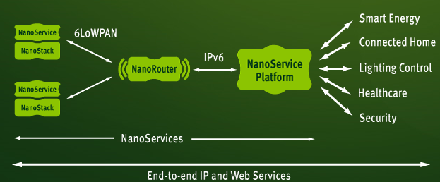
Goals
Get familiar with main components of sensor network
Node (radio + microcontroller + SW + sensor)
Edge router (radio + ethernet connection + SW)
Web service
Kuva: http://www.sensinode.com/EN/products.html

Slide 4
Approach 1
Node
Edge router
Web application
Temperature sensor
Ethernet
shield
ThinkSpeak
Arduino
Arduino
WRL10534
WRL10532

Slide 5
Approach 2
Node
Edge router
Web application
Temperature sensor
Apache server
Arduino
Arduino
Rasperry Pi
Xbee
Xbee

Slide 6
Approach 3
Node
Edge router
Web application
Temperature sensor
Some Windows SW
Arduino
Labtop PC
WiFi shield

