Slide 1
Wireless Sensor Networks
Project work

Slide 2
Tasks on 28.1.2014
Continue with your wireless sensor network project.
If you manage to finalize your project, let’s wait for other groups and make some new features to your project ( I got some more Rasberry Pi’s)
Prepare a presentation about your project
Explanation how it was made
Demo how it works
Proposals how your network could be enhanced or changed to function even better as a school project

Slide 3
Tasks on 28.1.2014 cont...
Get familiar with Iprotoxi company products and services
http://iprotoxi.fi/index.php?lang=en
The company has promised to visit our cource.
I have promised to deliver my class questions beforehand for the company.
Your task is to make those questions....

Slide 4
Background
In the coming years there will be project periods (= no traditional courses in the period)
One of the projects will make a sensor network implementation
There is urgent need to find suitable hardware and software to make the project happen.

Slide 5
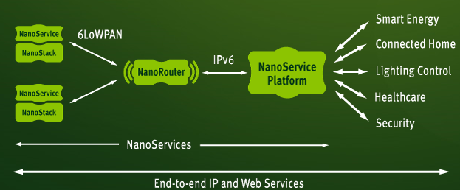
Goals
Get familiar with main components of sensor network
Node (radio + microcontroller + SW + sensor)
Edge router (radio + ethernet connection + SW)
Web service
Kuva: http://www.sensinode.com/EN/products.html

Slide 6
Approach 1
Node
Edge router
Web application
Temperature sensor
Ethernet
shield
ThinkSpeak
Arduino
Arduino
WRL10534
WRL10532

Slide 7
Approach 2
Node
Edge router
Web application
Temperature sensor
Apache server
Arduino
Arduino
Rasperry Pi
Xbee
Xbee

Slide 8
Approach 3
Node
Edge router
Web application
Temperature sensor
Some Windows SW
Arduino
Labtop PC
WiFi shield

