Slide 1





CSE360
Group 08
MD. Nezarul Islam
Apu Sardar
2018-1-60-235
2018-1-60-120
Md Jannatul Haq
2018-1-60-224
Sharmin Akther Rima
2018-2-60-112

Slide 2
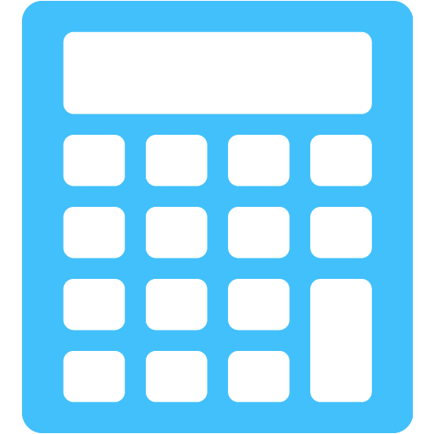
“Construct a Four-Function Calculator to Evaluate Infix and Postfix Expression”
40 + 29 = 69

Slide 3
Description
Our main objective is to develop a simple calculator using C++. We made a calculator with four functions in this project. These four-function are:
1
Addition
2
Subtraction
3
Multiplication
4
Division

Slide 4
Our Extension
After several hours of research and development (R & D), we have included Five new features in our project.
1
Sin(x)
2
Cos(x)
3
Tan(x)
4
Root
5
Square

Slide 5


A Simple Calculator
1 + 2 * 3 = 7
1 + 2 * 3 = 9

Slide 6
CODE
void init()
{
while (!Stack.empty())
Stack.pop();
}
int main()
{
cout << "\n\n****************************************************\n";
cout << " CALCULATOR\n \n";
cout << "****************************************************\n";
int choice,j=1;
for (int i=1; i<=j; i++)
{
init();
cout << "\n\nEnter The Method Which You Want to do:\n"
<< "\t1. Equation Method"
<< "\t2. Two Digit Method\n"
<< "\tEnter Your Option: ";
cin >> choice;
if(choice==1)
inFix();
else if(choice==2)
TwoDigitMethod();
else
cout << "\n\n****Wrong Choice**** \n\n";
cout << "\nDo you want to continue??? y/n: ";
char C;
cin >> C;
if(C=='y' || C=='Y')
j++;
}
}
void Substraction()
{
ll op1,op2,S;
op2=Stack.top();
Stack.pop();
op1=Stack.top();
Stack.pop();
S=op1-op2;
Stack.push(S);
}
void Addition()
{
ll op1,op2,S;
op2=Stack.top();
Stack.pop();
op1=Stack.top();
Stack.pop();
S=op1+op2;
Stack.push(S);
}
void Multiplication()
{
ll op1,op2,S;
op2=Stack.top();
Stack.pop();
op1=Stack.top();
Stack.pop();
S=op1*op2;
Stack.push(S);
}

Slide 7
void Division()
{
ll op1,op2,S;
op2=Stack.top();
Stack.pop();
if (op2)
{
op1=Stack.top();
Stack.pop();
S=op1/op2;
Stack.push(S);
}
else
cout << "\n\tWrong equation!!!
\n\n\tInput Correctly Again...\n\n";
}
void Calculator(char C)
{
if (C=='+')
Addition();
else if (C=='-')
Substraction();
else if (C=='*')
Multiplication();
else if (C=='/')
Division();
else if (C=='$')
root();
else if (C=='#')
square();
}
int prec(char C)
{
if(C=='*' || C=='/')
return 2;
else if(C=='+' || C=='-')
return 1;
else
return -1;
void root()
{
ll op1,S;
op1=Stack.top();
Stack.pop();
S=sqrt(op1);
Stack.push(S);
}
void square()
{
ll op1,S;
op1=Stack.top();
Stack.pop();
S=op1*op1;
Stack.push(S);
}
bool Digit(char C)
{
if(C>='0' && C<='9')
return true;
return false;
}
bool Operator(char C)
{
if(C=='+' || C=='-' || C=='*' || C=='/'|| C=='$'|| C=='#')
return true;
return false;
}

Slide 8
void inFix()
{
stack<char> st;
string ns;
printf("\nEnter The InFix Equation: ");
cin.ignore();
getline(cin,str);
st.push('N');
int l=str.length();
for(int i=0; i<l; i++)
{
if(Digit(str[i])){
ns+=str[i];
}
else if (str[i]==' '){
ns+=' ';
}
else if(str[i]=='(')
st.push('(');
else if(str[i]==')')
{
while(st.top()!='N' && st.top()!='(')
{
ns+=st.top();
st.pop();
}
if(st.top()=='(')
st.pop();
int TwoDigitMethod()
{
int choice;
long num1, num2, x;
double PI, r, y;
cout << "Please Choose Your Option:"
"\n\t1. Addition"
"\n\t2. Subtraction"
"\n\t3. Multiplication"
"\n\t4. Division"
"\n\t5. Squares"
"\n\t6. Root"
"\n\t7. Sin(X)"
"\n\t8. Cos(X)"
"\n\t9. Tan(X)"
"\n\t10. exit"
"\n\nChoice: ";
cin >> choice;
while(choice < 1 || choice > 10)
{
cout << "\nPlease Choose the above-Mentioned Option."
"\nChoice: ";
cin >> choice;
}
void postFixOpp(string str1)
{
int l=str1.length();
for(int i=0; i<l; i++)
{
if(str1[i]==' ')
continue;
if(Operator(str1[i]))
Calculator(str1[i]);
else if(Digit(str1[i]))
{
ll opp=0;
while(i<l && Digit(str1[i]))
{
opp=(opp*10)+(str1[i]-'0');
i++;
}
i--;
Stack.push(opp);
}
}
cout << "\n\tResult: " << Stack.top() << endl << endl;
}

Slide 9
switch (choice)
{
case 1:
cout << "Enter Two Numbers: \n";
cin >> num1 >> num2;
x = num1 + num2;
cout << "Sum = " << x;
break;
case 2:
cout << "Enter Two Numbers: \n";
cin >> num1 >> num2;
x = num1 - num2;
cout << "Subtraction = " << x;
break;
case 3:
cout << "Enter Two Numbers: \n";
cin >> num1 >> num2;
x = num1 * num2;
cout << "Product = " << x;
break;
case 4:
cout << "Enter Dividend: ";
cin >> num1;
cout << "Enter Divisor: ";
cin >> num2;
while(num2 == 0)
{
cout << "\nDivisor cannot be zero."
"\nEnter divisor once again: ";
cin >> num2;
}
x = num1 / num2;
cout << "\nQuotient = " << x;
break;
case 5:
cout << "Enter any Number: \n";
cin >> num1;
x = num1 * num1;
cout << "Square = " << x;
break;
case 6:
cout << "Enter any Number: \n";
cin >> num1;
x = sqrt(num1);
cout << "Root = " << x;
break;
case 7:
PI = 3.1415926;
cout << "Enter any Angle: ";
cin >> num1;
r= num1 * PI /180;
y = sin(r);
cout << "Sin("<< num1 <<")= " << y;
break;
case 8:
PI = 3.1415926;
cout << "Enter any Angle: ";
cin >> num1;
r= num1 * PI / 180;
y = cos(r);
cout << "Cos("<< num1 <<")= " << y;
break;
case 9:
PI = 3.1415926;
cout << "Enter any Angle: ";
cin >> num1;
r= num1 * PI /180;
y = tan(r);
cout << "Tan("<< num1 <<")= " << y;
break;
case 10:
return 0;
default: cout << "\nError";
}

Slide 10
Project Goal
1
Equation Method
2
Two-Digit Method

Slide 11
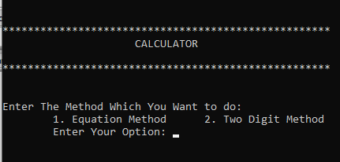
Working Method of Our Project
Our project is user-friendly. Anyone can easily operate our project.
After opening the project, you can see this-

Slide 12
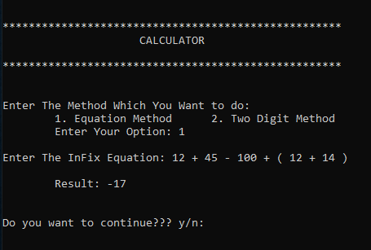
Now you can choose any option between 1 and 2.
Suppose you choose 1 then,

Slide 13
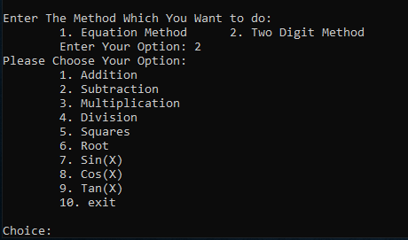
After completing this operation, you can operate another option called the 2-digit method

Slide 14
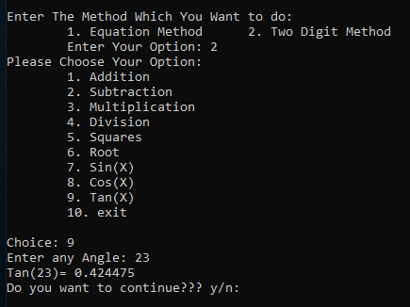
In this method, you can operate more than 8 operation

Slide 15
Limitations
Though our project is perfectly working, but we have some limitations
1
Our project can not operate with the binary number.
2
You should apply one space after taking one digit.
3
This project can not convert prefix to postfix.

Slide 16
Conclusions
In our project, we tried our best to solve all the bugs that occurred during designing this code. Hence, in conclusion, we were successful to make the code fully functional without much of an error. Besides, we only used one part of converting expression and sorting. In terms of future improvement, we will recommend exhaustive bug testing and bug fixes also with some other additional functions.

Slide 17
Thank You

