Slide 1



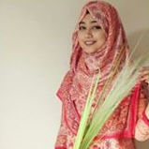

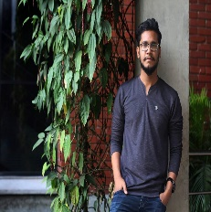


Che109 Group 1
Mohammad Ali Nijhoom
(2018-1-60-255)
Nilima Islam Bristy (2018-2-55-010)
Abul Kashem
(2018-1-60-108)
BM Jahidul (2017-2-60-133)
Md Saiful Islam Sabbir
(2016-3-60-040)
Maisha Maliha (2018-1-60-111)

Slide 2
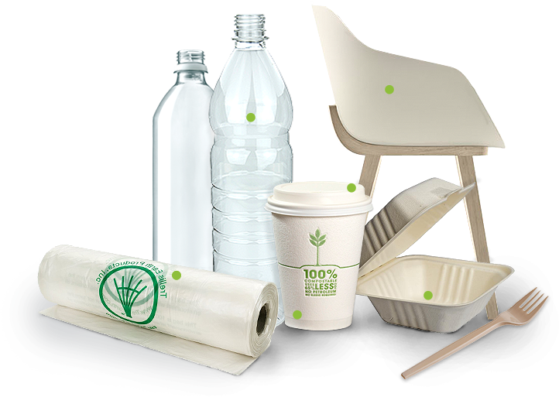

Bio Degradable Plastics

Slide 3
Overview
1
What is Biodegradable Plastic
2
Making Biodegradable Plastic
3
Why Bioplastic?
4
Use of Bioplastic
5
Regular Plastic vs. Biodegradable Plastic
6
Pros and Cons of Biodegradable Plastic
7
Biodegradable Plastic in Bangladesh
8
Enforce law in BD to prevent plastic
9
Global Bioplastics Market

Slide 4


What is Biodegradable Plastic?
Bioplastics
Biodegradable plastics are plastics that can be decomposed by the action of living organisms, usually bacteria.
Two basic classes of biodegradable plastics exist
Bioplastics
Petrochemicals
Whose components are derived from renewable raw materials
Whose plastics biodegradable additives which enhance biodegradation.

Slide 5
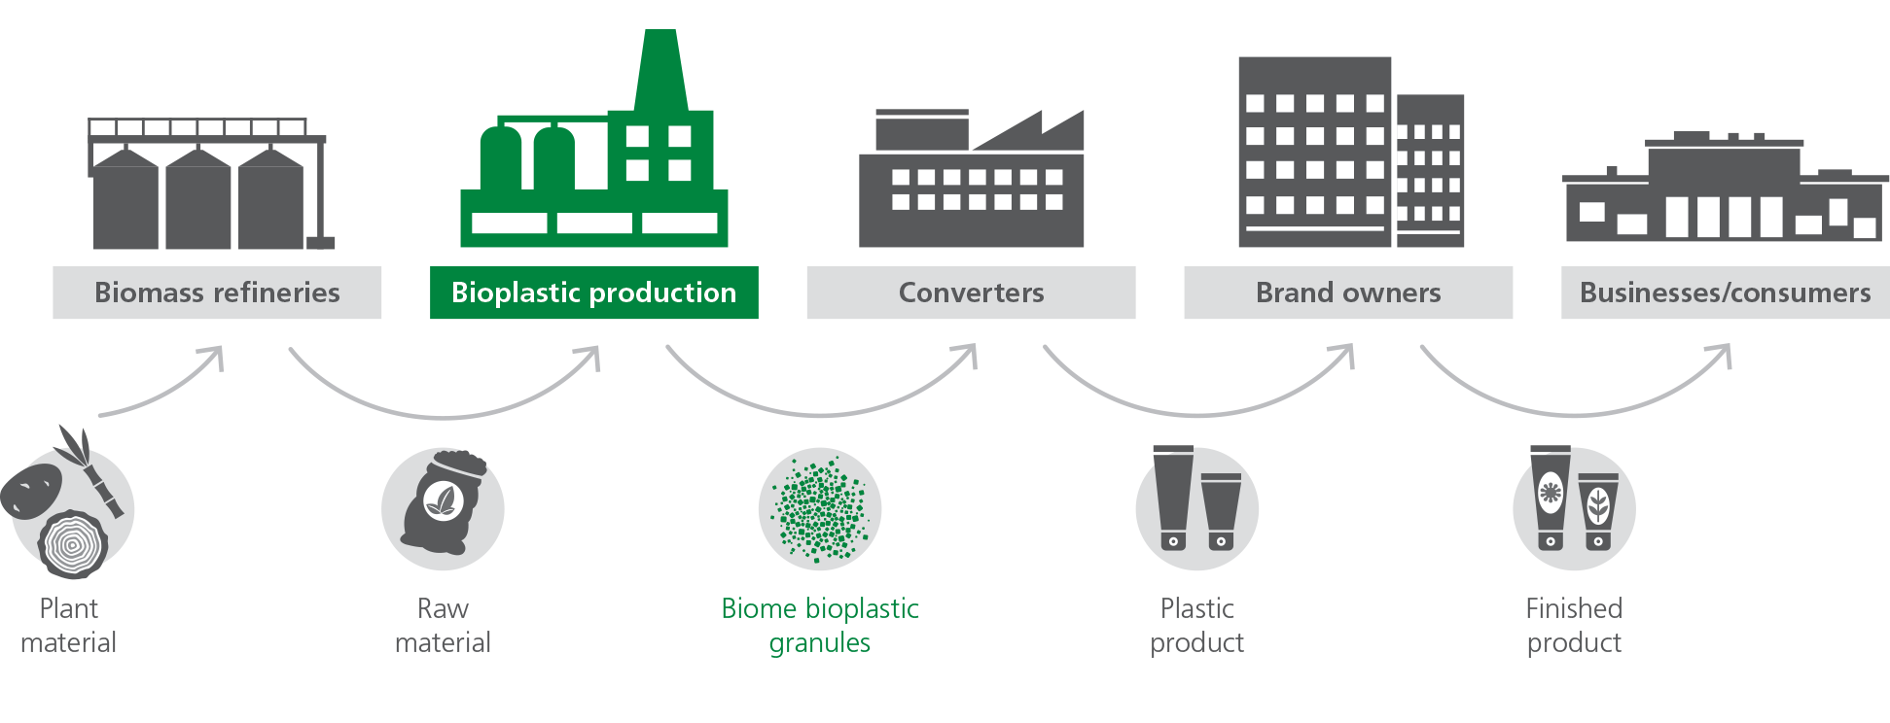
Making Biodegradable Plastic
Biodegradable plastics are made from all-natural plant materials. These can include corn oil, orange peels, starch, and plants.
The process of making biodegradable plastics begins with the melting down of all the materials. That mixture is then poured into molds of various shapes such as plastic water bottles and utensils.

Slide 6
Why Bioplastic?
Eco friendly & compostable
1
Consume less energy during the manufacturing cycle
2
Does not release the carbon dioxide into the atmosphere when burnt
3
Renewable resources are becoming a more viable and promising alternative
4
Bioplastics offers significant advantages on both ecological and economical sense
5
Bioplastics are environmentally friendly
6
Production results in less carbon dioxide emission
7
Bioplastics demand will continue to grow

Slide 7
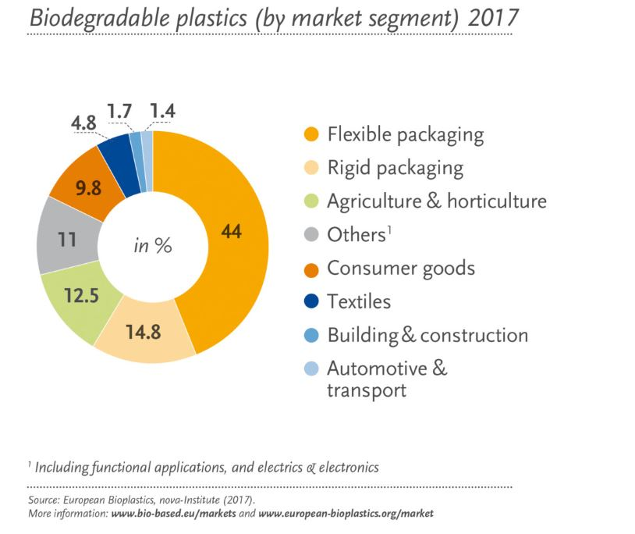
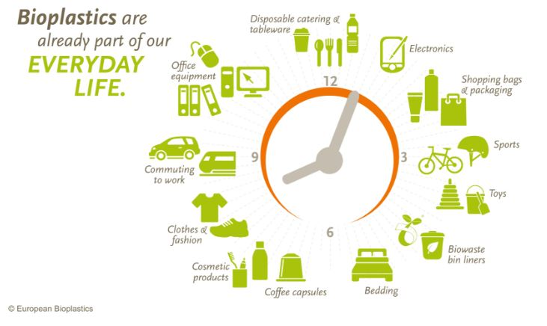
Use of Bioplastic

Slide 8
Use of Bioplastic
Eco friendly, cheap, compostable
1
Bioplastics are already being used in automobile interiors
2
The use of bioplastics for shopping bags is already very common
3
Trays and containers for fruit, vegetables, eggs and meat and bottles for soft drinks
4
Dairy products and blister foils for fruit and vegetables are also manufactured
5
Disposable crockery, pots and bowls
6
Bioplastics are used as a basis for the production of sanitary products
7
Catering products, medical Products

Slide 9
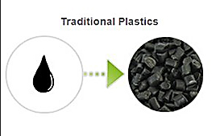
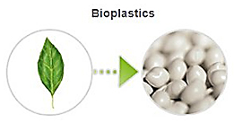
Regular Plastic vs. Biodegradable Plastic
1
After formation, regular plastics hold carbon
1
Biodegradable plastics do not release carbon
2
Methane and other forms of pollutants
could also be released
2
Do not contain those polluting materials
3
Are not able to be broken down by naturally occurring bacteria
3
Are able to be broken down by naturally occurring bacteria
4
Releases other dangerous items when it is burnt
4
Do not release other dangerous items upon decomposition
5
Less cost to produce
5
Slightly higher cost to produce

Slide 10
Pros and Cons of Biodegradable Plastic
Pros
Cons
1
Biodegradable plastics can mix with traditional products
1
Must follow a specific disposal procedure
2
Are broken down by naturally-occurring bacteria
2
May contain small pieces of metal
3
Can reduce greenhouse gas emission levels
3
Requires the weather to cooperate with their disposal
4
Do not release other dangerous items upon decomposition
4
Biodegradable plastics come at a higher capital cost
5
Reduces the amount of waste we produce
5
Biodegradable plastics may produce methane in landfills

Slide 11
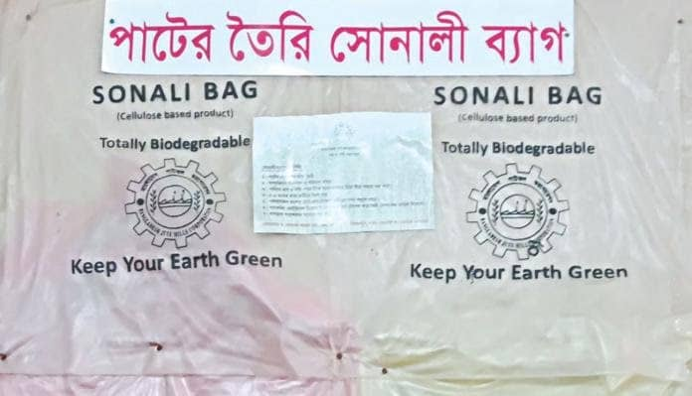
Biodegradable Plastic in Bangladesh
At present, around 5 million biodegradable bags are produced annually in the country - an insignificant amount against the ever-growing demand. The government now wants to ensure a solid supply of biodegradable plastic bags before declaring their usage mandatory.
Forget polythene!
Scientist invents biodegradable alternative from jute

Slide 12
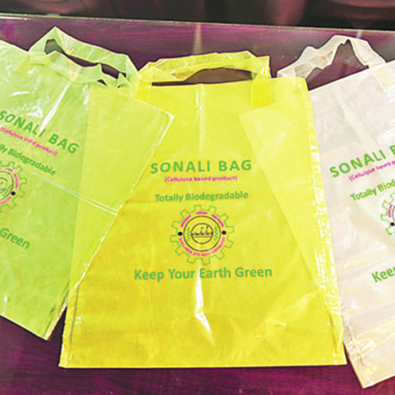
Biodegradable Plastic in Bangladesh
A Bangladeshi scientist has synthesized a polymer from jute fiber which can be used to create a kind of bag that works, looks and feels like a polythene bag but without the negative environmental impact.
Dr Mubarak Ahmad Khan, chief scientific officer at Bangladesh Jute Mills Corporation took six years to complete the process. His hard work has opened brand new avenues for jute, once known as the golden fiber.

Slide 13
Enforce law in BD to prevent plastic
In a press statement issued in advance of UN World Environment Day, Transparency International Bangladesh (TIB) also demanded a stronger enforcement of the law in order to curb the illegal production, marketing and use of plastic to prevent environment pollution.
The anti-corruption body placed an eight-point demand, which included:
Ensuring exemplary punishment for violating law;
Planning and implementing community based waste management systems;
Taking initiatives in government and non-government sector to ensure recycling of plastic goods;
Inventing environment friendly alternatives of plastics;
Practicing transparency in all climate fund-run activities.

Slide 14
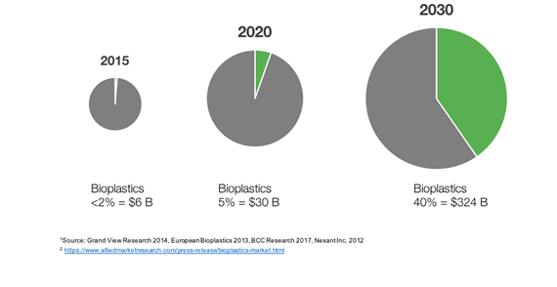
Global Bioplastics Market

Slide 15

Any Question?

Slide 16
Thank You

