Slide 1
RMSTU DIGITAL ELECTION HUB
A Secure & Transparent Online Voting Platform
Course: Java Programming | Rangamati MST University
Developed by: Md. Nayeem Uddin Peyal

Slide 2
PROBLEM STATEMENT
Manual paper-based voting is time-consuming & error-prone
Vote counting takes days — delayed results
No transparency in the voting process
Candidate manifestos not accessible to voters
Ballot box tampering & security concerns
Low voter turnout due to inconvenient process

Slide 3
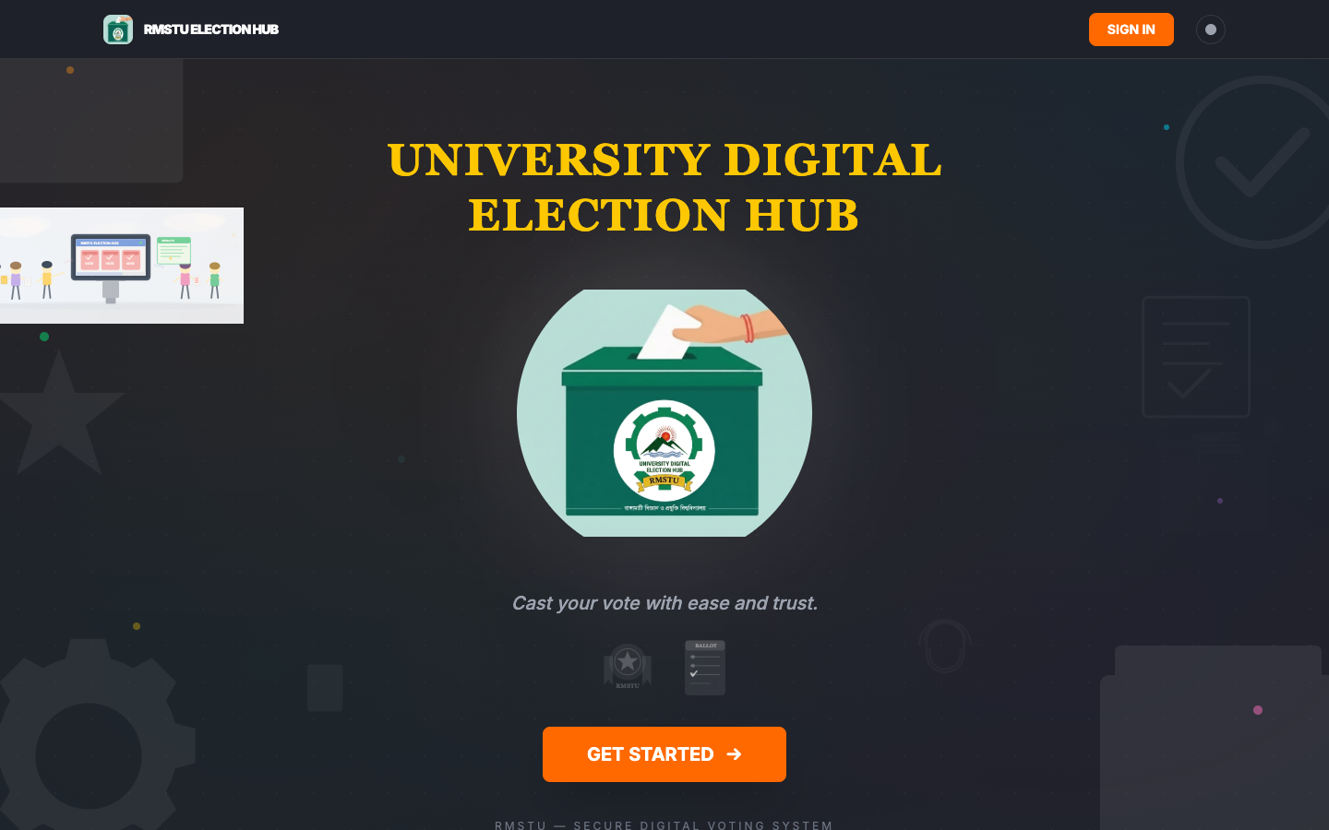
OUR SOLUTION
Fully digital — vote from anywhere, any device
Instant results — real-time vote counting
Transparent — live leaderboard for all voters
Candidate profiles with manifestos
Role-based access: Admin / Voter / Candidate
Secure backend with Firebase Security Rules
Dark/Light theme — modern responsive UI

Slide 4
TECHNOLOGY STACK
FRONTEND
BACKEND / DATABASE
JAVA VERSION
React 19 + TypeScript Vite 6 (Build Tool) Tailwind CSS v4 Framer Motion (Anim) Wouter (Client Routing)
Firebase Firestore (Real-time NoSQL) Firebase Auth Security Rules Serverless
Java SE (Console App) OOP Concepts Collections: HashMap, List Stream API / Lambdas Scanner I/O

Slide 5
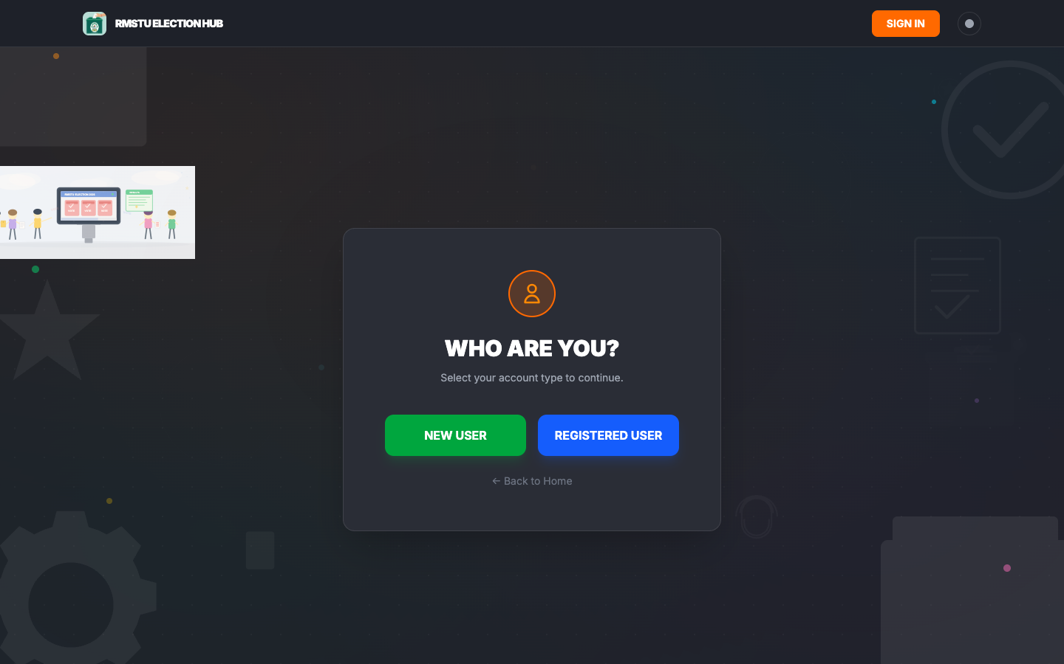
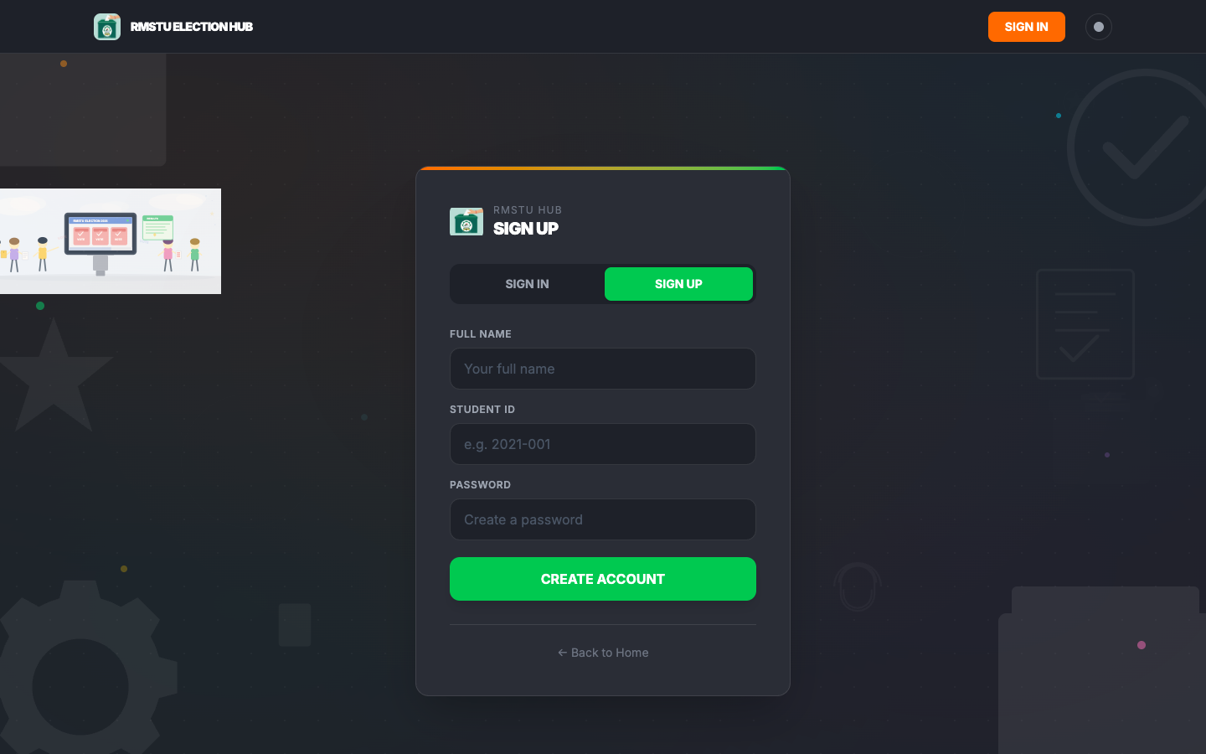
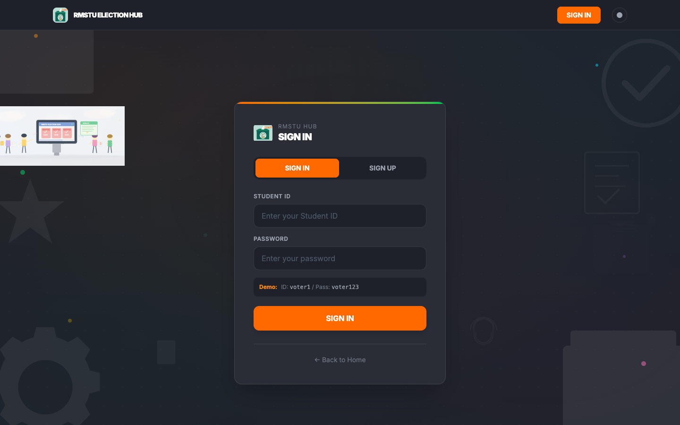
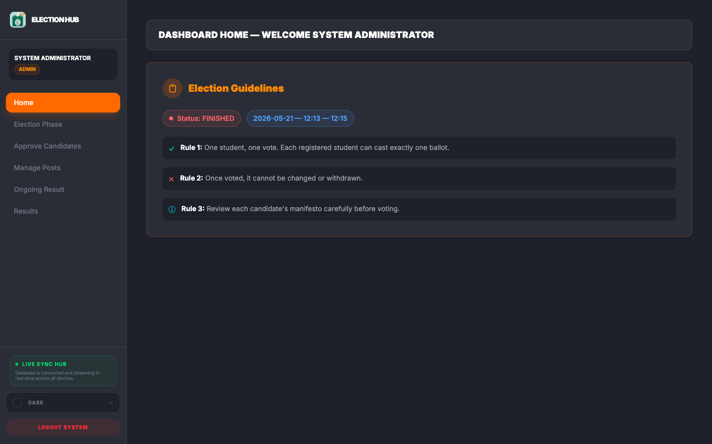
APPLICATION SCREENS
Home / Landing Page
Who Are You?
Sign Up Page
Sign In Page
Admin Dashboard

Slide 6
SYSTEM ARCHITECTURE
1. User Layer: Voter | Candidate | Admin (3 distinct dashboards)
2. Application Layer: React SPA (Single Page Application)
- Pages: Overview, Auth, Dashboard, Portal Select
- Components: Navbar, VoteBg, Theme Switcher
- Context: ElectionProvider (global state via useElection)
3. Data Layer: Firebase Firestore (real-time NoSQL)
- Collections: users/, candidates/, config/election
- Real-time listeners: onSnapshot() for live updates
4. Java Console: Standalone Java SE application
- Same logic, terminal-based UI, demonstrates OOP

Slide 7
USER ROLES & WORKFLOW
VOTER
CANDIDATE
ADMIN
Register Sign In View Candidates Cast Vote Track Live Results
Apply Get Approved Submit Manifesto Track Rankings
Schedule Election Approve Candidates Manage Config Reset Data
END-TO-END WORKFLOW:
Sign Up / Register → Sign In → Select Portal → Apply or Wait → Election Day
→ Cast Vote → Real-time Results → Election Ends → Winner Declared → Reset for Next

Slide 8
JAVA IMPLEMENTATION — CORE CLASSES
ElectionManager.java
Main.java
// ElectionManager.java - Core Logic public class ElectionManager { Map<String, User> users = new HashMap<>(); List<Candidate> candidates = new ArrayList<>(); ElectionStatus status = ElectionStatus.FINISHED; String officialWinner = ""; public boolean registerUser(String id, String name, String password) { if (users.containsKey(id)) return false; users.put(id, new User(id, name, password, User.UserRole.VOTER)); return true; } public List<Candidate> getRankedCandidates() { return getApprovedCandidates().stream() .sorted((a, b) -> Integer.compare( b.getVotes(), a.getVotes())) .collect(Collectors.toList()); }
// Main.java - Console Menu public static void main(String[] args) { ElectionManager election = new ElectionManager(); Scanner scanner = new Scanner(System.in); election.registerUser("admin", "Admin", "admin123"); while (true) { System.out.println("1. Register"); System.out.println("2. Sign In"); System.out.println("3. Apply as Candidate"); System.out.println("4. Vote"); System.out.println("5. Show Results"); System.out.println("0. Exit"); String choice = scanner.nextLine(); // ... handle each option } }

Slide 9
OOP CONCEPTS IN JAVA
OOP Examples
// ENCAPSULATION public class User { private String id; private String name; private UserRole role; private boolean hasVoted; public String getId() { return id; } public String getName() { return name; } public UserRole getRole() { return role; } } // POLYMORPHISM (Enum types) public enum UserRole { ADMIN, VOTER, CANDIDATE } public enum CandidateStatus { PENDING, APPROVED, REJECTED } // ABSTRACTION // ElectionManager hides 200+ lines // of business logic from Main.java // COLLECTIONS & STREAMS candidates.stream() .filter(c -> c.getStatus() == APPROVED) .sorted((a,b) -> b.getVotes()-a.getVotes()) .collect(Collectors.toList());

Slide 10
DATABASE DESIGN — FIRESTORE (NoSQL)
Collection: users/
Document: {id, name, password, role, hasVoted}
Example: voter1 {name: "Sample Voter", role: "VOTER"}
Collection: candidates/
Document: {id, userId, name, posts[], status, votes, manifesto}
Example: cand_01 {name: "Alice", posts: ["President"], votes: 42}
Collection: config/election (single doc)
Document: {status, date, duration, officialWinner, availablePosts[]}
Security: Read public | Write validated by role & field rules
Real-time: onSnapshot() listeners for live vote updates

Slide 11
KEY FEATURES
USER FACING
ADMIN / SECURITY
One Student, One Vote (no duplicates) Per-Post Voting (President, GS, VP) Automatic Winner Declaration Live Real-time Results Dark / Light Theme Toggle
Fully Responsive (Mobile, Tablet, Desktop) Admin-Only Controls (Schedule, Approve) Candidate Manifesto Submission Reset All Data for New Election Firebase Security Rules

Slide 12
JAVA CONSOLE — DEMO OUTPUT
Console Output
========================================= RMSTU DIGITAL ELECTION HUB ========================================= --- President --- #1 Alice 42 votes #2 Bob 15 votes --- General Secretary --- #1 Charlie 30 votes #2 David 10 votes OFFICIAL WINNER: Alice ========================================= [SYSTEM] All election data has been reset. [SYSTEM] Users deleted. Must re-register.

Slide 13
FUTURE ENHANCEMENTS
OTP-based voter verification via SMS / Email
Blockchain-based vote storage for tamper-proof audit
Voter turnout charts & analytics dashboard
Multi-language support (Bengali + English)
Mobile App (Android / iOS with Flutter)
Biometric / Fingerprint authentication
Export results as PDF / Excel
Java Spring Boot REST API (replace Firebase)

Slide 14
THANK YOU
RMSTU Digital Election Hub
Questions & Discussion Welcome!
GitHub: nayeemuddin0351/University-Digital-Election-Hub

