Slide 1
Analyzing Nursing Unit Similarity Using Correspondence Analysis
SI Team Meeting
26th September 2017
Nayef Ahmad

Slide 2
Overview
What is Correspondence Analysis?
Relationship to previous approach (Manhattan distances)
Working through an example
Interpreting results of nursing unit similarity analysis

Slide 3
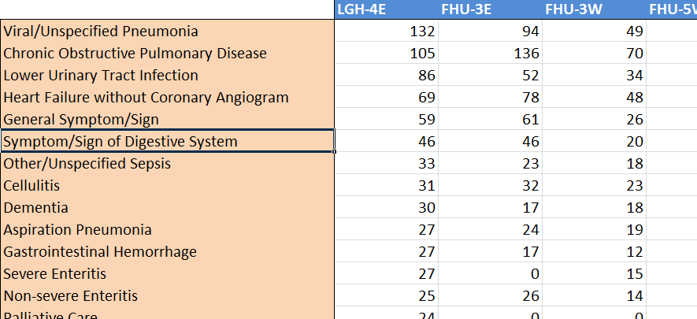
CA analyzes tabular data to find underlying structure
Nursing Unit Categories
CMG Categories
Count data

Slide 4
CA analyzes tabular data to find underlying structure
Which rows are closely related to other rows?
Which columns are closely related to other columns?
What are the relationships between rows and columns?

