Slide 1
Analyzing Nursing Unit Similarity Using Correspondence Analysis
SI Team Meeting
26th September 2017
Nayef Ahmad

Slide 2
Overview
What is Correspondence Analysis?
Relationship to previous approach (Manhattan distances)
Working through an example
Interpreting results of nursing unit similarity analysis

Slide 3
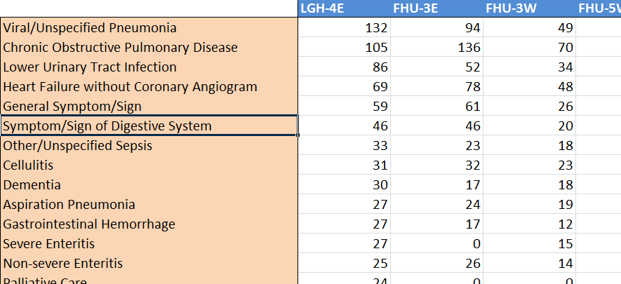
CA analyzes tabular data to find underlying structure
Nursing Unit Categories
…
…
CMG Categories
…
…
…
…
…
Count data
Notes:
8 med nursing units; 95 CMGs
Counts in cells are number of cases in FY 16/17
Ratio>interval>ordinal>categorical variables

Slide 4
CA analyzes tabular data to find underlying structure
Key Questions:
Which rows are closely related to other rows?
Which columns are closely related to other columns?
What are the relationships between rows and columns?
What are the key dimensions of variation in the data?
CA generalizes the idea of a scatterplot to work meaningfully with categorical variables

Slide 5
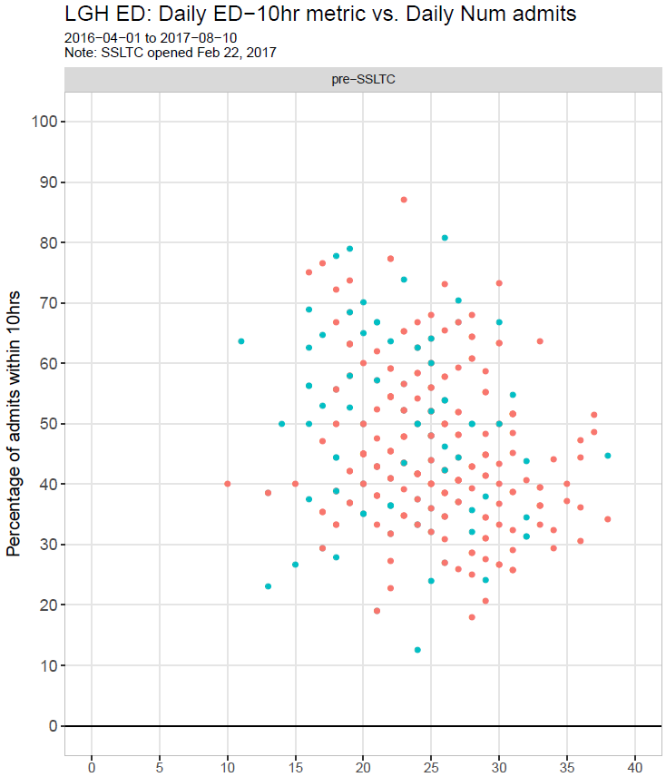
Can we produce something
like this for categorical variables?
Yes!

Slide 6
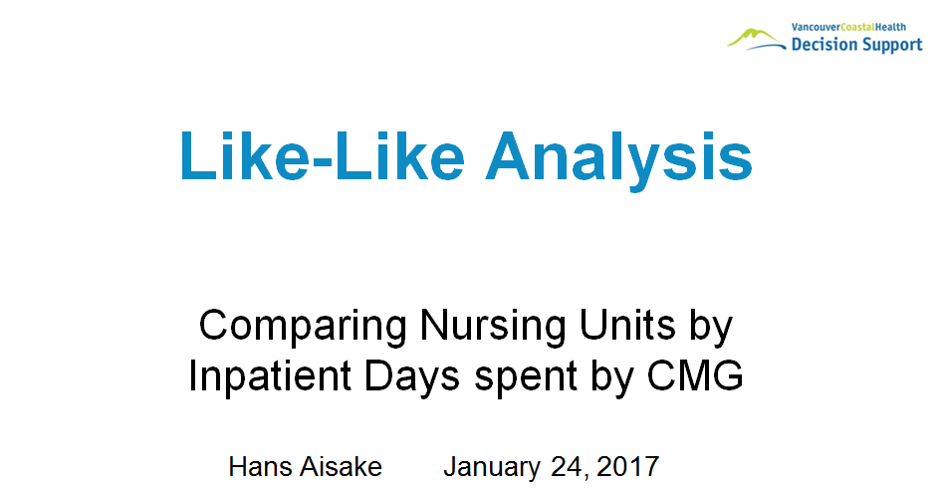
Relationship to previous methodology
CA is a complimentary approach
Manhattan distances vs. “chi-squared” distances
Appeals to visual intuition
Widely applicable as an EDA technique

Slide 7
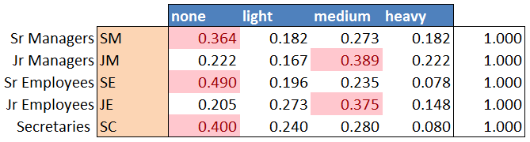
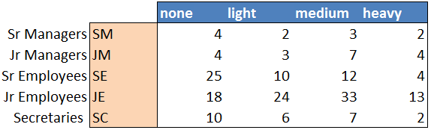
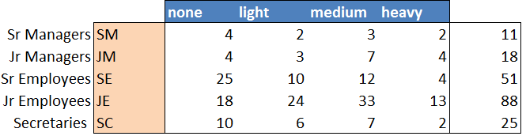
Example: Smoking data
Artificial dataset of smoking habits among 193 employees
Each row profile is a point in 4D space
How do we display this in a 2D scatterplot?

Slide 8
Squishing n-dimensional data onto 2D scatterplots
The goal is to find the optimum 2D surface that minimizes the amount of squishing necessary.
Then, we squish (aka “project”) all data points onto this surface

Slide 9
Technical notes
Chi-squared distances:
Objective function:
Symmetry of row and column analysis:
Percentage of variance explained:

Slide 10
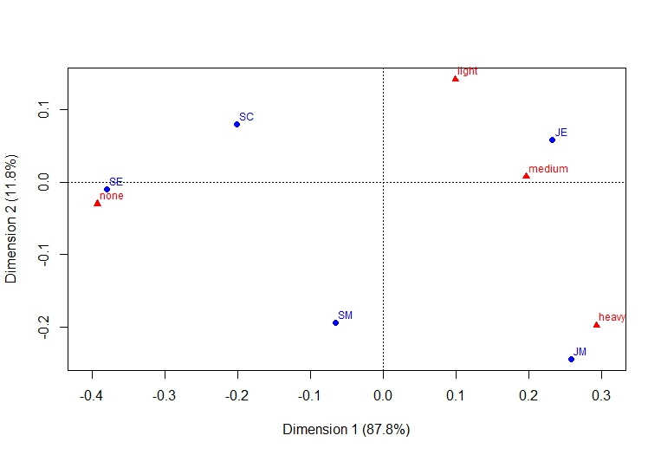
Results from smoking data

Slide 11
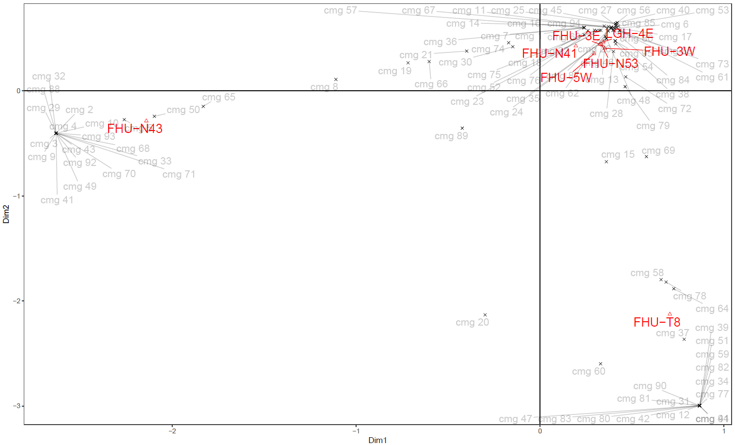
Medical units - Similarity Analysis
Cardiology-related CMGs
Neurology-related CMGs
Notes:
8 med nursing units; 95 CMGs
3 clusters of units:
Each unit is “pulled” towards the CMGs that are most common for it
Middle-of-nowhere CMGs, not strongly associated with any unit:
CMG 8: benign hypertension
CMG 89: Syncope
CMG 15: Convalescence

Slide 12
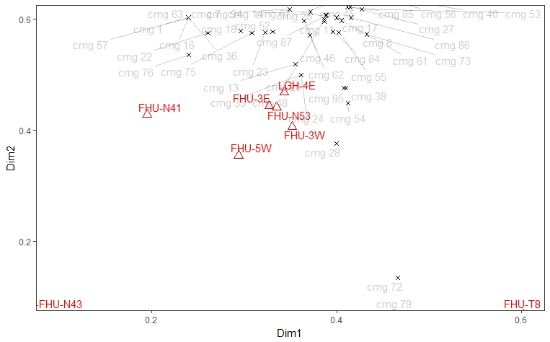
Medical units - Similarity Analysis
Zooming in on first quadrant of previous plot:
Notes:
3 clusters of units:
Each unit is “pulled” towards the CMGs that are most common for it

Slide 13
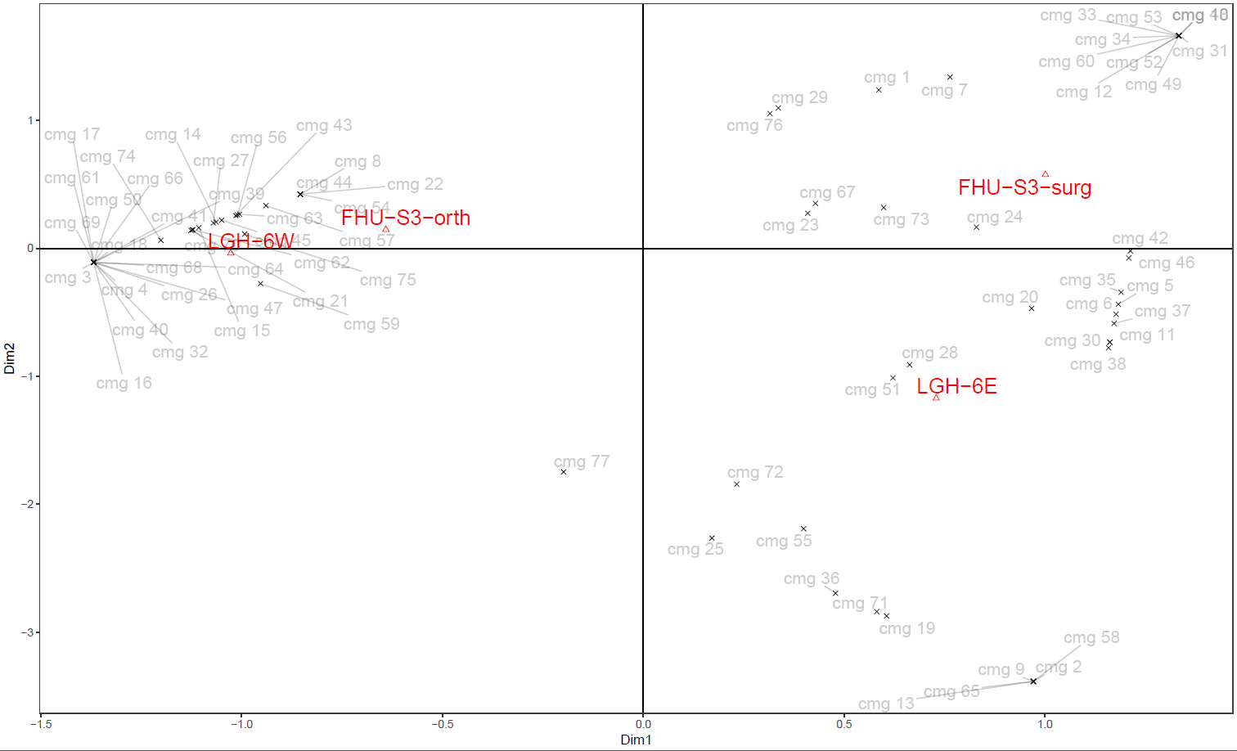
Surgical units - Similarity Analysis
Orthopedics-related CMGs
Notes:
4 surg units, 77 CMGs
Horizontal axis seems to be ortho-vs-gen surg
CMG 77: Viral/Unspecified Pneumonia
CMG 72: Symptom/Sign of Urinary System

Slide 15
Distance matrices

Slide 17
Appendix
Adding in columns to the plot

Slide 18
Appendix
CMGs close to FHU-N43:
cmg_code | cmg
cmg 10 | Cardiac Valve Disease, except Endocarditis
cmg 2 | Angina (except Unstable)/Chest Pain with Coronary Angiogram
cmg 29 | Heart Failure with Coronary Angiogram
cmg 3 | Angina (except Unstable)/Chest Pain without Coronary Angiogram
cmg 32 | Hypertensive Disease except Benign Hypertension
cmg 33 | Implantation of Cardioverter/Defibrillator
cmg 4 | Arrhythmia with Coronary Angiogram
cmg 41 | Management/Removal of Pacemaker/Defibrillator/Leads
cmg 43 | MCC 05 Unrelated Intervention
cmg 49 | Myocardial Infarction/Shock/Arrest with Coronary Angiogram
cmg 5 | Arrhythmia without Coronary Angiogram
cmg 50 | Myocardial Infarction/Shock/Arrest without Coronary Angiogram
cmg 65 | Other/Miscellaneous Cardiac Disorder
cmg 68 | Pacemaker Implantation
cmg 70 | Percutaneous Coronary Intervention with MI/Shock/Arrest/Heart Failure
cmg 71 | Percutaneous Coronary Intervention without MI/Shock/Arrest/Heart Failure
cmg 88 | Symptom/Sign of Respiratory System
cmg 9 | Cardiac Conduction System Intervention
cmg 92 | Unstable Angina/Atherosclerotic Heart Disease with Coronary Angiogram
cmg 93 | Unstable Angina/Atherosclerotic Heart Disease without Coronary Angiogram

Slide 19
Appendix
CMGs close to FHU-T8:
cmg_code | cmg
cmg 12 | Cerebrovascular Disorder
cmg 20 | Disequilibrium/Hearing Loss
cmg 31 | Hemorrhagic Event of Central Nervous System
cmg 34 | Infection/Inflammation of Central Nervous System except Meningitis
cmg 37 | Ischemic Event of Central Nervous System
cmg 39 | Major Ophthalmology Disorder
cmg 42 | MCC 01 Unrelated Intervention
cmg 44 | Migraine/Other Headache
cmg 47 | Multiple Intracranial Injury
cmg 51 | Neoplasm of Central Nervous System
cmg 58 | Other Disorder of Central Nervous System
cmg 59 | Other Disorder of Nerve
cmg 60 | Other Dysfunction of Central Nervous System
cmg 64 | Other Soft Tissue Disorder
cmg 77 | Respiratory Tuberculosis
cmg 78 | Seizure Disorder, except Status Epilepticus
cmg 80 | Single Intracranial Injury
cmg 81 | Somatoform/Dissociative Disorder
cmg 82 | Spinal Injury
cmg 83 | Status Epilepticus
cmg 90 | Transient Ischemic Attack
cmg 91 | Unspecified Stroke

Slide 20
Appendix
CMGs close to LGH-4E
cmg_code | cmg
cmg 11 | Cellulitis
cmg 13 | Chronic Obstructive Pulmonary Disease
cmg 14 | Cirrhosis/Alcoholic Hepatitis
cmg 17 | Dementia
cmg 18 | Diabetes
cmg 22 | Disorder of Fluid/Electrolyte Balance
cmg 23 | Disorder of Pancreas except Malignancy
cmg 24 | Fixation/Repair Hip/Femur
cmg 25 | Fracture/Dislocation/Rupture of Pelvis/Sacrum/Coccyx
cmg 26 | Gastrointestinal Hemorrhage
cmg 27 | Gastrointestinal Obstruction
cmg 28 | General Symptom/Sign
cmg 35 | Inflammatory Bowel Disease
cmg 38 | Lower Urinary Tract Infection
cmg 40 | Malignant Neoplasm of Respiratory System
cmg 45 | Minor Lower Gastrointestinal Intervention
cmg 46 | Minor Upper Gastrointestinal Intervention
cmg 48 | Multisystemic/Unspecified Site Infection with Intervention
cmg 52 | Non-severe Enteritis

Slide 21
Appendix
CMGs close to LGH-6E
cmg_code | cmg
cmg 11 | Endoscopic Large Intestine/Rectum Resection without Colostomy
cmg 13 | Extraction/Destruction of Calculus Common Bile Duct
cmg 19 | Gastrointestinal Hemorrhage
cmg 2 | Bypass/Extraction of Vein/Artery of Limb
cmg 25 | Lower Urinary Tract Infection
cmg 28 | Major Intervention on Upper Urinary Tract
cmg 30 | Minor Lower Gastrointestinal Intervention
cmg 36 | Non-severe Enteritis
cmg 37 | Open Large Intestine/Rectum Resection without Colostomy, Planned
cmg 38 | Open Large Intestine/Rectum Resection without Colostomy, Unplanned
cmg 51 | Partial Excision/Destruction of Prostate, Closed Approach
cmg 55 | Radical Excision of Prostate
cmg 58 | Repair/Reconstruction of Breast
cmg 6 | Complex Hernia Repair
cmg 65 | Severe Enteritis
cmg 71 | Symptom/Sign of Digestive System
cmg 72 | Symptom/Sign of Urinary System
cmg 9 | Disorder of Pancreas except Malignancy

Slide 22
Appendix
CMGs close to FHU-S3-surg
cmg_code | cmg
cmg 1 | Abortion Diagnosis with Abortive or Non-Major Obstetric/Gynecologic Intervention
cmg 10 | Ectopic Pregnancy with Ectopic or Non-Major Obstetric/Gynecologic Intervention
cmg 12 | Endoscopic Lung Resection
cmg 23 | Hysterectomy with Non Malignant Diagnosis
cmg 24 | Laparoscopic Cholecystectomy with/without Common Bile Duct Exploration
cmg 29 | Minor Intervention on Upper Urinary Tract, External/Per Orifice Approach
cmg 31 | Minor Upper Gastrointestinal Intervention
cmg 33 | Non-Complex Hernia Repair
cmg 34 | Non-Major Excision/Repair of Upper Gastrointestinal Tract, Planned
cmg 48 | Other Respiratory Intervention
cmg 49 | Other Thoraco-abdominal Intervention with Trauma/Complication of Treatment
cmg 52 | Pleurectomy
cmg 53 | Post-Operative Complication except Hemorrhage
cmg 60 | Respiratory Biopsy/Inspection
cmg 67 | Simple Appendectomy
cmg 7 | Complicated Appendectomy
cmg 73 | Thyroid/Parathyroid/Thymus Gland Intervention
cmg 76 | Urinary Obstruction without Percutaneous Drainage

